Slide 1
Saudi Arabia Boundaries
Oxagon

Slide 2
NEOM
Oxagon

Slide 3
The Line
Oxagon

Slide 4
Suez Canal
Oxagon

Slide 5
Major Saudi Arabia Cities
Oxagon

Slide 6
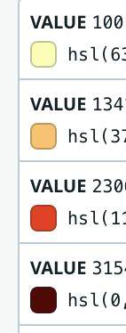
Oxagon
100 resident
1300 resident
2300 resident
3100 resident

Slide 7
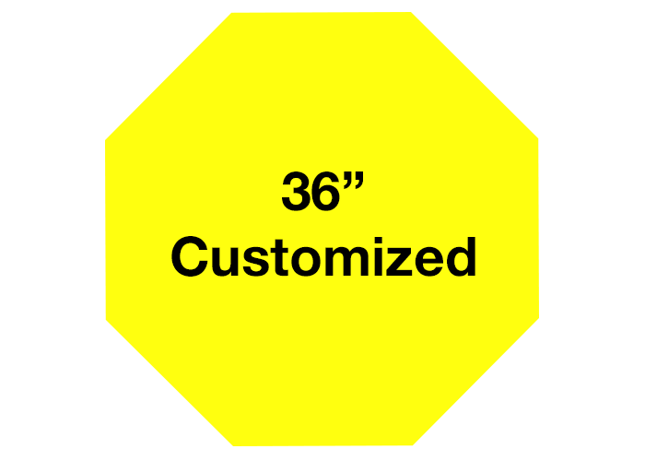
Oxagon
Oxagon Shape

