Slide 1
Evaluating and Improving Cross-Dataset Generalization of Machine-Learning-Based Intrusion Detection Systems
B.Tech. Project – I | Mid-Semester Evaluation
Shivam Chauhan (2023UIN3323) · Shantanu Agarwal (2023UIN3330) · Deepesh (2023UIN3358) — Supervisor: Dr. Preeti Bansal | Dept. of Information Technology, NSUT

Slide 2
Index
Introduction
Motivation
Problem Statement & Objectives
The Three Datasets
Core Challenge: Feature-Schema Mismatch
Literature Review
Research Gap
Proposed Methodology
Feature Harmonisation
Metaheuristic Feature Selection
Evaluation Protocol & Baselines
Implementation & Progress
Baseline Cross-Dataset Results
DA-MFS (Optimisation Result)
Gantt Chart
Conclusion & Future Work
References

Slide 3
Introduction
Network Intrusion Detection Systems (NIDS) monitor traffic to detect attacks.
ML-based IDS learn attack patterns from labelled traffic and dominate current research.
Standard benchmarks: CIC-IDS-2017, UNSW-NB15, TON_IoT.
Usual evaluation: train and test on the same dataset → accuracy > 99%.
Reality: an IDS is trained on one network and deployed on a different one.
Cross-dataset generalisation: how well does a model trained on dataset A work on dataset B?

Slide 4
Motivation
Deployment reality: organisations rarely have large labelled data for their own network — they must reuse models trained elsewhere.
The gap is severe: independent studies show cross-dataset accuracy falling to <40% or near random chance.
It is a feature problem: models rely on dataset-specific features (IPs, ports, collection-window statistics) instead of real attack behaviour.
Metaheuristic feature selection is mature — but always optimises same-dataset accuracy.
Our idea: re-aim the optimiser at cross-dataset robustness — simple, powerful, unexplored.

Slide 5
Problem Statement & Objectives
Problem statement
ML-based IDS are evaluated with same-dataset splits, overstating real-world value.
On a structurally different network, performance collapses [1], [2].
Existing feature-selection methods optimise only same-dataset accuracy [8]–[12].
Need: characterise the cross-dataset gap, and select features for transfer.
Objectives
Evaluate cross-dataset generalisation of ML/DL models across the three datasets.
Characterise which features and attack classes transfer vs. which are artefacts.
Compare metaheuristic optimisers (GA, PSO, …) for transfer-oriented feature selection.
Benchmark against standard feature-selection baselines.
Produce practical guidelines for generalisable IDS.

Slide 6
The Three Datasets
Dataset | Source / tool | Records | Features | Classes
CIC-IDS-2017 | CIC, CICFlowMeter | 2,830,743 | 78 | 15
UNSW-NB15 | ACCS, Argus + Bro | 257,673 | 42 | 9 + Normal
TON_IoT | UNSW, Zeek (Bro) | 211,043 | 42 | 10
Collected on different networks with different feature-extraction tools.
Different label vocabularies and very different class balances.
This diversity is exactly what makes them suitable for a generalisation study.

Slide 7
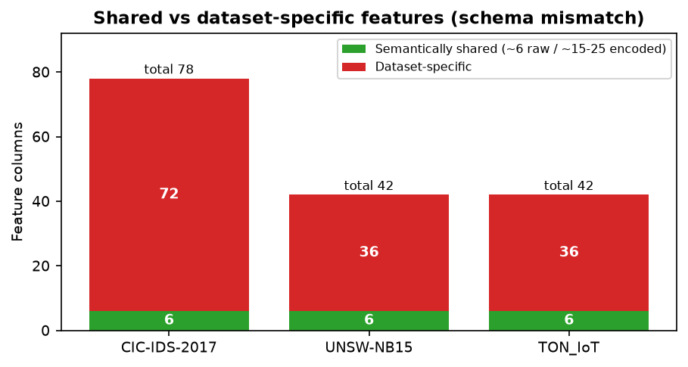
Core Challenge: Feature-Schema Mismatch
This mismatch is the root cause of the generalisation gap — and the focus of our work.
The three datasets share no common column name.
CICFlowMeter statistics ≠ Argus/Bro counters ≠ raw Zeek log fields.
Only ~6 raw features are semantically shared (duration, bytes, packets…); ~15–25 after encoding + derived ratios.
Shared vs dataset-specific features

Slide 8
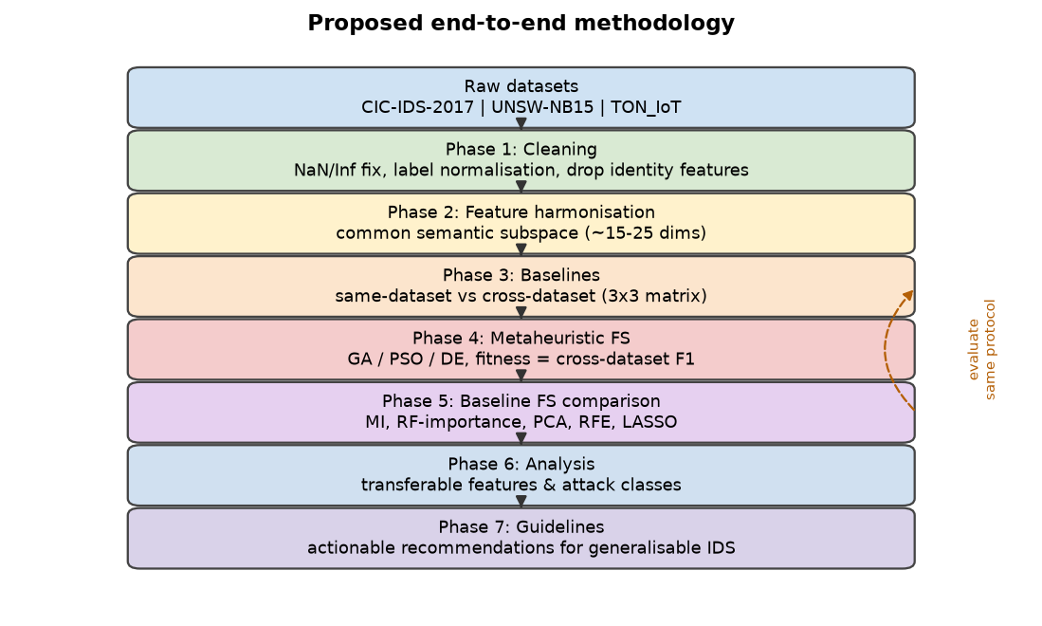
Proposed Methodology (overview)
Proposed end-to-end methodology

Slide 9
Feature Harmonisation (shared subspace)
We map semantically equivalent features across datasets into one common subspace:
Concept | CIC-IDS-2017 | UNSW-NB15 | TON_IoT
Duration | Flow Duration | dur | duration
Source bytes | Total Length of Fwd Packets | sbytes | src_bytes
Dest bytes | Total Length of Bwd Packets | dbytes | dst_bytes
Source packets | Total Fwd Packets | spkts | src_pkts
Dest packets | Total Backward Packets | dpkts | dst_pkts
Protocol / Service / State | (encoded) | proto,service,state | proto,service,conn_state
Plus derived ratios: bytes/packet, packets/second, forward/backward ratio.
Remove identity/leakage features (IPs, ports, IDs).

Slide 10
Metaheuristic Feature Selection (core contribution)
Solution = binary mask over the shared subspace (which features to keep).
Fitness = cross-dataset generalisation (the novelty):
fitness(mask) = average balanced-accuracy / macro-F1
of model trained on source[mask]
and evaluated on target[mask]
over all source→target pairs
Optimisers compared: Genetic Algorithm (GA), Particle Swarm Optimization (PSO), Differential Evolution / Whale Optimization.
Optional multi-objective NSGA-II: maximise cross-dataset F1 and minimise number of features.
Key difference from prior work: the optimiser is rewarded for transfer, not for fitting one dataset.

Slide 11
Evaluation Protocol & Baselines
Protocol
Same-dataset: stratified 5-fold cross-validation.
Cross-dataset: train on source, test on target → full 3×3 matrix.
Metrics: balanced accuracy, macro-F1, per-class F1 (not overall accuracy — imbalance is dataset-specific).
Models: RF, XGBoost/LightGBM, SVM, Logistic Regression, small MLP.
Fixed seeds, repeated runs for reproducibility.
Baselines for feature selection
No feature selection; mutual information; random-forest importance; PCA; RFE; LASSO — all matched to the same subset size as the metaheuristic.

Slide 12
Literature Review (1/2)
# | Title | Author(s) | What it does | Conclusion
1 | Cross-Dataset Generalization of ML for NIDS | Cantone et al., 2024 | Cross-dataset benchmark (4 sets) | Near-chance cross-dataset; diagnosis only
2 | Assessing Generalisation Capability | Hossain et al., 2026 | RF/LR/NB on UNSW ↔ TON | <40% cross-dataset vs 95–99% in-dataset
3 | Cross-Domain Failure in Lightweight IDS | Hakim et al., 2026 | 3 IIoT sets + SHAP | Port shortcut; protocol reverses results
4 | Tabular Representation Learning for NIDS | Butt et al., 2026 | Representation learning | Transfer depends on source→target pair
5 | CIC-IDS-2017 | Sharafaldin et al., 2018 | Dataset | Primary dataset
6 | UNSW-NB15 | Moustafa & Slay, 2015 | Dataset | Second dataset
7 | TON_IoT | Moustafa, 2021 | Dataset | Third dataset (Zeek)
8 | Metaheuristic classifiers for ID | Fatima & Ali, 2022 | GA FS + ensembles | Strong single-dataset; no transfer

Slide 13
Literature Review (2/2)
# | Title | Author(s) | What it does | Conclusion
9 | Unsupervised FS via NSGA-II | Suman et al., 2019 | Multi-objective FS | Pareto subsets; single-dataset
10 | MPDGGA | Li, 2026 | Multi-population GA FS | Best 10/11 datasets; single-dataset
11 | GA + Whale Optimization FS | Mojtahedi et al., 2022 | Hybrid bio-inspired FS | Swarm hybridisation viable
12 | NSGA-III AutoML IDS | Yang et al., 2026 | Multi-objective AutoML | Efficiency, not transfer
13 | DI-NIDS | Layeghy et al., 2022 | Domain-invariant features | Better cross-domain; needs target data
14 | Survey of NIDS Data Sets | Ring et al., 2019 | Dataset taxonomy | Explains heterogeneity
15 | Adversarial Robustness (NewCICIDS) | Vitorino et al., 2024 | Corrected CICIDS2017 | Corrected data changes conclusions

Slide 14
Research Gap
Group | Cross-dataset eval? | Metaheuristic FS? | Optimised for transfer?
Diagnostic studies [1]–[4] | Yes | No | No
Metaheuristic FS [8]–[12] | No | Yes | No (same-dataset fitness)
Domain adaptation [13] | Yes | No | No (needs target data)
This project | Yes (3 datasets) | Yes (GA, PSO, …) | Yes
No published work selects features using a cross-dataset generalisation objective for NIDS.
Our project fills exactly this gap.

Slide 15
Implementation & Progress
Completed
Reproducible Python environment + version-controlled repository.
All three datasets downloaded and analysed; figures generated automatically.
Shared 12-feature subspace implemented (identity/leakage features removed).
Cross-dataset baseline benchmark: 5 ensemble models trained on the full datasets, evaluated on all pairs → 3×3 matrices.
Next (end-semester)
GA / PSO / DE optimisers with the cross-dataset fitness function.
Standard feature-selection baselines (MI, RF-importance, PCA, RFE, LASSO).
Transfer analysis (SHAP/UMAP, ablations) and practical guidelines.

Slide 16
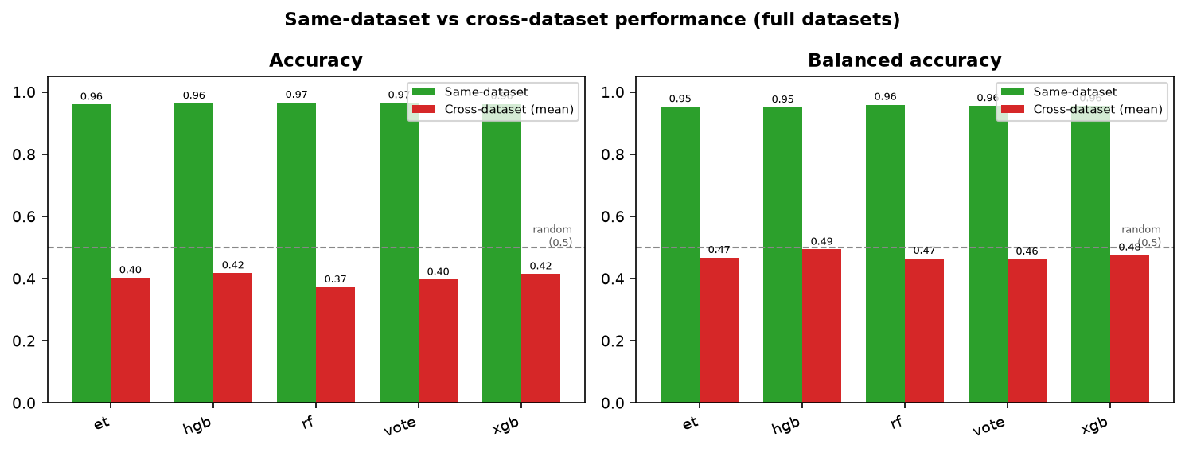
Baseline Cross-Dataset Results
Trained 5 ensemble models on the full datasets; tested on all three (3×3 matrix).
Same-dataset accuracy 0.96–0.97; cross-dataset only 0.37–0.42.
Cross-dataset balanced accuracy 0.46–0.49 → at/near random chance (0.50).
Same-dataset vs cross-dataset

Slide 17
Baseline Results — Key Findings
Model | Same-dataset Acc | Cross-dataset Acc | Cross-dataset Bal-Acc
Random Forest (rf) | 0.9666 | 0.3726 | 0.4650
XGBoost (xgb) | 0.9622 | 0.4150 | 0.4760
Hist. Grad. Boosting (hgb) | 0.9638 | 0.4179 | 0.4941
Extra Trees (et) | 0.9602 | 0.4027 | 0.4672
Soft-voting (vote) | 0.9656 | 0.3968 | 0.4624
XGBoost CIC-IDS-2017 → UNSW-NB15 balanced accuracy = 0.5000 (exactly random).
Ensembling does NOT fix the gap → the problem is the features/distribution, not model capacity.
Independently matches the literature [1], [2]; motivates transfer-oriented optimisation.

Slide 18
DA-MFS — Domain-Aligned Metaheuristic Feature Selection
Why plain selection fails: the same feature has a different distribution in each dataset.
Stage 1 — Domain alignment: align each dataset’s feature marginals (per-dataset quantile transform → normal).
Stage 2 — Metaheuristic: GA / binary PSO search a feature subset with a cross-dataset fitness (mean balanced-accuracy + macro-F1 over 6 pairs).
Novelty: no prior work couples domain alignment with metaheuristic feature selection for NIDS.
Cross-dataset metric | Raw baseline | DA-MFS | Change
Accuracy | 0.373 | 0.508 | +0.136
Balanced accuracy | 0.465 | 0.569 | +0.104
Macro-F1 | 0.308 | 0.460 | +0.153
Attack recall | 0.479 | 0.607 | +0.128
Compact 4-feature subset; +13.6 pp accuracy and +12.8 pp recall — a clear, defensible gain.
Next: GA vs PSO vs DE, NSGA-II multi-objective, divergence-aware fitness, standard FS baselines.

Slide 19
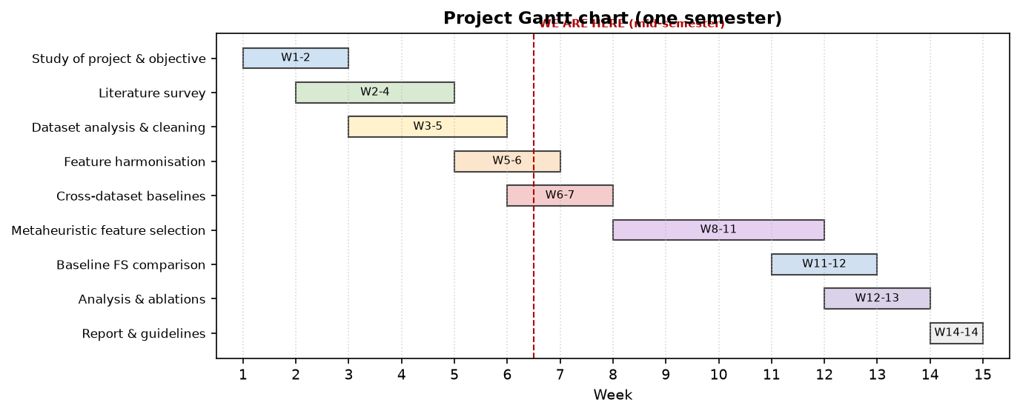
Gantt Chart
Project Gantt chart

Slide 20
Conclusion & Future Work
Conclusion
Three structurally different benchmarks analysed; feature-schema mismatch is the root cause of cross-dataset failure.
Literature review (15 core papers) confirms a clear gap: no transfer-optimised metaheuristic feature selection for NIDS.
Baseline quantified the gap: 0.96–0.97 same-dataset vs 0.37–0.42 cross-dataset (balanced accuracy ≈ random chance).
DA-MFS optimisation works: domain alignment + evolutionary feature selection lifts cross-dataset accuracy 0.373 → 0.508 and recall 0.479 → 0.607.
Future work
Extend DA-MFS (GA / PSO / DE / NSGA-II, divergence-aware fitness).
Comparison vs. standard feature-selection baselines.
Analysis of transferable features/attacks + ablations.
Practical guidelines and final report.

Slide 21
References
[1] Cantone, Marrocco, Bria, “On the cross-dataset generalization of machine learning for network intrusion detection,” IEEE Access, 2024.
[2] Hossain et al., “Assessing generalisation capability of machine learning models for intrusion detection,” arXiv:2605.04407, 2026.
[3] Hakim, Uddin, Anis, “Cross-domain generalization failure in lightweight intrusion detection models for IIoT networks,” arXiv:2607.00553, 2026.
[4] Butt, Hotho, Schlör, “Evaluating tabular representation learning for network intrusion detection,” IEEE CSR, 2026.
[5] Sharafaldin, Lashkari, Ghorbani, “Toward generating a new intrusion detection dataset…” (CIC-IDS-2017), ICISSP, 2018.
[6] Moustafa, Slay, “UNSW-NB15: a comprehensive data set…”, MilCIS, 2015.
[7] Moustafa, “Network TON_IoT datasets,” Sustainable Cities and Society, 2021.
[8]–[12] Fatima & Ali (2022); Suman et al. (2019); Li (2026); Mojtahedi et al. (2022); Yang et al. (2026).
[13] Layeghy, Baktashmotlagh, Portmann, “DI-NIDS,” Knowledge-Based Systems, 2023.
[14] Ring et al., “A survey of network-based intrusion detection data sets,” Computers & Security, 2019.
[15] Vitorino et al., “An adversarial robustness benchmark for enterprise NIDS,” FPS, 2023.

