Slide 1
Bulk systems neural network Ansatz
In this deck:
Introduction to the problem
Sketch of context (literature and previous work)
Motivation
Outline of what has been done so far
Outline of current issues

Slide 2

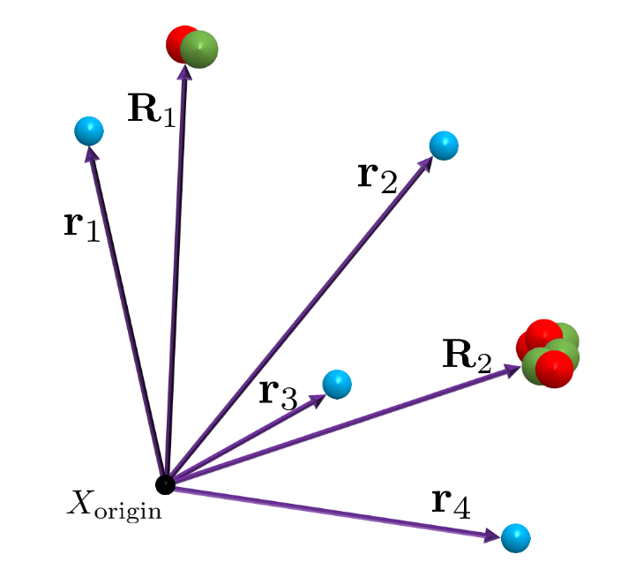
The problem
Approximately solve the Schrodinger equation
For a periodic fermionic solid system
With a neural network Ansatz

Slide 3
Context
Quantum Monte Carlo solids
Foulkes summary 2001
Shulenburger qmc applied to solids 2013
Etc
Neural network Ansatz
FermiNet and PauliNet works
In house expertise on atomic systems (follow up to FermiNet)

Slide 4
Motivation
Can neural networks improve the accuracy of the ground-state wave function of solid systems (as they have in isolated systems)?
Can neural networks improve the efficiency of these calculations (through optimized GPU operations)?
How large systems can be modelled with neural network Ansatz (with access to >30 gpus)?
Can other improvements be made to the Ansatz design?

Slide 5
Progress
Implemented, tested and verified variational Monte Carlo (with Kronecker Factored Approximate Curvature / approximate stochastic reconfiguration) and isolated system Ansatz in JAX (high performance framework).
Implemented solid system features required to model periodic boundary conditions
Minimum image convention
Ewald’s summation for potential
Real space wave function (complex numbers possible but not implemented)

Slide 6
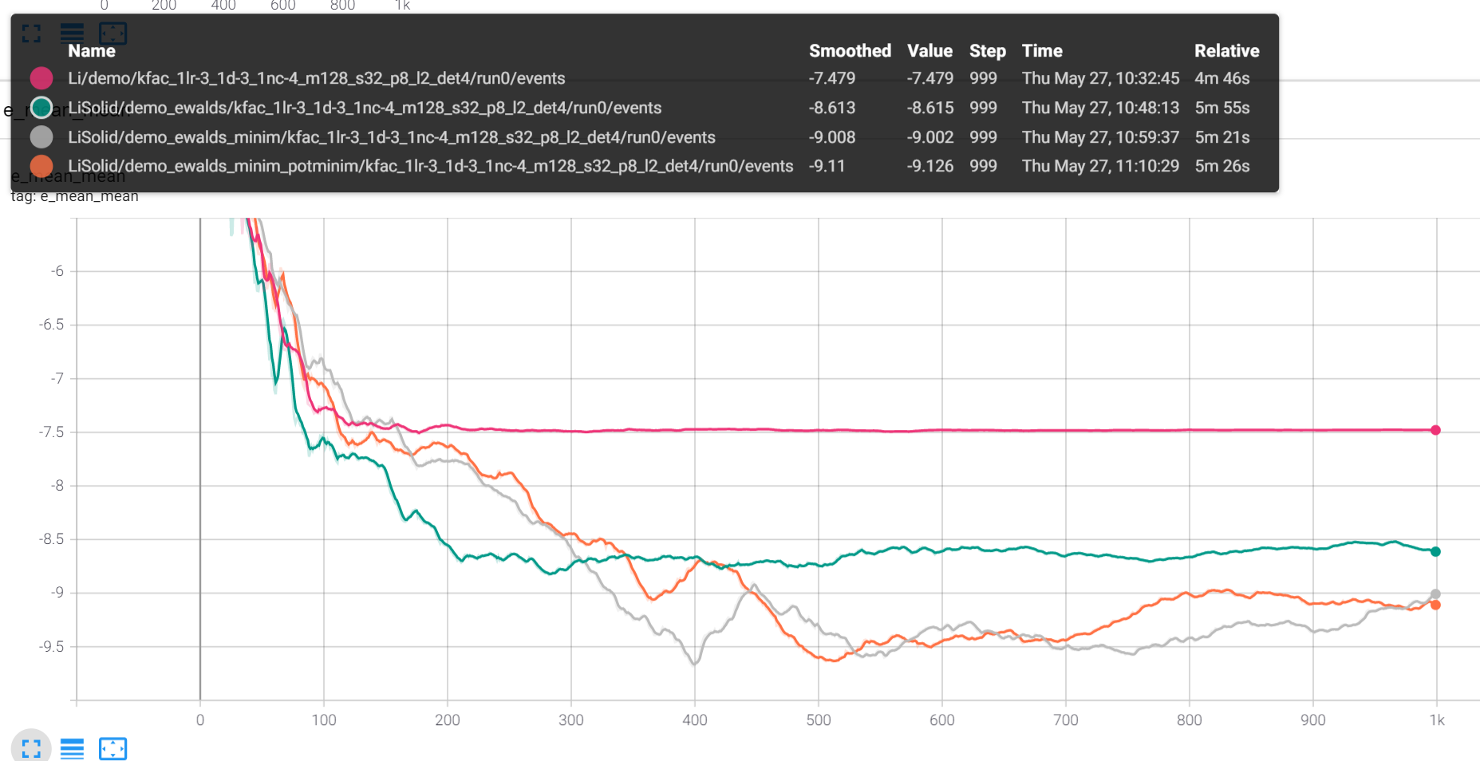
Issues
Target energy for Li solid is ~-7.54
No implementation so far returns this
Majority of the codebase is verified (works in the isolated case)
Possible issues:
Software bug:
Ewald’s summation
Minimum image convention (adjusting charged particle separation vectors)
Intialization:
Solid description correct (primitive cell vectors)
Theory:
Other standard approximations missing
Finite size errors
Pink: Li isolated atom finds ground state energy of wave function as expected (~-7.47 Hartree)
Green: Li Solid with Ewalds potential, unstable
Grey: Li Solid with Ewald’s potential and vectors between charged particles for the inputs adjusted to include adjacent cells (minimum image convention)
Orange: Li Solid with Ewald’s potential and vectors between charged particles for the inputs and Ewald’s summation adjusted to include adjacent cells (minimum image convention)

