Slide 2
Periodic neural network Ansätze
Max Wilson, *Saverio Moroni, Arghya Bhowmik, *Filip Wudarski, *Nicholas Gao, Ole Winther, Tejs Vegge
Notes:
Too deep too fast
Cut out a lot of content
What are we trying to achieve with the presentation
Latex plotssssss

Slide 3
Task
Learn a neural network model of the ground state of a metallic system

Slide 4
Other work
Solving the QMB with ANNs
Carleo & Troyer, Science 10, 2017
Spin system wave functions
Boltzmann machine
First demonstration
SchNet
Schütt et al, J. Chem. Phys. 148, 2019
Atomic/Molecular properties predictions
Graph NN
Fermi Net
Pfau et al, Nature Chemistry12, 2020
Atomic/molecular wave functions
Multi-electron orbitals
Graph NN
Expensive, but very accurate
PauliNet
Hermann et al, Nature Chemistry12, 2020
Atomic/molecular wave functions
Slater-Jastrow-backflow wave function
Graph NN
Fast, but less accurate

Slide 5
Problem sketch
Electrons
Nuclei
...
The model must be
Periodic
Antisymmetric (fermionic)
Continuous (first- and second- order derivatives)
...
...

Slide 6
System
Metallic lithium structure (body-centered cubic)

Slide 7

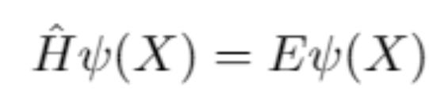

Variational Monte Carlo
Method for evolving a parameterized Ansatz toward the ground state
solving the Schrodinger equation
Evolving the Ansatz requires
Wave function
Hamiltonian
Energy
Laplacian
Potential
Monte Carlo Sampling
Derivatives wf wrt parameters
Local energy computation
Notes:
Need a model
A way to adapt the model
Computation of the gradients and the energies

Slide 8
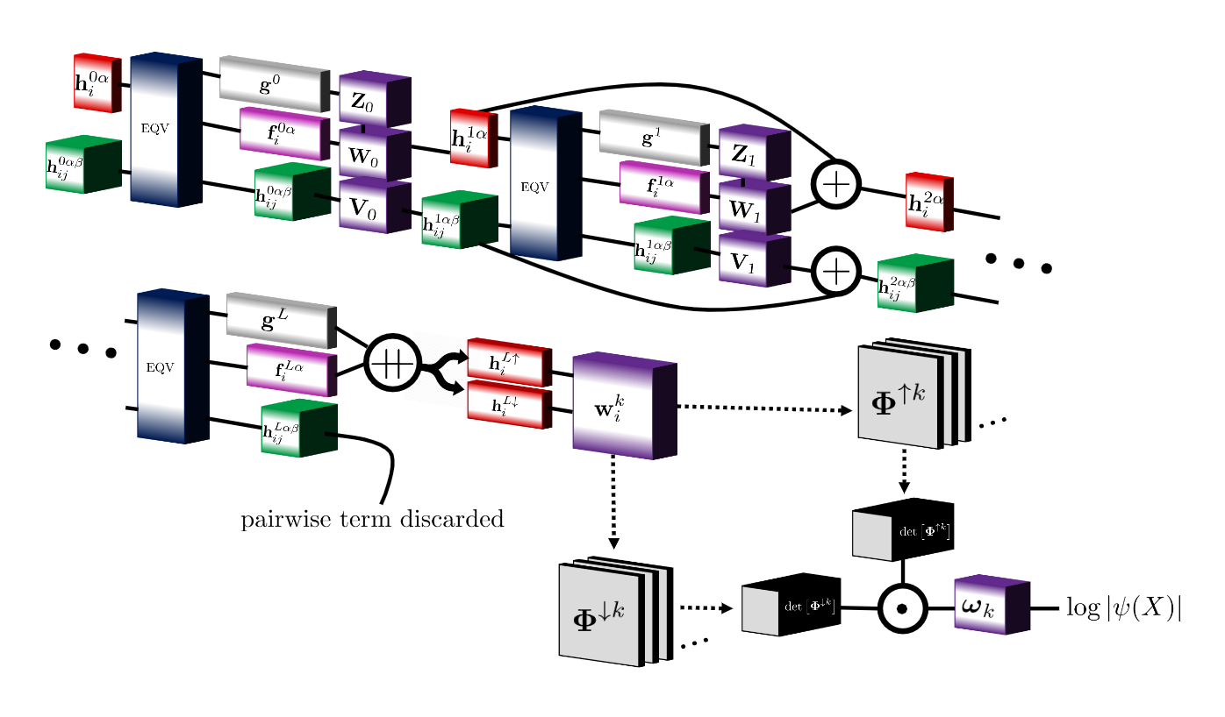
Ansatz
Not periodic inputs
Not periodic inputs
Permutation equivariant functions
Notes:
Permutation eqv functions important for antisymmetry
Will focus on the non periodic parts of the network

Slide 9
Periodic (torus) system
Simulation cell particle A
Image cell particle A

Slide 10
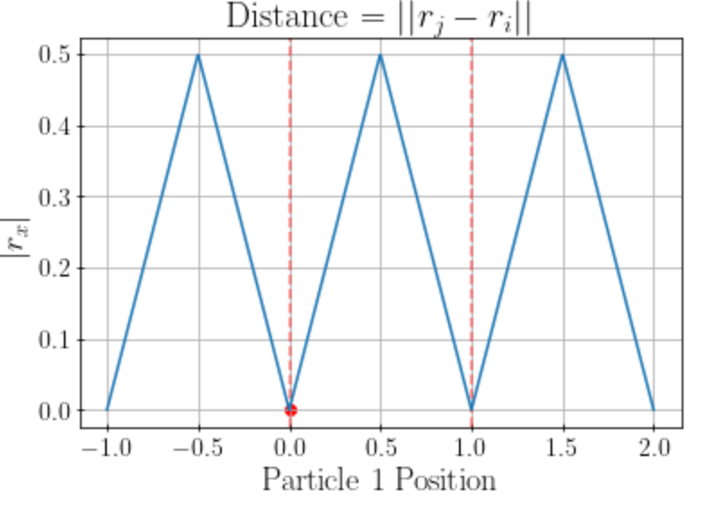
Minimum image convention
Simulation cell particle
Image cell particle

Slide 11
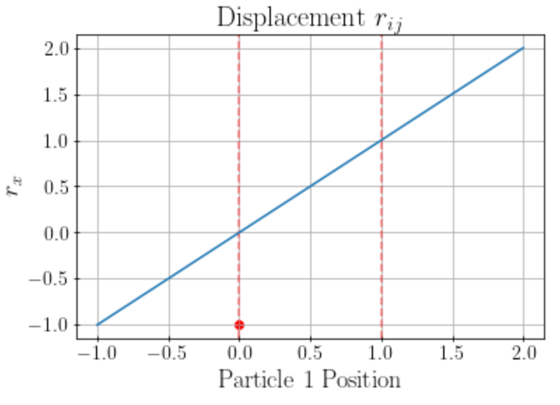
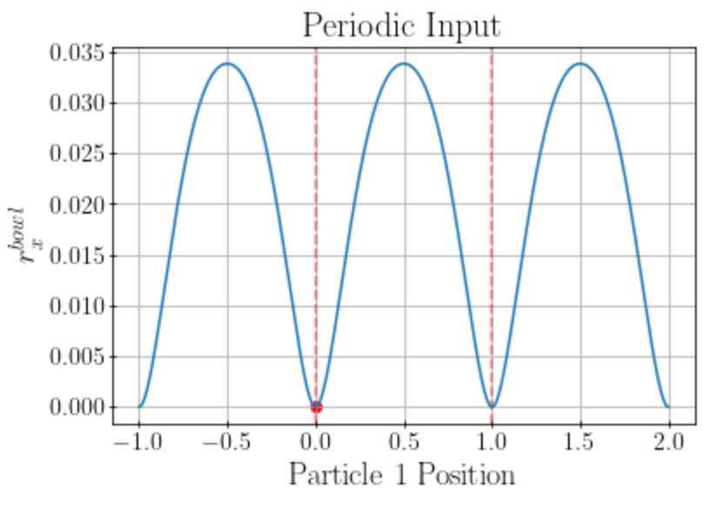
Periodic adjustments: Inputs
Previous
New
Minimum image convention (interacting with closest image particle)
Periodic boundaries
Smoothing function and removal of sign information

Slide 12
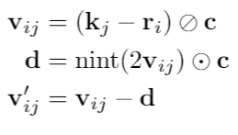
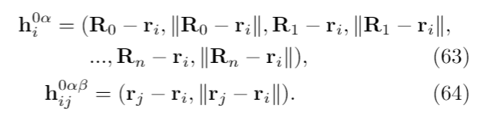
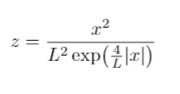
Periodic adjustments: Inputs
Previous
New

Slide 13
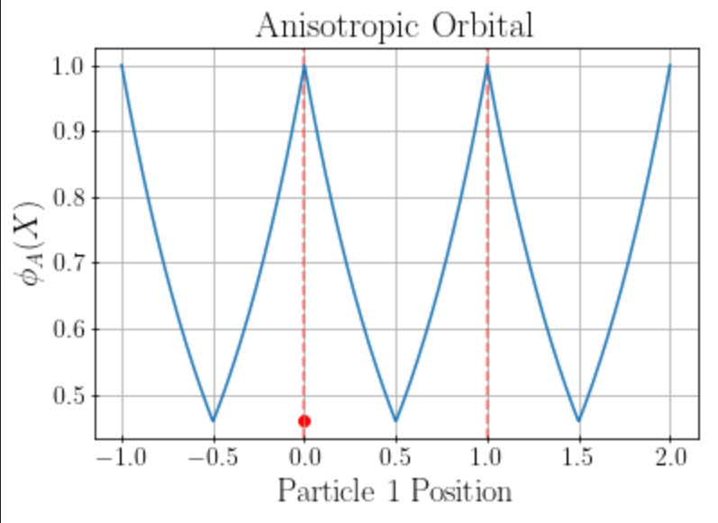
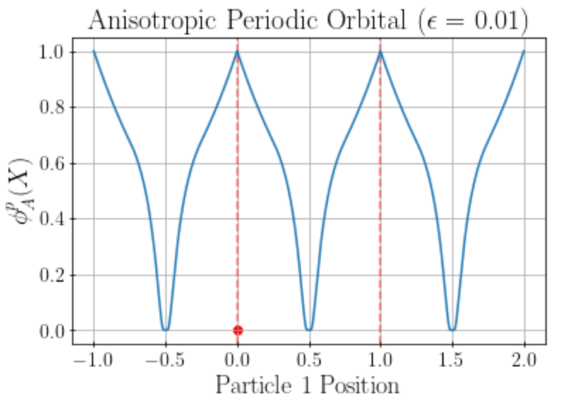
Periodic adjustments: Anisotropic Orbitals
Previous
New
Periodic boundaries with spline
Smoothing function and removal of sign information

Slide 14
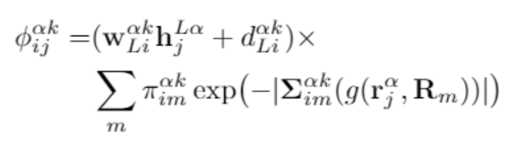
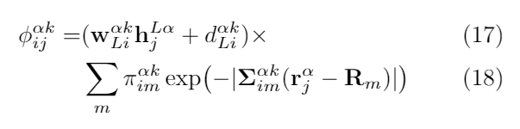

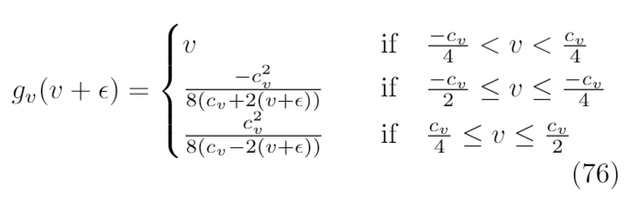

Periodic adjustments: Anisotropic Orbitals
Previous
New

Slide 15
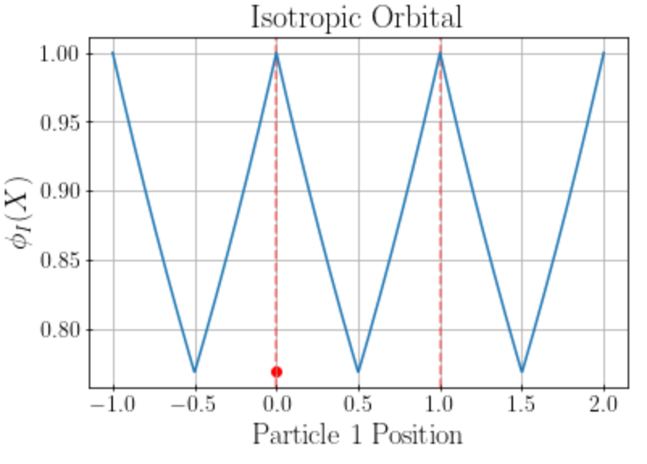
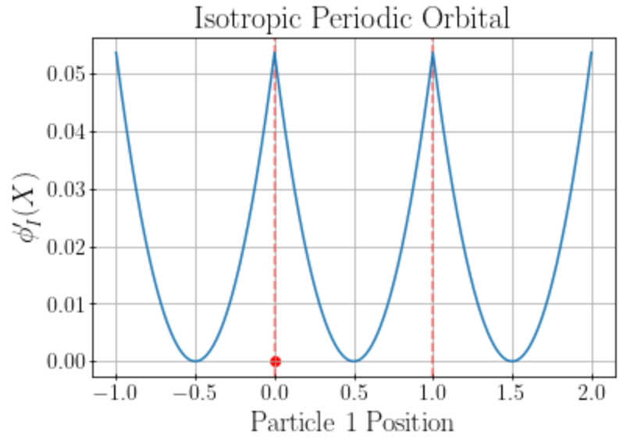
Periodic adjustments: Isotropic Orbitals
Previous
New

Slide 16

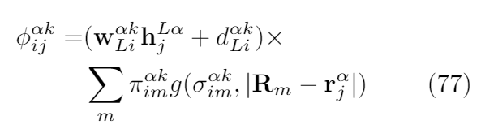
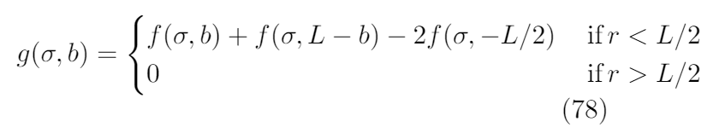
Periodic adjustments: Isotropic Orbitals
Previous
New

Slide 17
Problem sketch
Electrons
Nuclei
...
The model must be
Periodic
Antisymmetric (fermionic)
Continuous (first- and second- order derivatives)
...
...

Slide 18
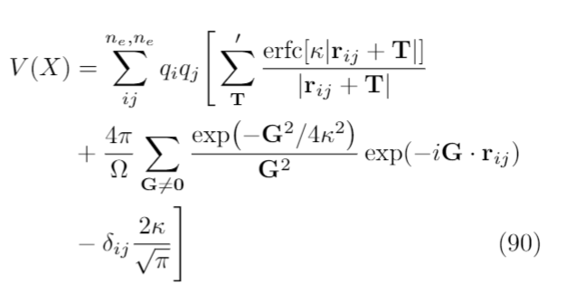
Energy computation
- Potential (Ewald’s Summation)
Real space sum
Reciprocal space sum
Self-interaction cancellation
from reciprocal space sum
Kinetic (no change to isolated case)
Compute Laplacian for all simulation cell electrons

Slide 19
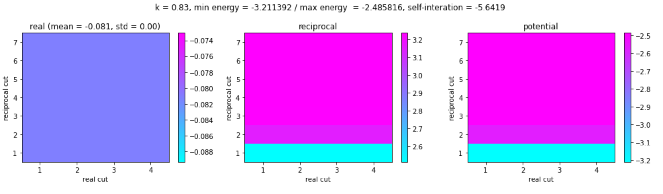
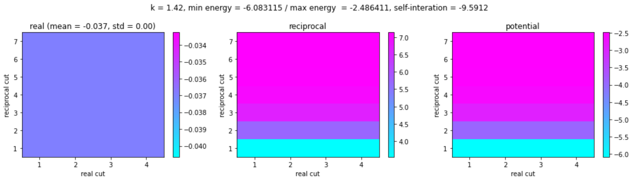
Ewald’s summation convergence

Slide 20

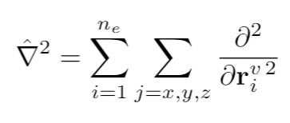
Kinetic energy

Slide 21
Move target electron along dashed line (corner to corner)
Plot as a function of 1 dimension for ease (putting boundaries at 0.0 and unit_cell_length)
Electrons sampled randomly in 1st experiment
Electrons sampled from wave function in 2nd experiment
Place up/down electrons in path in 3rd experiment

Slide 22
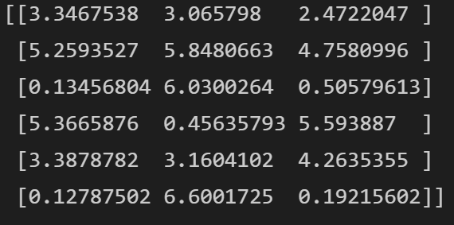
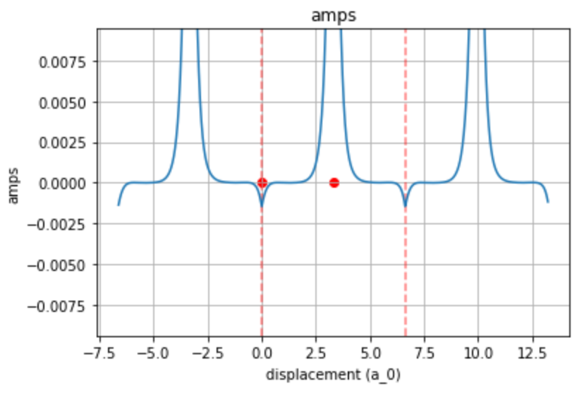
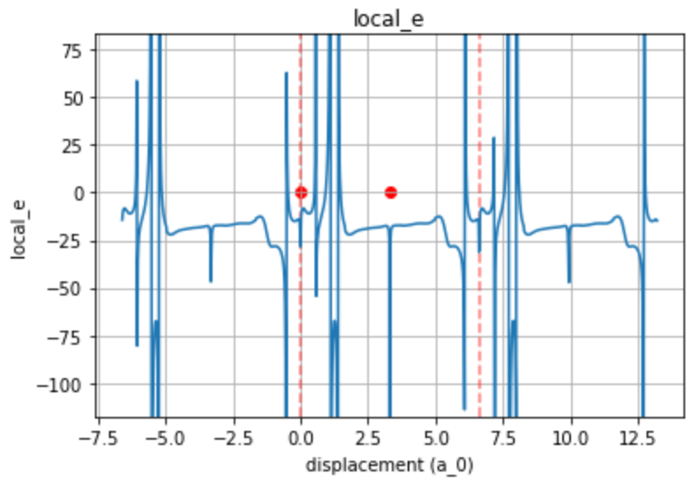
Whaddwe got? Equilibrated electrons
- First electron moved to line
- First electron moved to line

Slide 23
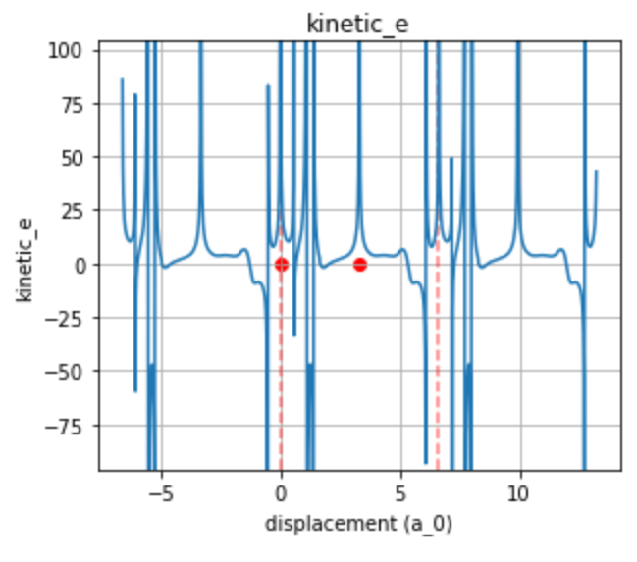
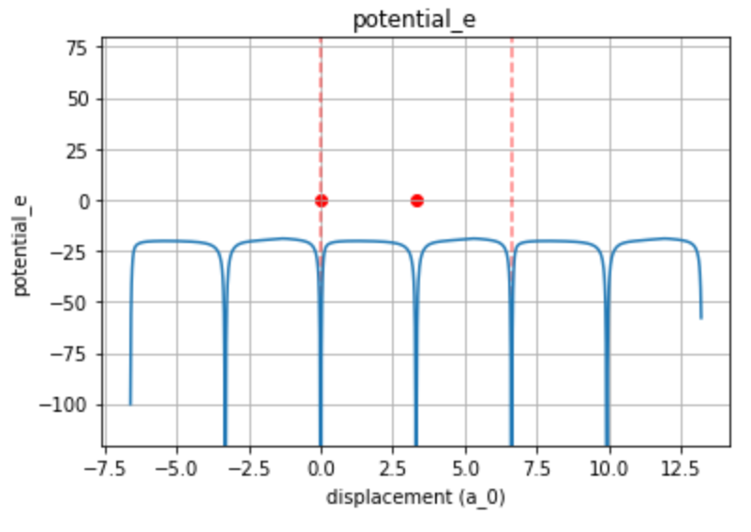

Slide 24
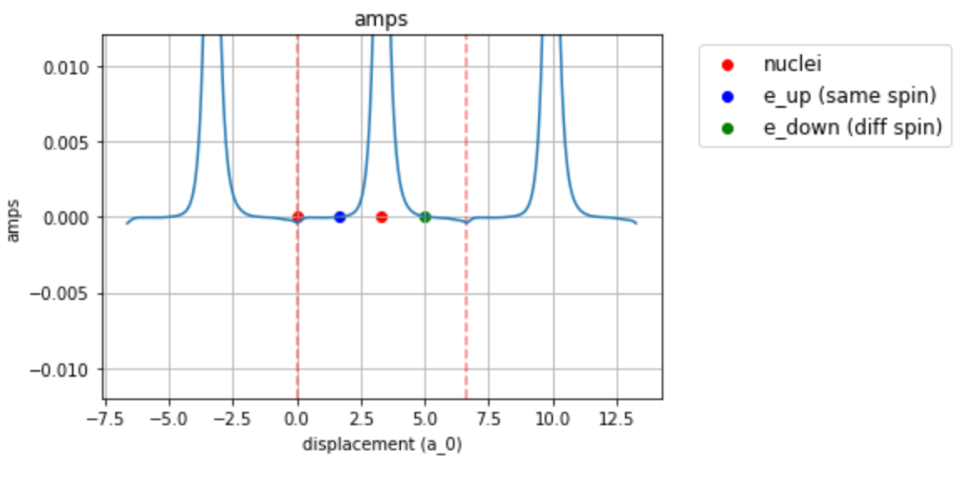
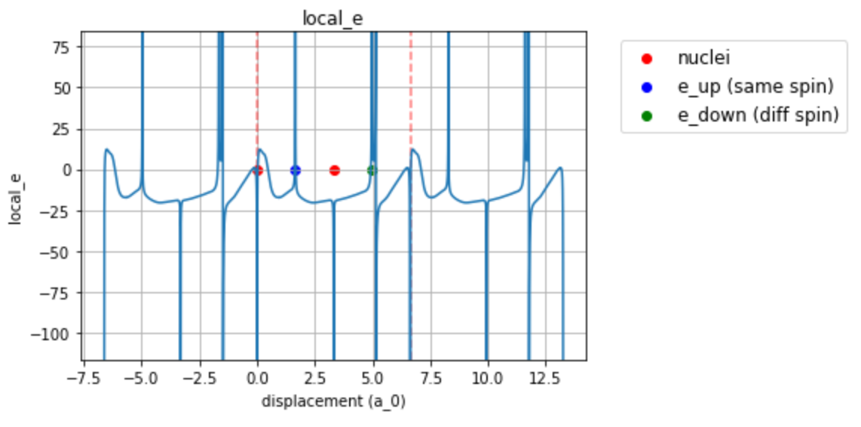
Electrons in line
First electron moved to line
Second electron moved 25% along line (between corners of cell)
Fourth electron moved 75% along line

Slide 25
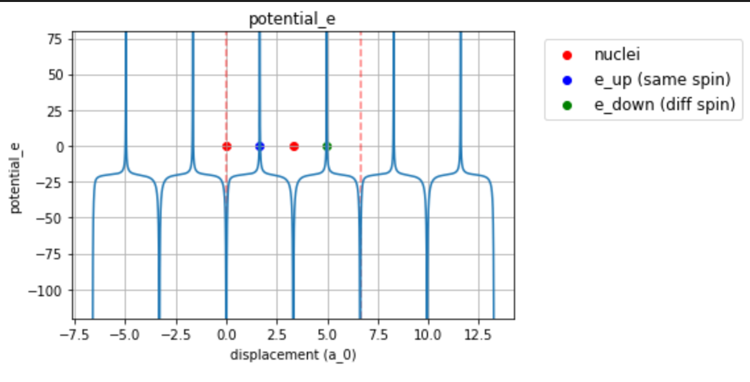
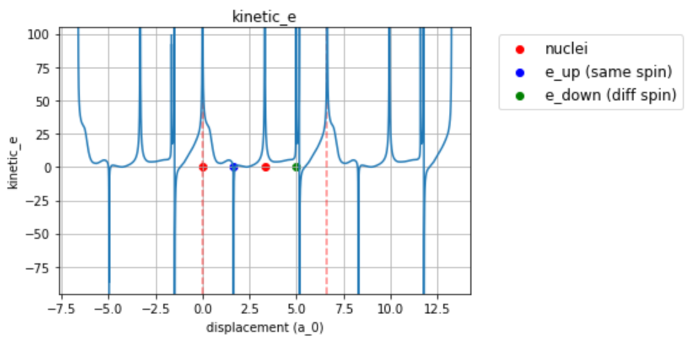

Slide 26
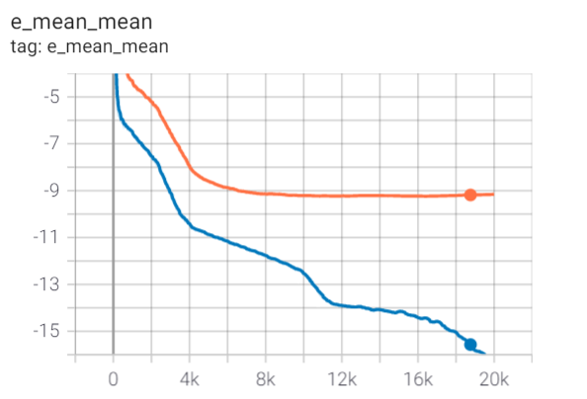
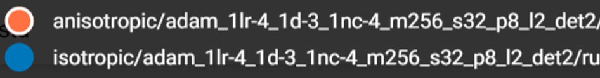

Slide 27
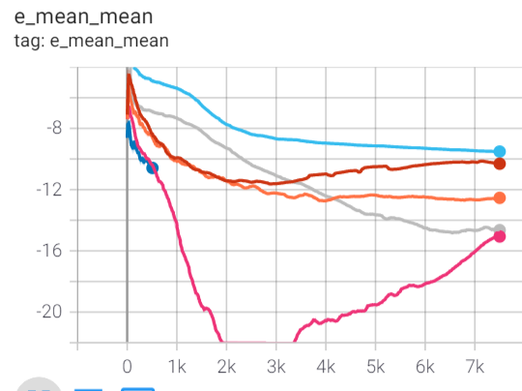
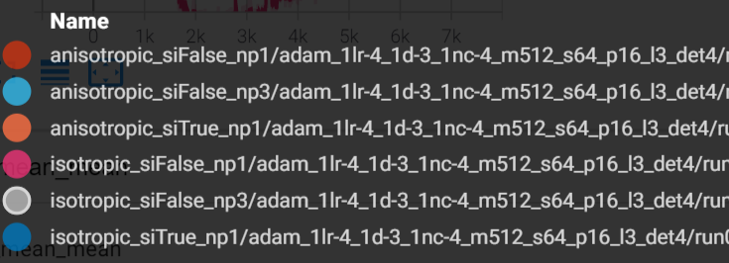
Other
Si = Scalar inputs (the inputs are reduced to the distances between particles)
Np = number periodic (the number of sin functions applied to the inputs, when the input is scalar no sin function is applied though it says np1)

