Slide 1
Experiments

Slide 2
Minimum image convention
Replace interaction terms (r_i – r_j) with nearest image terms (r_i – r_j’)
Ensure the inputs to the streams are periodic (L = cell_width)
(single sin) (r_i – r_j, |r_i – r_j|) -> (sin((2\pi/L)r_i – r_j), |r_i – r_j|)
(multiple sins) … ->
z_1 = (sin((2\pi/L)r_i – r_j), |r_i – r_j|), z_2 = (sin((4\pi/L)r_i – r_j), |r_i – r_j|)
Ensure the inputs to the orbital exponentials are periodic
|\Sigma (r_i – r_j)| -> |\Sigma (r_i’ – r_j)| where
r_i’ = (v_x’, v_y’, v_z’) where
v_x’ = 1/8(L – 2v_x) when v_x < -L/4
v_x’ = 1/8(L + 2v_x) when v_x > L/4
and because of mic |v_x | is never > L/2

Slide 3
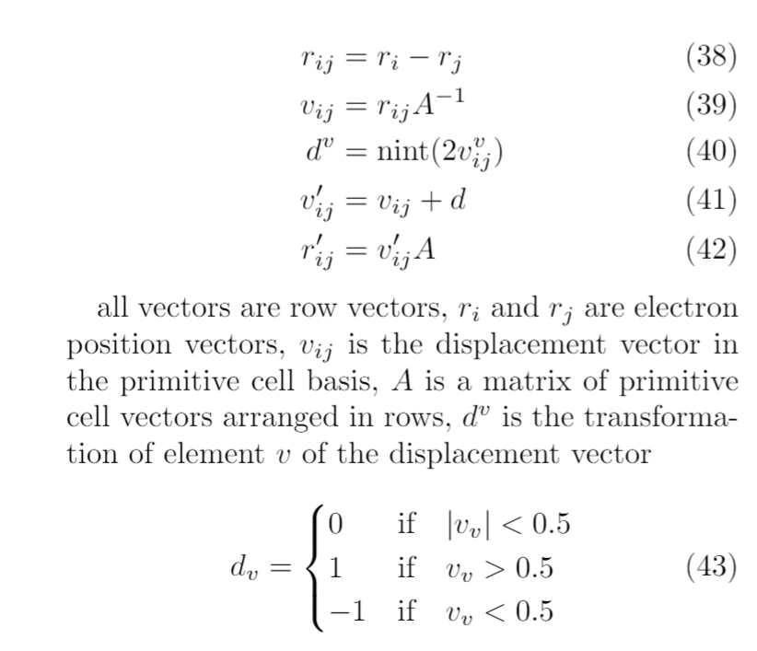
How MIC is implemented
! Currently backpropagating through all of this… ideally all these operations performed before input. How does this affect the grads?!

Slide 4
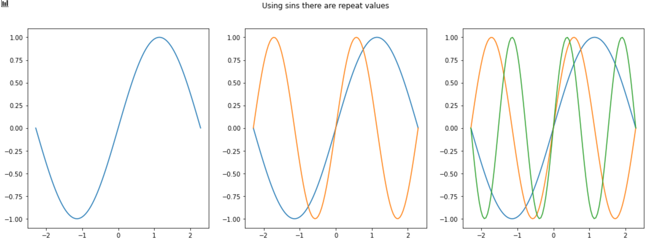
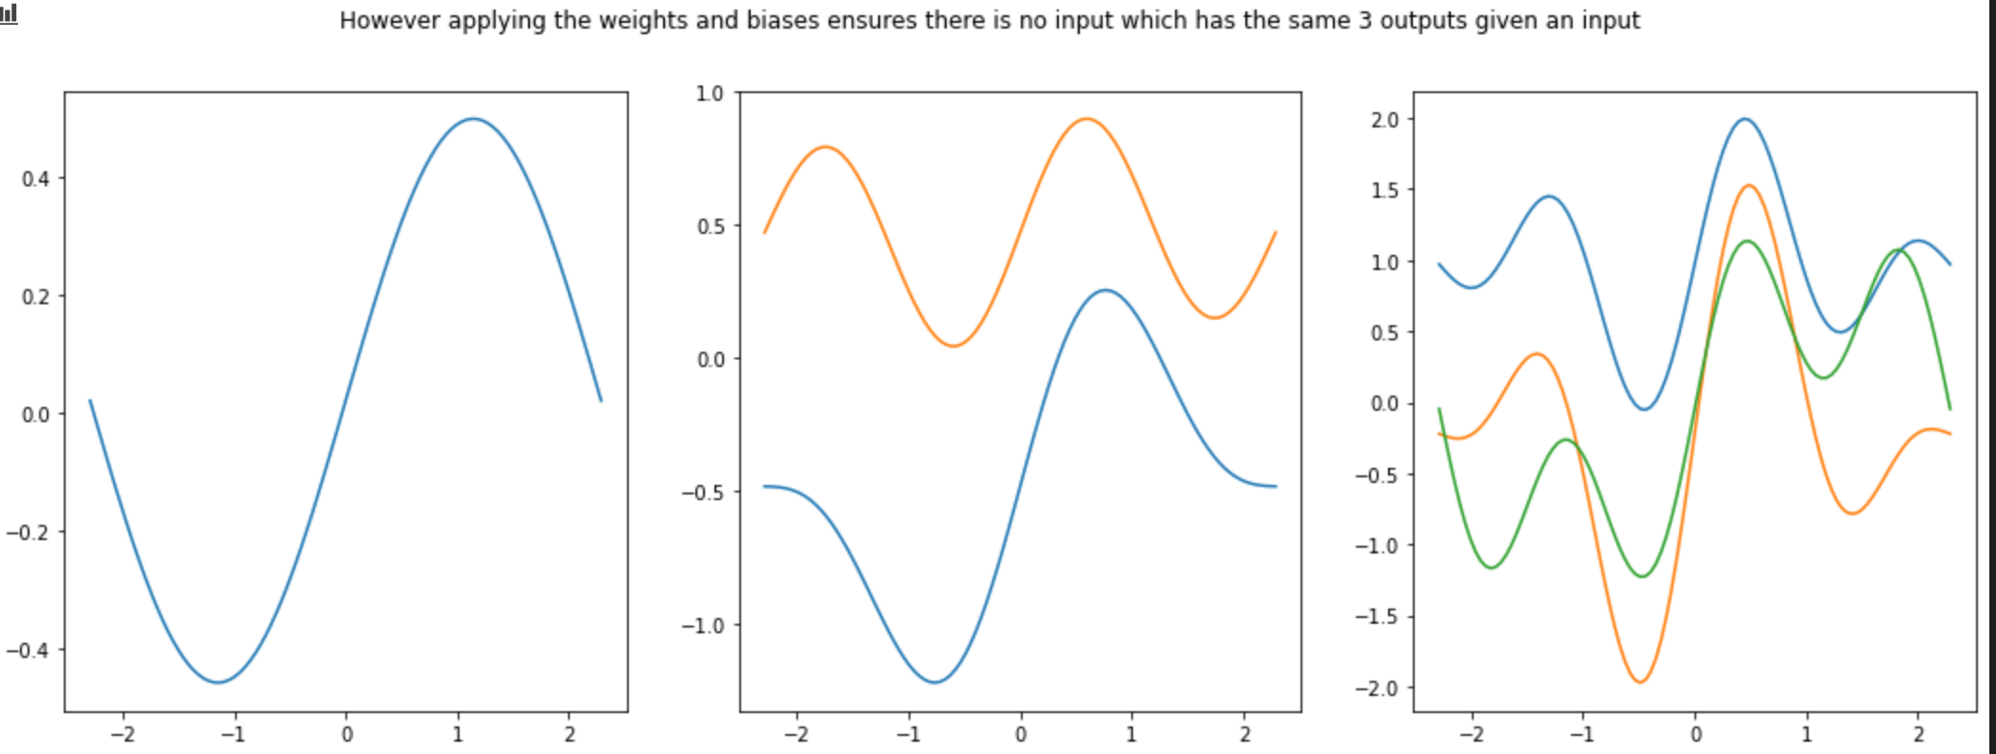
Sin inputs

Slide 5
