Slide 1

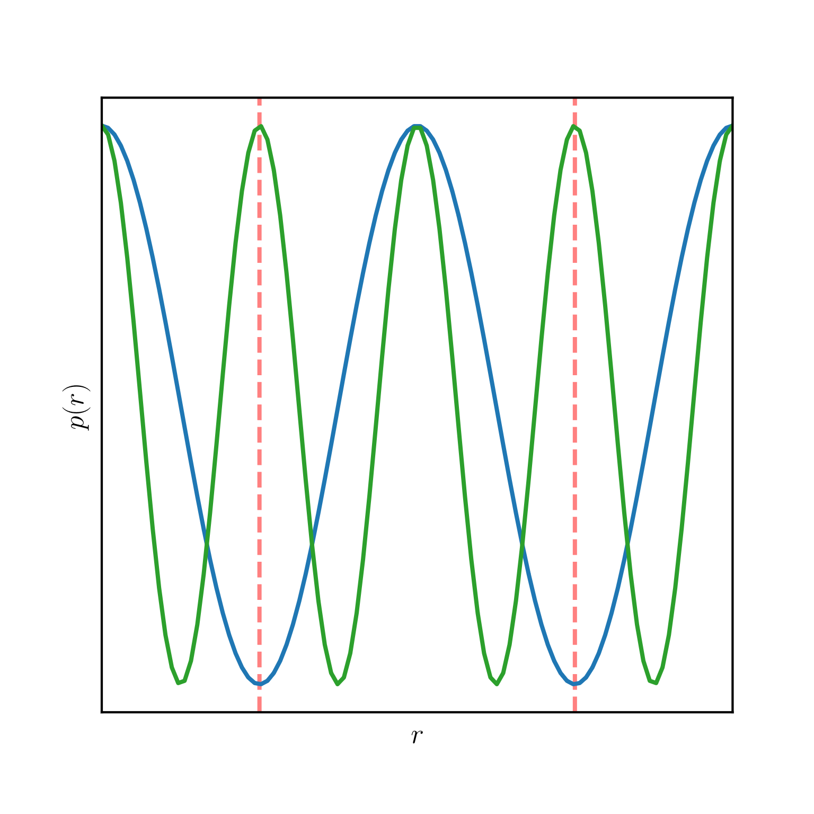
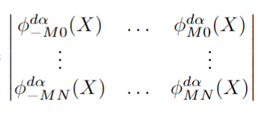

Input box
This box is a 2d representation of electrons in a box. This representation may change to include other boxes around the outside ‘to infinity and electrons are in the same relative positions as the center box (see Example 1). Color scheme doesn’t matter. Ideally there is a line between them labelled r_{ij} (See Fig). A 3d representation (if it looks good) is preferable, but aesthetic > 3d.
General
I think we should target something like example 3 (page 3) at least for starters.
- There’s a couple different formulations but I’m leaning towards symbol labels and a key (strongly leaning)
The basic structure for this is here, I need to provide the symbols, but the boxes / flow is generally correct.
The blowups (graph and equations) are optional, but I think they could look good, what do you think?
Example 1
Graph
I think this graph adds detail and can be made nice to look at/enhance the figure. 3d might be better I’ll make a dummy example. I can change the color scheme etc but these graphs will need to be altered by @max (they are generated with code).
Labels
Any labels must be times new Roman. Current figure labels the boxes, this might change to replace them with symbols, and then include a key. Imagine each box with a mathematical symbol then a key to the right symbol: description. I think this might look better, what do you think?
k-space embeddings
Periodic embeddings
Pairwise stream
Single stream
…
Permutation equivariant function
HF orbitals
…
Equations
This might look good? It’s not necessary but it’s like an expansion into more detail for the equations. What do you think @hannah?
Single stream
Lines & Arrows
These just need prettifying
Jastrow factor
Spin up determinants
Spin down determinants
$$J\left(X\right)+log{|ψ\left(X\right)|}$$
Boxes
The boxes represent variables/functions. In some cases it makes sense that they have ‘depth’ ie a cube instead of a box. They make it work Example 2 (page 2) but it’s not necessarily the best thing to do The joins between boxes (ie if they are adjacent) aren’t required. They are related (ie pairwise stream and single stream need to be at the same ‘level’) but they can be separated.
Hartree fock (HF) orbitals
I have a nice idea for this need to discuss with a colleage but it could be a plane representation of the wave function: Imagine rolling hills stretching off into the distance. 2nd thought its not technically accurate but I’ll see if we can work around that.

Slide 2


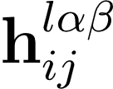






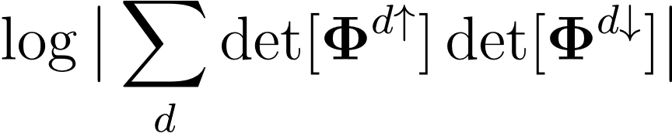
Periodic embedding :
k-space embedding :
Pairwise stream :
Single stream :
Permutation equivariant function:
HF orbitals :
Jastrow factor :
Spin up determinants :
Spin down determinants :
Log absolute amplitude :
…
…

Slide 3





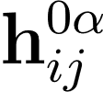


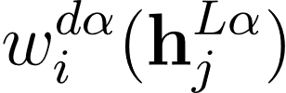



Periodic embedding :
k-space embedding :
Pairwise stream :
Single stream :
Permutation equivariant function:
HF orbitals :
Jastrow factor :
Spin up determinants :
Spin down determinants :
Log absolute amplitude :
Permutation equivariant layers

Slide 4
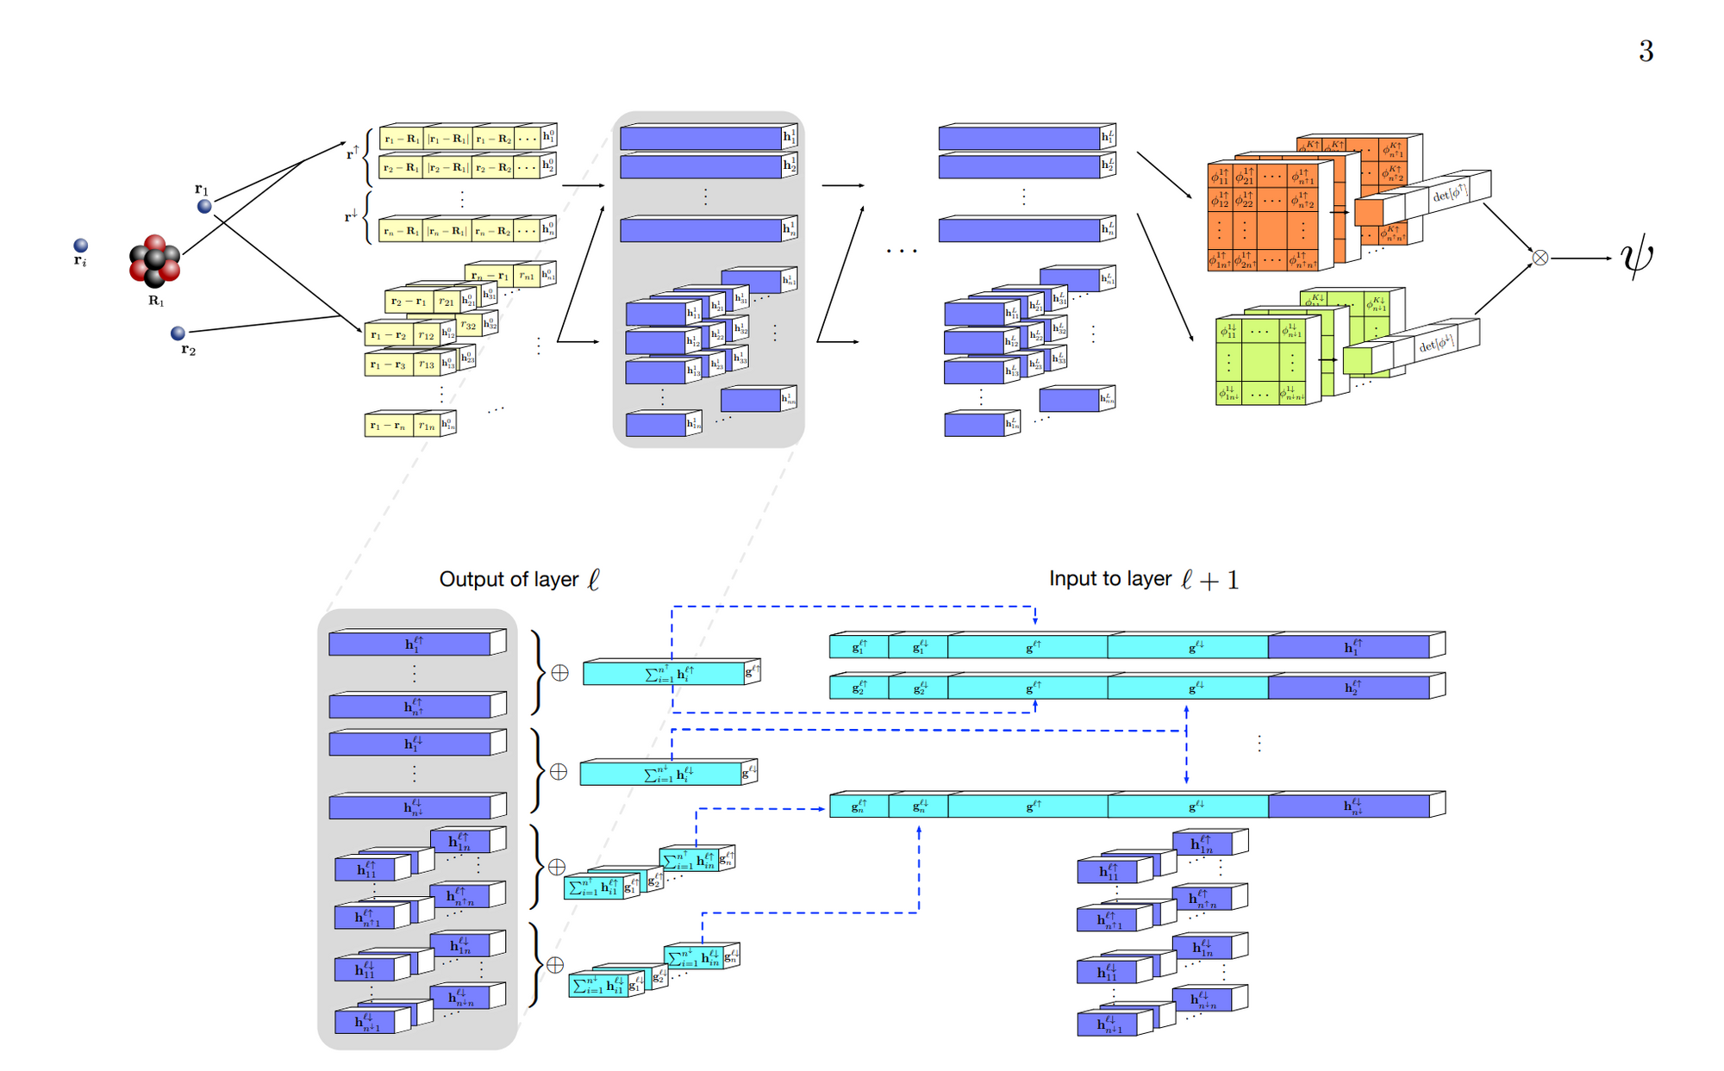
Example 2

Slide 5
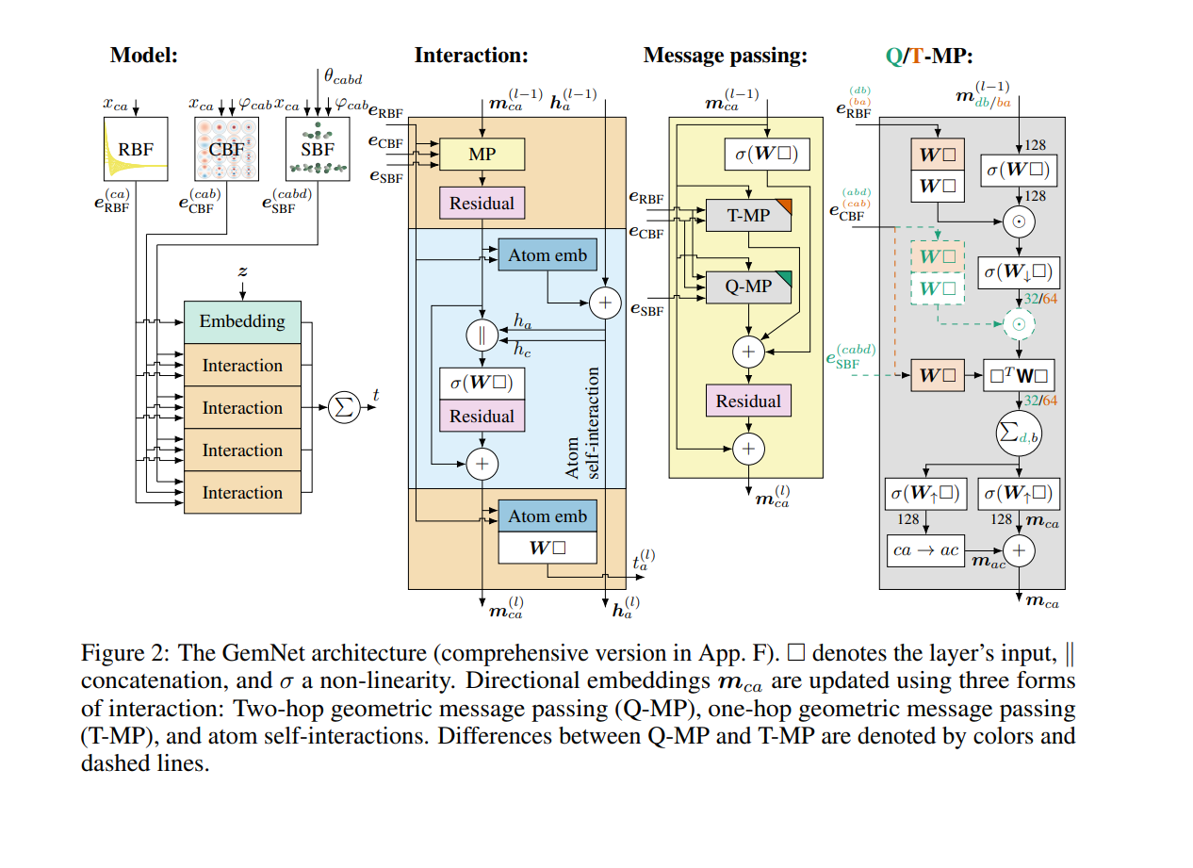
Example 3

