Slide 1
Simulations of state-of-the-art fermionic neural network wave functions with diffusion Monte Carlo
Max Wilson, Nicholas Gao, Filip Wudarski, Eleanor Rieffel & Norm Tubman

Slide 2
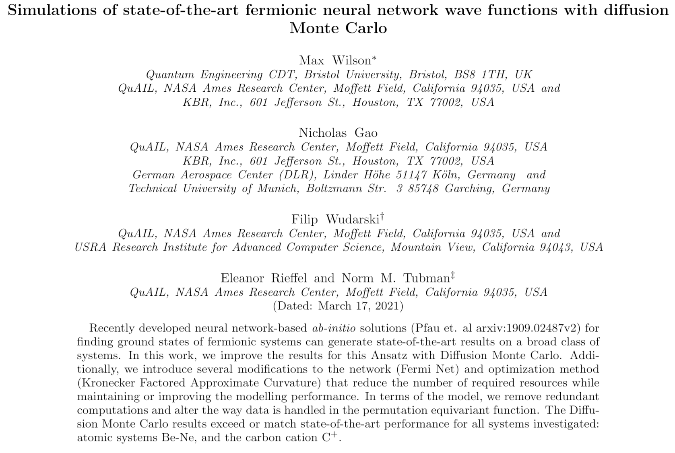

Slide 3
Outline
The problem
What are we trying to do?
Why would we want to do that?
Related work
What has been done before?
What is related now?
The model
What did we use to model the system?
The algorithms
What algorithms were used to solve the problem?
Some results
What results did we get?
Next steps
Where is this going?

Slide 4
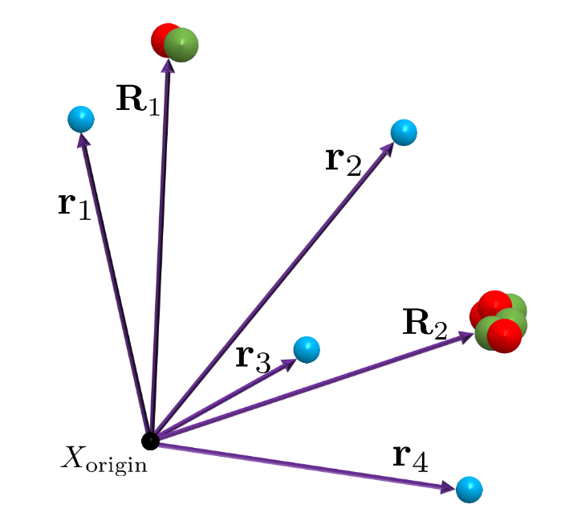

The problem
Quantum particles/systems
Superposition (waves)
Entanglement (non-classical correlations)
Exponential amount of information to model
Notes:
We want to understand the behavior of this system
Do this by modelling the wave function
We find the wave function of the ground state, because physical systems tend to be in lower energy states, by solving the schrodinger equation (which means finding psi)
H Hamiltonian, the energy operator of the system, psi is the wave function and in our case is some function we have dreamt up over X the configurations and E is the energy of the wave function

Slide 5
Related work
Solving the QMB with ANNs
Carleo & Troyer, Science 10, 2017
Spin system wave functions
Boltzmann machine
First demonstration
SchNet
Schütt et al, J. Chem. Phys. 148, 2019
Atomic/Molecular properties predictions
Graph NN
Fermi Net
Pfau et al, Nature Chemistry12, 2020
Atomic/molecular wave functions
Multi-electron orbitals
Graph NN
Expensive, but very accurate
PauliNet
Hermann et al, Nature Chemistry12, 2020
Atomic/molecular wave functions
Slater-Jastrow-backflow wave function
Graph NN
Fast, but less accurate
Notes:
-Solving the schrodinger equation is a hard problem

Slide 6
Related work
Contributions of this work
Improvements in efficiency to Fermi Net
First (known to us) application of DMC to neural network Ansatz
Matching or exceeding state-of-the-art results on atomic systems Be-Ne and ion C⁺
Other differences
Changes to the optimisation (KFAC)

Slide 7
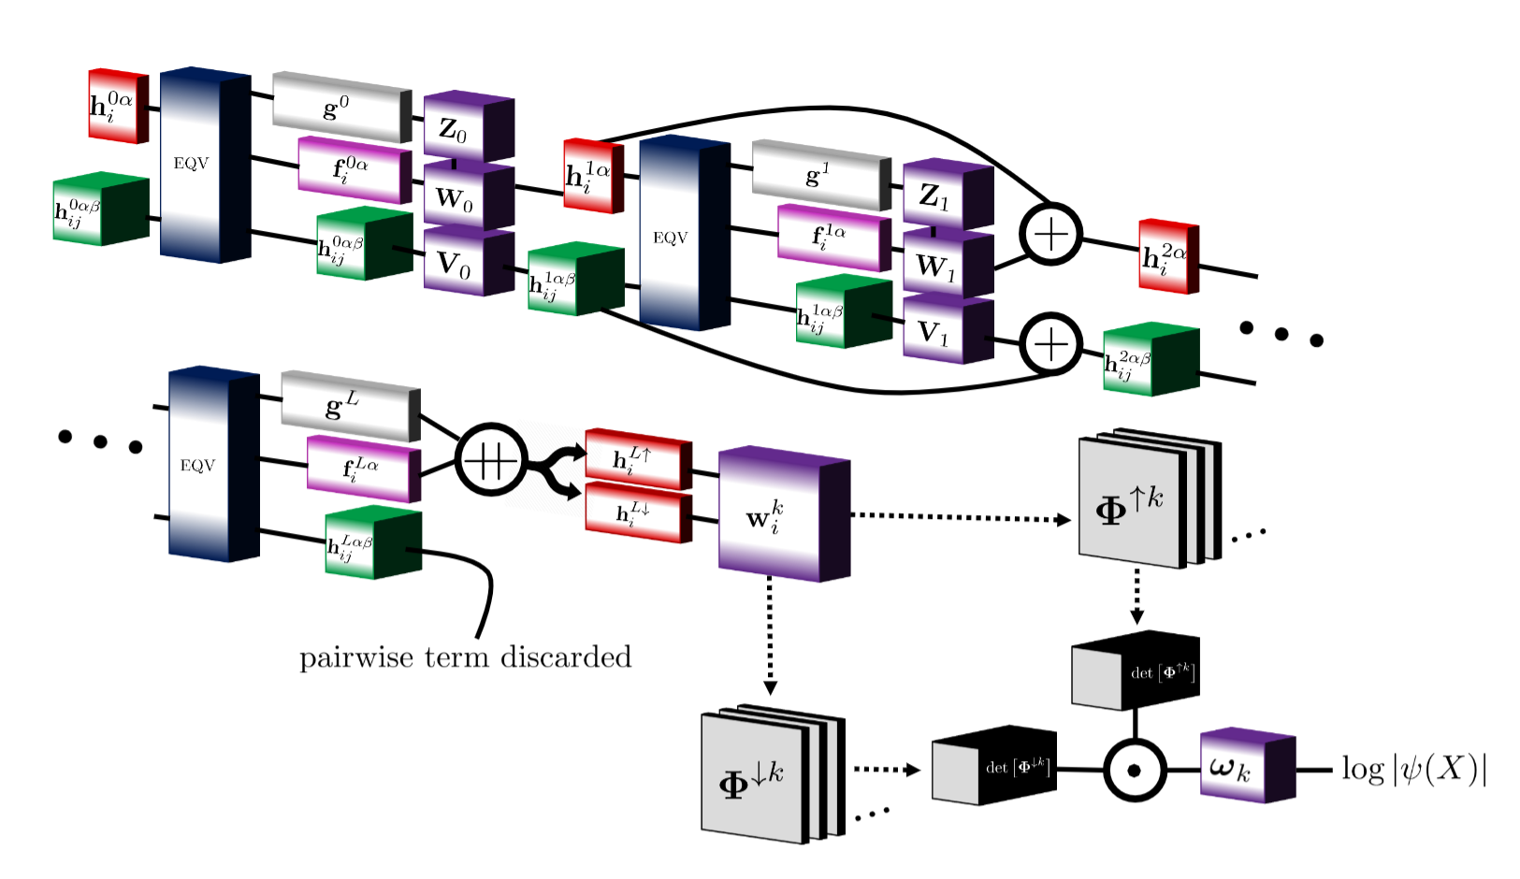
The model
‡
†
Purple: functions with parameters
Blue: permutation equivariant function
Other colors: data

Slide 8
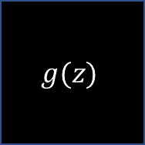
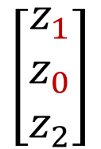
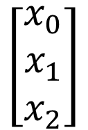
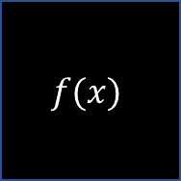
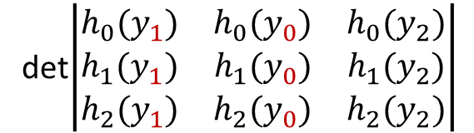

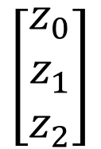

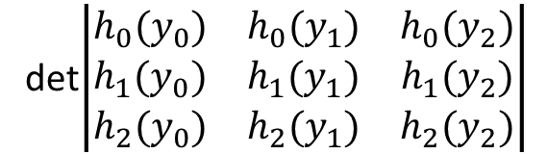

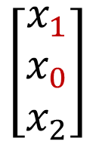
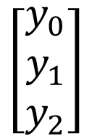


The model
‡
‡
†
$$\left[\begin{matrix}x_{0} \\ x_{1} \\ x_{2}\end{matrix}\right]$$
$$f(x)$$
$$\left[\begin{matrix}z_{0} \\ z_{1} \\ z_{2}\end{matrix}\right]$$
$$g(z)$$
$$\left[\begin{matrix}y_{0} \\ y_{1} \\ y_{2}\end{matrix}\right]$$
det$\left|\left.\begin{matrix}h_{0}(y_{0}) & h_{0}(y_{1}) & h_{0}(y_{2}) \\ h_{1}(y_{0}) & h_{1}(y_{1}) & h_{1}(y_{2}) \\ h_{2}(y_{0}) & h_{2}(y_{1}) & h_{2}(y_{2})\end{matrix}\right|\right.$
$$ψ\left(x\right)$$
$$\left[\begin{matrix}x_{1} \\ x_{0} \\ x_{2}\end{matrix}\right]$$
$$f(x)$$
$$\left[\begin{matrix}z_{1} \\ z_{0} \\ z_{2}\end{matrix}\right]$$
$$g(z)$$
$$\left[\begin{matrix}y_{1} \\ y_{0} \\ y_{2}\end{matrix}\right]$$
det$\left|\left.\begin{matrix}h_{0}(y_{1}) & h_{0}(y_{0}) & h_{0}(y_{2}) \\ h_{1}(y_{1}) & h_{1}(y_{0}) & h_{1}(y_{2}) \\ h_{2}(y_{1}) & h_{2}(y_{0}) & h_{2}(y_{2})\end{matrix}\right|\right.$
$$−ψ\left(x\right)$$
Swapping inputs results in change of sign of the wave function = antisymmetric = fermionic system
Pfaffian wave function https://pubmed.ncbi.nlm.nih.gov/16711968/
Vandermonde wave function https://ieeexplore.ieee.org/document/9297114/
- …

Slide 9
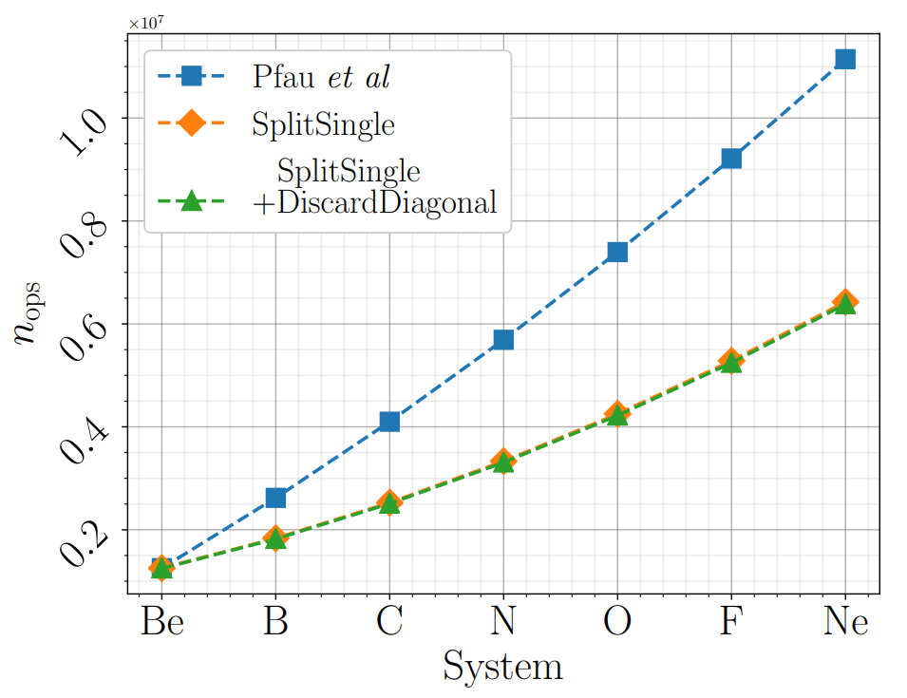
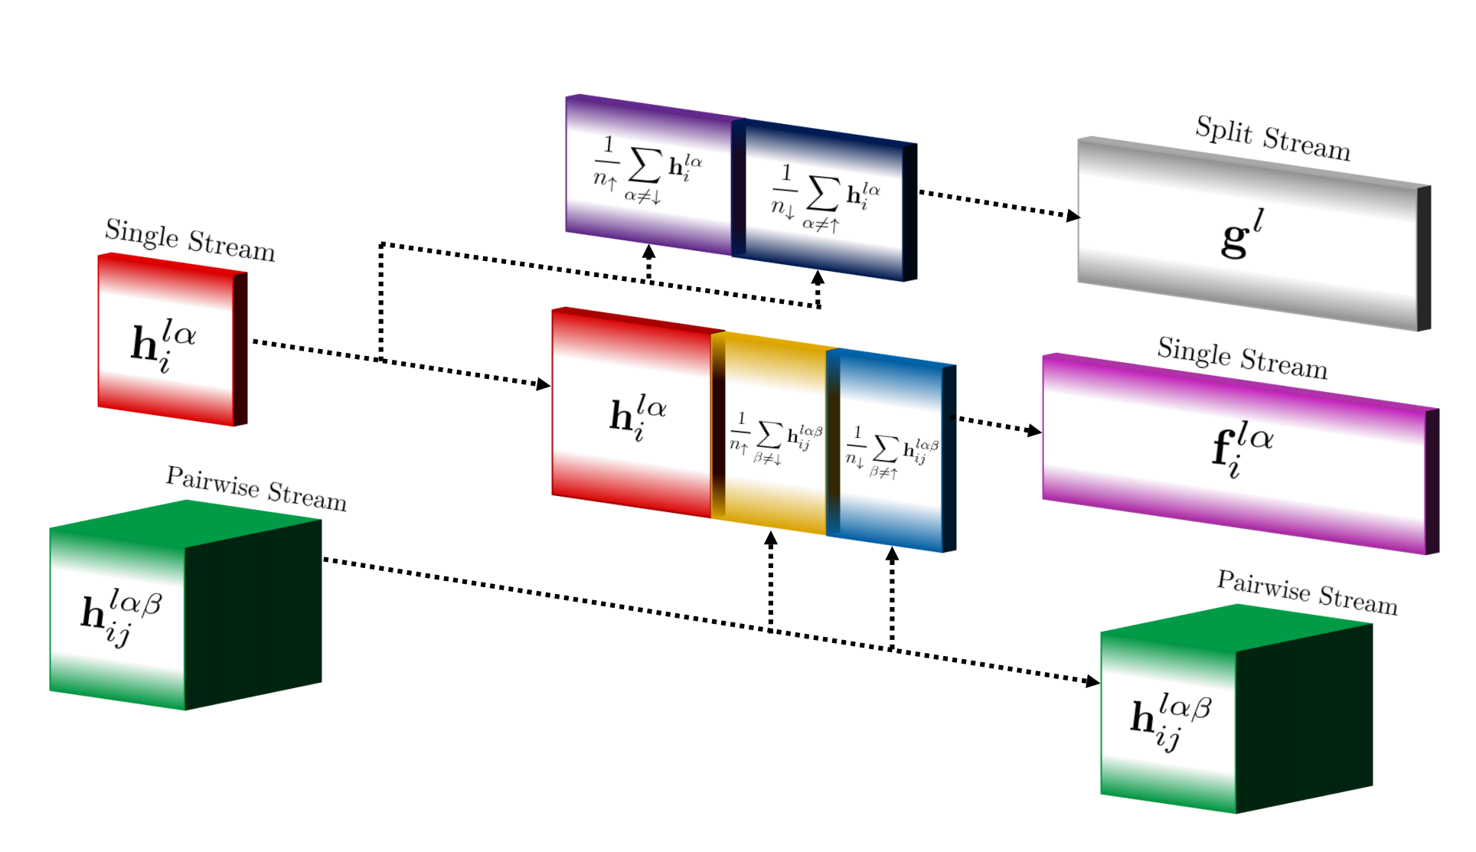
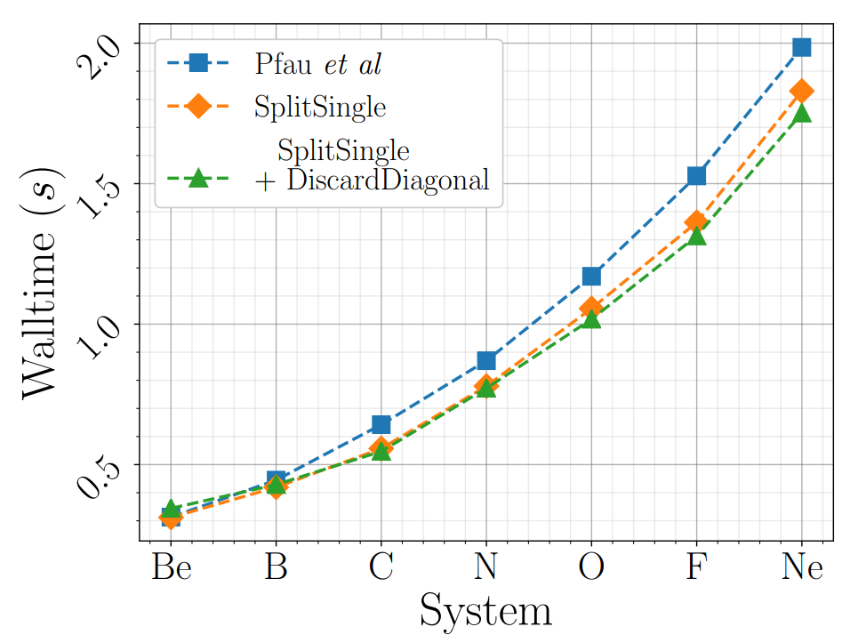
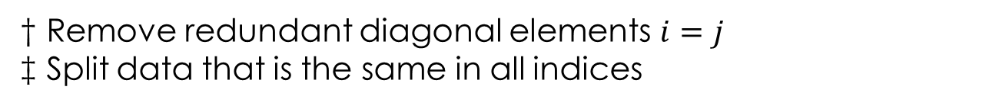
The model
‡
†
† Remove redundant diagonal elements $i=j$
‡ Split data that is the same in all indices
Notes:
Describe both

Slide 10
The algorithms
Variational Monte Carlo
VMC
Iterative improvement of the wave function Ansatz by changing the parameters performed under the Born-Oppenheimer approximation (fixed nuclei)
Kronecker Factored Approximate Curvature
KFAC
Approximate second order optimization related to stochastic reconfiguration
Diffusion Monte Carlo
DMC
Projector method iteratively improving the wave function by reweighting the walkers performed under the fixed-node approximation
Approximate stochastic reconfiguration

Slide 11
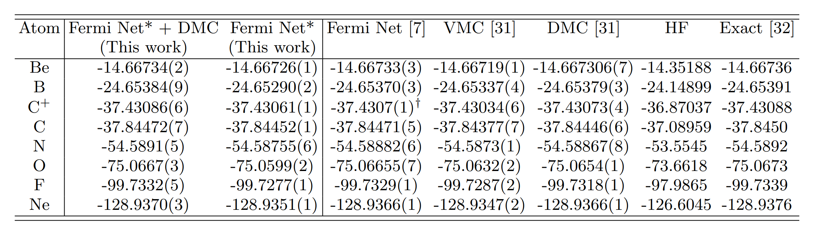
Some results

Slide 12
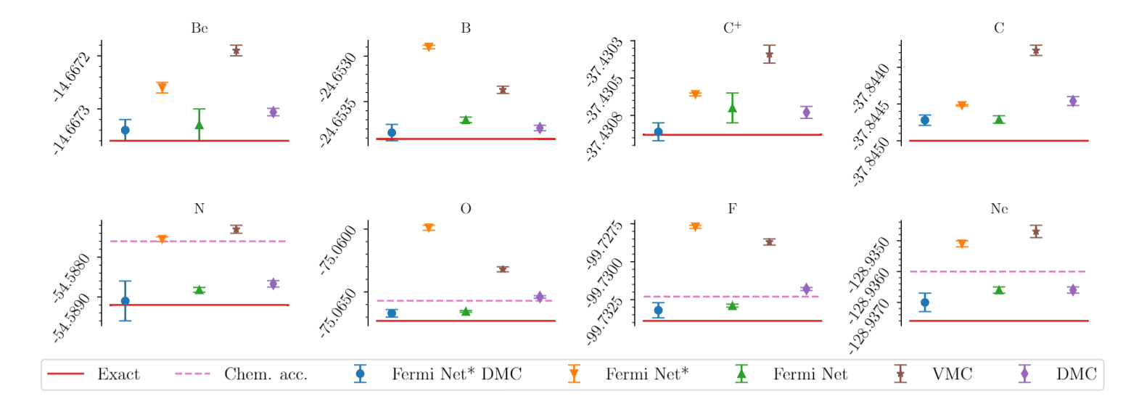
Some results

Slide 13
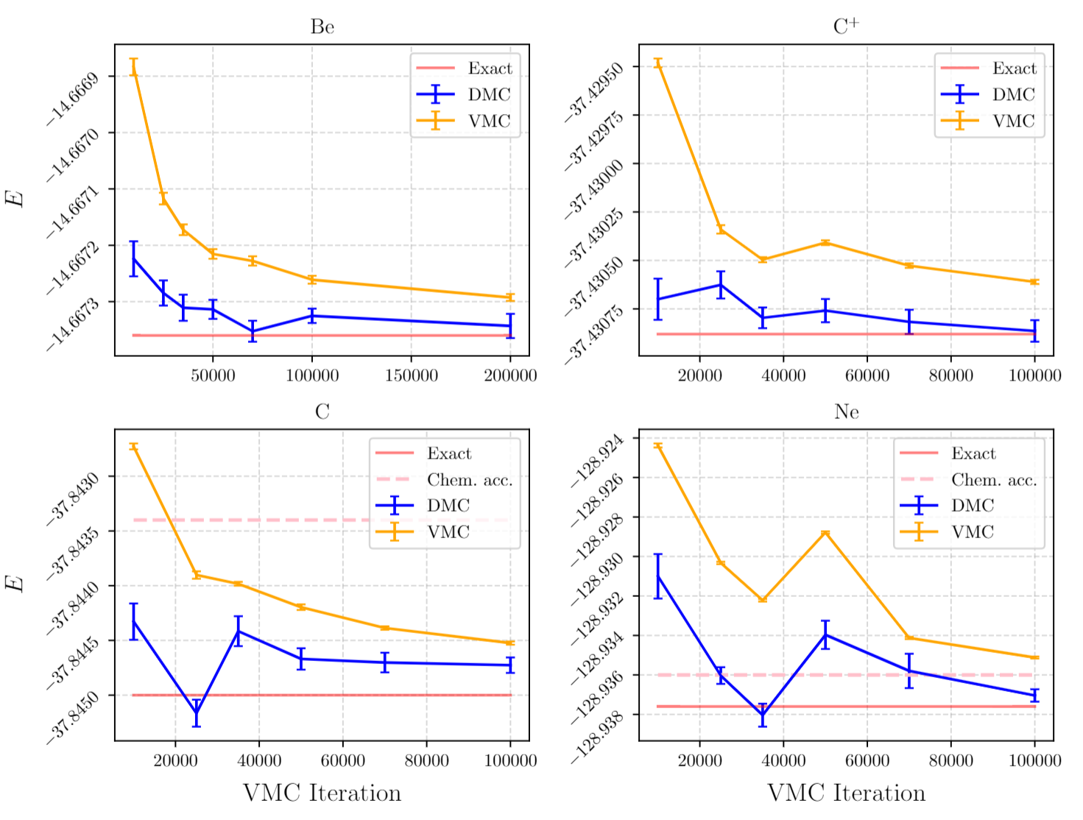
Some results

Slide 14
Next steps
Improved Ansatz design
Can other changes be made to Fermi Net?
Other wave functions?
Improved VMC
CG SR?
KFAC features?
Mixed precision training?
Other systems
Solids?
Where else is VMC used?
Other VMC methods
Pseudopotentials?
Scaling
Most efficient way to model large systems?
What are the technical challenges of scaling?

Slide 15
Final Comments
Long-term vision
Infrastructure (GPUs and deep learning frameworks) will continue to improve
Quantum chemistry neural network methods will adopt other standard quantum chemistry methods
Neural network methods will supplement or replace standard quantum chemistry methods
Takeaways
We improved the Fermi Net by changing how data was handled and extended with diffusion Monte Carlo
There is a long-term case for investing in neural network method for modelling wave functions

