Slide 1
Periodic Neural Network Ansatze

Slide 2
Contents
Story for constructing the periodic system
Requirements
Ansatz (periodicity)
Ewald’s summation
Kinetic energy computation

Slide 3
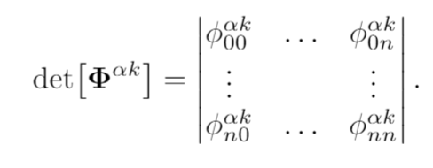
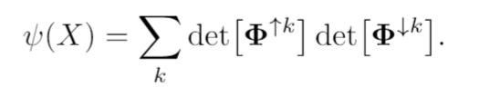
Story for system
Lots of nuclei and electrons
Enforce repeating structure
Only learn the wave function of a single cell
The wf in a single cell is the same in every cell
Compute the per cell wf with the per cell potential energy and the per cell kinetic energy
Particles still interact with particles outside the cell
Ignore some of the interactions

Slide 4

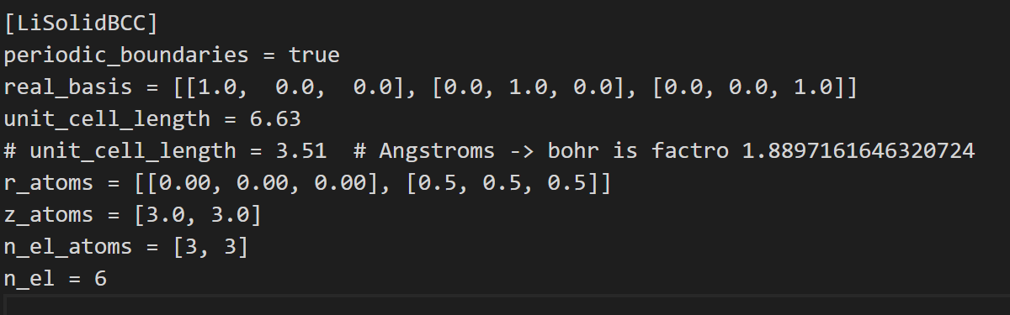
Requirements
The wf is antisymmetric
The wf is periodic
The corresponding system energy calculation is correct
The system description is correct

Slide 5
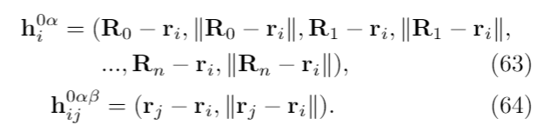
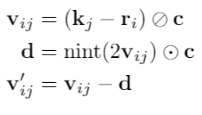
Inputs and minimum image convention

Slide 6
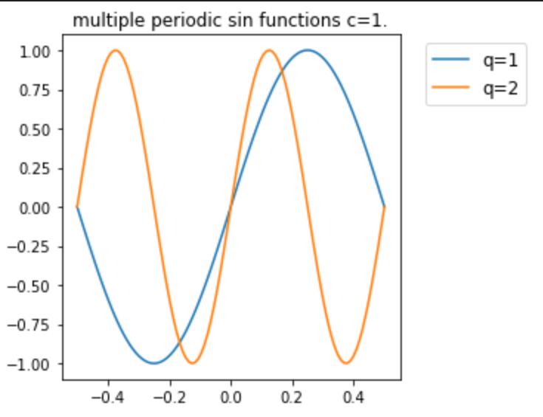


Slide 7
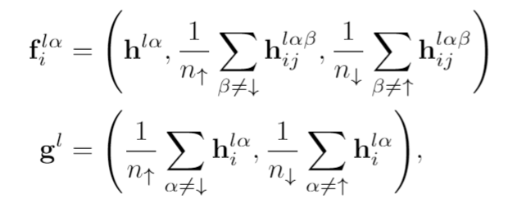
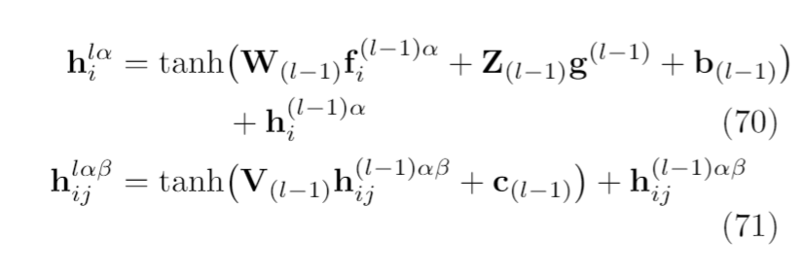
Intermediate layers (Permutation Equivariant)

Slide 8
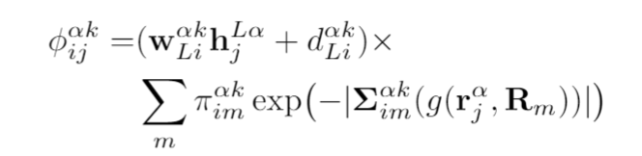

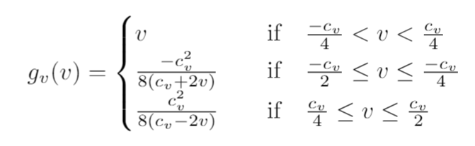

Anisotropic orbitals

Slide 9
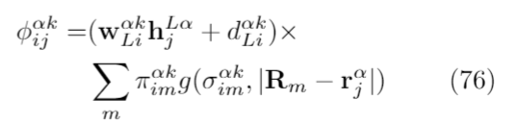
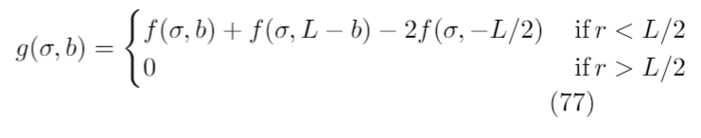
Isotropic orbitals

Slide 10
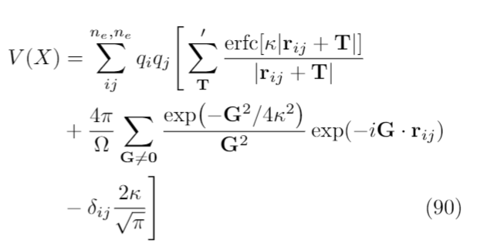

Ewald’s Summation

Slide 11
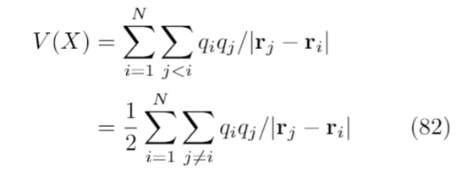
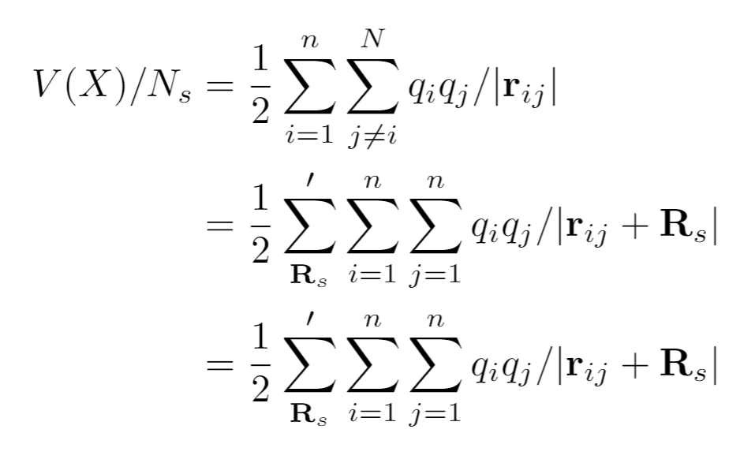
Ewald’s Summation
Potential energy of the system
Potential energy per cell is the interactions of all particles inside the cell with all particles outside the cell but NOT outside with outside.
Expressed as sum of erf and erfc functions

Slide 12
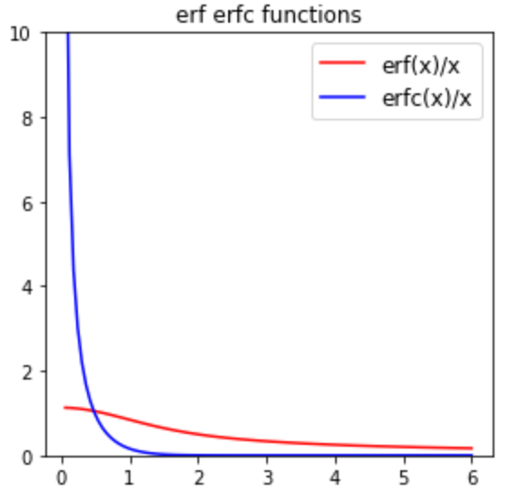
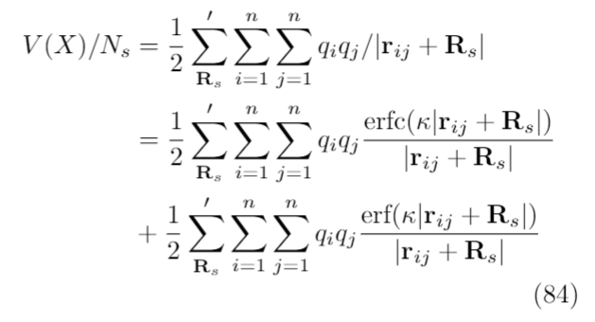
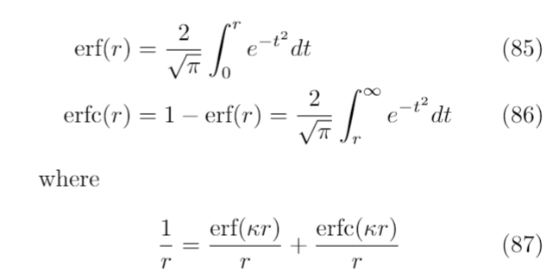
Express as erf and erfc

Slide 13
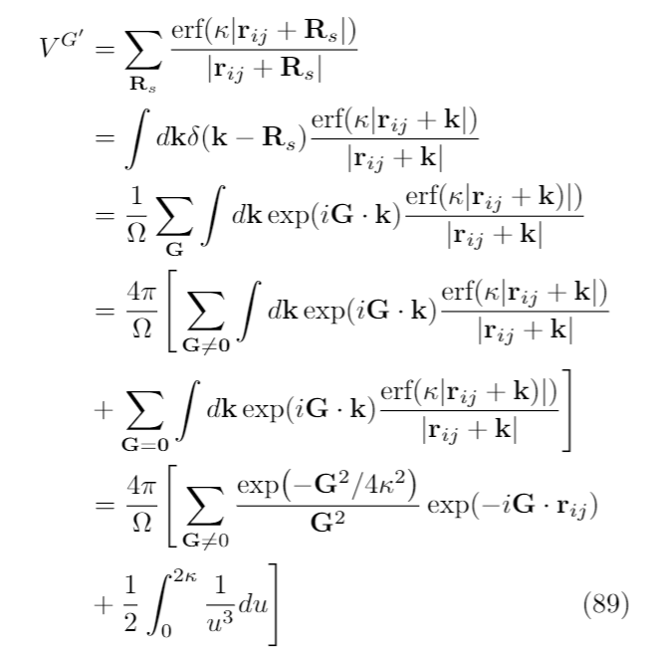
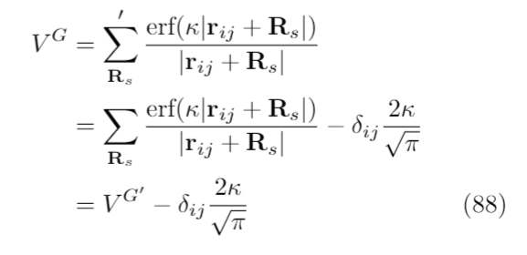
Fourier transform erf

Slide 14
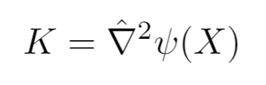
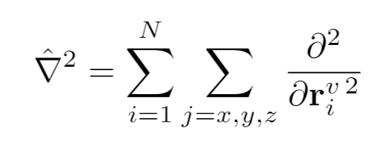
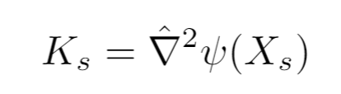
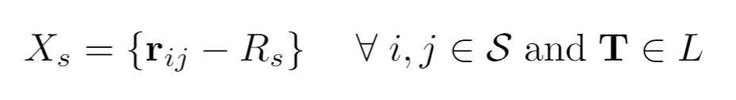
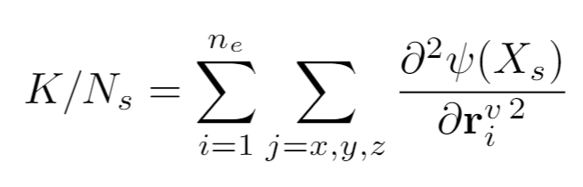
Kinetic Energy Computation
Kinetic energy of wavefunction of whole system / Laplacian
Kinetic energy of the periodic wf where interactions are limited to all interactions of all other particles with particle in the simulation cell
Kinetic energy of cell

Slide 15
Questions
If we just take the kinetic energy of the interactions within the simulation cell, will the result still be valid (given the interaction distance has changed)
What does it mean to apply the minimum image convention? Ie we substitute in the position vector of another particle, why would the wf understand how this interaction affects the output?

Slide 16









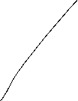










Energy

Slide 17



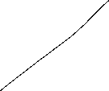

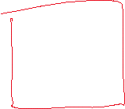
Energy

