Slide 1
CIScreen
XM
https://github.com/xmbms/CIScreen

Slide 2
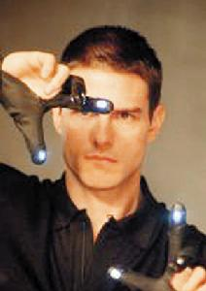
Objectives
More interesting Presentation
Free hand
Body Control Interface

Slide 3
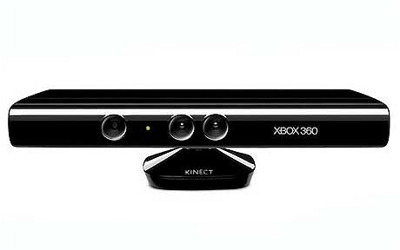


Reference Tools
Kinect
OpenNI && NITE
OpenCV

Slide 4
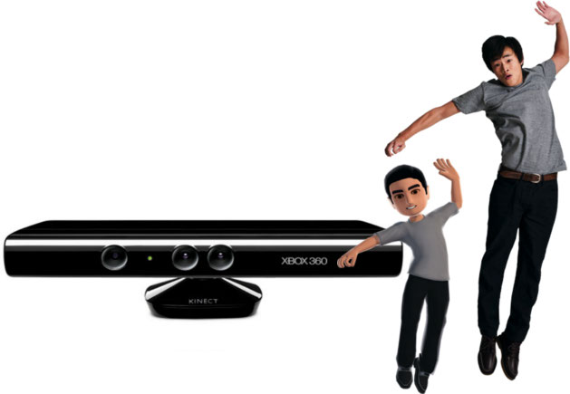
NITE Support Gesture
Push
Wave
Swipe

Slide 5




Hand Gesture
Move
Drag
Zoom
Draw

Slide 6
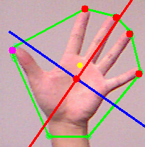
Finger Detection
Depth Image Data
Convex hull
Kmeans
PCA

Slide 7
CIScreen Usage
Using the stable detection and recognition
Session Start
Wave
Tips on the left top of screen

Slide 8
CIScreen Usage
Presentation control
Begin
Swipe up
Next
Push/Click
Previous
Drag/make a fist
Draw Line/Rectangle
Draw/Zoom hand gesture(mentioned above)
Exit
Raise two hands and make a fist

Slide 9
Thanks

