Slide 1


Slide 2
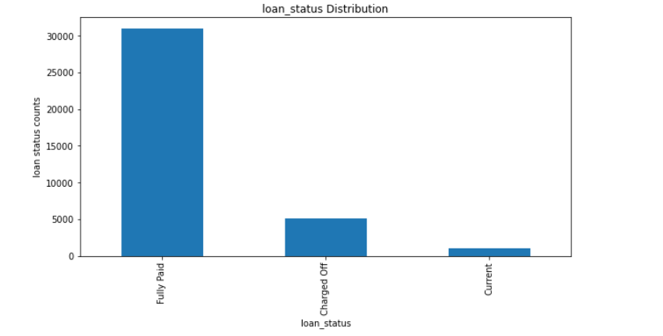
Loan_Status Distribution
As we can see from the bar chart that fully paid consumers are more than charged off followed by current

Slide 3
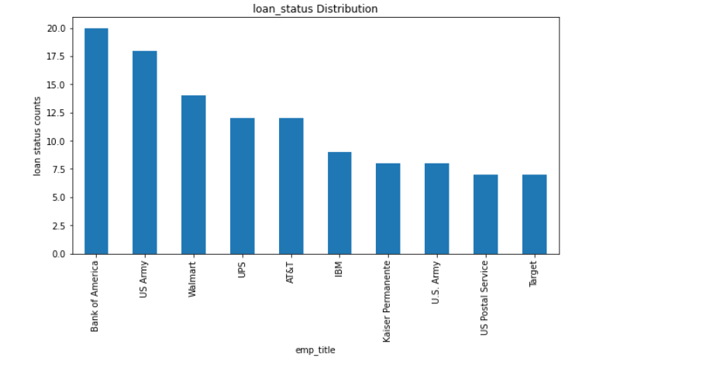
Emp_title vs Loan_Status for charged off consumers
The distribution clearly states that in charged off consumer most of the consumers belong to Bank of America. These are top 10 consumers in charged off segment.

Slide 4
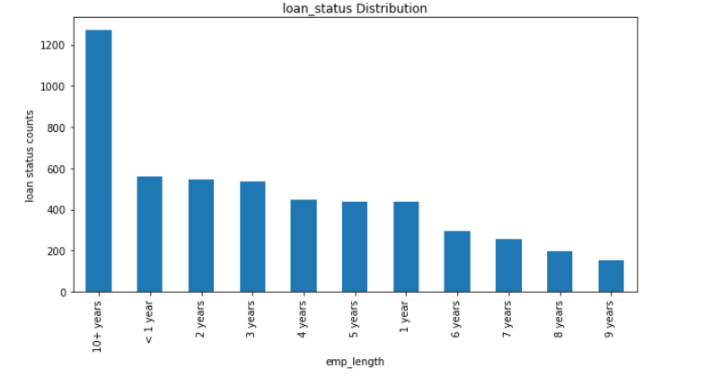
Emp_length vs Loan_Status for charged off consumers
As we can see that consumers who are having more than 10+ years of experience are having more charged off than consumers who are having less years of experience.

Slide 5
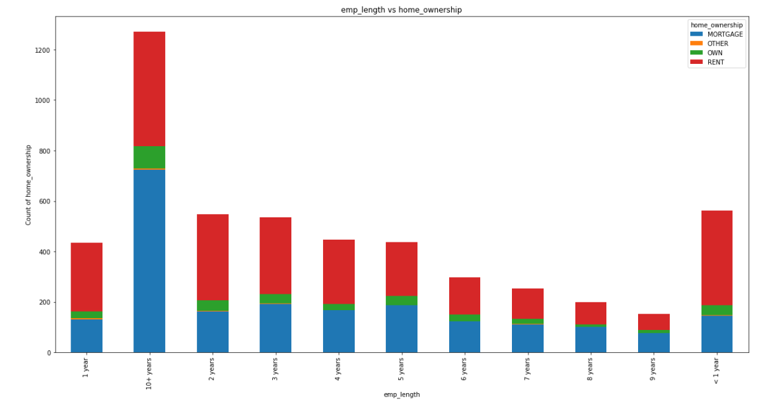
Emp_length vs home_ownership for charged off consumers
As we can see that in 10+ years of employment length people are more into mortgage. Also we can observe from the stacked chart, we can see that most of the consumers below 10 years are on rent. So, can we see that in 10+ years of experience which are more into charged off depending upon the home_ownership?

Slide 6
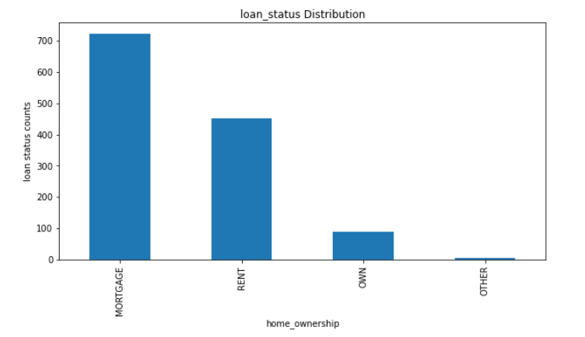
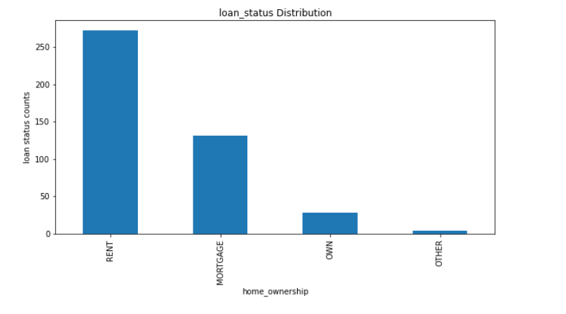
Emp_length (10+ years,<1 year) home_ownership vs loan status for charged off consumers
As we can see from our analysis that in 10+ years of employment length, consumer in mortgage are mostly charged off followed by consumers on rent. This can be one factor when providing loans to consumer to check if they belong to 10+ years of experience they must not come in Mortgage otherwise on rent as well and provide low value loan or no loan to those type of consumers.
As we can see from our analysis that in employment length <1 year, consumer in rent are mostly charged off followed by consumers on mortgage. This can be one factor when providing loans to consumer to check if they belong to experience <1 year they must not come in rent and provide low value loan or no loan to those type of consumers.

Slide 7
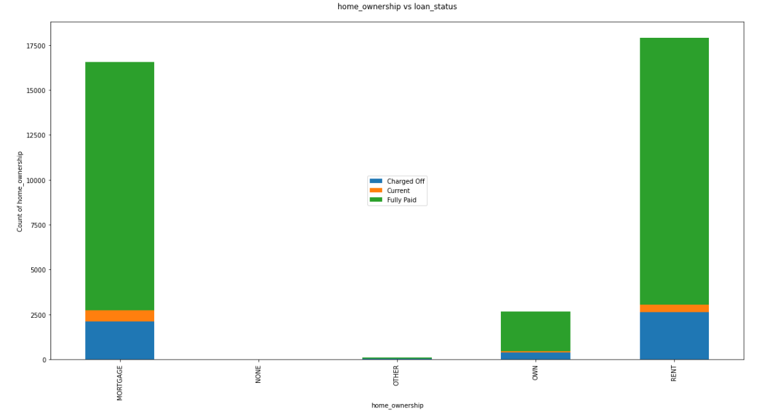
home_ownership vs loan_status
As we can see that Fully Paid & charged off are more in mortgage and rent home ownership, but as we saw above that home_ownership and emp_length are both driving factor from consumer attributes point of view. Hence, we should consider emp_length along with home_ownership to offer loans to consumers.

Slide 8
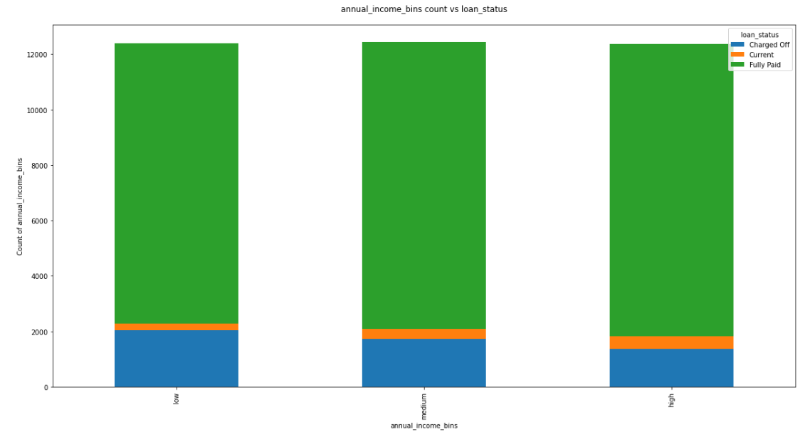
Annual Income vs loan status
The bins are created using annual income and allocated categories like low, medium & high. As we can see that in low & medium categories charged off are more compared to high category of annual income. So, in this case LC can give lesser amount/no loans to these categories of consumers.

Slide 9
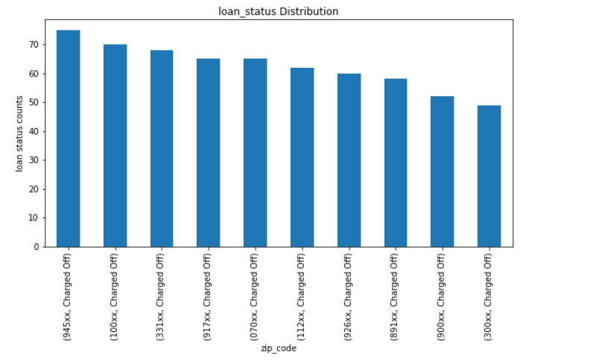
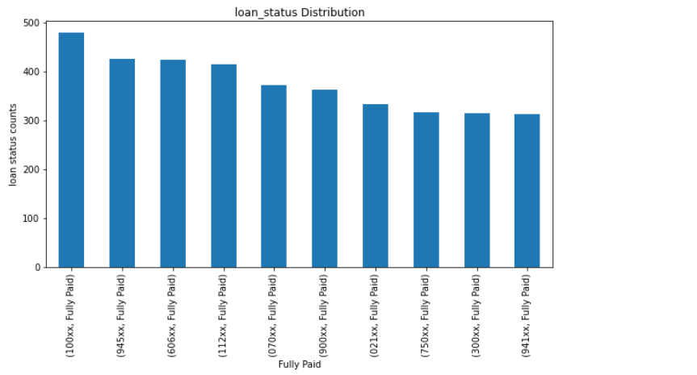
Zip code vs loan status
As we can see from the chart these are top 10 consumers who are charged off so LC should consider zip codes while providing loans to consumers.
As we can see from the bar chart that consumer zip code which are present in charged off are also present in fully paid. Also we can see that similar consumers zip code in charged off have fully paid maximum no of times loan. Hence, while lending loans we can offer loans to them at nominal amount or as decided by business.

Slide 10
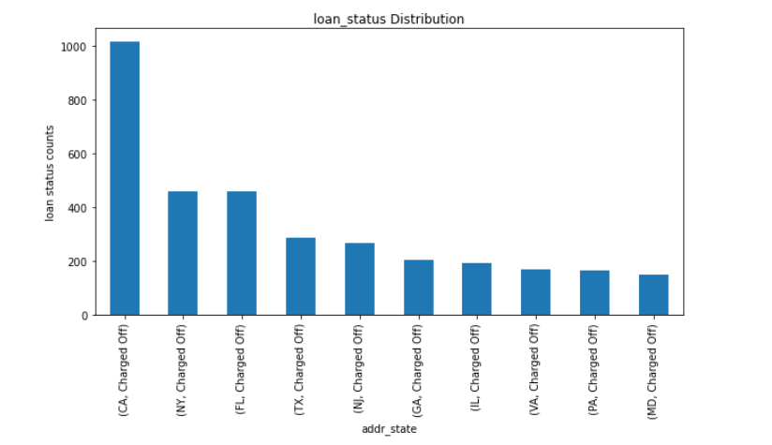
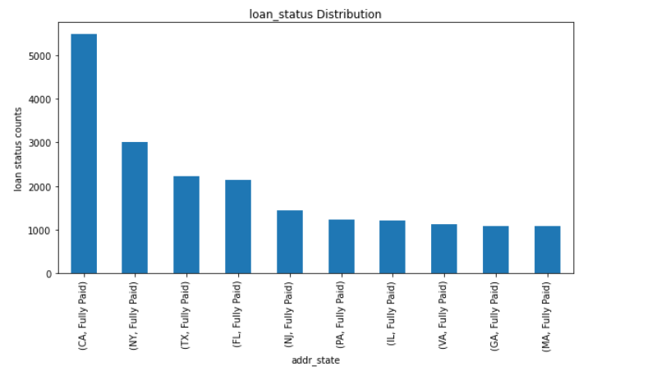
Address state vs loan status
As we can see that CA state has most no of charged off so while offering loans to those consumers who belong to CA state should be considered. Along with this zip code is an important factor while offering loans to consumer since state is an aggregated values but we must consider at granular level while offering loan to consumers.

Slide 11
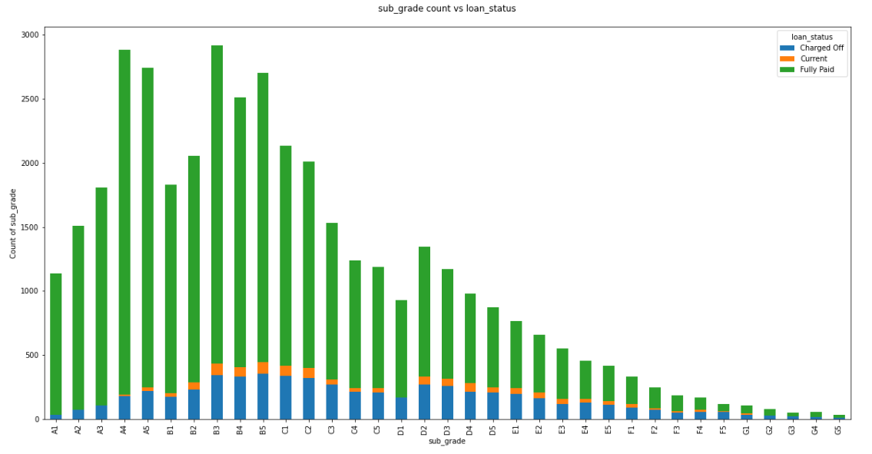
sub_grade vs loan status
1) As we can see from the chart for charged off consumers, most charged off consumers are falling in B5 sub_grade. There are other sub_grades as well where charged off consumers are falling.
2) As we can see from the chart for fully paid consumers, most Fully Paid consumers are falling in B3 sub_grade. There are other sub_grades as well where Fully paid consumers are falling.
Hence, as we saw above sub_grades are important when considering any consumers like charged_off, fully paid

Slide 12
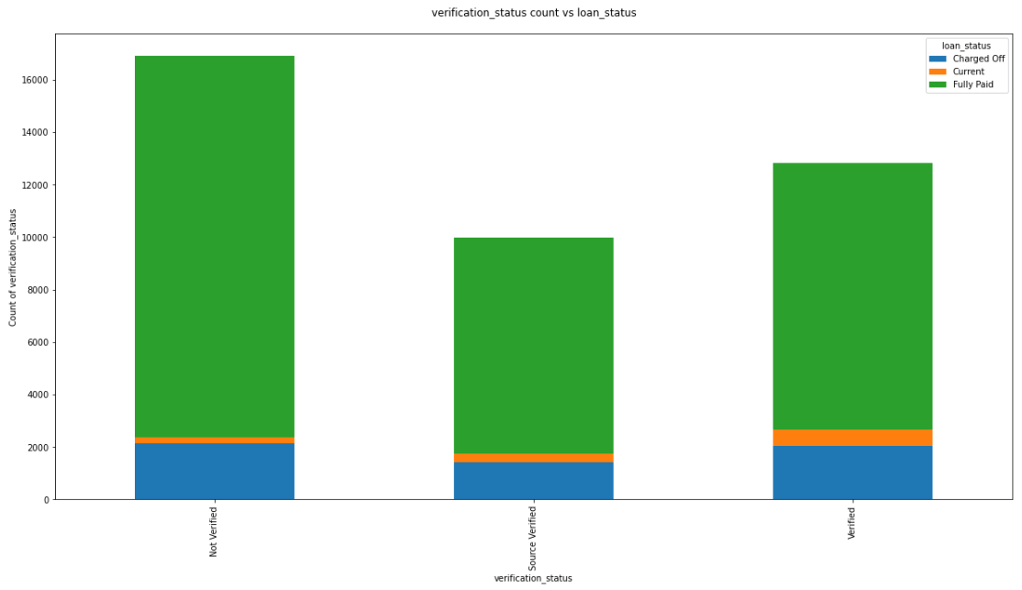
Verification_status vs loan status
As we can see from the chart that there are lot of consumers who have fully paid the loan irrespective of verification status. Also, if we see in charged off consumers it is less where Source Verified segments but more or less equal in Not Verified & Verified segments.

Slide 13
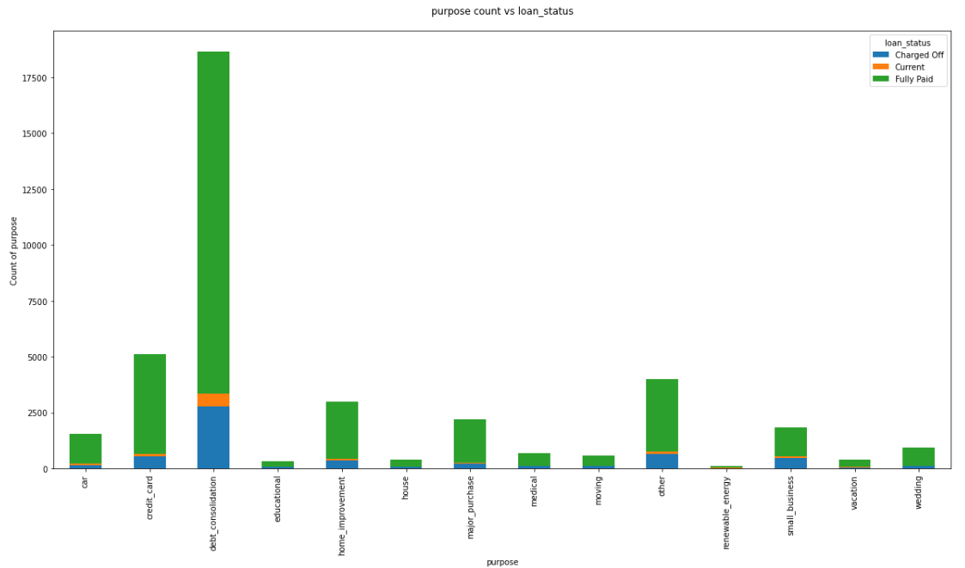
purpose vs loan status
1) As we can see from the chart that purpose of loan having debt_consolidation is high in charged off consumers followed by other purpose of loan like credit_card,other,small_business,major_purchase,car etc.
Hence, purpose can also be driving factor for charged off consumers

Slide 14
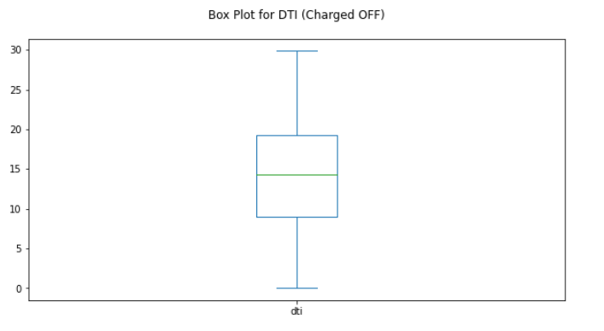
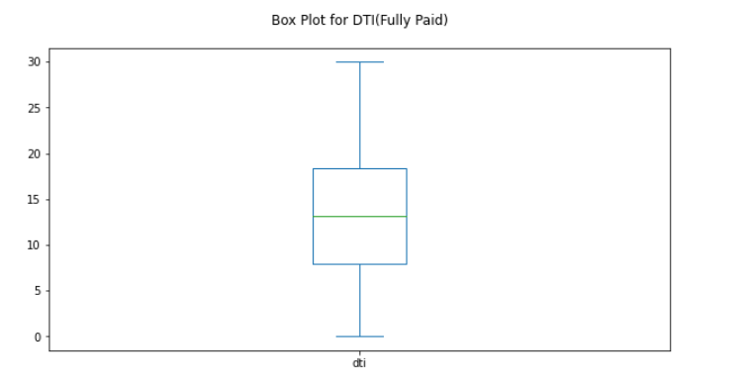
DTI for consumers
1) As we can see from the plots and quartiles that charged off consumers have more dti compared to fully paid consumers.
2) If we see from the values obtained 50% of consumers have dti<=14.29(for charged off) and dti<=13.2(for fully paid) where dti(charged off consumers are more) than dti(fully paid consumers). Hence charged off consumers have more monthly debts.
3) If we see from the values obtained 75% of consumers have dti<=19.29(for charged off) and dti<=18.39(for fully paid) where dti(charged off consumers are more) than dti(fully paid consumers). Hence charged off consumers have more monthly debts.

Slide 15
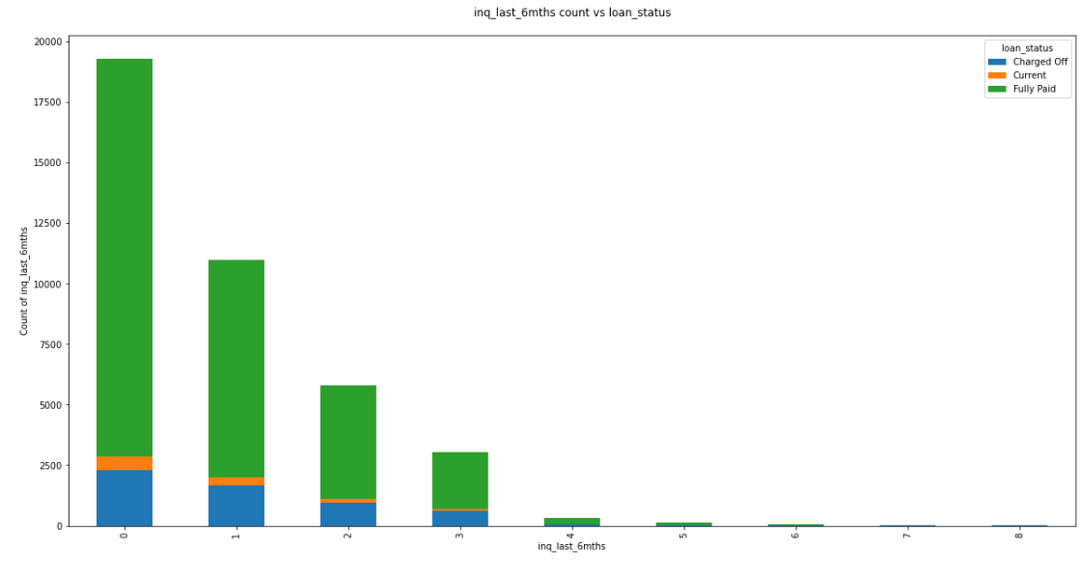
inq_last_6mnths vs loan_status
As we can see from the stacked chart the more inquiry in last 6 months, the lesser consumers will come under charged off.

Slide 16
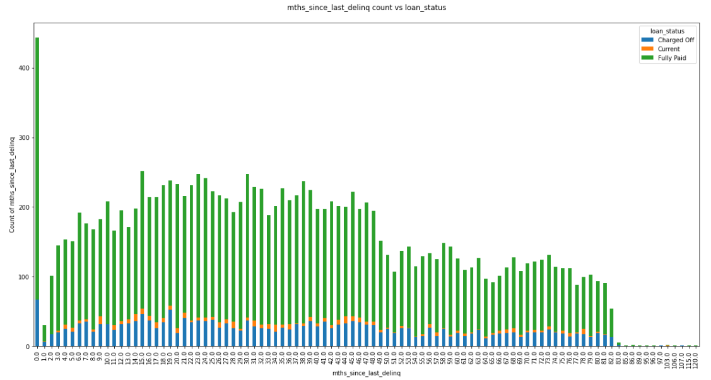
mths_since_last_delinq vs loan_status
As we can see that consumers in fully paid are more in mnths_since_last_delinq compared to charged off which tells us that charged off consumers will be less having more mnth_since_last_delinq compared to fully paid consumers

Slide 17
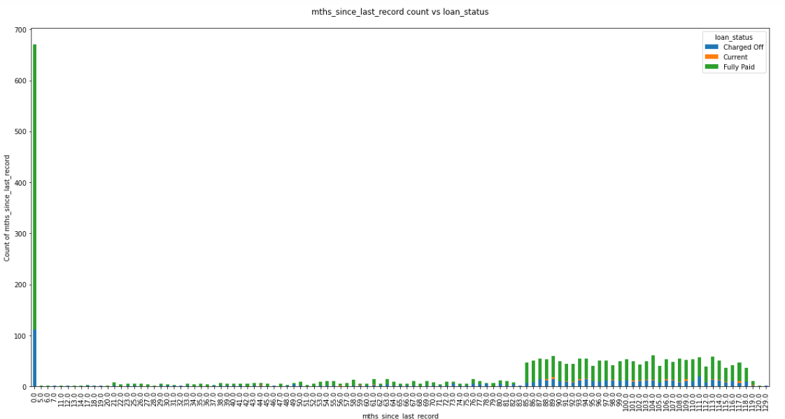
mths_since_last_record vs loan_status
As we know that public record remain on report for 7-10 years. If we see from the chart that for straight 7 years (84 month) very less consumers in charged off but after 7 years(84 months) there is a slight increase in the charged off consumers.

Slide 18
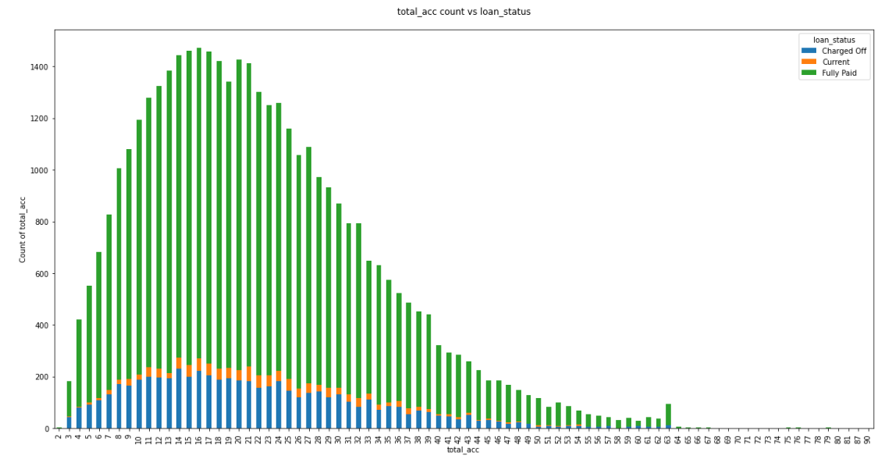
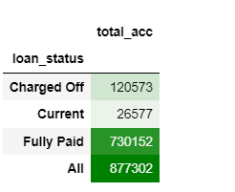
total_acc vs loan_status
As we can see from the charts and pivot table that there are large no of total accounts for fully paid consumers compared to charged off consumers. This can happen because generally charged off consumers will not be eligible much for loan or credit card compared to fully paid consumers.

Slide 19
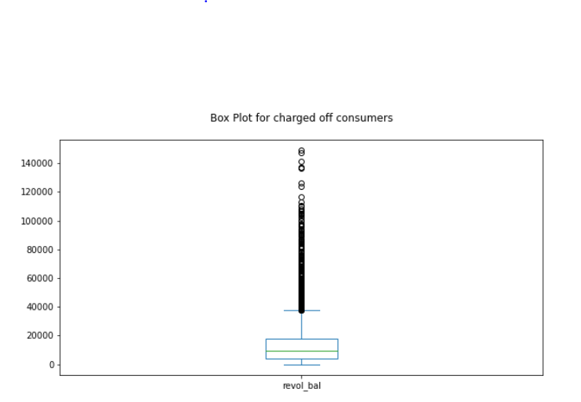
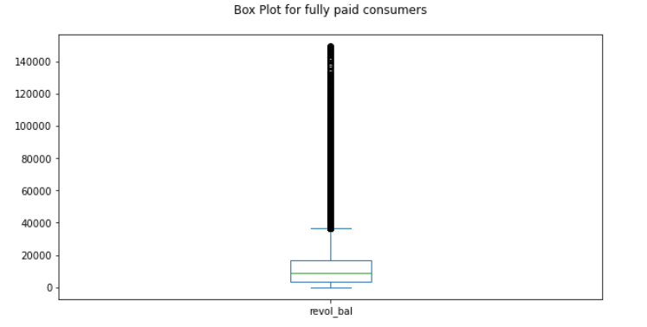
Revolving Balance vs loan_status
As we can see from the above plots and percentiles 50th & 75th percentile says that charged off consumers have more revolving balance compared to fully paid consumers

Slide 20
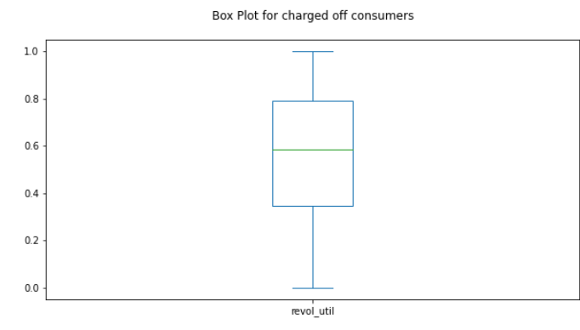
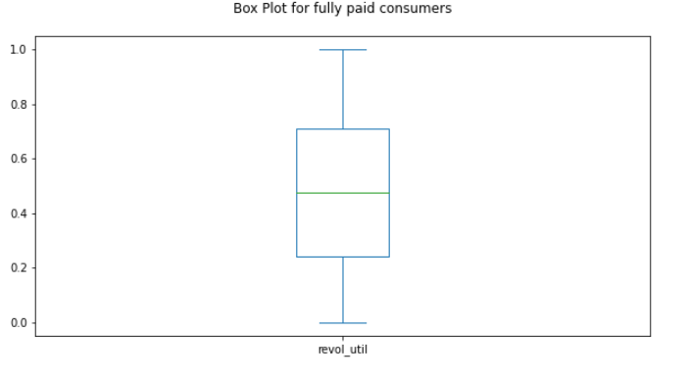
revol_util vs loan_status
As we can see from the plots and 50th & 75th percentile that fully paid consumers have less revolving utilization but there is a high revolving utilization in charged off consumers

Slide 21
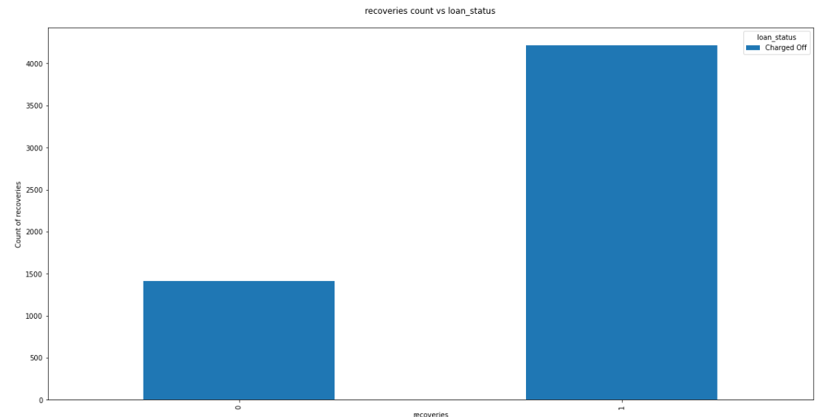
Recoveries vs loan_status
As we can see that some recovery has happened for charged off consumers but there are few consumers with whom there is still a need to recover the loan amount. This can also be a factor while lending loan to any consumer LC can check if the recovery has happened and how much the amount got recovered

Slide 22
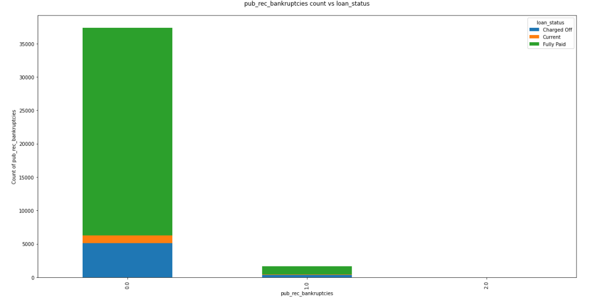
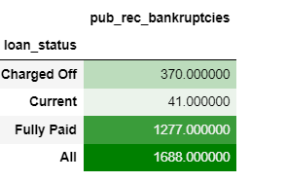
pub_rec_bankruptcies vs loan_status
As we can see from the chart and pivot table that fully paid consumers have more public recorded bankruptcies which means few of the consumers who have fully paid the loan got bankrupted.

Slide 23
Conclusion
Consumer Attributes
Emp title must be checked like organisation name and where consumer work.
Emp length is an important factor as we saw consumer with more than 10+ years of experience are more into charged off than consumer with less years of experience. Along with we saw that emp_length and home ownership were important drivers for charged off consumers.
Zip code at granular level can also be taken into account but as we saw that few zip codes were both in fully charged and charged off with maximum times paying as fully charged hence while offering loans to those zip code consumers LC can offer attractive loans with good interest rates.
Loan Attributes
sub_grades, verification status,purpose, dti, inq_last_6mths, mths_since_last_delinq, mths_since_last_record, open_acc, revol_bal, revol_util, total_acc, recoveries, pub_rec_bankruptcies

