Slide 1

Techno Gen LLC
ELEVATING YOUR CUSTOMER SUPPORT EXPERIENCE

Slide 2



Our mission is to have the most committed and skilled workforce in the industry in order to pioneer the highest level of customer satisfaction.
Our vision is to be one of the market leader in providing quality BPO-enabled services to our domestic and Global Clients
We shall strive towards achieving total customer satisfaction by rendering reliable IT-enabled services on time and within the budgeted cost. We shall accomplish this by continually improving our best practices in business process management procedures through periodic review of our defined objectives.

Slide 3
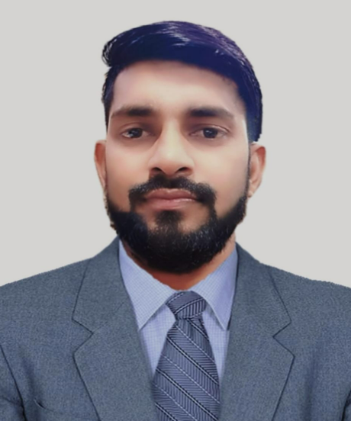
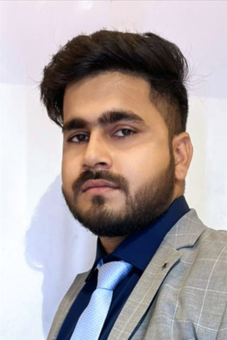
Leadership Techno Gen LLP is proud to introduce the leaders that are best fit in the BPO industries and offers well fitted solutions.
Mr. Durgesh Kumar Gupta Director Operations
Mr. Sonu Kumar Director Finance

Slide 4
Durgesh Kumar Gupta
Designation : Director Operations
Overview:
Dedicated and enthusiastic, this roll-up-your-sleeves executive has expertise creating and leading effective support teams across a range of industries, including gaming, banking, telecom and retail.
Have always demonstrated the ability to instill a common vision and develop a dynamic team based on trust and mutual respect.
Able to see the big picture, predict how it will unfold and take action to achieve corporate goals.
Worked with iEnergizer on multiple international projects spread across verticals like CreditOne Bank, DSW and Electronic Art(EA) and domestic projects like AirCel, RBL Bank, ClixCapital and Hero Fincorp.

Slide 5
Specialties
Customer Experience, Strategy and Implementation, Operations Management, Delivery.
CRM, KPI Management.
Multi-Channel, Multi-Language Operations.
Training & Quality, Business Process Improvement, RFI, RFP and RFQ processes.
People Management, Strong Team-building Skills, Employee Development, Mentoring and Coaching.
Problem Solving, Breakthrough Thinking, Conflict Management, Best Practices Expertise.

Slide 6
Personal Competencies
Strategic thinker: Identify and see the relationship among key issues while understanding the bigger picture.
Forward thinker: Anticipate and plan on hand to deal with future events, trends, problems or opportunities.
Inquisitive: Investigate and ask relevant questions needed to get the whole picture then provide specific actionable recommendations for excellence.
Team Player: Believe in encouraging team collaboration, work well with peers across multiple functions within the company - Promote enthusiasm, motivate relationship building.
High-energy, assertive and decisive person with strong interpersonal skills and can build rapport and trust quickly in order to form strong business partnerships.
Creative: Ability to find out-of-the-box/non-traditional ways of problem solving and apply innovative thinking when approaching and defining solutions.
Get it done: Believe in actions speak louder than words philosophy, thrive on achievements.

Slide 7
Sonu Kumar
Designation : Director Finance
Overview:
Committed to excellent communication and leadership has been pivotal in driving the finance department towards operational excellence and strategic growth.
5+ years of industry experience working collaboratively with leadership teams. Adept in leading the efforts of various programs to ensure fiscal responsibilities are met, and community and professional relationships are strengthened.
Meticulous consolidation and finalization of accounts, ensuring rigorous scrutiny and reconciliation that align with standards.
Worked with TATA AIA financial accounts and operations with a 35-employee team.

Slide 8
Specialties
Overseeing financial reporting and analysis.
Managing budgets and financial forecasts.
Developing and implementing financial strategies.
Ensuring compliance and financial regulations
Supporting business developments and strategic initiatives.
Collaborating with operations department on financial matters.

Slide 9
Personal Competencies
Strong understanding of various financial disciplines, including accounting, financial planning and analysis, budgeting, risk management and potentially even treasury operations.
Can see the bigger picture and how different financial decision impact the overall business strategy.
Readily adapt to changing business needs and take on different roles as required, making them valuable in dynamic environment.
Effectively collaborate with operations to achieve the company’s financial goals.
Can handle a wide range of tasks and responsibilities, potentially reducing the need for multiple specialized finance professionals.

Slide 10
OUR SERVICES
VOICE | NON-VOICE
Customer support | Customer care - Chat/ Email
Technical support | IT Support
Sales | Billing
Collections | Data processing

Slide 11
OUR SERVICES
Call Centre Services :
Techno Gen offers a variety of call centre services to meet the needs of different businesses. We can help you with your call centre needs, weather you are start-up or full scale enterprise.
Collections :
We are responsible for resolving overdue bills and collecting payments from those who owe. It includes the strategies to accrue debts and due payments from the business's clients.
Sales :
We are responsible for selling products and meeting customer needs while obtaining orders from existing or potential sales.
KPO services :
We offers outsourcing knowledge intensive activities that are data driven and encompass the process of gathering, managing, analyzing and delivering objective insights into businesses.
Bulk SMS Services :
We offers a variety of Bulk SMS Services to meet the needs of different businesses. Whether you are a small business or a large enterprise, Techno Gen can help you with your massage services needs.

Slide 12
Why Choose u s
There are several reasons why you ought to use our Techno Gen BPO services.
World-Class service: We are dedicated to deliver highest level of services to our clients.
Competitive Pricing: We offer our services at competitive prices.
Flexible solutions : We can tailor our services to meet your specific customer service requirements.
Delivery: We deliver our best results within the given timelines.
Quality: We deliver quality which is a set of guidelines that outline the expected level of quality in the service provided
Sales & Collections: We are one of the best in the market in terms of selling any product or collection of due bills by team experts.

Slide 13

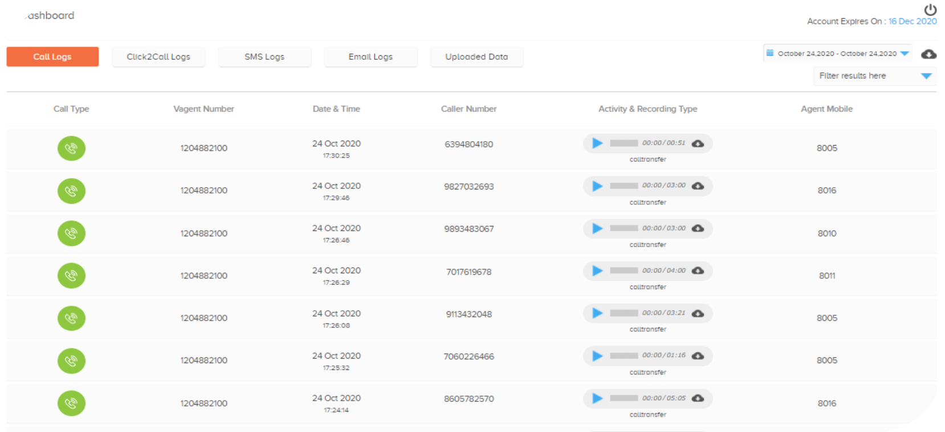
Call Logger
Downloading call logs for audit and giving feedback to agents to improve soft skills

Slide 14
T e c h n o G e n I T & Se c u r i t y Policy
11. Internet and Intranet Access Security Policy
12. Operating System Security Policy
13. Incident Response and Management Policy
14. Third Party Security Policy
15. Asset Management Policy
16. Web Server Security Policy
17. Firewall Security Policy
18. Database Security Policy
19. Virus Protection Policy
20. Review, Audit and Compliance Policy
Organizational Security Policy
Physical Security Policy
Logical Access Control Policy
Password Security and ControlPolicy
Network and Telecommunication Security Policy
Application Security Policy
Change Management, Version control, Patch Management Policy
B u s i n e s s Continuity Management Policy
Electronic Mail Security Policy
Background Recovery Policy

Slide 15



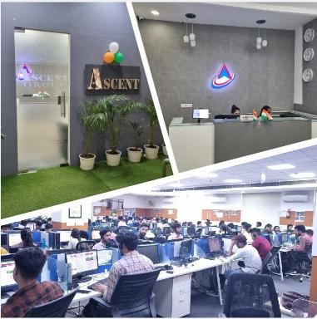



Entrance
Reception
Techno Gen
Operations Floor

Slide 16





EXISTING CLIENTS

Slide 17


+91 9911001358
+91 9748899923
+917048963989
17004 LLANO ST SANTA FE,
NM 87110 New Mexico
info@technogenllc.com

