Slide 1
Checking Resource Models
Xactium Ltd

Slide 2
Resource Models
A collection of groups is a resource model. Each group:
Specifies a user constraint.
Specifies the services provided to the group.
Specifies the resources used by each service.

Slide 3
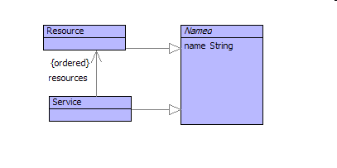
Services Use Resources

Slide 4
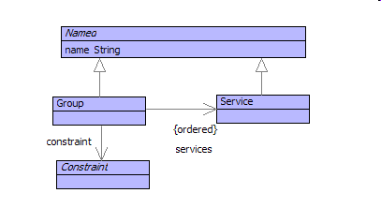
Groups Are Service Specifications

Slide 5
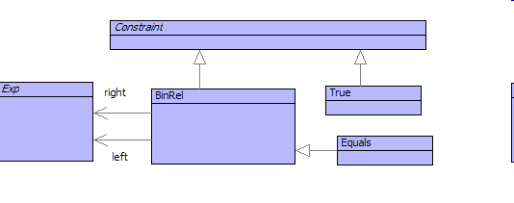
Constraints Are Modelled

Slide 6
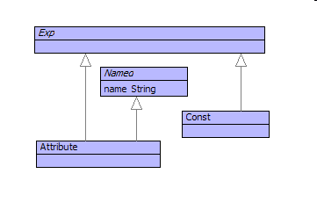
Expressions Are Modelled

Slide 7
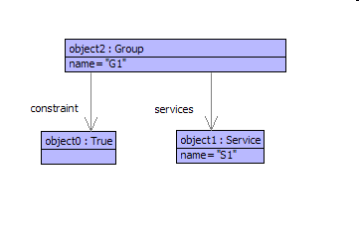
A System Model

Slide 8
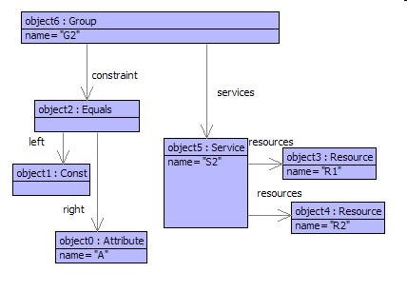
Group G2 provides S2 when User has a given value for A

Slide 9
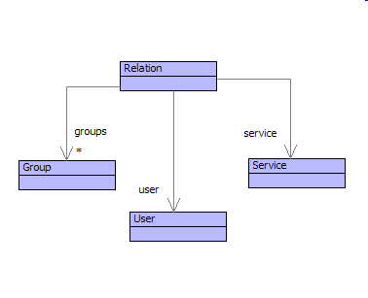
Resource Model Relations

Slide 10
Representation In XRules
context ServiceRules
@Rule Relation(Groups,User,Service)
// Given the collection of groups can
// the supplied candidate user access the
// service?
Member(Group,Groups) // Legal group
Provides(Group,Service) // Provides service
Satisfies(User,Group) // Constraint OK
end

Slide 11
Check Access Rights
Groups
Relation
User
Yes/No
Service

Slide 12
Produce Permissible Services
Groups
Relation
Services
User

Slide 13
Produce Candidate Users
Groups
Relation
Users
Services

Slide 14
Check Access Rights
@WithRules(ServiceRules) Relation(<Groups>,<User>,<Service>)
return true
end

Slide 15
Produce Permissible Services
@WithRules(ServiceRules)
Relation(<Groups>,<User>,Service)
returnAll Service
end

Slide 16
Check Multiple Services
@WithRules(ServiceRules)
Relation(<Groups>,U1,<Service2>)
Relation(<Groups>,U2,<Service3>)
Append(U1,U2,User)
WellFormed(User)
return User
end

