Slide 1
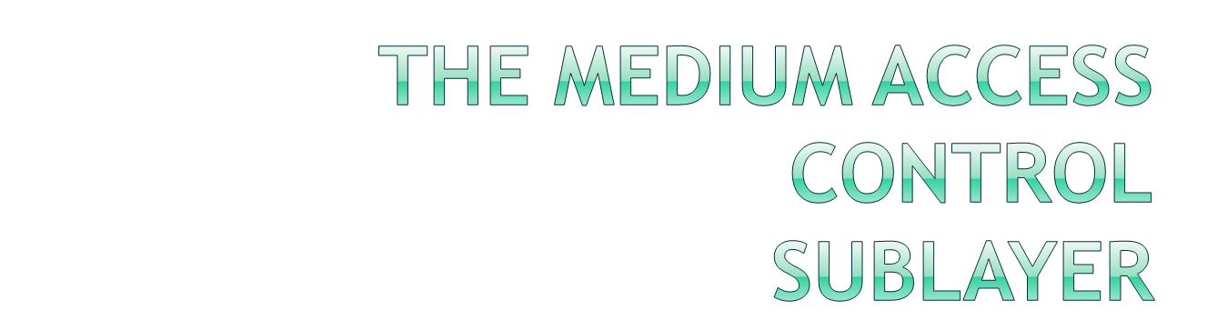
Chapter 4

Slide 2

In broadcast networks (Multi-access/random-access channels)
  The key issue is how to determine who gets to use the channel when there is competition for it.
  MAC=Protocol to determine who goes next on channel
  It’s important for LANs, WANs are point-to-point.
The Channel Allocation Problem:
  Static Channel Allocation in LANs and MANs
    FDM and TDM
  Dynamic Channel Allocation in LANs and MANs

Slide 3
Assumptions (1):
  Station Model:
    Assumes that each of N "stations" (packet generators, Terminal) independently produce frames.
    The probability of producing a packet in the interval Δt is λ.Δt where λ is the constant arrival rate.
    That station generates no new frame until that previous one is transmitted.
  Single Channel Assumption:
    There's only one channel
    all stations are equivalent and can send and receive on that channel.
  Collision Assumption:
    If two frames overlap in any way time-wise, then that's a collision.
    Any collision is an error, and both frames must be retransmitted. Collisions are the only possible error.

Slide 4
Assumptions (2):
  Continuous/ Slotted Time:
    Time is not in discrete chunks.
    Frame transmission can begin at any instant.
    Alternatively, in slotted, frame transmissions always begin at the start of a time slot.
    Any station can transmit in any slot (with a possible Collision.)
  Carrier/No-Carrier Sense:
    Stations can tell a channel is busy before they try it.
    NOTE - this doesn't stop collisions. LANs have this, satellite networks don't.

Slide 5

Carrier Sense Multiple Access (CSMA)
  37% utilization is low yet!
  Stations can listen for a carrier and there is no transmission send it’s data.
Persistent and non-persistent:
  persistent: When channel is found to be busy, keep monitoring to find THE instant when it becomes free.
  non-persistent: When channel is found to be busy, don't keep monitoring to find THE instant when it becomes free. Instead, wait a random time and then sense again.

Slide 6
◆ 1-persistent CSMA
  Station listens.
  If channel idle, it transmits.
  If collision, wait a random time and try again.
  If channel busy, wait until idle.
  If station wants to send AND channel == idle then do send.
  Propagation delay has an important effect on transmission.
  Success here depends on transmission time - how long after the channel is sensed as idle will it stay idle (there might in fact be someone else's request on the way.)
❖ Non-persistent CSMA (equivalent to 0-persistent CSMA)
  Same as above EXCEPT, when channel is found to be busy, don't keep monitoring to find THE instant when it becomes free.
  Instead, wait a random time and then sense again.
  Leads to better utilization

Slide 7

⬥ p-persistent CSMA
  For slotted time channels
  If ready to send AND channel == idle then
  send with probability p and with prob. q = 1 - p defers to the next slot.
  Example:
    0.5-persistent , 0.01-persistent
  Lower probability is better for higher frame transmission per frame-time

Slide 8

CSMA with Collision detection (CD) = CSMA/CD
  CSMA protocols are clearly improved over ALOHA
  CSMA protocols can improve if stations abort their transmission as soon as they detect a collision.
  Used with LANs.
  In CSMA/CD, when a station detects a collision, it stops sending, even if in mid-frame. Waits a random time and then tries again.

Slide 9

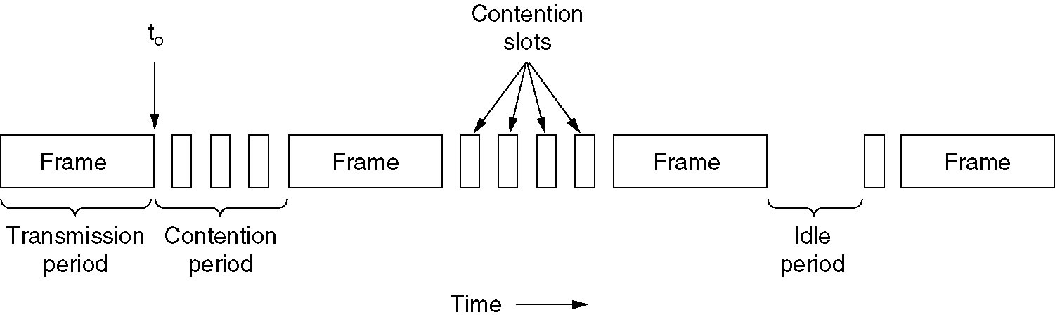
CSMA/CD can be in one of three states:
  1-Contention,
  2-transmission,
  3-idle.
  conceptual model

Slide 10
t₀, a station has finished transmitting its frame.
Any other station having a frame to send may now attempt to do so.
If two or more stations decide to transmit simultaneously, there will be a collision.
Collisions can be detected by looking at the power or pulse width of the received signal and comparing it to the transmitted signal.

Slide 11
Details of the contention algorithm.
Suppose that two stations both begin transmitting at exactly time t₀.
How long will it take them to realize that there has been a collision?
  answer is: vital to determining the length of the contention period and hence what the delay and throughput will be.
The minimum time to detect the collision is then just the time it takes the signal to propagate from one station to the other.
worst-case scenario
Let the time for a signal to propagate between the two farthest stations be t.
At t₀, one station begins transmitting.
At t -Ԑ , an instant before the signal arrives at the most distant station, that station also begins transmitting.
Of course, it detects the collision almost instantly and stops, but the little noise burst caused by the collision does not get back to the original station until time 2t - e.
In other words, in the worst case a station cannot be sure that it has seized the channel until it has transmitted for 2t without hearing a collision.

Slide 12
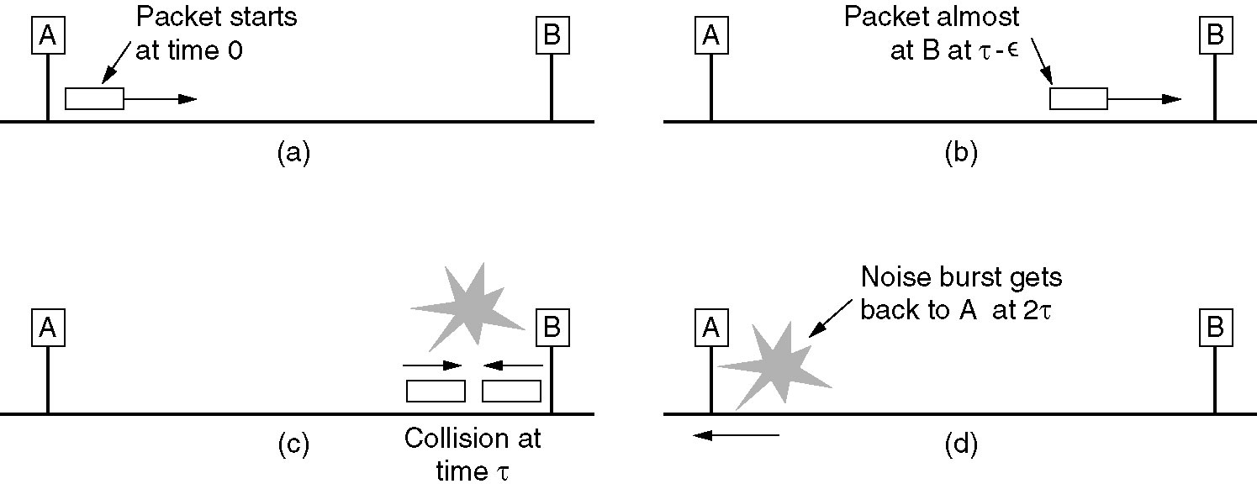

Slide 13

CSMA with Collision detection (CD) = CSMA/CD
  What is contention interval- how long must station wait after it sends until it knows it got control of the channel? It's twice the time to travel to the furthest station.
Collision-free protocols:
  Bit-map protocol
  Binary countdown

Slide 14

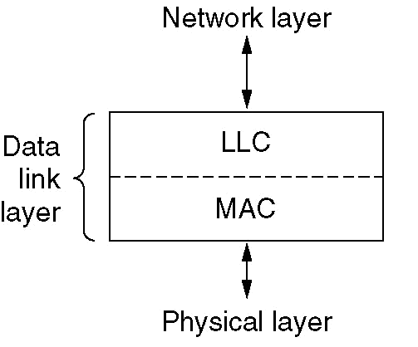
IEEE 802.2: Describes the upper part of the data link layer, the LLC (Logical Link Control).
  Hide the differences between the various kinds of MAC protocols by providing a single format to network layer
  IEEE 802.2 standard
Descriptions of the physical and lower part of the DLL are (MAC):
  IEEE 802.3 CSMA/CD LAN
  IEEE 802.4 Token Bus
  IEEE 802.5 Token Ring

Slide 15

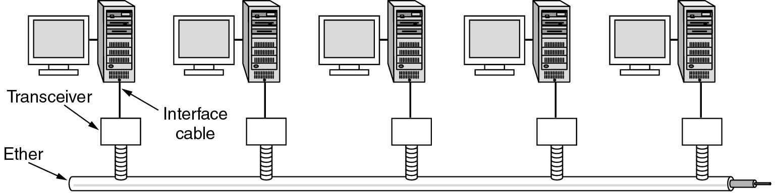
Ethernet
  LAN standard (IEEE 802.3)
  1-persistent CSMA/CD + Binary Exponential Back-off
Architecture of the original Ethernet.

Slide 16

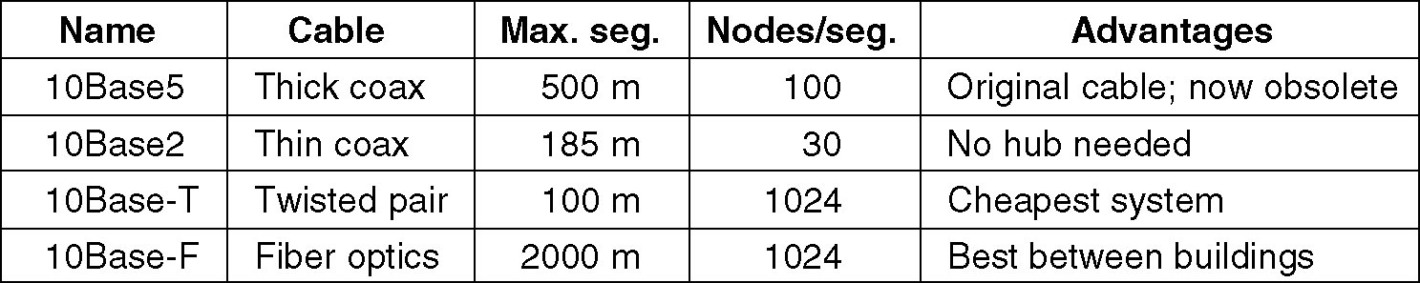
Ethernet Cabling (1)
  10Base=10 Mbps, Base-band signaling

Slide 17

Ethernet Cabling (2)
  Transceiver: Electronic circuits that handle carrier detection and collision detection
10Base5,
10Base2,
10Base-T.

Slide 18

Ethernet Cabling (3)
  In Binary coding there's no way to distinguish a 0 bit from nothing-happening. Need to know when is middle of bit WITHOUT a clock => Manchester Encoding
  ◆ In Manchester:
    Bit 1= High-Low
    Bit 0= Low-High
    Used in Ethernet
  ❖ Differential Manchester
    Bit 1 indicated by absence of transition at the start of interval
    Better noise immunity
    Used in Token ring

Slide 19

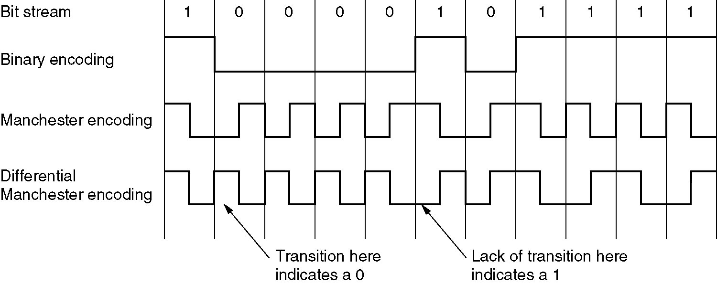
Ethernet Cabling (4)
  Manchester Encoding

Slide 20
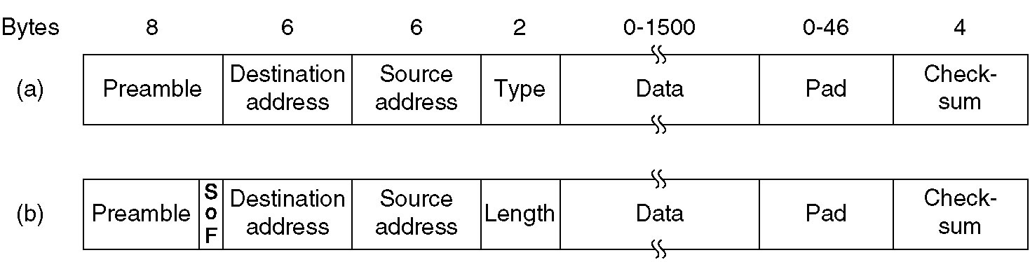
Ethernet MAC Protocol
  Preamble == 7 bytes of 10101010 for synchronization
  SOF: Start of Frame == 1 byte of 10101011 for compatibility with 802.4 and 802.5
  Dest. Add. == 6 bytes of mac address
    multicast == (47th bit=1) sending to a group of stations.
    Broadcast == (dest. = all 1's) to all stations on network
  Source Ad. == 6 bytes of MAC address
  Length/Type == number of bytes of data/Type of protocol
  Data == comes down from network layer
  Pad == ensures 64 bytes from Dest. Add. addr thru checksum.
  Checksum == 4 bytes of CRC.
DIX Ethernet
IEEE 802.3.

Slide 21
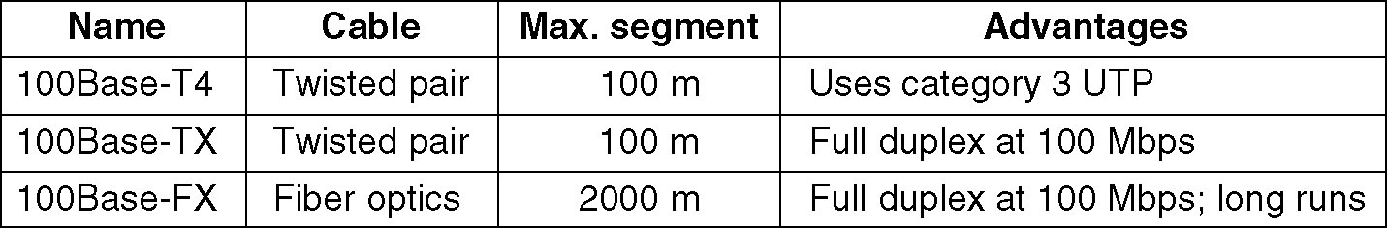
IEEE 802.3u: An addendum of existing 802.3 (1995)
Idea: keep all old frame formats, interfaces and procedural rules but just reduce bite time from 100 nsec. to 10 nsec.
  Commonly use twisted pair cabling
  100Base-T4: Use Ternary (3-level) signaling and UTP-Cat3 cabling
  100Base-TX: Use 4B/5B (use 5 bits for transmit 4 bits) signaling and UTP-Cat5 cabling

Slide 22

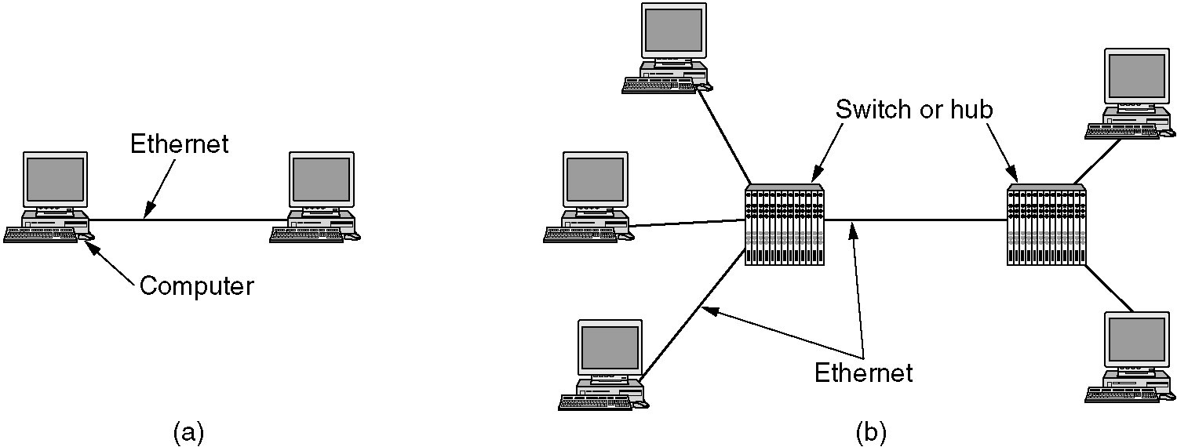
IEEE 802.3z: Another addendum of existing 802.3 (1998)
  Goal: make 10 times faster + Compatible with existing Ethernet standard
  Support unacknowledged datagram service in both unicast and multicast
  Configuration is point-to-point rather than multi-drop (Use Hub or Switch)

Slide 23

Two different modes:
  Full-Duplex:
    Allows traffic in both directions at same time
    Is used when there is a switch connect to computer or other switches
    All lines are buffered ➔ Contention is impossible ➔ CSMA/CD is not used
  Half-Duplex
    When computers connect to Hub rather than Switches
    Don’t buffer frames, is just like classic Ethernet ➔ Need CSMA/CD protocol ➔ Reduce length of cable
  Carrier Extension: Tell hardware to add its own padding to extend frame length to 512 bytes.

Slide 24

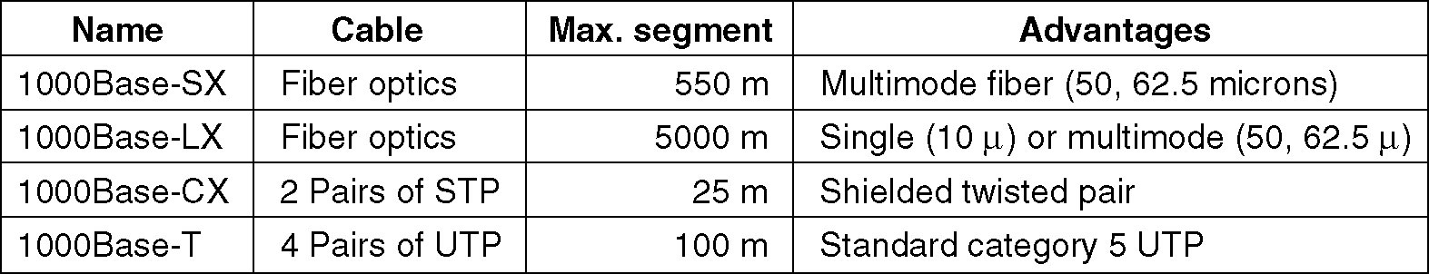
  Frame Bursting: Allow a sender to transmit a concatenated sequence of frames in a single transmission.
    This is efficient and perfect over carrier extention
Cabling
  Use 8B/10B signaling for Fiber optic
  Use different encoding for 1000Base-T

Slide 25

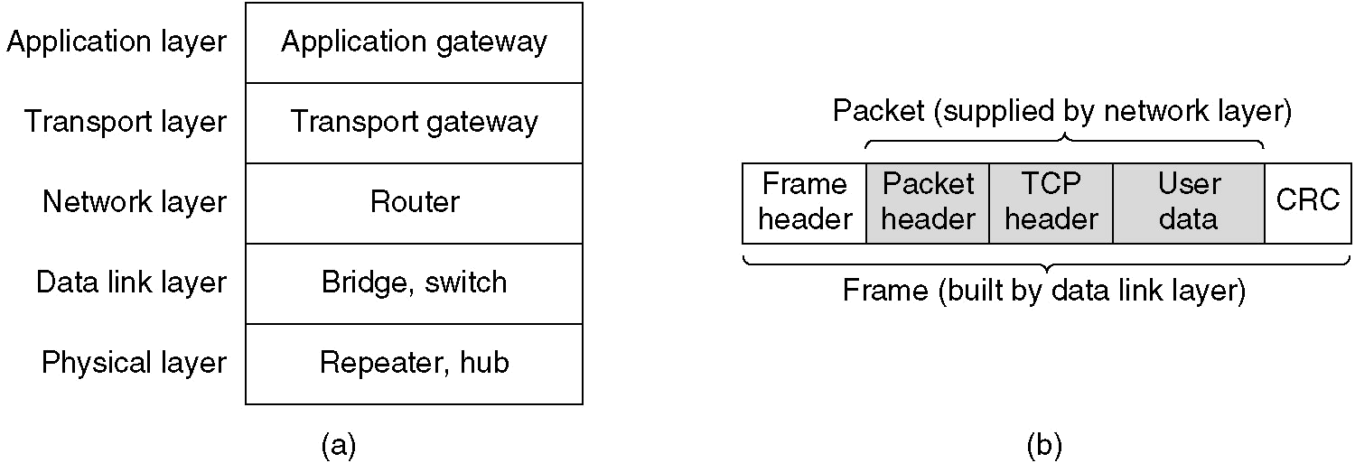
User generate some data:
  Data are passed to Transport layer and adds a header, i.e. TCP header
  The resulting unit passes down to Network layer, adds headers, IP packet
  Then goes to DLL which adds its own header (CRC)
  Resulting frame given to Physical layer
These devices operate in different layers 

Slide 26

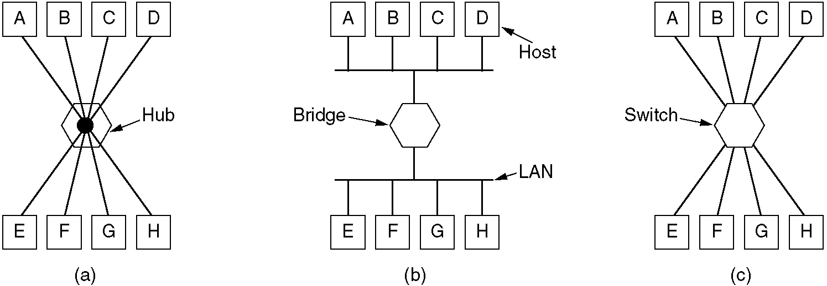
Physical layer:
  Repeaters:
    Analog devices that are connected two cable segments, Amplifying incoming signal from one side and send out other.
    Don’t understand frames, packets or headers, Just understand Volt
    In classic Ethernet, to extend max. cable length from 500 meters to 2500 meters, 4 repeaters was allowed.
  Hubs:
    Has a number of input lines that it joins electrically. Frames arriving on any of the lines are send out on all others.
    If two frames arrive at the same time ➔ Collision occurs
    Are like repeater and don’t understand frames, but usually don’t amplify incoming signal

Slide 27
Data Link Layer:
  Bridges:
    Connect two or more LANs.
    Use des. Add. In frame header to
    determine destination
  Switches:
    Are like Bridges and use des. Add. To find the route.
    Used to connect individual computers ➔ need more number of ports, each port has own collision domain.
    Store & Forward: Get entire a frame then transmit
    Cut-through-switches: start forwarding the frame as soon as the des. Add. Field has come in.

Slide 28

Network layer:
  Routers:
    When a packet comes into, the frame header and trailer are stripped off and packet located in the frame’s payload field is passed routing software.
Transport and Application layer:
  Transport gateway:
    Connect two computers that use different connection-oriented transport protocols.
    Ex. TCP/IP and ATM
  Application gateway:
    Understand the format and content of data and translate message from one format to another one.

Slide 29

Frame formats. (a) DIX Ethernet, (b) IEEE 802.3.

Slide 30


Slide 31
WI-FI | WiMAX
Indoor - deals with mobility- 802.11 was designed to be mobile Ethernet | Outdoor-provides service to buildings, and buildings are not mobile. They do not migrate from cell to cell often- so 802.16 was designed to be wireless, but stationary building
distances involved can be several meters | distances involved can be several kilometers
LAN – more secure | MAN - open communication over a city means that security and privacy are essential and mandatory
802.11 can use half-duplex communication, (single radio –which switch back & forth between Tx & Rx mode)something avoids to keep the cost of the radios low & that's why we have CSMA/CA & not CD. Uses spread spectrum | 802.16 can use full-duplex communication - Traditional narrow-band radio is used with conventional modulation schemes QAM, QPSK etc.
Indoor technology-Less users-required less bandwidth-use 2.4 and 5 GHz ISM range – less error prone | Outdoor technology - Supports more users – need more bandwidth-uses 10-66 GHz ISM range- millimetre waves – use line of sight –absorb by rain – more error prone-need completely diff Tx-Rx tech-so completely diff physical layer-
802.11 is Omni directional | Millimetre waves can be focused into directional beams , so multipath propagation is major issue.
QoS- quality of service - 802.11 provides some support for real-time traffic (using PCF mode), it was not really designed for telephony and heavy-duty multimedia usage | 802.16 is expected to support these applications completely because it is intended for residential as well as business use.

Slide 32
The protocol stack
Physical layer radio transmission techniques
MAC sublayer protocol
Frame structure and
Services

Slide 33

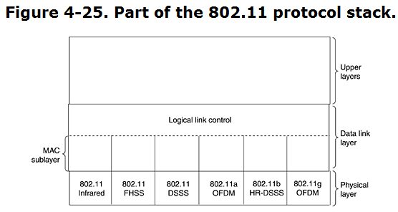
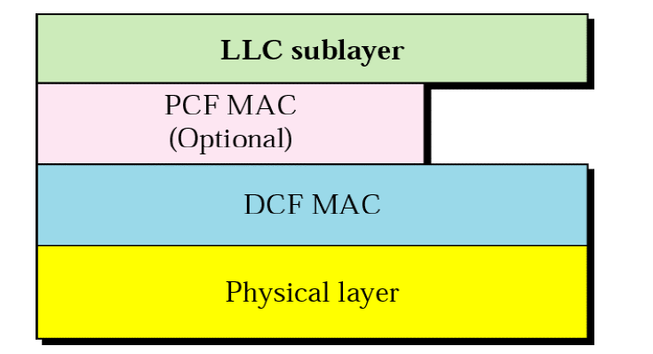

Slide 34
The infrared option:
  It uses diffused (i.e., not line of sight) transmission at 0.85 or 0.95 microns.
  Two speeds are permitted: 1 Mbps and 2 Mbps.
  @ 1 Mbps, an encoding scheme is used in which a group of 4 bits is encoded as a 16-bit codeword containing fifteen 0s and a single 1 - called Gray code.
  This code has the property that a small error in time synchronization leads to only a single bit error in the output.
  @ 2 Mbps, the encoding takes 2 bits and produces a 4-bit codeword
Infrared signals cannot penetrate walls, so cells in different rooms are well isolated from each other.
due to the low bandwidth this is not a popular option.

Slide 35
(2) FHSS (Frequency Hopping Spread Spectrum)
  Frequency-hopping spread spectrum (FHSS) is a method of transmitting radio signals by rapidly switching a carrier among many frequency channels, using a pseudorandom sequence known to both transmitter and receiver.
  It uses 79 channels, each 1-MHz wide, starting at the low end of the 2.4-GHz ISM band.
  A pseudorandom number generator is used to produce the sequence of frequencies hopped to.
  The amount of time spent at each frequency called the dwell time, is an adjustable parameter, but must be less than 400 msec.
Pros:
      It provides a security since an intruder who does not know the hopping sequence or dwell time cannot eavesdrop on transmissions.
      Over longer distances, multipath fading can be an issue, and FHSS offers good resistance to it.
      It is also relatively insensitive to radio interference, which makes it popular for building-to-building links.
    Cons:
its low bandwidth.

Slide 36
(3) DSSS (Direct Sequence Spread Spectrum)
  In telecommunications, direct-sequence spread spectrum (DSSS) is a modulation technique.
  As with other spread spectrum technologies, the transmitted signal takes up more bandwidth than the information signal that is being modulated.
  DSSS is also restricted to 1 or 2 Mbps.
  The scheme used has some similarities to the CDMA system but differs in other ways.
  Each bit is transmitted as 11 chips, using what is called a Barker sequence.
  It uses phase shift modulation at 1 Mbaud,
  transmitting 1 bit per baud when operating at 1 Mbps and
  2 bits per baud when operating at 2 Mbps.

Slide 37
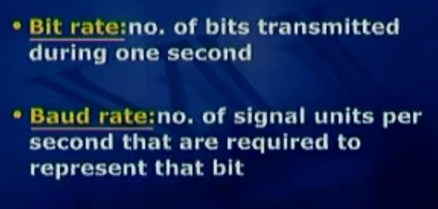

Slide 38
(4) OFDM (Orthogonal Frequency Division Multiplexing)
  The first of the high-speed wireless LANs, 802.11a
  to deliver up to 54 Mbps in the wider 5-GHz ISM band.
  As the term FDM suggests, different frequencies are used—
  52 of them=( 48 for data + 4 for synchronization)
  Since transmissions are present on multiple frequencies at the same time, this technique is considered a form of spread spectrum
  Splitting the signal into many narrow bands has some key advantages over using a single wide band,
      including better immunity to narrowband interference and the possibility of using non-contiguous bands.
  A complex encoding system is used, based on phase-shift modulation for speeds up to 18 Mbps and on QAM above that.
  At 54 Mbps, 216 data bits are encoded into 288-bit symbols.

Slide 39
(5) HR-DSSS (High Rate Direct Sequence Spread Spectrum)
  Another spread spectrum technique
  It uses 11 million chips/sec to achieve 11 Mbps in the 2.4-GHz band.
  It is called 802.11b but is not a follow-up to 802.11a.
  Data rates supported by 802.11b are 1, 2, 5.5, and 11 Mbps.
  The two slow rates run at 1 Mbaud, with 1 and 2 bits per baud, respectively, using phase shift modulation (for compatibility with DSSS).
  The two faster rates run at 1.375 Mbaud, with 4 and 8 bits per baud, respectively, using Walsh/Hadamard codes.
  In practice, the operating speed of 802.11b is nearly always 11 Mbps.
  Although 802.11b is slower than 802.11a, its range is about 7 times greater, which is more important in many situations.

Slide 40
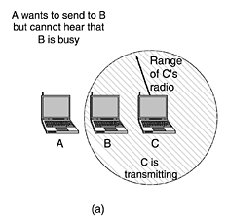
The 802.11 MAC sub layer protocol is quite different from that of Ethernet
With Ethernet, a station just waits until the ether goes silent and starts transmitting.
If it does not receive a noise burst back within the first 64 bytes, the frame has almost assuredly been delivered correctly.
With wireless, this situation does not hold.
To start with, there are 2 problems.
A
B
C
(1)Hidden station problem
Not all stations are within radio range of each other transmissions going on in one part of a cell may not be received elsewhere in the same cell.
In this example, station C is transmitting to station B.
If A senses the channel, it will not hear anything
and falsely conclude that it may now start transmitting

Slide 41
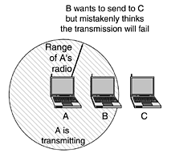
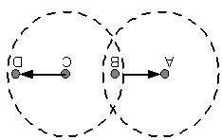




(2)Exposed station problem
B wants to send to C so it listens to the channel.
When it hears a transmission, it falsely concludes that it may not send to C, even though A may be transmitting to D .
In addition, most radios are half duplex, meaning that they cannot transmit and listen for noise bursts at the same time on a single frequency.
As a result of these problems, 802.11 does not use CSMA/CD, as Ethernet does.

Slide 42
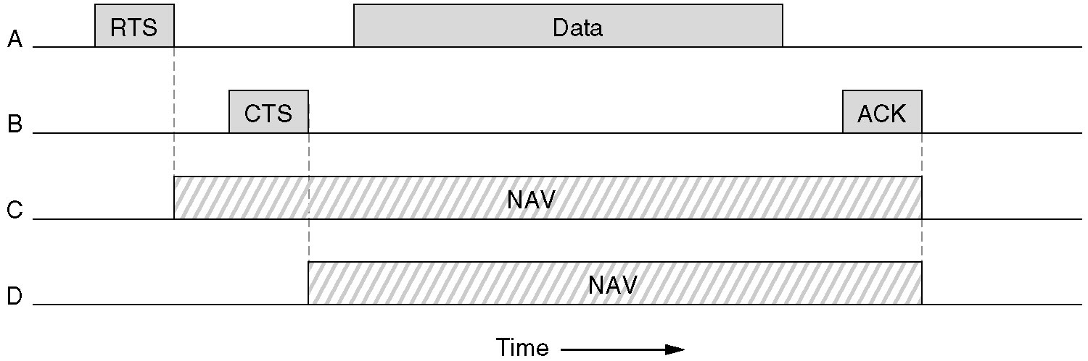
virtual channel sensing, see fig.
In this example, A wants to send to B. C is a station within range of A (and possibly within range of B, D is a station within range of B but not within range of A.
The protocol starts when A decides it wants to send data to B.
It begins by sending an RTS frame to B to request permission to send it a frame.
When B receives this request, it may decide to grant permission, in which case it sends a CTS frame back.
Upon receipt of the CTS, A now sends its frame and starts an ACK timer.
Upon correct receipt of the data frame, B responds with an ACK frame, terminating the exchange.
If A's ACK timer expires before the ACK gets back to it, the whole protocol is run again.
D
B
A
C

Slide 43
Now let us consider this exchange from the viewpoints of C and D.
C is within range of A, so it may receive the RTS frame.
If it does, it realizes that someone is going to send data soon, so for the good of all it desists from transmitting anything until the exchange is completed.
From the information provided in the RTS request, it can estimate how long the sequence will take, including the final ACK, so it asserts a kind of virtual channel busy for itself, indicated by NAV (Network Allocation Vector) in Fig. 4-27.
D does not hear the RTS, but it does hear the CTS, so it also asserts the NAV signal for itself.
Note that the NAV signals are not transmitted; they are just internal reminders to keep quiet for a certain period of time.

Slide 44

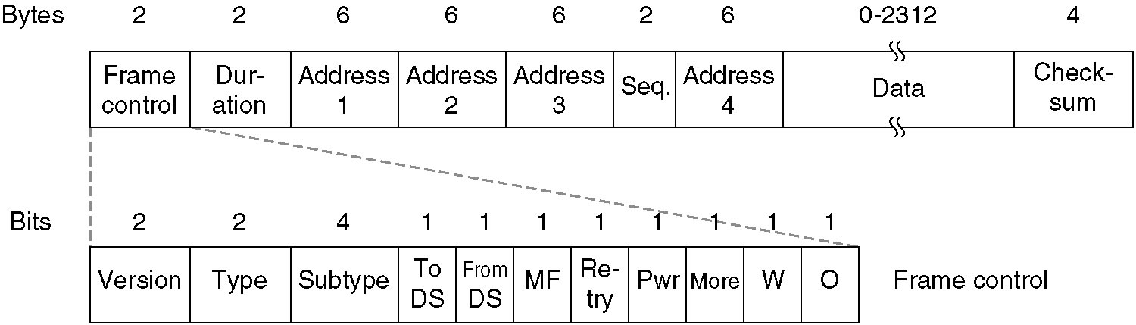
The 802.11 data frame.

Slide 45
The 802.11 standard defines three different classes of frames on the wire:
  data,
  control, and
  management.
  Each of these has a header with a variety of fields used within the MAC sublayer.
  In addition, there are some headers used by the physical layer but these mostly deal with the modulation techniques used
First comes the Frame Control field.
  It itself has 11 subfields.
    The first of these is the Protocol version, which allows two versions of the protocol to operate at the same time in the same cell.
    Type (data, control, or management) and Subtype fields (e.g., RTS or CTS).
    The To DS and From DS bits indicate the frame is going to or coming from the intercell distribution system (e.g., Ethernet).
    The MF bit means that more fragments will follow.
    The Retry bit marks a retransmission of a frame sent earlier.
    The Power management bit is used by the base station to put the receiver into sleep state or take it out of sleep state.
    The More bit indicates that the sender has additional frames for the receiver.
    The W bit specifies that the frame body has been encrypted using the WEP (Wired Equivalent Privacy) algorithm.
    Finally, the O bit tells the receiver that a sequence of frames with this bit on must be processed strictly in order.

Slide 46
second field of the data frame, the Duration field, tells how long the frame and its acknowledgement will occupy the channel. This field is also present in the control frames and is how other stations manage the NAV mechanism.
The frame header contains four addresses, all in standard IEEE 802 format.
The source and destination are obviously needed,
other two for - frames may enter or leave a cell via a base station.
The other two addresses are used for the source and destination base stations for intercell traffic.
The Sequence field allows fragments to be numbered.
Of the 16 bits available, 12 identify the frame and 4 identify the fragment.
The Data field contains the payload, up to 2312 bytes,
followed by the usual Checksum.

Slide 47
Management frames have a format similar to that of data frames,
  except without one of the base station addresses, because management frames are restricted to a single cell.
Control frames are
  shorter ,
  having only one or two addresses,
  no Data field, and
  no Sequence field.
  The key information here is in the Subtype field, usually RTS, CTS, or ACK.

Slide 48
The 802.11 standard states that each conformant wireless LAN must provide 9 services.
These services are divided into two categories:
  5 distribution services and 4 Intercell station services.
    The distribution services relate to
      managing cell membership and
      interacting with stations outside the cell.
    the station services relate to
      activity within a single cell.

Slide 49

5 Distribution Services
Association
Disassociation
Reassociation
Distribution
  (how to route the frame directly- via adhoc N/w)
Integration
  Frame Translation service - from 802.11 to non 802.11 standard N/w

Slide 50
Association.
  This service is used by mobile stations to connect themselves to base stations.
  Typically, it is used just after a station moves within the radio range of the base station.
  Upon arrival, it announces its identity and capabilities.
  The capabilities include
    the data rates supported,
    need for PCF services (i.e., polling), and
    power management requirements.
    The base station may accept or reject the mobile station. If the mobile station is accepted, it must then authenticate itself.
Disassociation.
  Either the station or the base station may disassociate,
  thus breaking the relationship.
  A station should use this service before shutting down or leaving,
  base station may also use it before going down for maintenance.

Slide 51

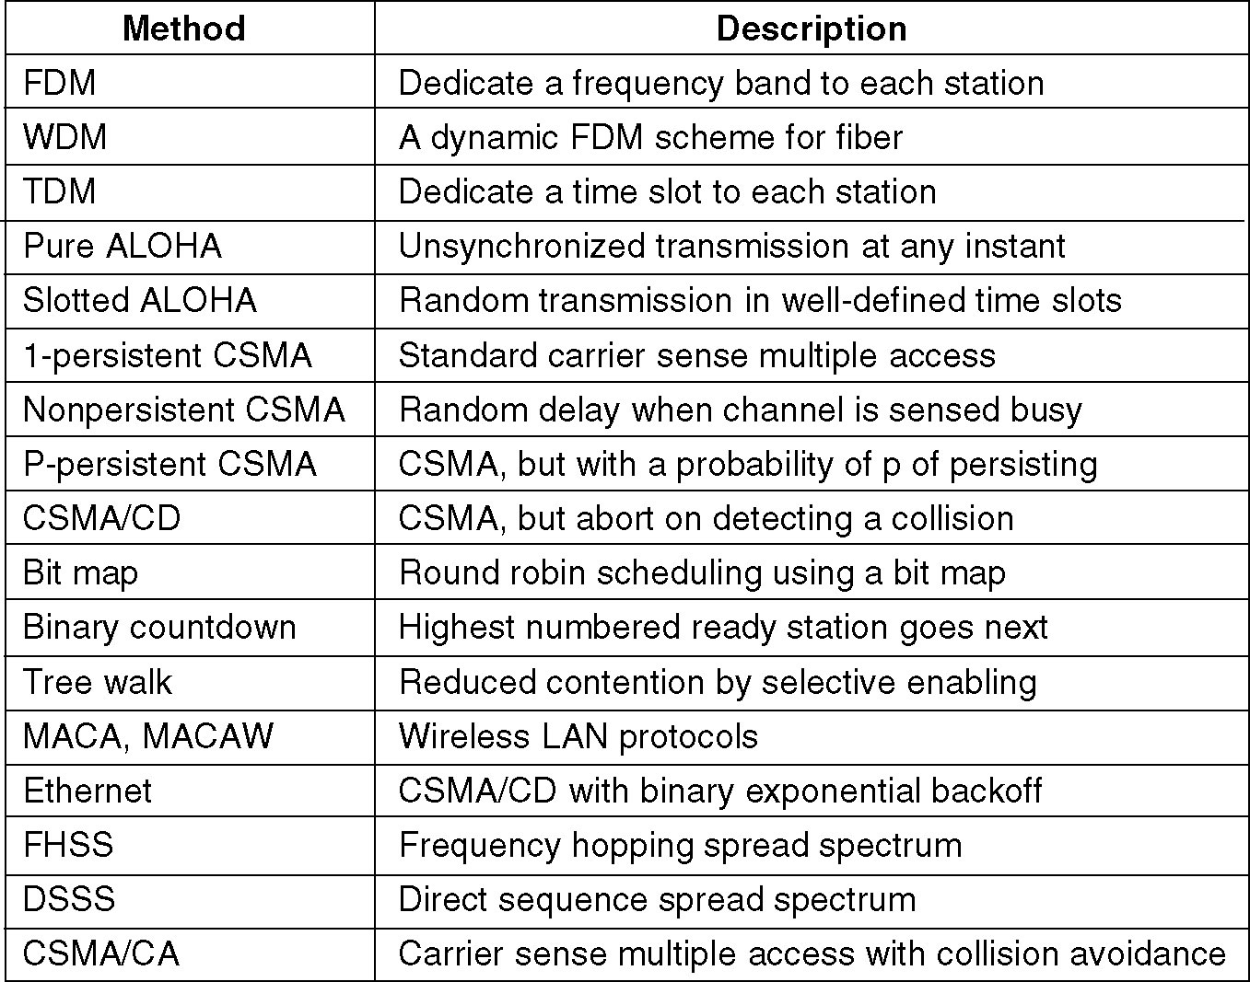
Channel allocation methods and systems for a common channel.

