Slide 1
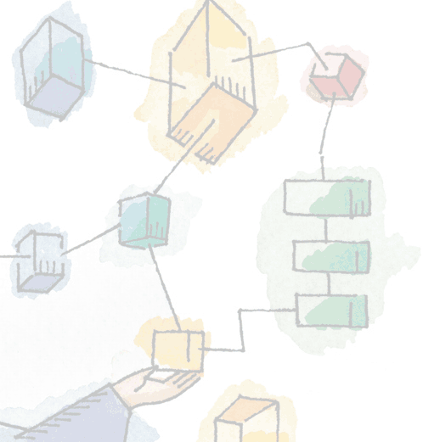
Chapter 13 Embedded Systems
Operating Systems: Internals and Design Principles, 6/E William Stallings
Notes:
These slides are intended to help a teacher develop a presentation. This PowerPoint covers the entire chapter and includes too many slides for a single delivery. Professors are encouraged to adapt this presentation in ways which are best suited for their students and environment.

Slide 2
Roadmap
Embedded Systems
Characteristics of Embedded Operating Systems
eCos
TinyOS
Notes:
We begin with an overview, followed by a look at various file organization schemes.
Although file organization is generally beyond the scope of the operating system, it is essential to have a general understanding of the common alternatives to appreciate some of the design tradeoffs involved in file management.
The remainder of this chapter looks at other topics in file management.

Slide 3
Embedded System
One of the most important and widely used categories of operating systems
Hardware and software designed to perform a dedicated function
Tightly coupled to their environment
Often, embedded systems are part of a larger system or product,
E.G. antilock braking system in a car.
Notes:
One of the most important and widely used categories of operating systems:
embedded operating systems.
“Embedded system. A combination of computer hardware and software, and perhaps additional mechanical or other parts, designed to perform a dedicated function. In many cases, embedded systems are part of a larger system or product, as in the case of an antilock braking system in a car.”

Slide 4
Real Time
Embedded systems are tightly coupled to their environment.
This imposes real-time constraints by the need to interact with the environment.
required speeds of motion,
required precision of measurement,
required time durations.
Notes:
Often, embedded systems are tightly coupled to their environment.
This can give rise to real-time constraints imposed by the need to interact with the environment.
Constraints, such as
required speeds of motion,
required precision of measurement,
required time durations, dictate the timing of software operations.
If multiple activities must be managed simultaneously, this imposes more complex real-time constraints.

Slide 5
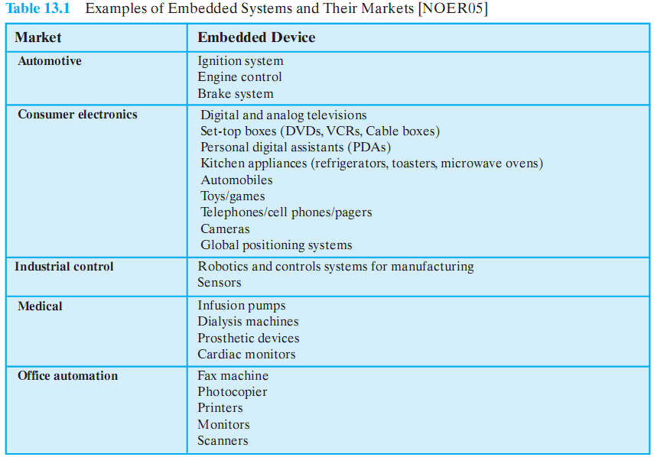
Examples of Embedded Devices

Slide 6
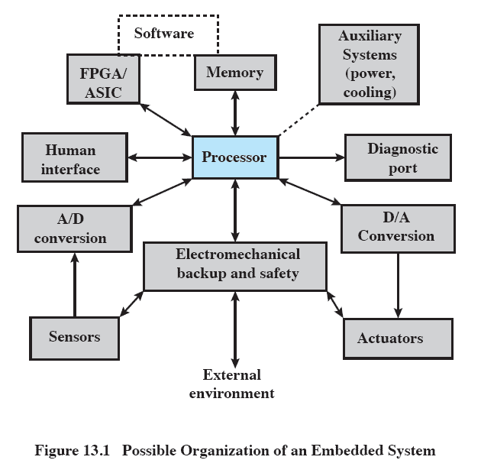
Embedded System Organization
Notes:
This figure shows in general terms an embedded system organization.

Slide 7
Differences from typical computer
A variety of Interfaces.
Use of a diagnostic.
Special purpose hardware may be used to increase performance or safety.
Field programmable (FPGA),
application specific (ASIC),
or even nondigital hardware.
Single purpose software.
Notes:
In addition to the processor and memory, there are a number of elements that differ from the typical desktop or laptop computer.
There may be a variety of interfaces that enable the system to measure, manipulate, and otherwise interact with the external environment.
The human interface may be as simple as a flashing light or as complicated as real-time robotic vision.
The diagnostic port may be used for diagnosing the system that is being controlled
Special-purpose field programmable (FPGA), application specific (ASIC), or even nondigital hardware may be used to increase performance or safety.
Software often has a fixed function and is specific to the application.

Slide 8
Roadmap
Embedded Systems
Characteristics of Embedded Operating Systems
eCos
TinyOS

Slide 9
Characteristics of Embedded OS
Real-time operation
Reactive operation
Configurability
I/O device flexibility
Streamlined protection mechanisms
Direct use of interrupts
Notes:
Real-time operation:
In many embedded systems, the correctness of a computation depends, in part, on the time at which it is delivered.
Often, real-time constraints are dictated by external I/O and control stability requirements.
Reactive operation:
Embedded software may execute in response to external events.
If these events do not occur periodically or at predictable intervals, the embedded software may need to take into account worst-case conditions and set priorities for execution of routines.
Configurability:
Because of the large variety of embedded systems, there is a large variation in the requirements, both qualitative and quantitative, for embedded OS functionality.
Thus, an embedded OS intended for use on a variety of embedded systems must lend itself to flexible configuration so that only the functionality needed for a specific application and hardware suite is provided.
I/O device flexibility:
There is virtually no device that needs to be supported by all versions of the OS, and the range of I/O devices is large.
Streamlined protection mechanisms:
Embedded systems are typically designed for a limited, well-defined functionality. Untested programs are rarely added to the software.
After the software has been configured and tested, it can be assumed to be reliable.
Thus, apart from security measures, embedded systems have limited protection mechanisms.
Direct use of interrupts:
General-purpose operating systems typically do not permit any user process to use interrupts directly.

Slide 10
Developing an Embedded OS
Two general approaches
Take an existing OS and adapt it for embedded purposes
Design a purpose-built OS solely for embedded use
Notes:
There are two general approaches to developing an embedded OS.
The first approach is to take an existing OS and adapt it for the embedded application.
The other approach is to design and implement an OS intended solely for embedded use

Slide 11
Adapting an Existing OS
Examples include Windows, Linux, BSD
Generally slower than special purpose OS
Advantage is familiar interface
Need to add
real-time capability
Streamlining operation
Add other specialized and necessary functionality for the given device
Notes:
Typically use Linux, FreeBSD, Windows, and other general-purpose operating systems.
Such operating systems are typically slower and less predictable than a special-purpose embedded OS.
An advantage of this approach is that the embedded OS derived from a commercial general-purpose OS is based on a set of familiar interfaces, which facilitates portability.
The disadvantage of using a general-purpose OS is that it is not optimized for real-time and embedded applications.

Slide 12
Purpose-Built Embedded OS
Typical characteristics include:
fast and lightweight process or thread switch
Scheduling policy is real time and dispatcher module is part of scheduler
Small size
Responds to external interrupts quickly
Minimizes intervals during which interrupts are disabled
Notes:
Typical characteristics of a specialized embedded OS include the following:
Has a fast and lightweight process or thread switch
Scheduling policy is real time and dispatcher module is part of scheduler instead of separate component.
Has a small size
Responds to external interrupts quickly; typical requirement is response time of less than 10 μs
Minimizes intervals during which interrupts are disabled
Provides fixed or variable sized partitions for memory management as well as the ability to lock code and data in memory
Provides special sequential files that can accumulate data at a fast rate

Slide 13
Timing Constraints
To deal with timing constraints, the kernel:
Provides bounded execution time for primitives
Maintains a real-time clock
Provides for special alarms and timeouts
Supports real-time queuing disciplines
Provides primitives to delay processing by a fixed amount of time and to suspend/resume execution
Notes:
The characteristics just listed are common in embedded operating systems with real-time requirements.
However, for complex embedded systems, the requirement may emphasize predictable operation over fast operation, necessitating different design decisions, particularly in the area of task scheduling.

Slide 14
Roadmap
Embedded Systems
Characteristics of Embedded Operating Systems
eCos
TinyOS

Slide 15
eCos: Embedded Configurable OS
Open source, Royalty-free
Real-time OS
Most widely used embedded OS
Targeted at high-performance small embedded systems.
An embedded form of Linux or other commercial OS would not provide the streamlined software required.
Notes:
The Embedded Configurable Operating System (eCos) is an open source, royalty-free, real-time OS intended for embedded applications.
The system is targeted at high-performance small embedded systems.
For such systems, an embedded form of Linux or other commercial OS would not provide the streamlined software required.

Slide 16
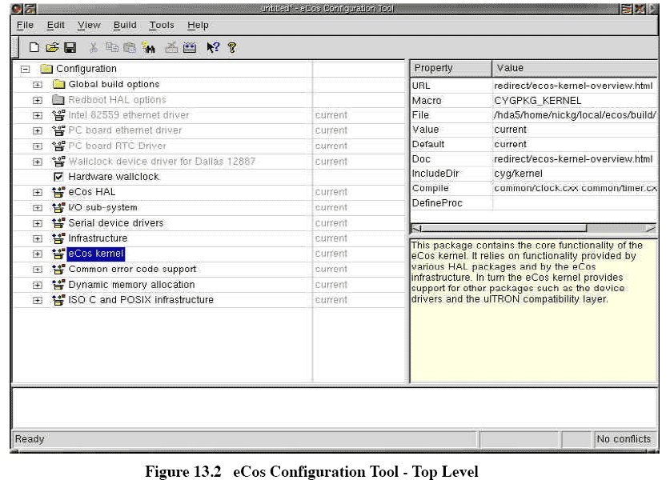
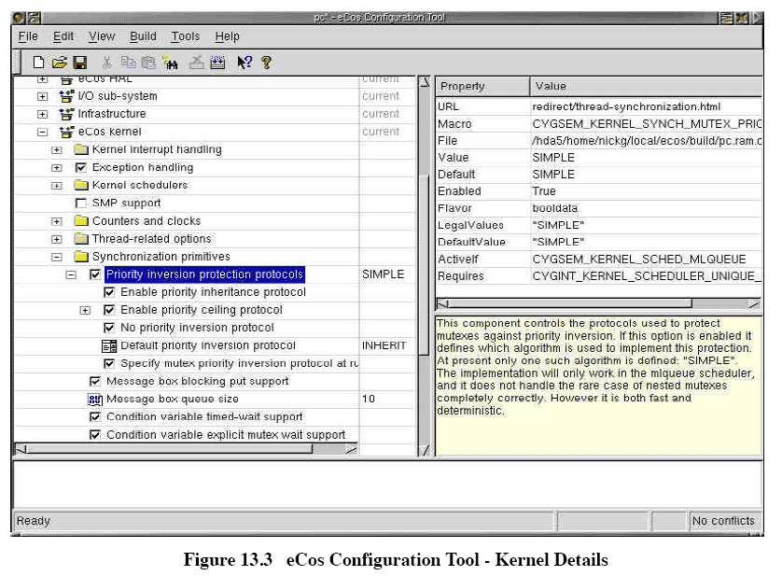
eCos Configuration Tool
Notes:
The top level of the eCos configuration tool as seen by the tool user.
Each of the items on the list in the left-hand window can be selected or deselected

Slide 17
eCos Configuration Tool

Slide 18
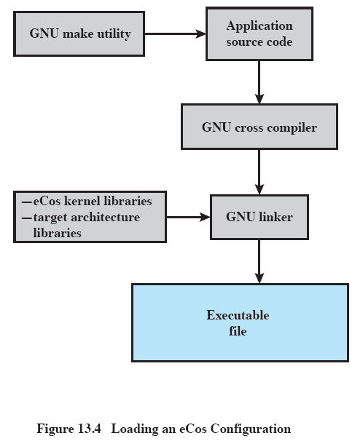
Loading an eCos Configuration
Notes:
This figure shows a typical example of the overall process of creating the binary image to execute in the embedded system.
This process is run on a source system, e.g. Windows or Linux platform, and the executable image is destined to execute on a target embedded system, such as a sensor in an industrial environment.
At the highest software level is the application source code for the particular embedded application.
This code is independent of eCos but makes use of application programming interfaces (API) to sit on top of the eCos software.
There may be only one version of the application source code, or there may be variations for different versions of the target embedded platform.
In this example, the GNU make utility is used to selectively determine which pieces of a program need to be compiled or recompiled (in the case of a modified version of the source code) and issues the commands to recompile them.

Slide 19
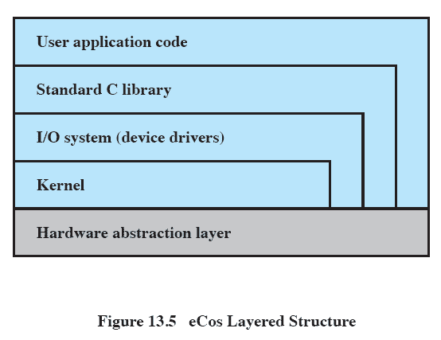
eCos Layered Structure
Notes:
A key design requirement for eCos is portability to different architectures and platforms with minimal effort.
To met this requirement, eCos consists of a layered set of components

Slide 20
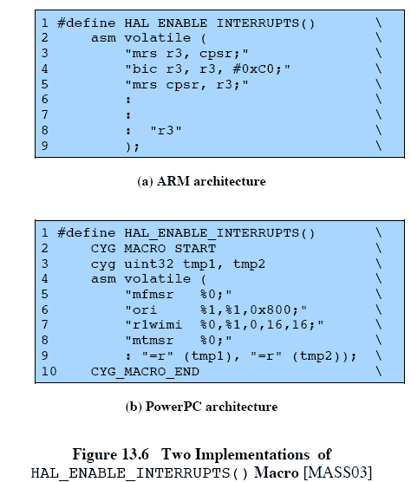
Hardware Abstraction Layer
Presents consistent API to upper layers
Different for each hardware platform

Slide 21
HAL

Slide 22
HAL Modules
Architecture
Processor family type
Variant
Support features of specific processor
Platform
Support of tightly coupled peripherals
Notes:
The HAL is implemented as three separate modules:
Architecture:
Defines the processor family type.
This module contains the code necessary for processor startup, interrupt delivery, context switching, and other functionality specific to the instruction set architecture of that processor family.
Variant:
Supports the features of the specific processor in the family.
An example of a supported feature is an on-chip module such as a memory management unit (MMU).
Platform:
Extends the HAL support to tightly coupled peripherals like interrupt controllers and timer devices.
This module defines the platform or board that includes the selected processor architecture and variant.
It includes code for startup, chip selection configuration, interrupt controllers, and timer devices.

Slide 23
eCos Kernel Design
The eCos kernel was designed to satisfy four main objectives:
Low interrupt latency
Low task switching latency
Small memory footprint
Deterministic behavior
Notes:
The eCos kernel was designed to satisfy four main objectives:
Low interrupt latency:
The time it takes to respond to an interrupt and begin executing an ISR.
Low task switching latency:
The time it takes from when a thread becomes available to when actual execution begins.
Small memory footprint:
Memory resources for both program and data are kept to a minimum by allowing all components to configure memory as needed.
Deterministic behavior:
Throughout all aspect of execution, the kernels performance must be predictable and bounded to meet real-time application requirements.

Slide 24
Not in eCos Kernel
Memory allocation
Device driver
This makes for a lean kernel.
Notes:
Some functionality that is typically included in the kernel of an OS is not included in the eCos kernel.
E.g. memory allocation is handled by a separate package.
Similarly, each device driver is a separate package.

Slide 25
eCos I/O System
Framework for supporting device drivers
A variety of drivers are available through the configuration package
Principle objective is efficiency with no unnecessary software layering
Notes:
The eCos I/O system is a framework for supporting device drivers.
A variety of drivers for a variety of platforms are provided in the eCos configuration package.
These include drivers for serial devices, Ethernet, flash memory interfaces, and various I/O interconnects such as PCI (peripheral component interconnect) and USB (universal serial bus).
In addition, users can develop their own device drivers.
The principal objective for the I/O system is efficiency, with no unnecessary software layering or extraneous functionality.
Device drivers provide the necessary functions for input, output, buffering, and device control.
Device drivers and other higher-layer software may be implemented directly on the HAL if this is appropriate.
If specialized kernel type functions are needed, then the device driver is implemented using kernel APIs.

Slide 26
eCos Scheduler
Bitmap scheduler
Efficient for small number of threads active
Each thread has different priority
Multilevel queue scheduler
Appropriate when number of threads is dynamic
Multiple threads at each priority
Time slicing
Notes:
The eCos kernel can be configured to provide one of two scheduler designs:
the bitmap scheduler and
a multilevel queue scheduler.
The bitmap scheduler provides efficient scheduling for a system with a small number of threads that may be active at any point in time.
The multiqueue scheduler is appropriate if the number of threads is dynamic or if it is desirable to have multiple threads at the same priority level.
The multilevel scheduler is also needed if time slicing is desired.

Slide 27
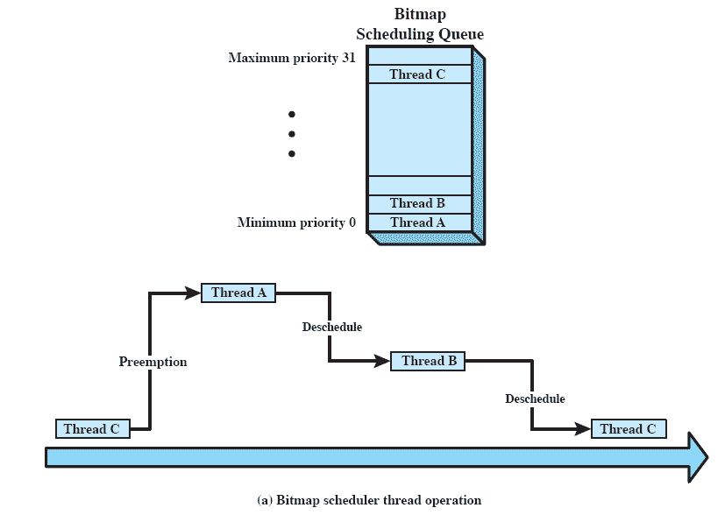
Bitmap Scheduler Priority Levels
Notes:
A bitmap scheduler supports multiple priority levels, but only one thread can exist at each priority level at any given time.
Scheduling decisions are quite simple with this scheduler.
When a blocked thread become ready to run, it may preempt a thread of lower priority.
When a running thread suspends, the ready thread with the highest priority is dispatched.
A thread can besuspended because it is blocked on a synchronization primitive, because it is interrupted, or because it relinquishes control.
Because there is only one thread, at most, at each priority level, the scheduler does not have to make a decision as to which thread at a given priority level should be dispatched next.
The bitmap scheduler is configured with 8, 16, or 32 priority levels.
A simple bitmap is kept of the threads that are ready to execute.
The scheduler need only determine the position of the most significant one bit in the bitmap to make a scheduling decision.

Slide 28
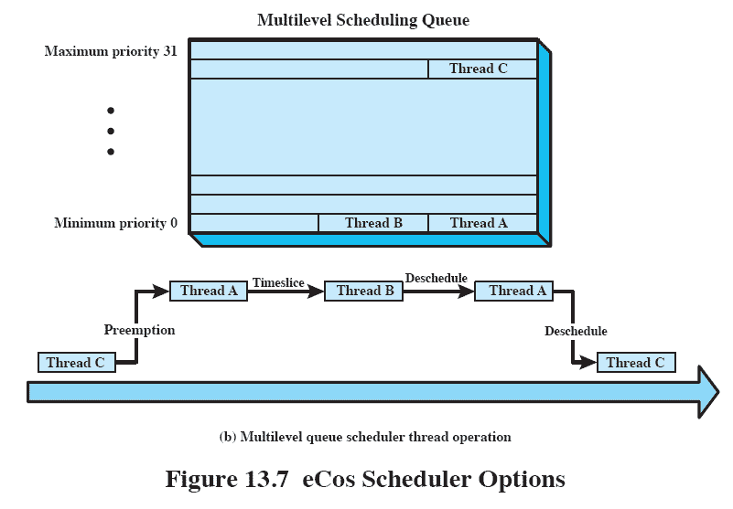
Multilevel Queue Scheduler Priorities
Notes:
The multilevel queue scheduler supports up to 32 priority levels.
The multilevel queue scheduler allows for multiple active threads at each priority level, limited only by system resources.
This Figure illustrates the nature of the multilevel queue scheduler.
A data structure represents the number of ready threads at each priority level.
When a blocked thread become ready to run, it may preempt a thread of lower priority.
As with the bitmap scheduler, a running thread may be blocked on a synchronization primitive, because it is interrupted, or because it relinquishes control.
When a thread is blocked, the scheduler must first determine if one or more threads at the same priority level as the blocked thread is ready.
If so, the scheduler chooses the one at the front of the queue.
Otherwise, the scheduler looks for the next highest priority level with one or more ready threads and dispatches one of these threads.
In addition, the multilevel queue scheduler can be configured for time slicing.
If a thread is running and there is one or more ready threads at the same priority level, the scheduler will suspend the running thread after one time slice and choose the next thread in the queue at that priority level.
This is a round-robin policy within one priority level.
Not all applications require time slicing.

Slide 29
eCos Thread Synchronization
Classic mechanisims
Mutexes
Semaphores
Condition variables
synchronization/communication mechanisms
Event flags
Mailboxes
SMP support(symmetric multiprocessing)
Spinlocks
Notes:
The eCos kernel can be configured to include one or more of six different thread synchronization mechanisms.
These include the classic synchronization mechanisms:
mutexes,
semaphores, and
condition variables.
In addition, eCos supports two synchronization/communication mechanisms that are common in real-time systems, namely
event flags and
mailboxes.
Finally, the eCos kernel supports spinlocks, which are useful in SMP (symmetric multiprocessing) systems.

Slide 30
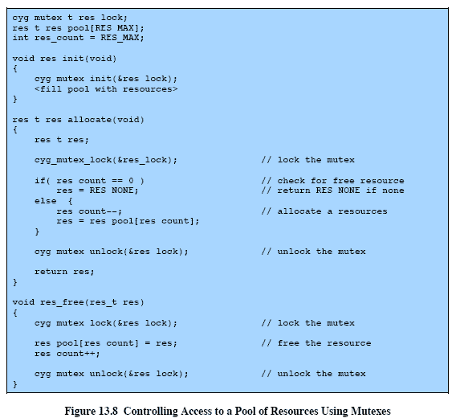
Mutexes
Notes:
Mutex is used to enforce mutually exclusive access to a resource, allowing only one thread at a time to gain access.
The mutex has only two states:
locked and
unlocked.
Similar to a binary semaphore:
When a mutex is locked by one thread, any other thread attempting to lock the mutex is blocked;
when the mutex is unlocked, then one of the threads blocked on this mutex is unblocked and allowed to lock the mutex and gain access to the resource.
The mutex differs from a binary semaphore in two respects.
the thread that locks the mutex must be the one to unlock it.
But t is possible for one thread to lock a binary semaphore and for another to unlock it.
The other difference is that a mutex provides protection against priority inversion, whereas a semaphore does not.
The eCos kernel can be configured to support either a priority inheritance protocol or a priority ceiling protocol.

Slide 31
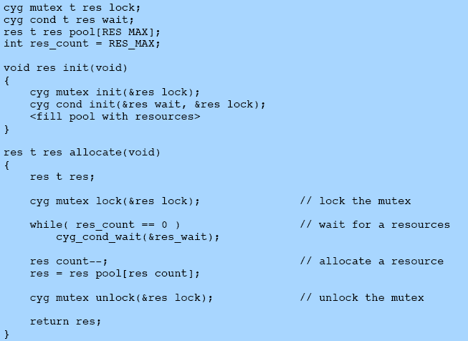
Mutexes and Condition Variables
Notes:
A condition variable is used to block a thread until a particular condition is true.
Condition variables are used with mutexes to allow multiple thread to access shared data.
In eCos, condition variables are typically used in conjunction with mutexes to implement long-term waits for some condition to become true.

Slide 32
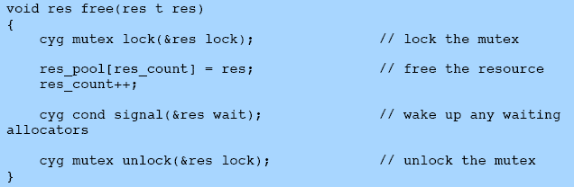
Mutexes and Condition Variables

Slide 33
Roadmap
Embedded Systems
Characteristics of Embedded Operating Systems
eCos
TinyOS

Slide 34
TinyOS
400 bytes of code
Not a real-time OS
No kernel
There are no processes;
OS doesn’t have a memory allocation system
interrupt and exception handling is dependent on the peripheral; and
Nonblocking, so there are few explicit synchronization primitives.
Notes:
TinyOS takes the process of streamlining to a much further point, resulting in a very minimal OS for embedded systems.
The core OS requires 400 bytes of code and data memory, combined.
TinyOS represents a significant departure from other embedded operating systems.
TinyOS is not a real-time OS.
The reason for this is the expected workload, which is in the context of a wireless sensor network.
Because of power consumption, these devices are off most of the time.
Applications tend to be simple, with processor contention not much of an issue.
In TinyOS there is no kernel, as there is no memory protection and it is a component-based OS;
There are no processes;
The OS itself does not have a memory allocation system
interrupt and exception handling is dependent on the peripheral; and
it is completely nonblocking, so there are few explicit synchronization primitives.

Slide 35
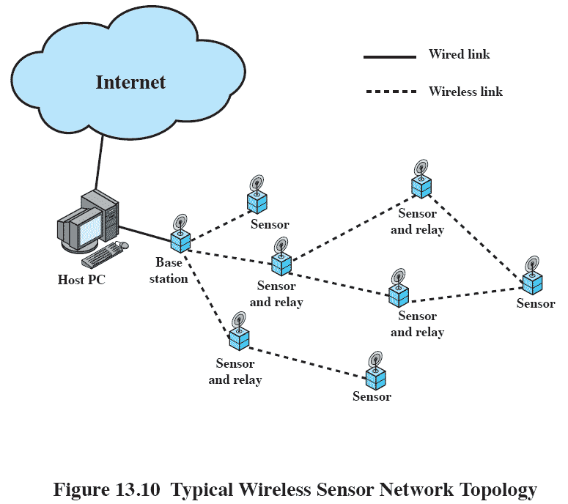
Wireless Sensor Network Topology
Notes:
TinyOS was developed primarily for use with networks of small wireless sensors.
A number of trends have enabled the development of extremely compact, low-power sensors.
Low cost, small size, low-power-consuming wireless sensors make can be used in a host of application.
This figure shows a typical configuration.

Slide 36
TinyOS Goals
With the tiny distributed sensor application in mind, the following goals were set for TinyOS:
Allow high concurrency
Operate with limited resources
Adapt to hardware evolution
Support a wide range of applications
Support a diverse set of platforms
Be robust
Notes:
With the tiny, distributed sensor application in mind, the following goals were set for TinyOS:
Allow high concurrency:
In a typical wireless sensor network application, the devices are concurrency intensive.
Several different flows of data must be kept moving simultaneously.
While sensor data is input in a steady stream, processed results must be transmitted in a steady stream.
Also, external controls from remote sensors or base stations must be managed.
Operate with limited resources:
Target platform has limited memory and computational resources and run on batteries or solar power.
A single platform may offer only kilobytes of program memory and hundreds of bytes of RAM.
The software must make efficient use of the available processor and memory resources while enabling low-power communication.
Adapt to hardware evolution:
hardware is in constant evolution; applications and most system services must be portable across hardware generations.
It should be possible to upgrade the hardware with little or no software change, if the functionality is the same.
Support a wide range of applications:
Applications exhibit a wide range of requirements in terms of lifetime, communication, sensing, and so on.
A modular, general-purpose embedded OS is desired so that a standardized approach leads to economies of scale in developing applications and support software.
Support a diverse set of platforms:
A general-purpose embedded OS is desirable.
Be robust:
Once deployed, a sensor network must run unattended for months or years.
Ideally, there should be redundancy both within a single system and across the network of sensors.
However, both types of redundancy require additional resources.
One software characteristic that can improve robustness is to use highly modular, standardized software components.

Slide 37
TinyOS Components
Embedded software systems built with TinyOS consist of a set of modules – called components
Such as:
Single-hop networking
Ad-hoc routing
Power management
Times
Nonvolatile storage control
Notes:
An embedded software system built using TinyOS consists of a set of small modules, called components,
each of which performs a simple task or set of tasks and which interface with each other and with hardware in limited and well-defined ways.

Slide 38
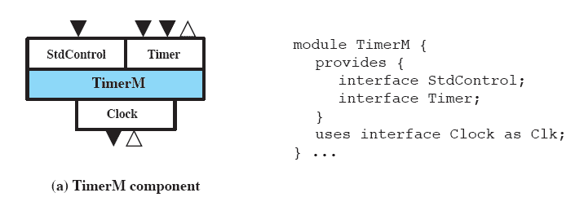
TimerM Component
Notes:
All components in a TinyOS configuration have the same structure, an example of which is shown here.
The shaded box in the diagram indicates the component, which is treated as an object that can only be accessed by defined interfaces, indicated by white boxes.
A component may be hardware or software.

Slide 39
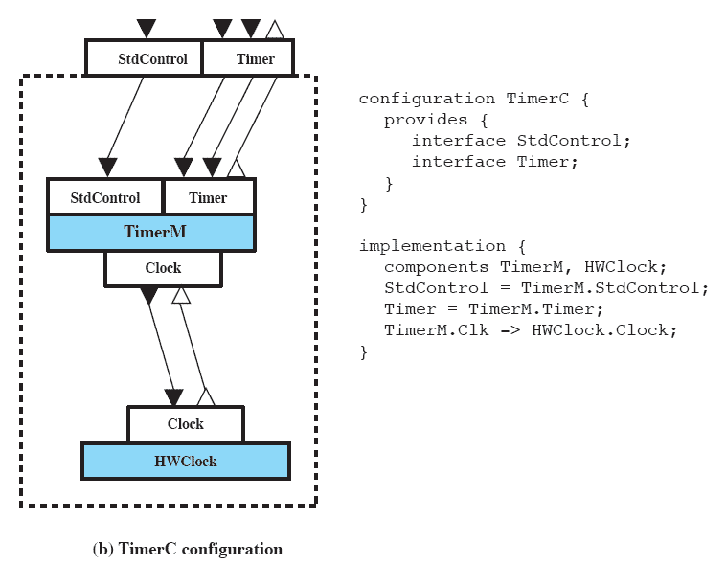
TimerM Configuration
Notes:
Components are organized into configurations by “wiring” the together at their interfaces and equating the interfaces of the configuration with some of the interfaces of the components.
A simple example is shown here

Slide 40
TinyOS Scheduler
Operates across all components
Only one task executes at one time
Simple FIFO queue
Schedular is power aware
Puts processor to sleep when no task in queue
Notes:
The TinyOS scheduler operates across all components.
Virtually all embedded systems using TinyOS will be uniprocessor systems, so that only one task among all the tasks in all the components may execute at a time.
The scheduler is a separate component.
It is the one portion of TinyOS that must be present in any system.
The default scheduler in TinyOS is a simple FIFO (first-in-first-out) queue.
A task is posted to the scheduler (place in the queue) either as a result of an event, which triggers the posting, or as a result of a specific request by a running task to schedule another task.
The scheduler is power aware.
This means that the scheduler puts the processor to sleep when there are no tasks in the queue.
The peripherals remain operating, so that one of them can wake up the system by means of a hardware event signaled to a lowest-level component.
Once the queue is empty, another task can be scheduled only as a result of a direct hardware event.
This behavior enables efficient battery usage

Slide 41
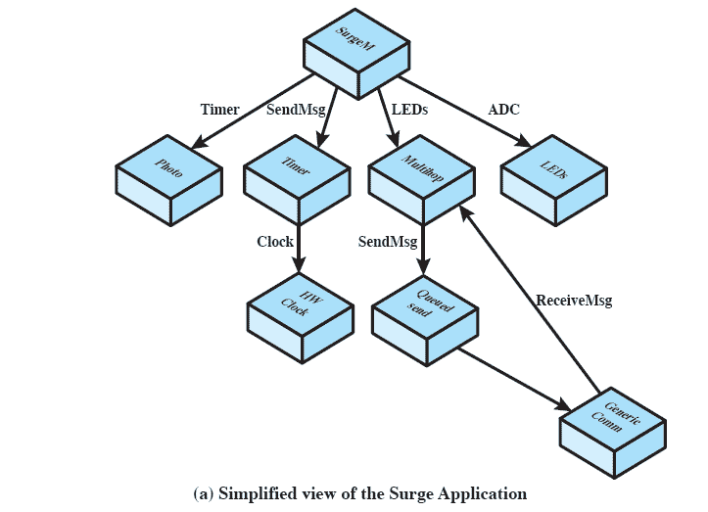
Surge: An Example TinyOS Application
Notes:
This figure shows a configuration assembled from software and hardware components.
This simplified example, called Surge performs periodic sensor sampling and uses ad-hoc multihop routing over the wireless network
to deliver samples to the base station.

Slide 42
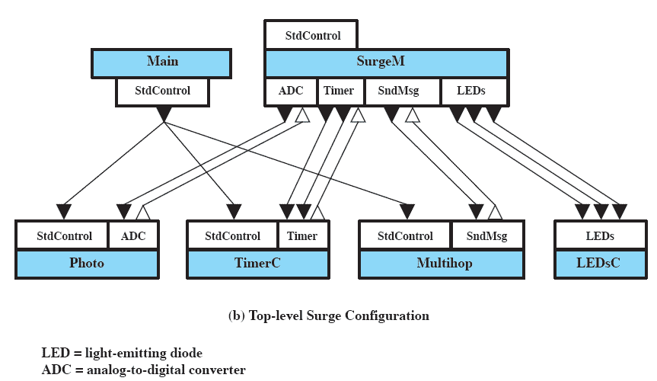
Configuration for Surge
Notes:
This figure shows a portion of the configuration for the Surge application.

Slide 43
TinyOS Resource Interface
TinyOS provides a simple but powerful set of conventions for dealing with resources.
Dedicated
Virtualized
Shared
Notes:
TinyOS provides a simple but powerful set of conventions for dealing with resources.
Dedicated:
A resource that a subsystem needs exclusive access to at all times.
In this class of resources, no sharing policy is needed since only a single component ever requires use of the resource.
Examples of dedicated abstractions include interrupts and counters.
Virtualized:
Every client of a virtualized resource interacts with it as if it were a dedicated resource, with all virtualized instances being multiplexed on top of a single underlying resource.
The virtualized abstraction may be used when the underlying resource need not be protected by mutual exclusion.
An example is a clock or timer.
Shared:
The shared resource abstraction provides access to a dedicated resource through an arbiter component.
The arbiter enforces mutual exclusion, allowing only one user (called a client) at a time to have access to a resource and enabling the client to lock the resource.

Slide 44
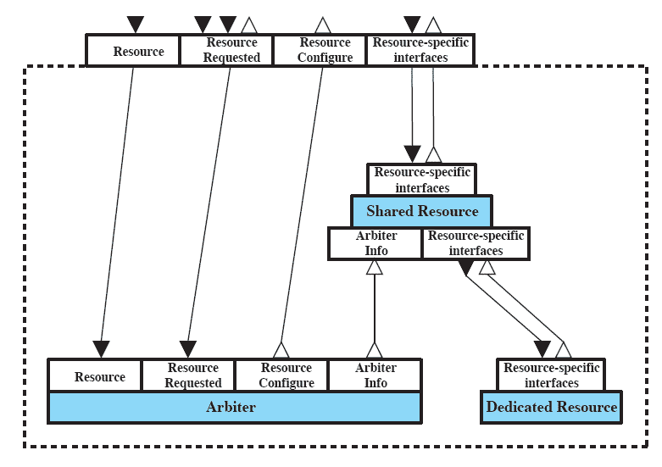
Shared Resource Configuration
Notes:
This figure shows a simplified view of the shared resource configuration used to provide access to an underlying resource.
Associated with each resource to be shared is an arbiter component.
The arbiter enforces a policy that enables a client to lock the resource, use it and then release the resource.`

