Slide 1
The Data Link Layer
Chapter 3

Slide 2
Data Link Layer Design Issues
◆ Services Provided to the Network Layer
  The network layer wants to be able to send packets to its neighbors without worrying about the details of getting it there in one piece.
❖ Framing
  Group the physical layer bit stream into units called frames. Frames are nothing more than "packets" or "messages". By convention, we use the term "frames" when discussing DLL.
 Error Control
  Sender checksums the frame and transmits checksum together with data. Receiver re-computes the checksum and compares it with the received value.
 Flow Control
  Prevent a fast sender from overwhelming a slower receiver.

Slide 3
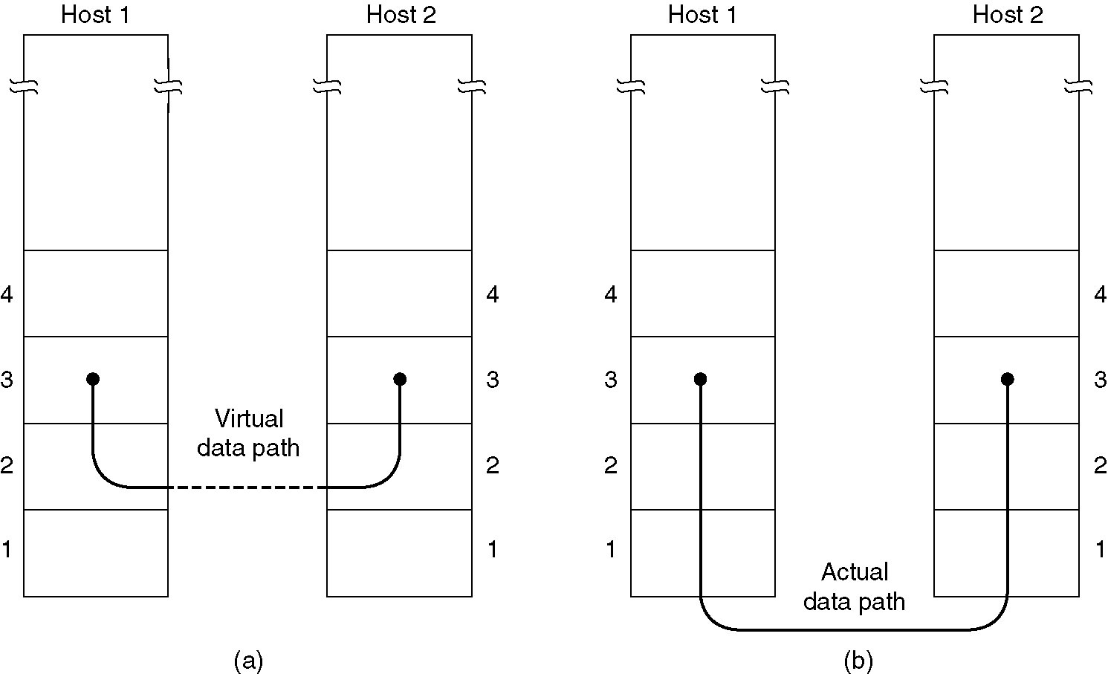
Services Provided to Network Layer (1)
Network layer and DLL should work independent
Virtual communication.
Actual communication.

Slide 4
Services Provided to Network Layer (2)
Delivery Mechanisms
  Un-acknowledge connectionless
    Receiver does not return acknowledgments to the sender,
    ➔Sender has no way of knowing if a frame has been successfully delivered.
    Applications:
      1. When errors are so infrequent that there is little to be gained by the data link layer performing the recovery (Higher layers can recover from errors with little loss in performance).
      Example: LAN
      2. For real-time applications requiring "better never than late". Old data may be worse than no data.
      Example: Sound stream

Slide 5
Services Provided to Network Layer (3)
Delivery Mechanisms
  ❖ Acknowledge connectionless
    Receiver returns an acknowledgment frame to the sender indicating that a data frame was properly received.
    Each frame is assigned a unique sequence number, which the receiver returns in an acknowledgment frame to indicate which frame the ACK refers to.
      Sender must retransmit unacknowledged (e.g., lost or damaged) frames.

Slide 6
Services Provided to Network Layer (4)
Delivery Mechanisms
   Acknowledge connection-oriented: Reliable Delivery
    Frames are delivered to the receiver reliably and in the same order as generated by the sender.
    Connection state keeps track of sending order and which frames require retransmission. For example, receiver state includes which frames have been received, which ones have not, etc.

Slide 7
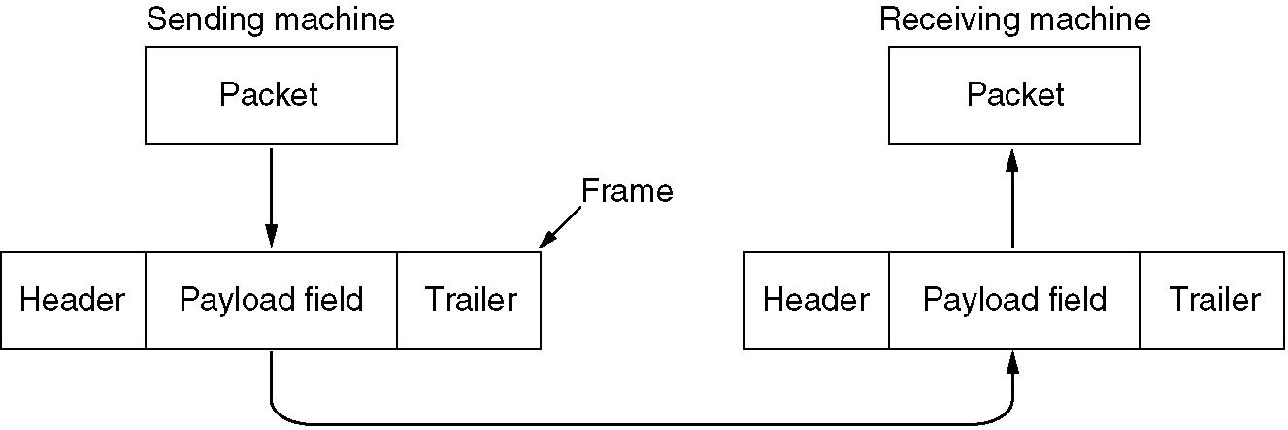
Different methods of Framing
DLL translates the physical layer's raw bit stream into discrete units (messages) called frames.
How can frame be transmitted so the receiver can detect frame boundaries? That is, how can the receiver recognize the start and end of a frame?
    ◆ Character Count
    ❖ Flag byte with Byte Stuffing
    ⬥ Starting and ending flag with bite stuffing
     Encoding Violations

Slide 8
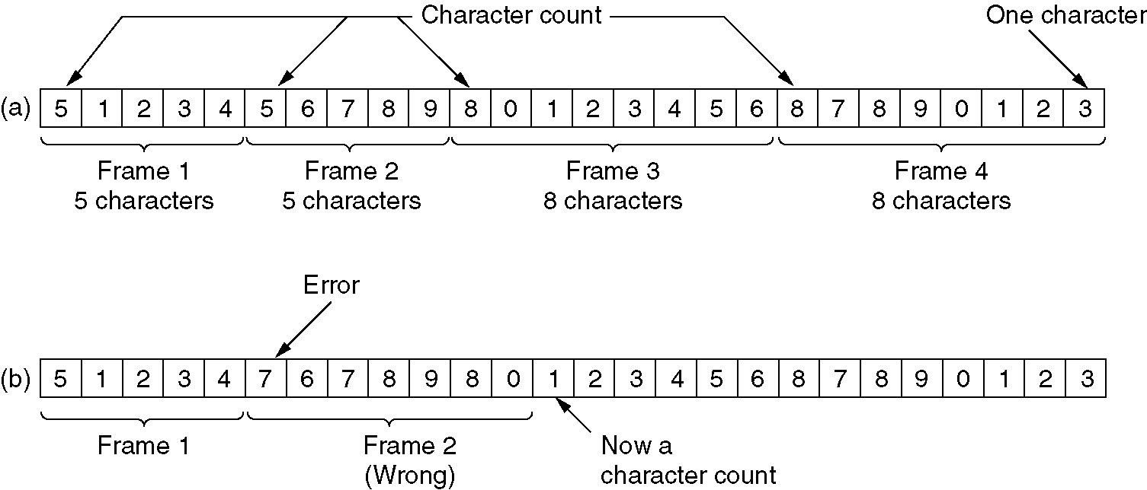
Framing - Character Count
◆ Character Count
  First field in the frame's header = the length of the frame.
  Disadvantage:
    Receiver loses synchronization when bits become garbled. If the bits in the count become corrupted during transmission, the receiver will think that the frame contains fewer (or more) bits than it actually does.
 Without errors
 With one error

Slide 9
Framing - Character Count
A character stream. (a) Without errors. (b) With one error.

Slide 10
Problem with Framing with CC
What if the count is garbled
Even if with checksum, the receiver knows that the frame is bad there is no way to tell where the next frame starts.
Asking for retransmission doesn’t help either because the start of the retransmitted frame is not known
No longer used

Slide 11
Coding: Character Count

Slide 12
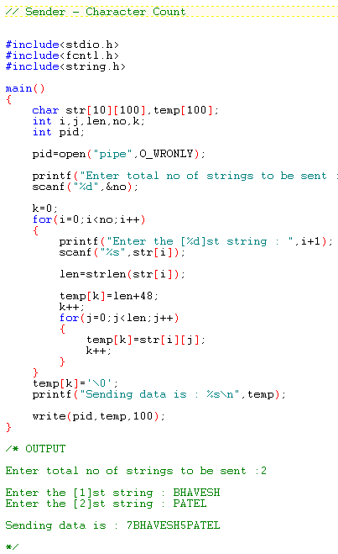
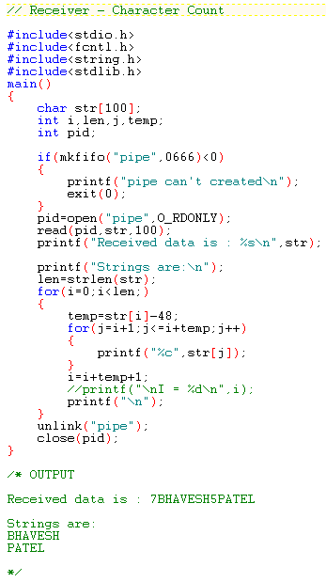

Slide 13
Framing - Byte Stuffing

Slide 14
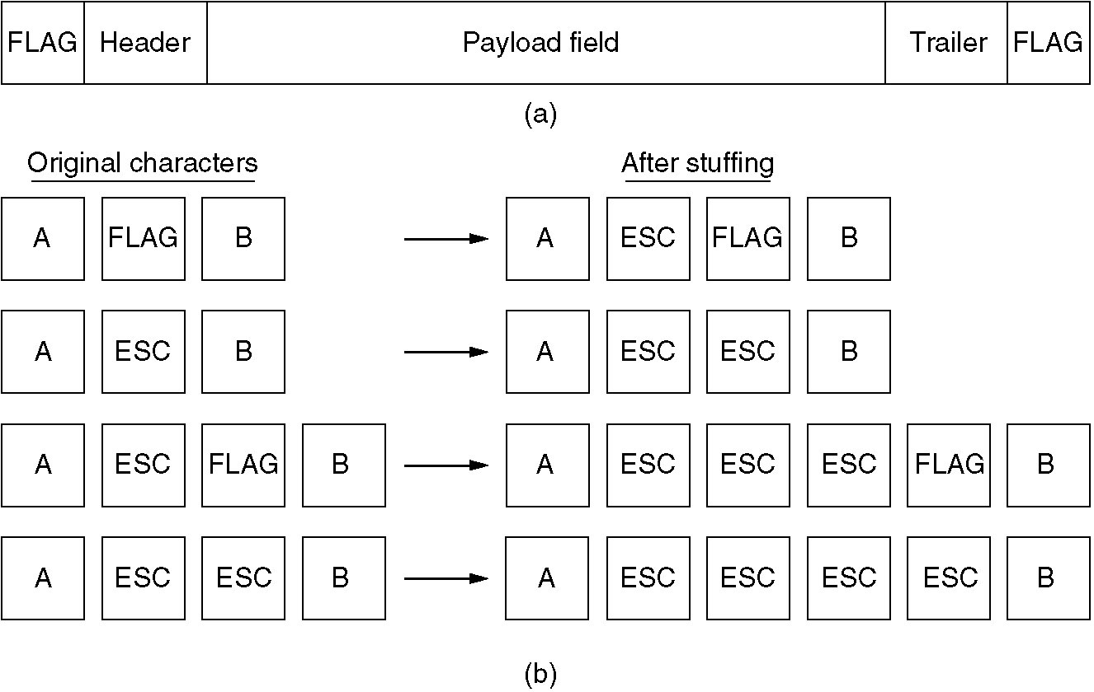
Framing - Byte Stuffing
(a) A frame delimited by flag bytes.
(b) Four examples of byte sequences before and after stuffing.

Slide 15
Framing - Byte Stuffing - Continue
❖ Flag byte with Byte Stuffing
  Use reserved bit patterns (Flag byte) to indicate the start and end of a frame.
  Problem: What happens if the reserved delimiter happens to appear in the frame itself?
  Solution: Use byte stuffing (Character stuffing): insert a special escape byte (ESC) just before accidental flag byte in data. ➔ Another problem: if an ESC byte occurs in data
  ➔ Solution: ESC stuff with another ESC byte
  Major problem: Dependent on 8-bite character
  What about Unicode Scheme which uses 16 & 32 bits

Slide 16
Framing with byte stuffing
Problem :
  fixed character size : assumes character size to be 8 bits
  can’t handle heterogeneous(system with different architecture) environment.

Slide 17
Coding: Byte Stuffing

Slide 18
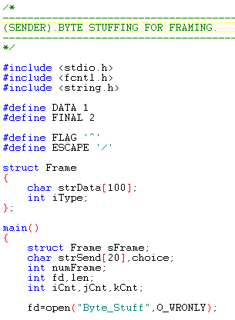
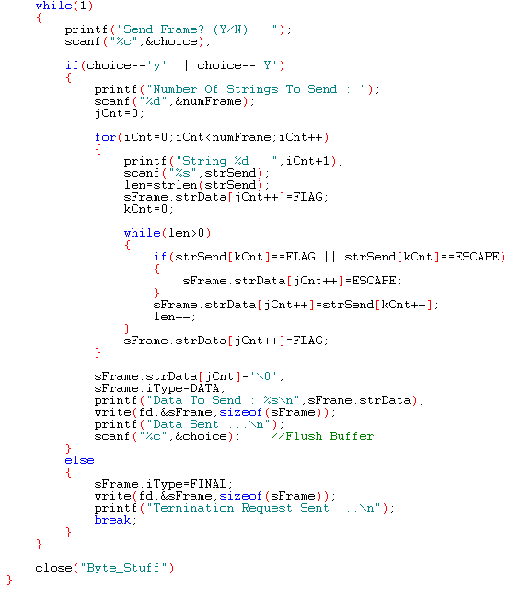

Slide 19
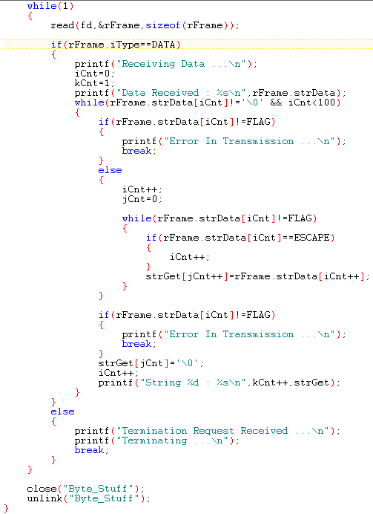
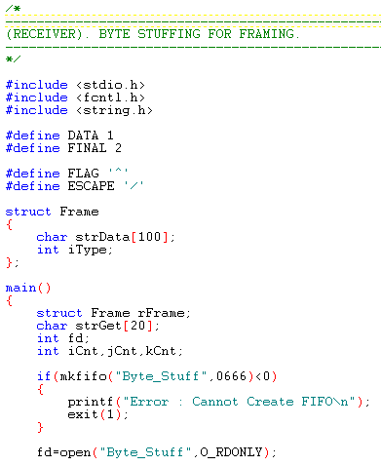

Slide 20
Framing - Bit Stuffing

Slide 21
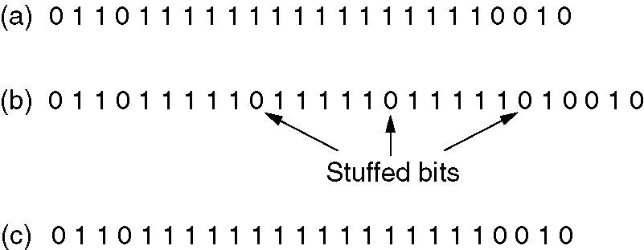
Framing - Bit Stuffing
Bit stuffing
(a) The original data.
(b) The data as they appear on the line.
(c) The data as they are stored in receiver’s memory after destuffing.

Slide 22
Coding: Bit Stuffing

Slide 23
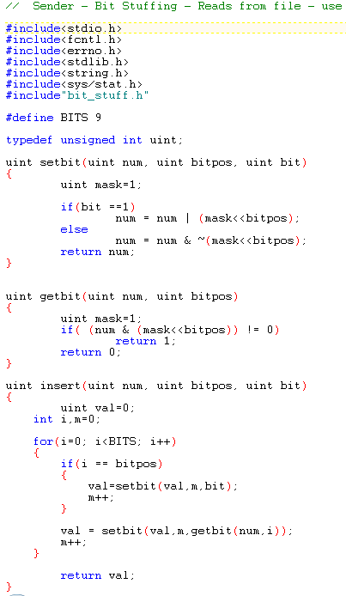
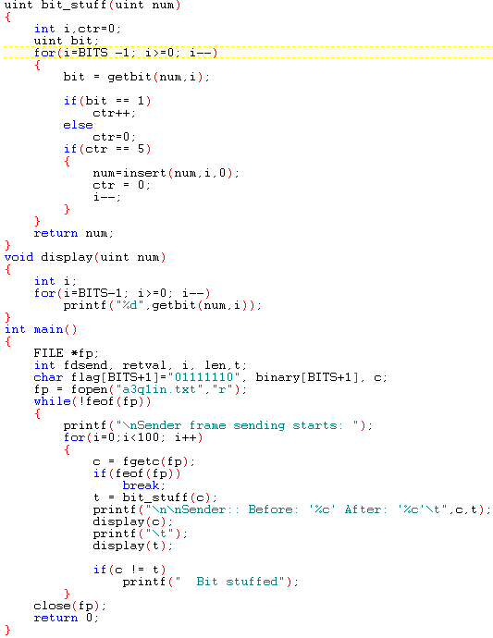

Slide 24
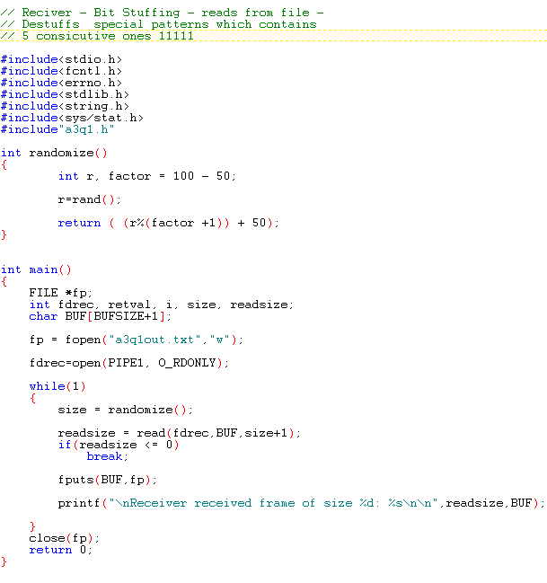
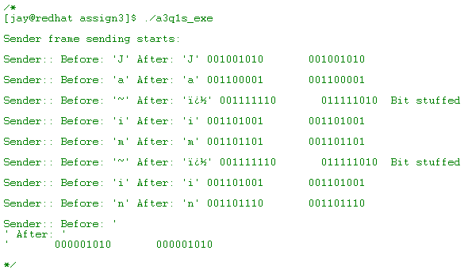

Slide 25
Error Control
Must insure that all frames are eventually delivered (possibly in order) to a destination.
Three components are required to do this:
  ◆ Acknowledgments:
    Receiver returns a special acknowledgment (ACK) frame to the sender indicating the correct receipt of a frame.
    In some systems, the receiver also returns a negative acknowledgment (NACK) for incorrectly-received frames.
  ❖ Timers:
    What happens if an ACK or NACK becomes lost?
    Retransmission timers are used to resend frames that don't produce an ACK.
  Sequence Numbers:
    Retransmissions introduce the possibility of duplicate frames.
    To suppress duplicates, add sequence numbers to each frame, so that a receiver can distinguish between new frames and repeats of old frames.

Slide 26
Error detection and error correction
In data communication, line noise is a fact of life (e.g., signal attenuation)
There are two types of attacks against errors:
  ◆ Error Detecting Codes: Include enough redundancy bits to detect errors and use ACKs and retransmissions to recover from the errors.
  Error Correcting Codes: Include enough redundancy to detect and correct errors.
Detecting and correcting errors requires redundancy (sending additional information along with the data).
m bits
r bits
Messages (frames) data | redundancy
n = ( m + r ) bit codeword

Slide 27
Error Detection
and Correction
Types of error
Detection
Correction

Slide 28
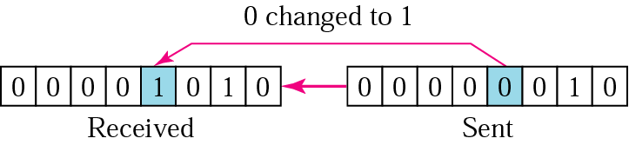
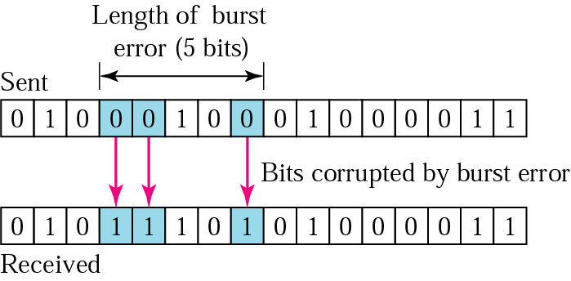
1 Types of Errors
Single bit error – only one bit is changed from 1 to 0 or from 0 to 1.
Burst error – two or more bits in the data unit have changed.

Slide 29
3 common error detection techniques
Parity Check
Checksum
(most basic)
(used primarily by upper layers)
Cyclic Redundancy Check (CRC)
(normally implemented in link layer)

Slide 30
Parity check: 2 method
VRC Vertical Redundancy Check
LRC Longitudanal Redundancy Check
Redundancy ????

Slide 31
Parity : 2 type
Odd parity
Even parity

Slide 32
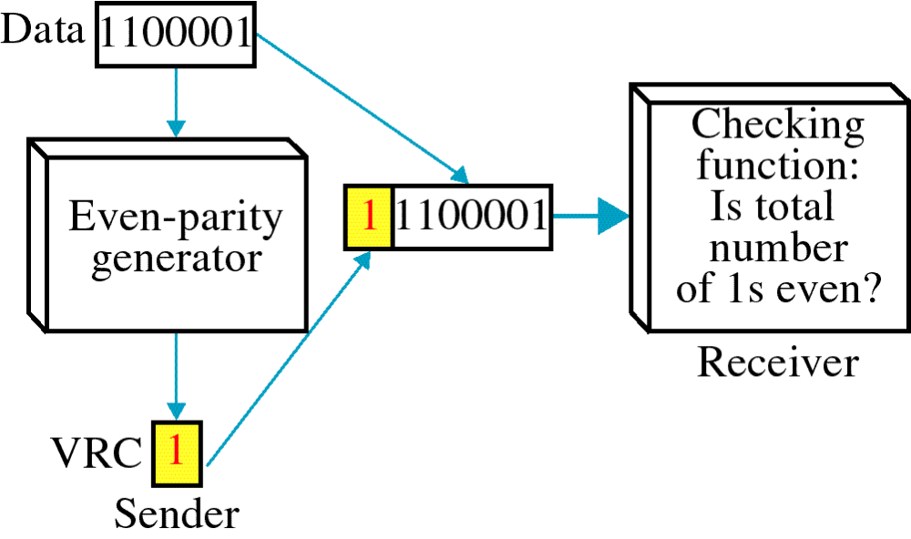
Parity Check
Simplest technique.
A redundant bit (parity bit), is appended to every data unit.
Even parity - the total number of 1's in the data plus parity bit must be an even number.

Slide 33
Even Parity Generator
Data #1's in data P Total # 1's (data and P)
0110110 4 (Even) 0 4 (Even)
0011111 5 (Odd) 1 6 (Even)
0000000 0 (Even) 0 0 (Even)
1010100 3 (Odd) 1 4 (Even)
1111111 7 (Odd) 1 8 (Even)

Slide 34
Example 1
Even Parity
Suppose the sender wants to send the word world. In ASCII the five characters are coded as
1110111 1101111 1110010 1101100 1100100
The following shows the actual bits sent
11101110 11011110 11100100 11011000 11001001

Slide 35
Example 2
Even Parity
Now suppose the word world in Example 1 is received by the receiver without being corrupted in transmission.
11101110 11011110 11100100 11011000 11001001
The receiver counts the 1s in each character and comes up with even numbers (6, 6, 4, 4, 4). The data are accepted.

Slide 36
Example 3
Even Parity
Now suppose the word world in Example 1 is corrupted during transmission.
11111110 11011110 11101100 11011000 11001001
The receiver counts the 1s in each character and comes up with even and odd numbers (7, 6, 5, 4, 4). The receiver knows that the data are corrupted, discards them, and asks for retransmission.

Slide 37
Checksum

Slide 38

Checksum
The error detection used by the higher-layer protocols.
Check generator – in the sending node
Checksum checker – at receiving node
Ethernet frame

Slide 39
Checksum generator
In the sender, the checksum generator subdivides the data unit into equal segments of n bits (usually 16).
These segments are added together using one’s complement arithmetic in such a way that the total is also n bits long.
The total(sum) is then complemented and appended to the end of the original data unit as redundancy bits, called checksum field.
The extended data unit is transmitted across the network.
So if the sum of the data segment is T, the checksum will be -T

Slide 40
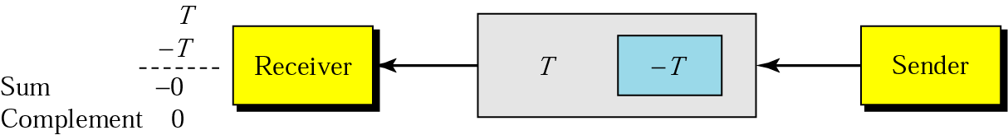
Data unit and checksum

Slide 41
Checksum checker
The receiver subdivides the data unit as above and adds all segments together and complements the result.
If the extended data unit is intact, the total value found by adding the data segments and the checksum field shud be zero.
If the result is not zero, the packet contains an error and the receiver rejects it.

Slide 42
The sender follows these steps:
The unit is divided into k sections, each of n bits
All sections are added together using one’s complement to get the sum.
The sum is complemented and becomes the checksum.
The checksum is sent with the data.

Slide 43
The receiver follows these steps
The unit is divided into k sections, each of n bits.
All sections are added together using one’s complement to get the sum.
The sum is complemented.
If the result is zero, the data are accepted. Otherwise, they are rejected.

Slide 44
Example 6
Suppose the following block of 16 bits is to be sent using a checksum of 8 bits.
10101001 00111001
The numbers are added using one’s complement
10101001
00111001
------------
Sum 11100010
Checksum 00011101
The pattern sent is 10101001 00111001 00011101

Slide 45
Example 7
Now suppose the receiver receives the pattern sent in Example 6 and there is no error.
10101001 00111001 00011101
When the receiver adds the three sections, it will get all 1s, which, after complementing, is all 0s and shows that there is no error.
10101001
00111001
00011101
------------
Sum 11111111
Complement 00000000 means that the pattern is OK.

Slide 46
Example 8
Now suppose there is a burst error of length 5 that affects 4 bits.
Original data 10101001 00111001 00011101
Corrupted data 10101111 11111001 00011101
When the receiver adds the three sections, it gets
10101111
11111001
00011101
Partial Sum 1 11000101
Carry 1
Sum 11000110
Complement 00111001 the pattern is corrupted.

Slide 47
Coding: Checksum

Slide 48
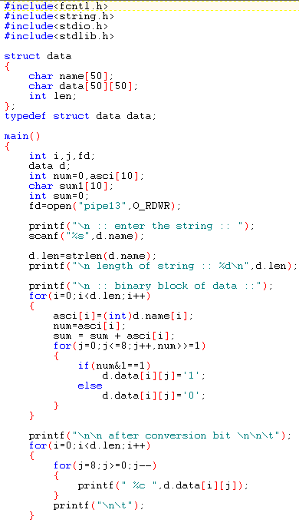
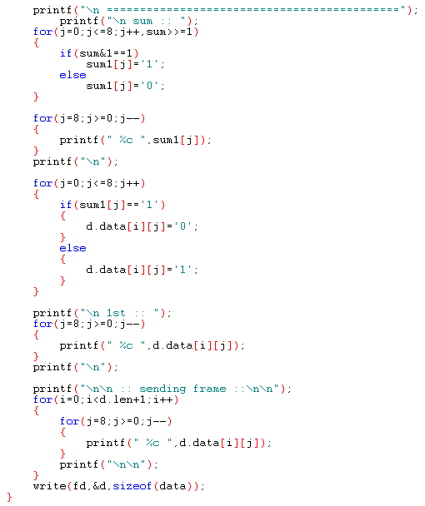
Sender Site: Main File Which define Checksum procedure Page - 1

Slide 49
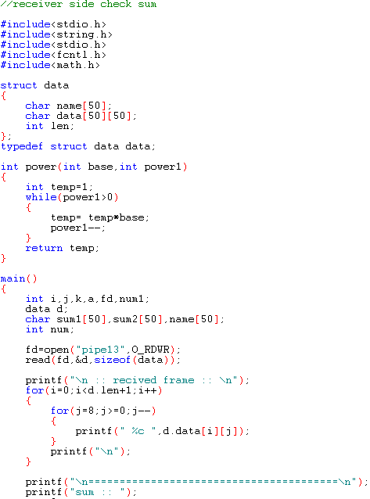
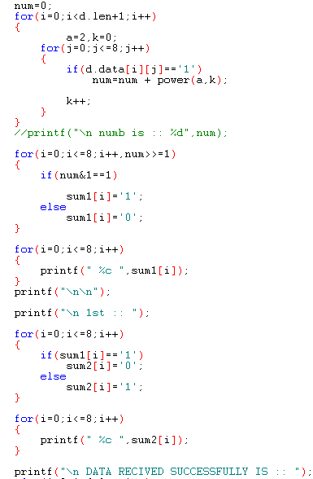
Receiver Site: Main File Which define Checksum procedure Page - 1

Slide 50
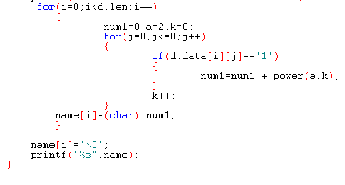
Sender Site: Main File Which define Checksum procedure Page - 3

Slide 51
Hamming Code

Slide 52
Error Correction
Hamming Code
Focus on a simple case: Single-Bit Error Correction
Use the relationship between data and redundancy bits
Developed by Richard Hamming

Slide 53
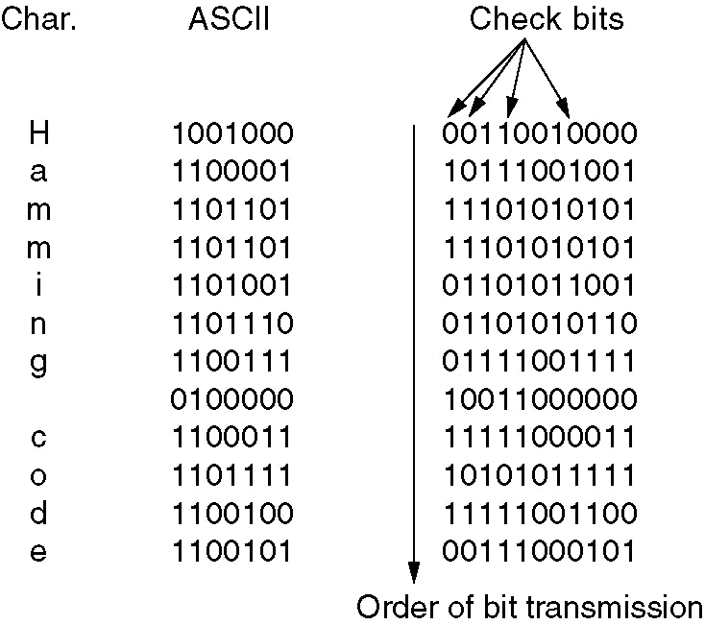
Hamming Code : Correct burst errors
Error correction (5)
  ❖ Hamming code example(4)
    Correct burst errors
      Send one column at a time

Slide 54
Coding: Hamming Code

Slide 55
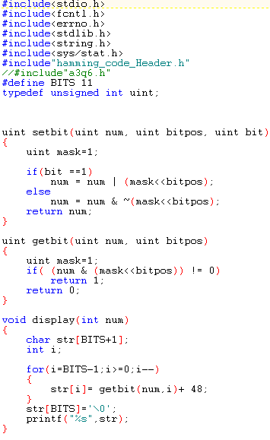
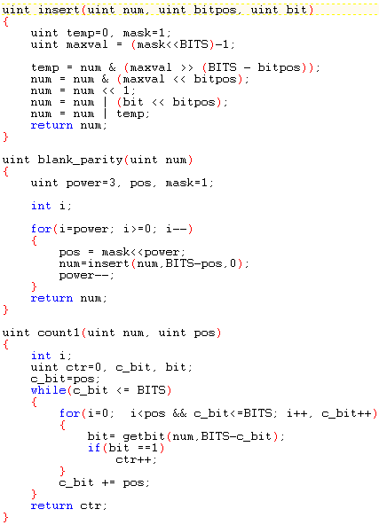
Sender Site: Main File Which define Hamming Code procedure Page - 1

Slide 56
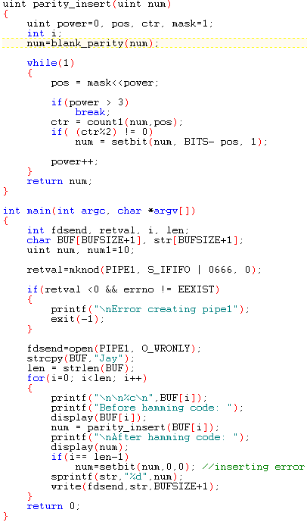
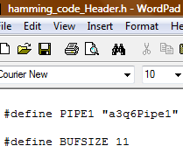
Sender Site: Main File Which define Hamming Code procedure Page - 2

Slide 57
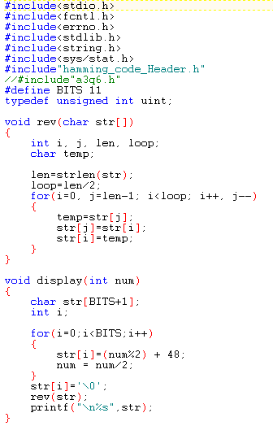
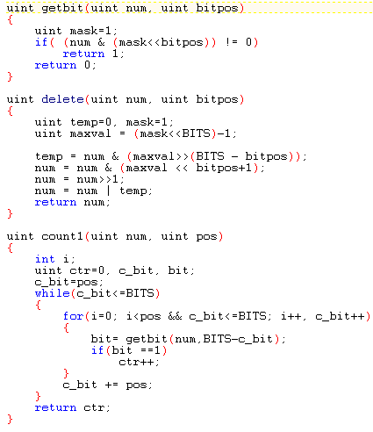
Receiver Site: Main File Which define Hamming Code procedure Page - 1

Slide 58
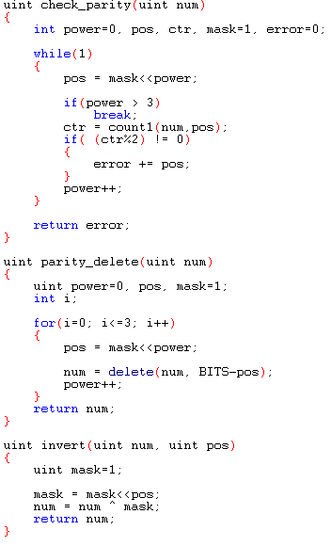
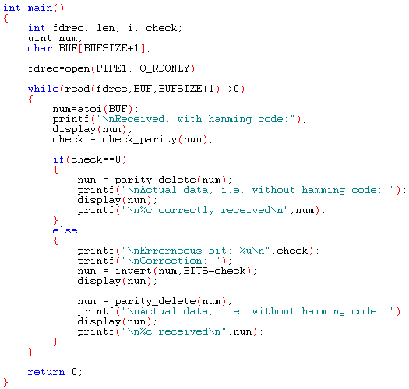
Receiver Site: Main File Which define Hamming Code procedure Page - 2

Slide 59
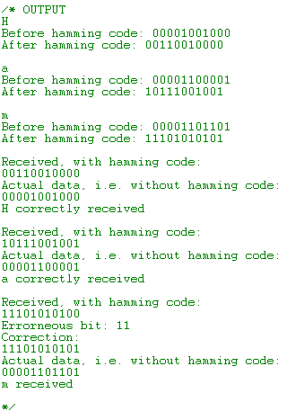
Receiver Site: Main File Which define Hamming Code procedure Page - 3

Slide 60
CRC

Slide 61
CRC
The most powerful of the redundancy checking technique.
Based on binary division.
The redundancy bits used by CRC are derived by dividing the data unit by a predetermined divisor; the remainder is the CRC.
A CRC must:
  have exactly one less bit than the divisor
  appending it to the end of the data string must make the resulting bit sequence exactly divisible by the divisor.

Slide 62
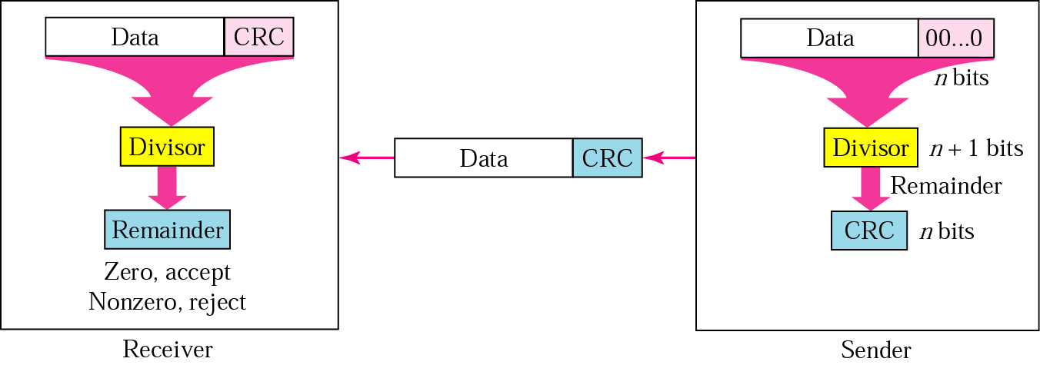
CRC generator and checker
Receive the frame.
Divide it by divisor.
Check the reminder.
Get the raw frame.
Left shift the raw frame by n bits and divide it by divisor.
The remainder is the CRC bit.
Append the CRC bit to the frame and transmit.

Slide 63

Division in CRC encoder

Slide 64
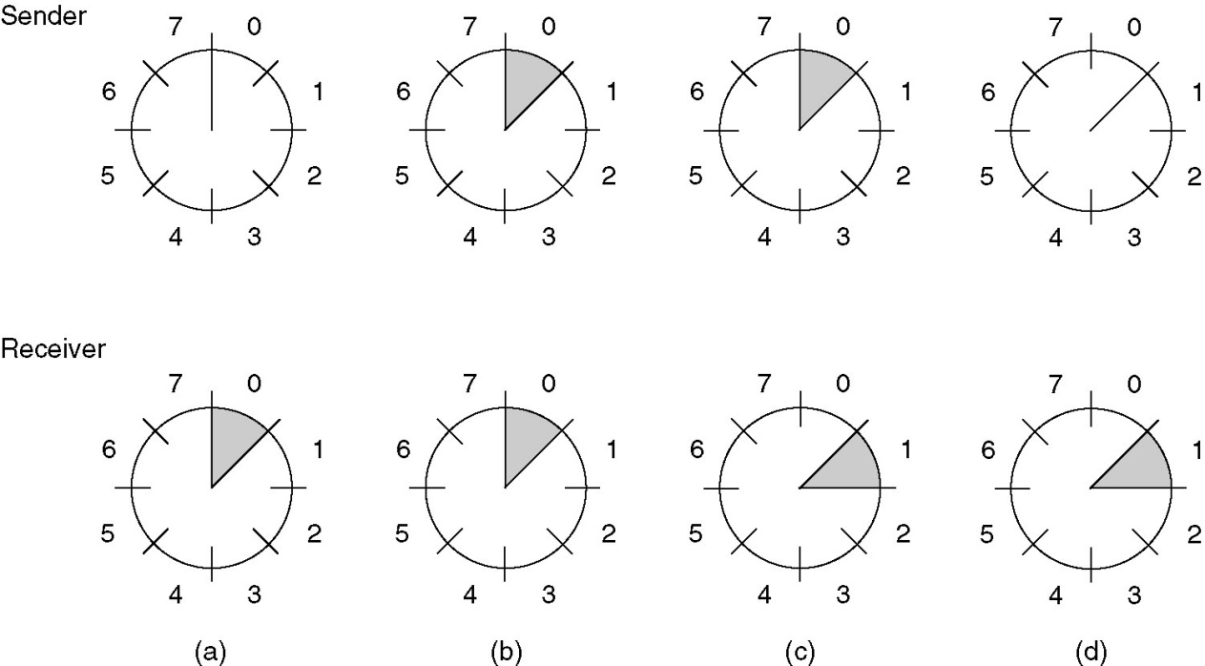
Sliding Window Protocols (2)
A sliding window of size 1, with a 3-bit sequence number.
(a) Initially.
(b) After the first frame has been sent.
(c) After the first frame has been received.
(d) After the first acknowledgement has been received.

Slide 65
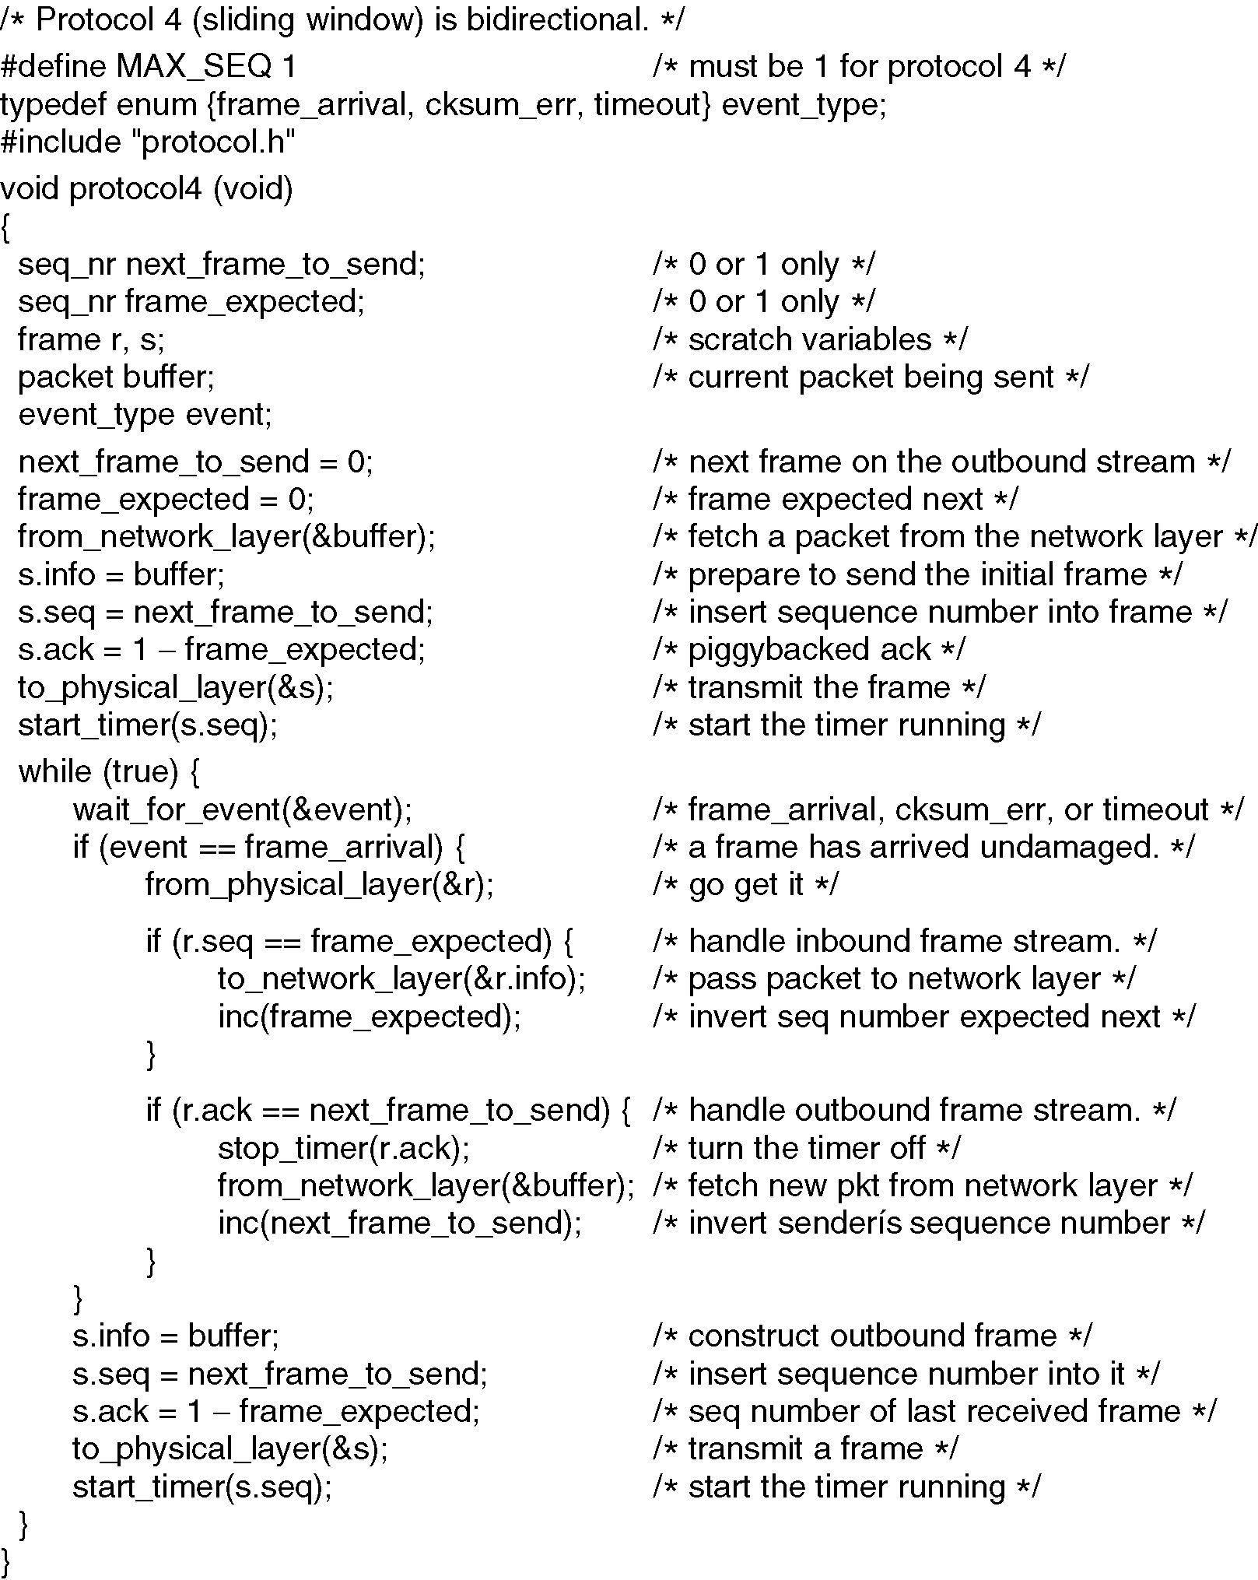
A One-Bit Sliding Window Protocol
Continued →

Slide 66
A One-Bit Sliding Window Protocol (ctd.)

Slide 67
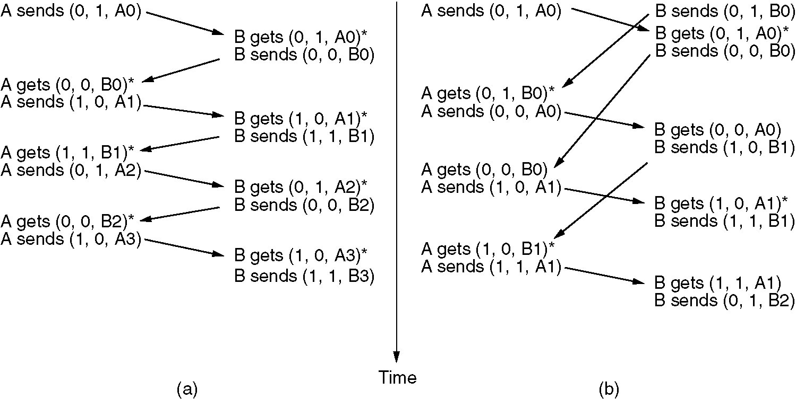
A One-Bit Sliding Window Protocol (2)
Two scenarios for protocol 4. (a) Normal case. (b) Abnormal case. The notation is (seq, ack, packet number). An asterisk indicates where a network layer accepts a packet.

Slide 68
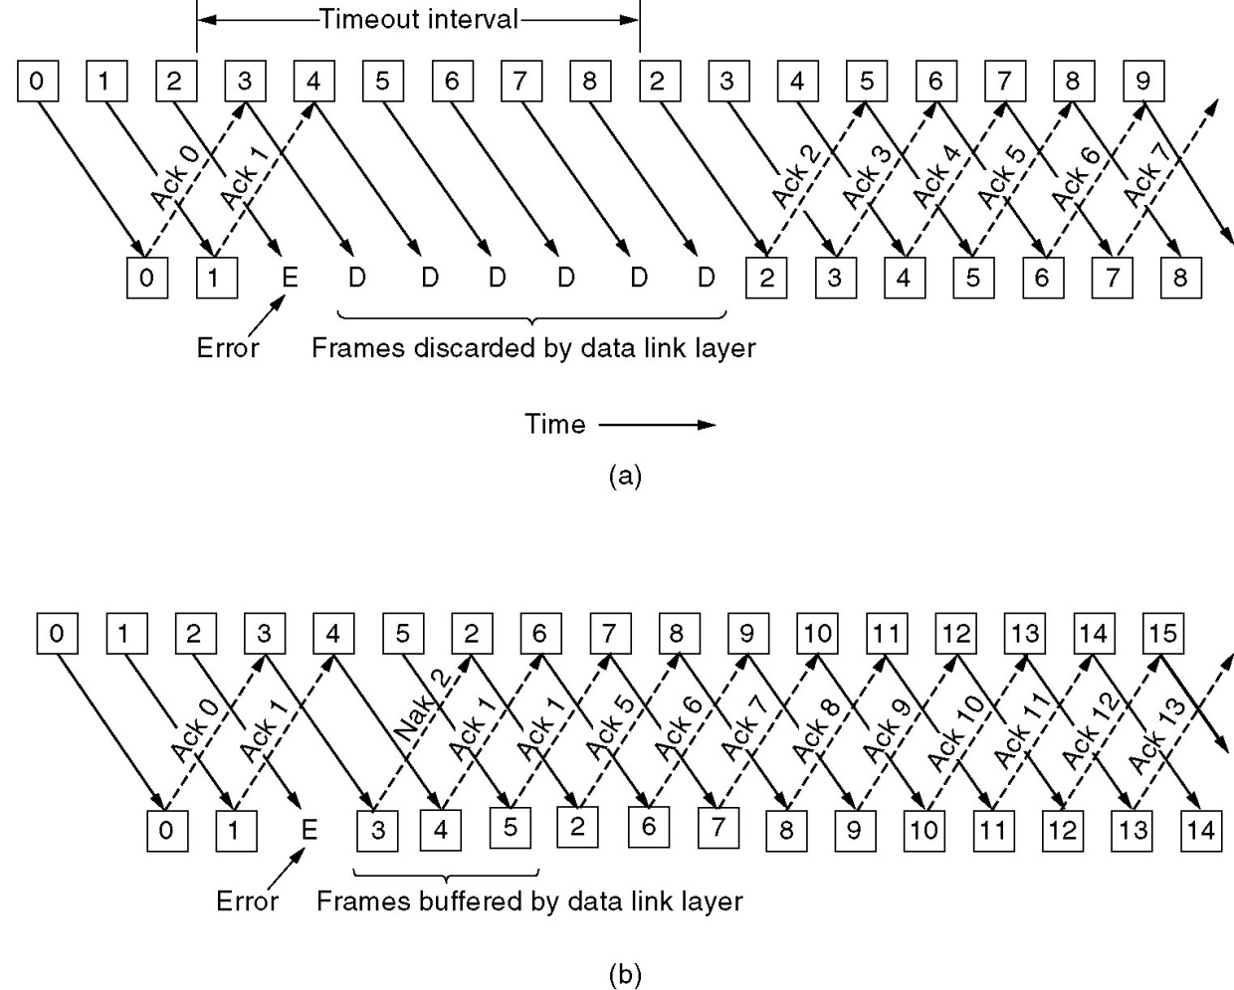
A Protocol Using Go Back N
Pipelining and error recovery. Effect on an error when
(a) Receiver’s window size is 1.
(b) Receiver’s window size is large.

