Slide 1
English title: Kubernetes cluster deployment for production environment
Polish title: Wdrażanie klastra Kubernetes w środowisku produkcyjnym
Student: Ewa Czechowska
Supervisor: Aneta Poniszewska-Marańda, DSc, PhD, MSc
Lodz University of Technology
Łódź, 25th May 2020

Slide 2
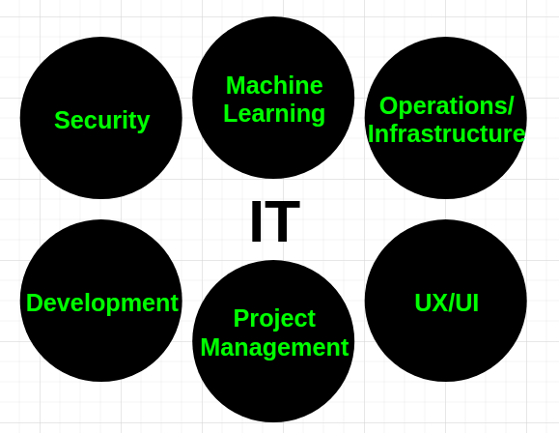
IT - classification
Source: Own work

Slide 3
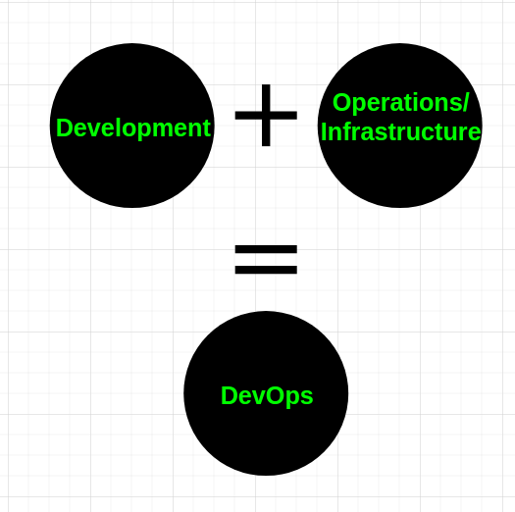
DevOps
Source: Own work

Slide 4
DevOps
“DevOps is a movement to reduce barriers (...) [between] development, operations, and other stakeholders involved in planning, building, and running software.
Although technology is the most visible (...), it’s culture, people, and processes which have the most impact on flow and effectiveness“[2]

Slide 5
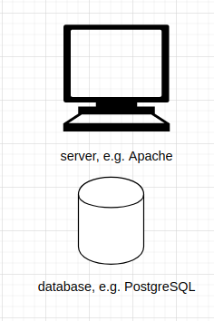
An example system to deploy
Source: Own work

Slide 6
An example system to deploy - requirements
Production environment requirements[2][3][6]
It works (verified by tests)
Central logging system
Central monitoring system (CPU, Memory usage)
Security (HTTPS, authorization, authentication)
Autoscaling
more…
Source: Own work

Slide 7
Orchestration
Deploying multiple machines, which together create an application, can be optimized through automation.
This kind of automation is referred to as orchestration[8].
Source: Own work

Slide 8
An example system to deploy - managed by Kubernetes
Kubernetes provides a reliable and scalable platform for running containerized workloads[7].
Source: Own work

Slide 9


Kubernetes (k8s)
An open-source system for automating deployment, scaling, and management of containerized applications[1]
A platform for managing application containers across multiple hosts[1]
First released in 2014[1]
Can be deployed on many clouds (AWS, GCP, Azure) or n-premises - unified experience[1]
Based on 15 years of experience of running production workloads at Google[9]
A CNCF graduated project[9]

Slide 10
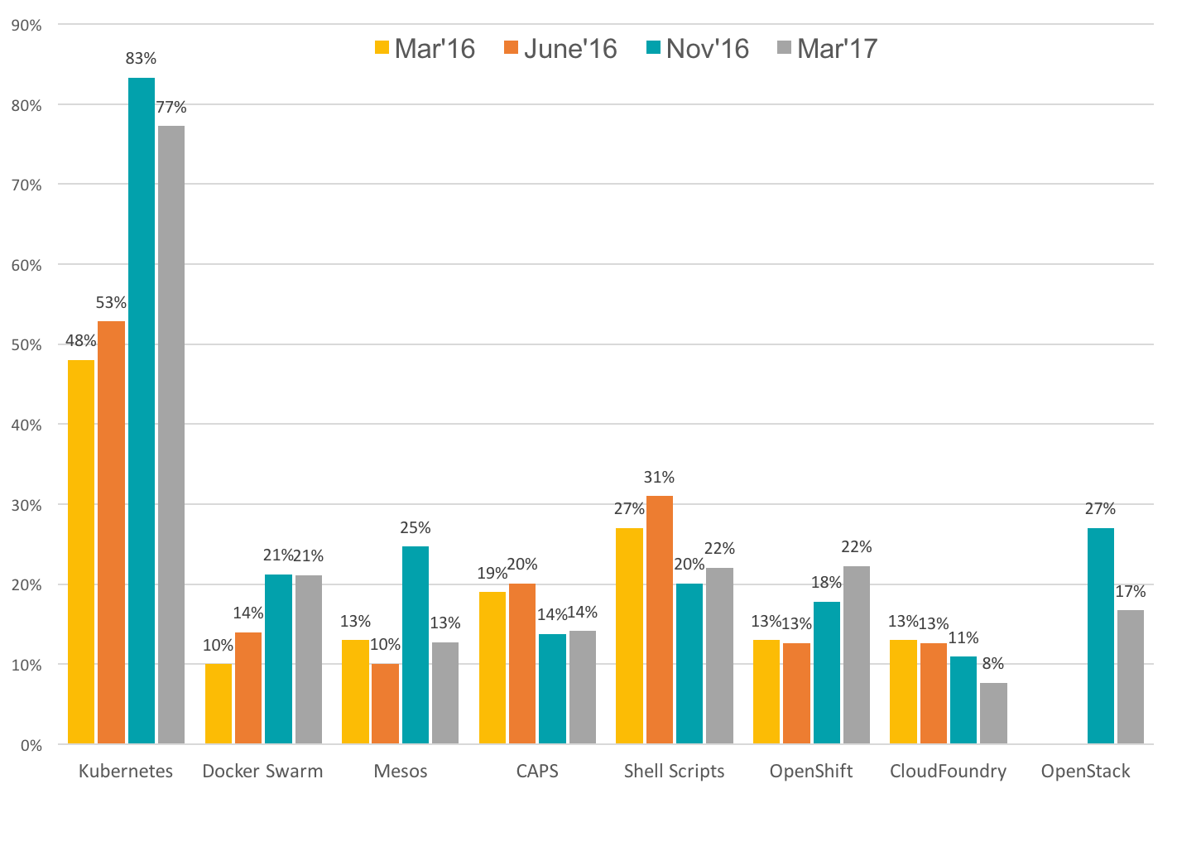
Kubernetes alternatives, based on CNCF survey 2017[17]

Slide 11
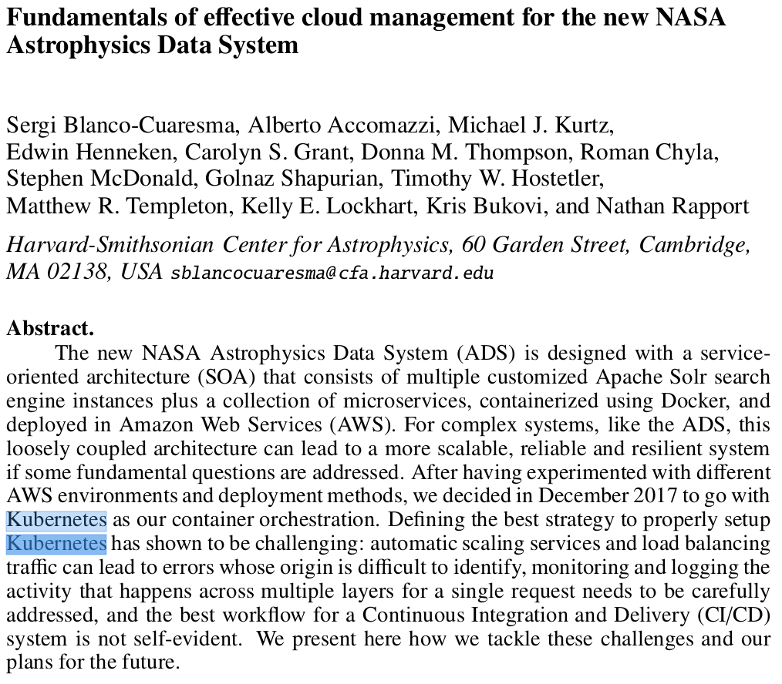
Kubernetes is used by NASA[19]

Slide 12
The problem is...
how to deploy Kubernetes.

Slide 13
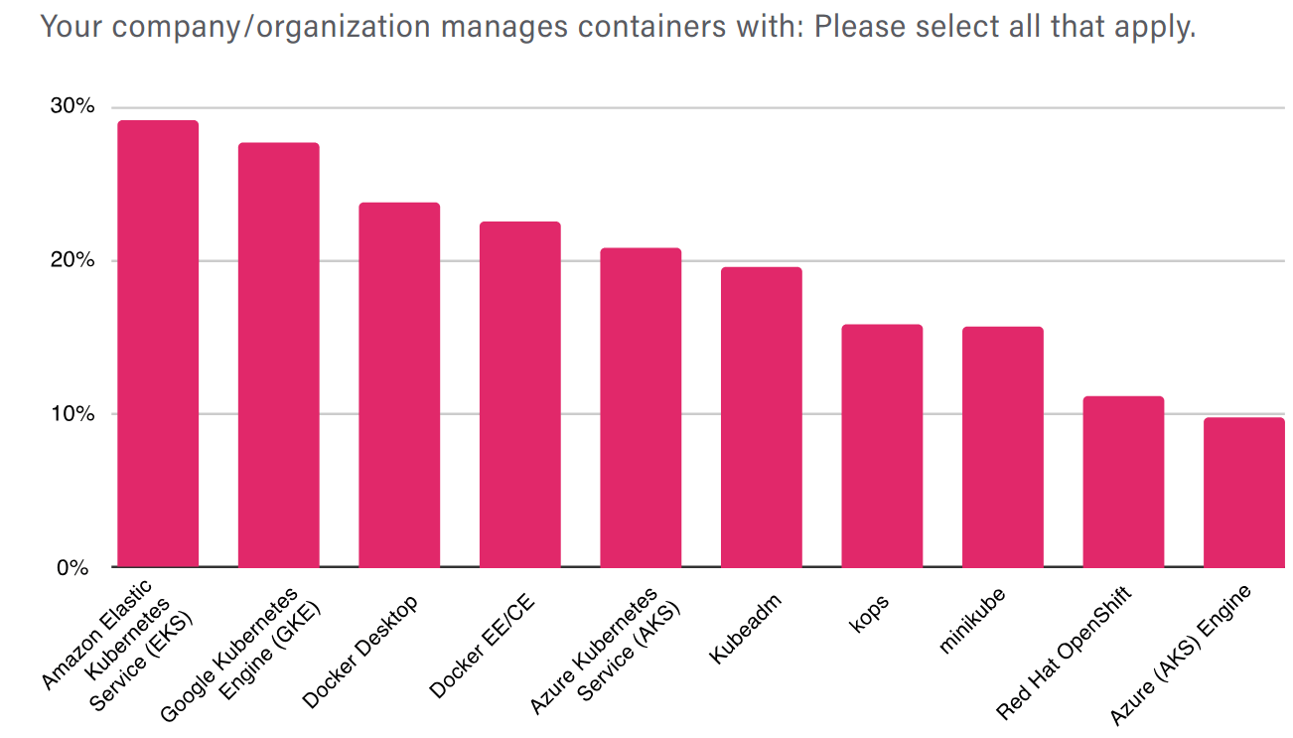
Available methods of Kubernetes cluster deployment[18]

Slide 14
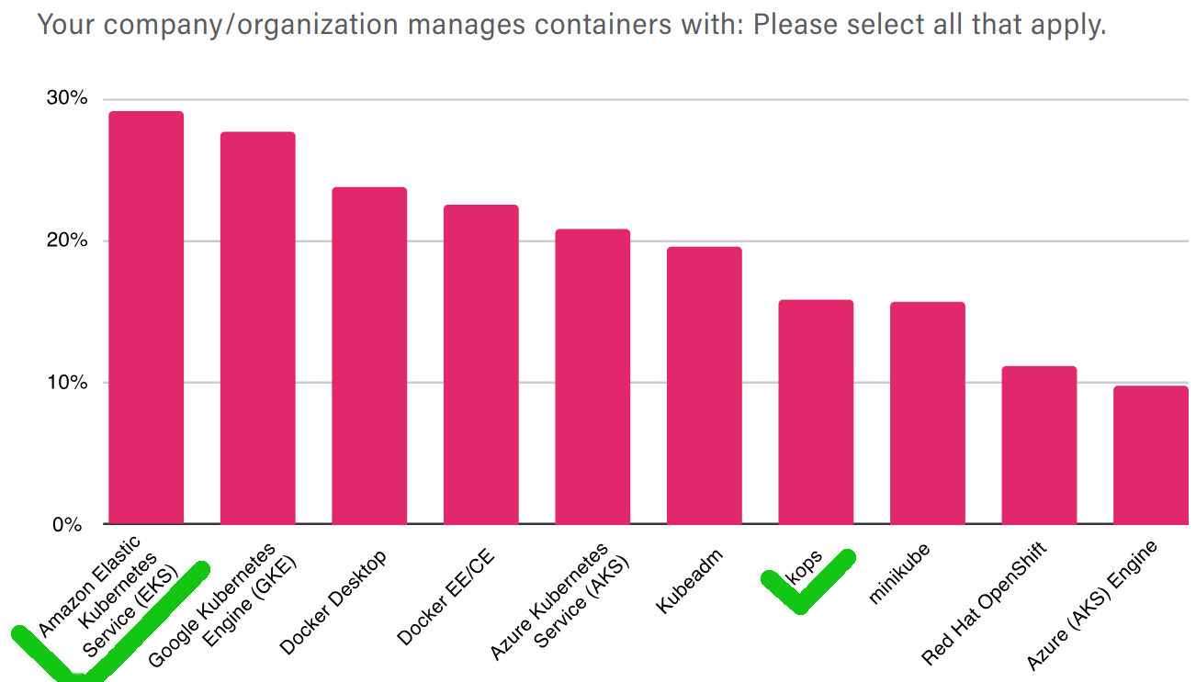
The master thesis will compare two methods

Slide 15
The aim of the thesis
to deploy a Kubernetes cluster
using two methods (comparison)
satisfying production environment requirements

Slide 16
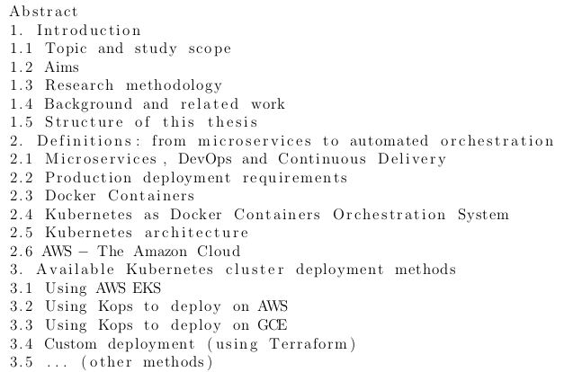
Table of Contents - part 1

Slide 17
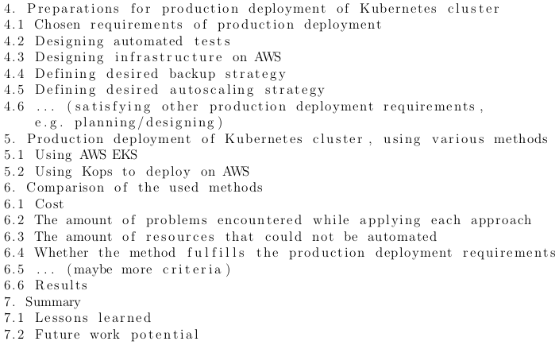
Table of Contents - part 2

Slide 18
1.1 Topic and study scope
The choice of comparing two deployment methods on AWS:
Kubernetes cluster deployment methods are described by blog posts and tutorials - not formal literature, but practitioners use them
Comparison of two deployment methods on AWS is not found in literature (however usage of Kubernetes cluster in production environment was handled)
AWS is a broadly adopted cloud with long history

Slide 19
1.1 Topic and study scope
The choice of focusing on production environment:
To facilitate others plan such deployment better by letting them be aware upfront of its limitations and known issues
To apply a practical approach
Production environment is the one creates value for businesses and customers, it generates profit
Because it is challenging and interesting to satisfy the requirements of a production environment

Slide 20
1.2 Aims and 1.3 Research Methodology
Theoretical approach:
Search of existing literature (academic and other)
Gather requirements of deployment in production environment
Describe two deployment methods of Kubernetes cluster on AWS
Practical approach:
Perform the two deployments while conforming to the DevOps best practices and Agile methodology
Compare these methods in the context of production environment
List encountered problems and try to provide solutions

Slide 21
1.4 Related work - Formal literature
Concern many clouds, practical approach, some production
environment elements:
book: Saito, Hideto. DevOps with Kubernetes: Accelerating software delivery with container orchestrators. Packt Publishing, 2017. ISBN-13: 978-1788396646.
book: Morris, Kief. Infrastructure as Code. Edition 1. O’Reilly Media, 2016. ISBN-13: 978-1491924358.
book: Sayfan, Gigi, et. al. Mastering Kubernetes. Edition: 2. Packt Publishing, 2018. ISBN-13: 978-1788999786.
book: Burns, Brendan, et. al. Kubernetes: Up and Running: Dive into the Future of Infrastructure. Edition: 2. O’Reilly Media, 2019. ISBN-13: 978-1492046530. - many clouds, practical approach, no production environment elements

Slide 22
1.4 Related work - Formal literature cont.
book: Arundel, John, et. al. Cloud Native DevOps with Kubernetes: Building, Deploying, and Scaling Modern Applications in the Cloud. Edition: 1. O’Reilly Media, 2019. ISBN-13: 978-1492040767. - many clouds, theoretical approach
book: Source: Uphill, Thomas, et. al. DevOps: Puppet, Docker and Kubernetes. Packt Publishing, 2017. ISBN 978-1788297615. - AWS, practical approach
papers acknowledge using Kubernetes, but do not explain details of its deployment

Slide 23
1.4 Related work - Informal literature
Many clouds compared, only theoretical approach:
Platform9. Kubernetes Cloud Services: Comparing GKE, EKS and AKS. [online]. 06.01.2020 [access: 20.04.2020]. Available in the Internet at: https://platform9.com/blog/kubernetes-cloud-services-comparing-gke-eks-and-aks/
Klein, Evan. Kubernetes as a Service: GKE vs. AKS vs. EKS. [online]. 11.06.2019 [access: 20.04.2020]. Available in the Internet at: https://logz.io/blog/kubernetes-as-a-service-gke-aks-eks/
Vasi, Ioana. The State of Kubernetes Cloud Providers in 2019. [online]. 29.05.2019 [access: 20.04.2020]. Available in the Internet at: https://www.presslabs.com/blog/kubernetes-cloud-providers-2019/
Practical approach, one method described:
Weaveworks. eksctl - The official CLI for Amazon EKS. [online]. 2020 [access: 20.04.2020]. Available in the Internet at: https://eksctl.io/
Gruntwork. How to deploy a production-grade Kubernetes cluster on AWS. [online]. 2020 [access: 20.04.2020]. Available in the Internet at: https://gruntwork.io/guides/kubernetes/how-to-deploy-production-grade-kubernetes-cluster-aws
Hightower, Kelsey. Kubernetes The Hard Way. [online]. 15.09.2019 [access: 20.04.2020]. Available in the Internet at: https://github.com/kelseyhightower/kubernetes-the-hard-way
Berman, Daniel. Deploying a Kubernetes Cluster with Amazon EKS. [online]. 17.02.2020 [access: 20.04.2020]. Available in the Internet at: https://logz.io/blog/amazon-eks-cluster/

Slide 24
1.5 Structure of this thesis
The 1st chapter serves as introduction and presents study topic, scope, aims, research methodology and related work
The chapters: 2. and 3. are theoretical
Chapter 2. focuses on definitions
Chapter 3. presents available k8s cluster deployment methods
The chapters: 4., 5. and 6. are practical
Chapter 4. focuses on preparations before producing any code
Chapter 5. summarizes the deployment methods performed for this study by the author
Chapter 6. compares the deployment methods
Chapter 7. provides a summary and future potential

Slide 25
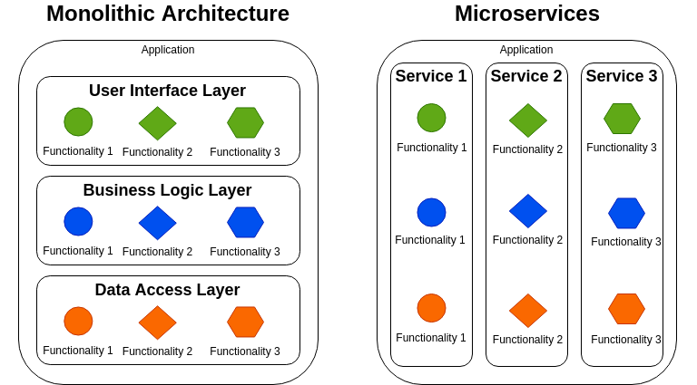
2.1 Microservices
Microservices = A new architecture for applications which
evolved as a solution to monolith’s problems.
Source: Own work, based on a blog post[21]

Slide 26
2.2 Production deployment requirements[2][3][6]
A healthy service/cluster
Automation
Security
High Availability, failover, fault-tolerance
Backup and restore, Disaster Recovery
Centralized Monitoring
Centralized Logging
Centralized Audit
The k8s cluster must be healthy
Autoscaling

Slide 27
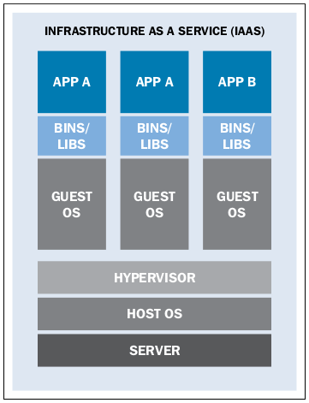
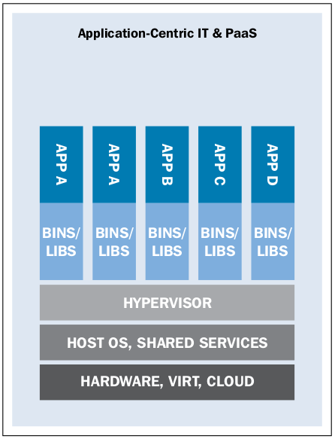
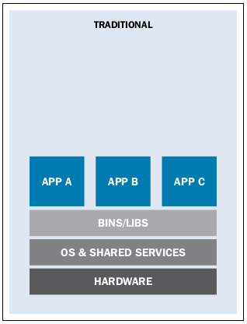
2.3 Docker containers[5]
Applications were installed on physical hardware directly
Virtualization was invented. Virtual Machines (VMs) have separate OS and provide a safer environment
In 2013 Docker was created as a standard way to manage containers.

Slide 28
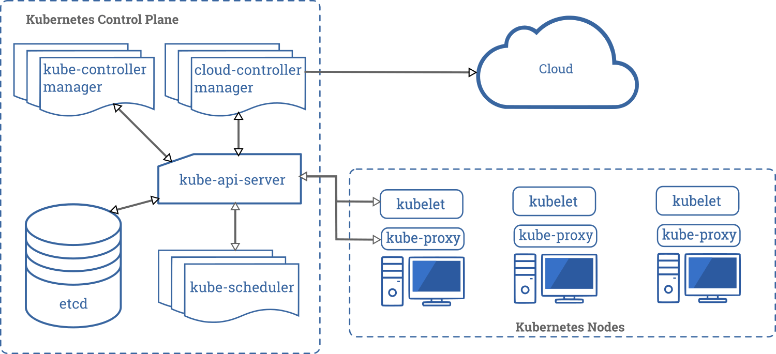
2.5 Kubernetes architecture[21]

Slide 29
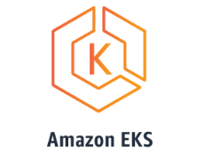
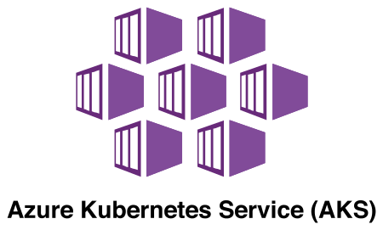
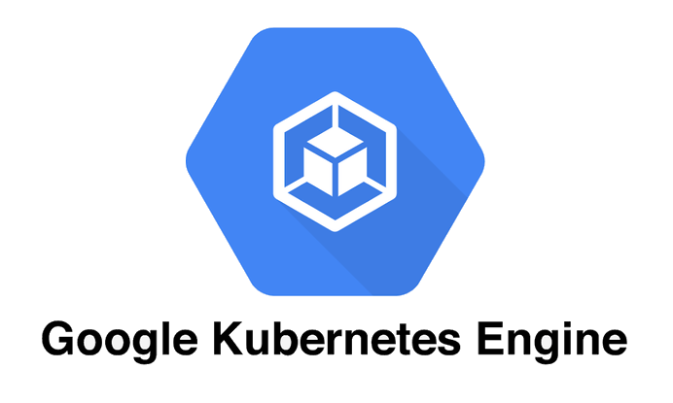
3. k8s cluster deployment methods - Managed k8s

Slide 30
3. k8s cluster deployment methods - custom solutions

Slide 31
4.1 Chosen requirements of production deployment
The k8s cluster must be healthy
Automation, Continuous Integration, Continuous Development, Infrastructure as Code
Security
Centralized Monitoring
Centralized Logging

Slide 32
4.2 Verifying that k8s cluster is healthy
Check health status of all k8s services
Use a status dashboard
Check it every 1 minute
Deploy a small app on k8s to test that k8s is usable
Run these tests also in a CICD pipeline

Slide 33
4.3 Satisfying the Automation requirement
A CICD pipeline
Design 2 environments: testing and production

Slide 34
4.4 Satisfying the Security requirement
Encryption in transit: HTTPS
Use a static linter e.g. to check for hardcoded passwords or
ssh keys
RBAC, IAM - identity and access management on k8s AWS

Slide 35
4.5 Satisfying the Centralized Monitoring requirement
Use a server like Nagios, Grafana, InfluxDB, Prometheus, etc.
Use some AWS service e.g. CloudWatch

Slide 36
4.6 Satisfying the Centralized Logging requirement
Use a server like Graylog, Fluentd, LogStash
Use some AWS service e.g. CloudWatch

Slide 37
5.1 Production deployment - using method: AWS EKS
Link to code
Main steps summarized
Overall how it went
Some problems + solutions

Slide 38
5.2 Production deployment - using method: AWS with
Kops
Link to code
Main steps summarized
Overall how it went
Some problems + solutions

Slide 39
6.1 Criterium 1: Cost

Slide 40
6.2 Criterium 2: The amount of problems

Slide 41
6.3 Criterium 3: The amount of not automated resources

Slide 42
6.4 - Criterium 4: Production deployment requirements
met?

Slide 43
6.5 Comparison summary
 | AWS EKS | AWS Kops
Cost
Problems count
Not automated resources count
Production requirements met

Slide 44
7.1 Lessons learned and achieved results
Choose which method was better, applying specified criteria
Maybe some more preparations were needed - more planning, design

Slide 45
7.2 Future work potential
Compare more methods of deployment
Use more comparison criteria
Use more production requirements, e.g. automated upgrades
Apply more load and run load and performance tests
Instead of satisfying production requirements, test enterprise and big data deployments requirements - create a survey to get lessons learned based on long running clusters and their administration
Test available Kubernetes tools like Velero for backup

Slide 46
8. Literature
Saito, Hideto. DevOps with Kubernetes: Accelerating software delivery with container orchestrators. Packt Publishing, 2017. ISBN-13: 978-1788396646.
Morris, Kief. Infrastructure as Code. Edition 1. O’Reilly Media, 2016. ISBN-13: 978-1491924358.
Sayfan, Gigi, et. al. Mastering Kubernetes. Edition: 2. Packt Publishing, 2018. ISBN-13: 978-1788999786.
Burns, Brendan, et. al. Kubernetes: Up and Running: Dive into the Future of Infrastructure. Edition: 2. O’Reilly Media, 2019. ISBN-13: 978-1492046530.
Uphill, Thomas, et. al. DevOps: Puppet, Docker and Kubernetes. Packt Publishing, 2017. ISBN 978-1788297615.
Humble, Jez, et. al. Continuous Delivery: Reliable Software Releases through Build, Test, and Deployment Automation. Edition 1. Addison-Wesley Professional, 2010. ISBN: 978-0321601919.
Arundel, John, et. al. Cloud Native DevOps with Kubernetes: Building, Deploying, and Scaling Modern Applications in the Cloud. Edition 1. O’Reilly Media, 2019. ISBN: 978-1492040767.
Diouf, Gor, et. al. On Byzantine Fault Tolerance in Multi-Master Kubernertes Clusters. ArXiv abs/1904.06206. 2019.
Kubernetes Community. Kubernetes Documentation. [online]. 06.03.2020 [access: 20.04.2020]. Available in the Internet at: https://kubernetes.io/.

Slide 47
8. Literature
Platform9. Kubernetes Cloud Services: Comparing GKE, EKS and AKS. [online]. 06.01.2020 [access: 20.04.2020]. Available in the Internet at: https://platform9.com/blog/kubernetes-cloud-services-comparing-gke-eks-and-aks/.
Klein, Evan. Kubernetes as a Service: GKE vs. AKS vs. EKS. [online]. 11.06.2019 [access: 20.04.2020]. Available in the Internet at: https://logz.io/blog/kubernetes-as-a-service-gke-aks-eks/.
Vasi, Ioana. The State of Kubernetes Cloud Providers in 2019. [online]. 29.05.2019 [access: 20.04.2020]. Available in the Internet at: https://www.presslabs.com/blog/kubernetes-cloud-providers-2019.
Weaveworks. eksctl - The official CLI for Amazon EKS. [online]. 2020 [access: 20.04.2020]. Available in the Internet at: https://eksctl.io/.
Gruntwork. How to deploy a production-grade Kubernetes cluster on AWS. [online]. 2020 [access: 20.04.2020]. Available in the Internet at: https://gruntwork.io/guides/kubernetes/how-to-deploy-production-grade-kubernetes-cluster-aws.
Hightower, Kelsey. Kubernetes The Hard Way. [online]. 15.09.2019 [access: 20.04.2020]. Available in the Internet at: https://github.com/kelseyhightower/kubernetes-the-hard-way.
Berman, Daniel. Deploying a Kubernetes Cluster with Amazon EKS. [online]. 17.02.2020 [access: 20.04.2020]. Available in the Internet at: https://logz.io/blog/amazon-eks-cluster/.
CNCF. CNCF Survey [online]. 2017. [access 20.04.2020]. Available in the Internet at: https://www.cncf.io/blog/2017/06/28/survey-shows-kubernetes-leading-orchestration-platform/.
CNCF. CNCF Survey [online]. 2019. [access 20.04.2020]. Available in the Internet at: https://www.cncf.io/blog/2020/03/04/2019-cncf-survey-results-are-here-deployments-are-growing-in-size-and-speed-as-cloud-native-adoption-becomes-mainstream.
Blanco-Cuaresma, Sergi, et. al. Fundamentals of effective cloud management for the new NASA Astrophysics Data System. ArXiv. Cambridge, 2019.
Simon, John. A Transition From Monolith to Microservices. [online]. 22.05.2018 [access: 15.05.2020]. Available in the Internet at: https://dzone.com/articles/a-transition-from-monolith-to-microservices.
Source: Kubernetes. Cloud Controller Manager. [online]. 18.03.2020 [access: 20.06.2020]. Available in the Internet at: https://kubernetes.io/docs/concepts/architecture/cloud-controller/

