Slide 1

_aux

Slide 2

More details about timers

Slide 3
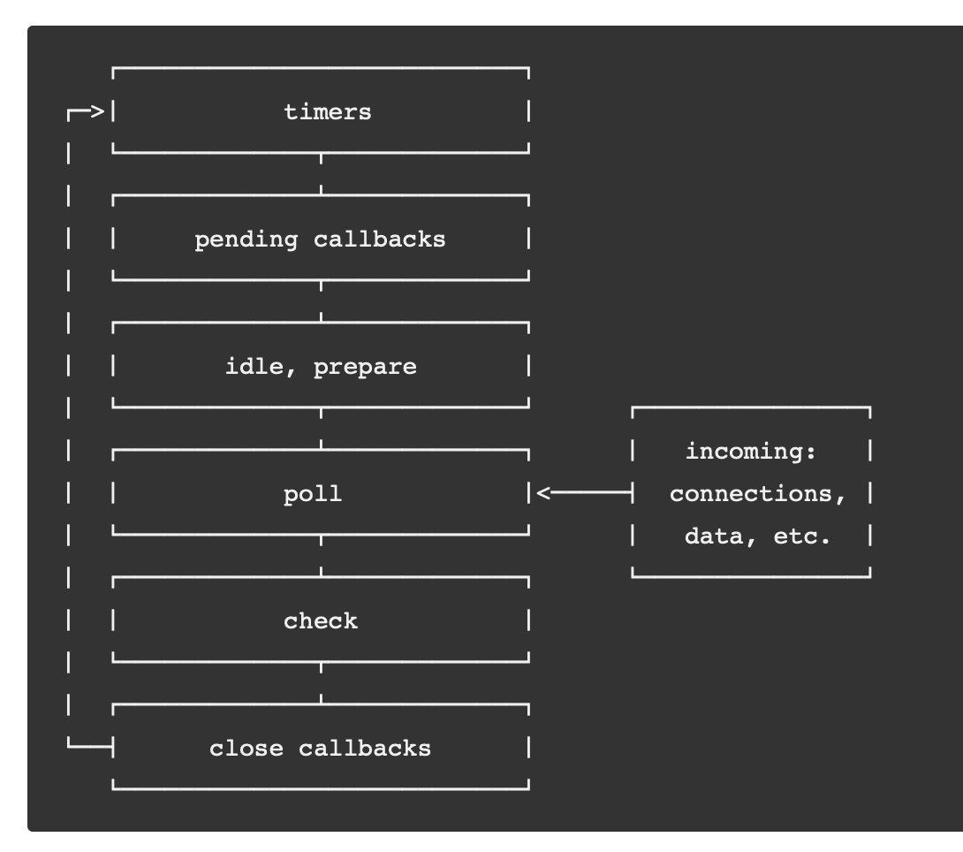
How node.js event loop works in general
Each phase has a FIFO queue of callbacks to execute. While each phase is special in its own way, generally,
when the event loop enters a given phase, it will perform any operations specific to that phase,
then execute callbacks in that phase's queue until the queue has been exhausted or the maximum number of callbacks has executed.
When the queue has been exhausted or the callback limit is reached, the event loop will move to the next phase, and so on.

Slide 4
process.nextTick
timers: this phase executes callbacks scheduled by setTimeout() and setInterval().
setImmediate() is designed to execute a script once the current poll phase completes
check: setImmediate() callbacks are invoked here.
process.nextTick() is not technically part of the event loop. Instead, the nextTickQueue will be processed after the current operation on stack completes, regardless of the current phase of the event loop.

Slide 5
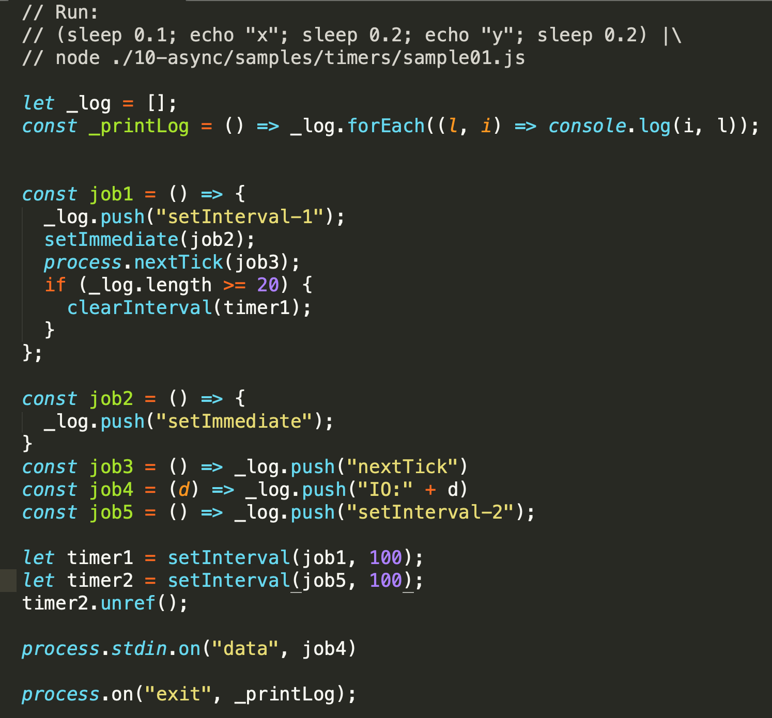
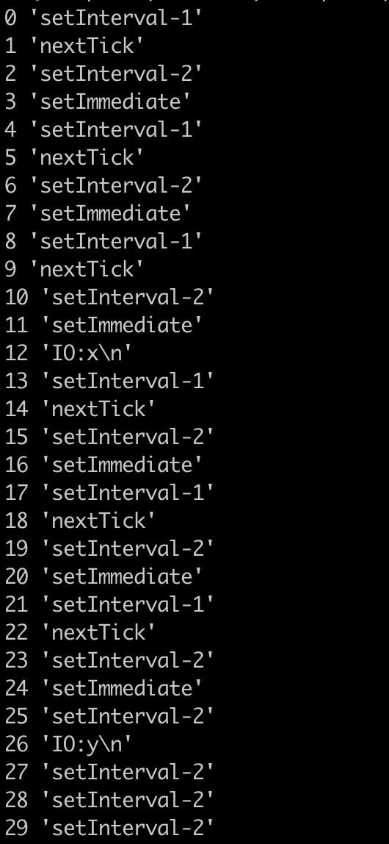
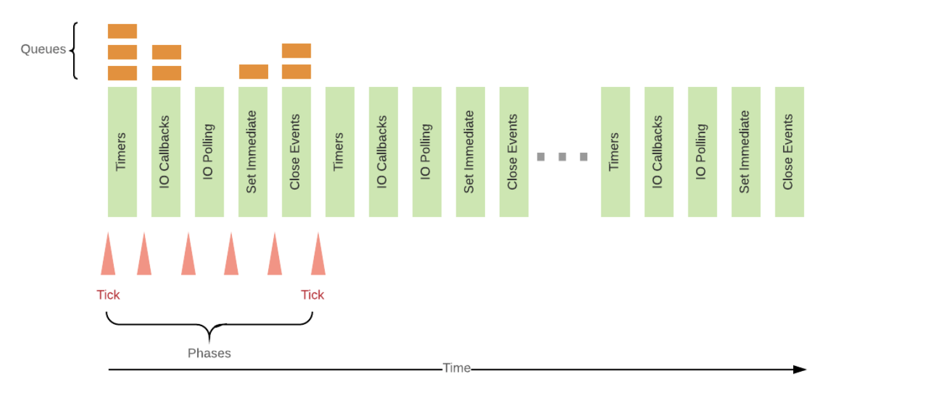
Event loop and order

Slide 6
setTimeout timers in browsers vs. node
it's important to note that setTimeout(..) doesn't put your callback on the event loop queue. What it does is set up a timer; when the timer expires, the environment places your callback into the event loop, such that some future tick will pick it up and execute it.
https://github.com/getify/You-Dont-Know-JS/blob/master/async%20%26%20performance/ch1.md
tak ako to je v node su sucastou event loopu IMHO....

Slide 7
ES6 now specifies how the event loop works
ES6 now specifies how the event loop works, which means technically it's within the purview of the JS engine, rather than just the hosting environment. One main reason for this change is the introduction of ES6 Promises, which we'll discuss in Chapter 3, because they require the ability to have direct, fine-grained control over scheduling operations on the event loop queue (see the discussion of setTimeout(..0) in the "Cooperation" section).

Slide 8
Synchronous and Asynchronous iteration

Slide 9
Asynchronous iteration
ES 2015 - synchronous iterations
ES 2017 - async functions
ES 2018 – async iterations

Slide 10
Iteration
Processing each of the items in a collection is a very common operation.
JavaScript provides a number of ways of iterating over a collection,
simple for loops
map() and filter()
...
Iterators and Generators bring the concept of iteration directly into the core language and provide a mechanism for customizing the behavior of for...of loops.

Slide 11
npm co
Generator based control flow goodness for nodejs and the browser,
using promises, letting you write non-blocking code in a nice-ish way.
v4

Slide 12
setTimeout timers in browsers vs. node
it's important to note that setTimeout(..) doesn't put your callback on the event loop queue. What it does is set up a timer; when the timer expires, the environment places your callback into the event loop, such that some future tick will pick it up and execute it.
https://github.com/getify/You-Dont-Know-JS/blob/master/async%20%26%20performance/ch1.md

Slide 13
ES6 now specifies how the event loop works
ES6 now specifies how the event loop works, which means technically it's within the purview of the JS engine, rather than just the hosting environment. One main reason for this change is the introduction of ES6 Promises, which we'll discuss in Chapter 3, because they require the ability to have direct, fine-grained control over scheduling operations on the event loop queue (see the discussion of setTimeout(..0) in the "Cooperation" section).

Slide 14
Starving the event loop with microtasks
https://gist.github.com/jesstelford/bbb30b983bddaa6e5fef2eb867d37678

Slide 15
Links
http://exploringjs.com/es2018-es2019/ch_asynchronous-iteration.html
https://jakearchibald.com/2017/async-iterators-and-generators/
https://medium.com/javascript-scene/the-hidden-power-of-es6-generators-observable-async-flow-control-cfa4c7f31435
https://medium.com/@deaniusaur/how-to-stream-json-data-over-rest-with-observables-80e0571821d3
https://medium.com/@fknussel/a-simple-observable-implementation-c9c809c89c69
https://rxjs-dev.firebaseapp.com/guide/observable

