Slide 1
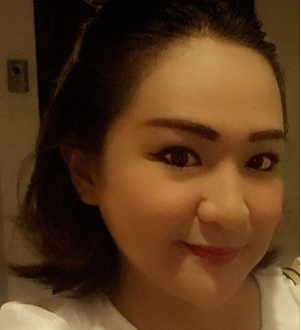
STELLA SETH PANGILINAN
Hand Phone 09260997810
Diploma in Business Administration
Major in Marketing, Advertising and Public relations
Kolej IBMS - Jalan Bukit Mata, Kuching, Sarawak
Malaysia - 2003
BS Computer Science - Graduate 2001
AMA Dasmarinas, Cavite
Human Resource/Public Relations Manager
March 2015- February 2018
Bui Gia Astec
Hanoi, Vietnam
Monday to Saturday 2 PM - 9 PM Sunday- On call
Language Specialist- English/Science Teacher
2009-2018
Doan Thi Diem Private School Hanoi Vietnam
2012-2018 Full Time with Flexible schedule (8-12) Monday- Saturday
Hello International School- Ho Chi Minh, Vietnam
2009-2011 - Full Time

