Slide 1

Real Time Fire Detection Using CNN
Capstone Project
Presented by: Wenping Wang
Professor: Macros Bittencourt
GitHub Link: https://github.com/xmjcc/capstone

Slide 2
Business Purpose
Traditional smoke and heat detection method can not detect fire at early stage.
Traditional fire detection not suitable for large space, complex building etc.
Take long time to deployment and higher cost.
AI camera can detect fire at early stage.
AI camera can deploy quickly and at lower cost.
AI detection model can be trained to suit complex places.

Slide 3
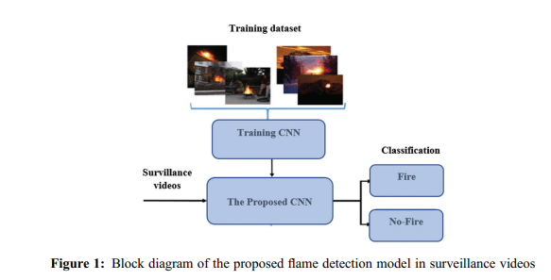
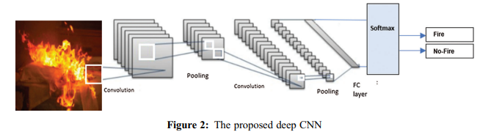
Solution Architecture

Slide 4
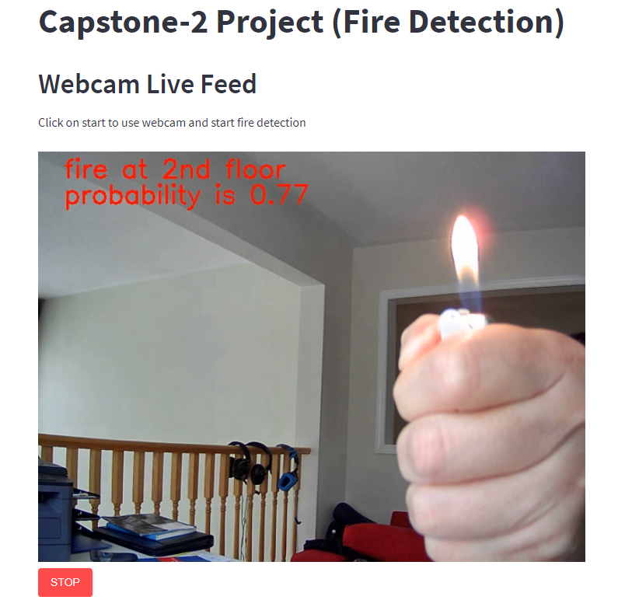
Main feature
Detect fire at real time.
Detect fire from uploaded picture.
Alarm the fire and display at the interface.
System will display normal when there is no fire
System can display the location of fire when fire is detected.
Capable of selection input of video cameras.
Run on client and server mode.
Can be accessed from many browsers simultaneously.

Slide 5
Challenges
No experience at developing the app at all.
Not able to deploy the model to Heroku due to the app and the dependency size hit the Heroku limit of 500 mega byte (need a paid account to do this), might fix the problem if there were more member in the team.
Very time consuming on trouble-shooting errors during coding and debug period, can take week to fix one small issue, but I learn a lot from the trouble-shooting.

Slide 6
Improvement on future of the application
Deploy the app to the internet.
Log the history of the alarms.
. Enable more cameras to detect fire simultaneously.
. More data to train the model to improve the accuracy.

Slide 7
Demo
http://localhost:8501/
https://firedetectionapp.herokuapp.com/ (need upgraded Heroku account)

Slide 8
References:
https://file.techscience.com/ueditor/files/iasc/TSP_IASC-31-3/TSP_IASC_20629/TSP_IASC_20629.pdfLog the history of the alarms.
https://towardsdatascience.com/early-fire-detection-system-using-deep-learning-and-opencv-6cb60260d54a

Slide 9
Thank you!

