Slide 1
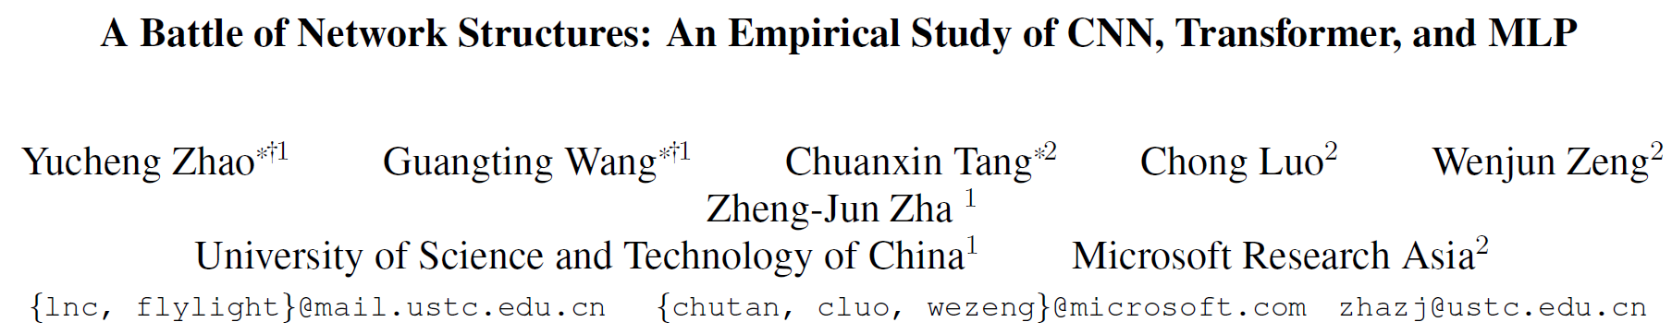
Jeonbuk National University, Korea
Multimedia Lab Under Prof. Park and Prof. Yoon
Reporter: Mingle Xu
2021 Sep 24

Slide 2
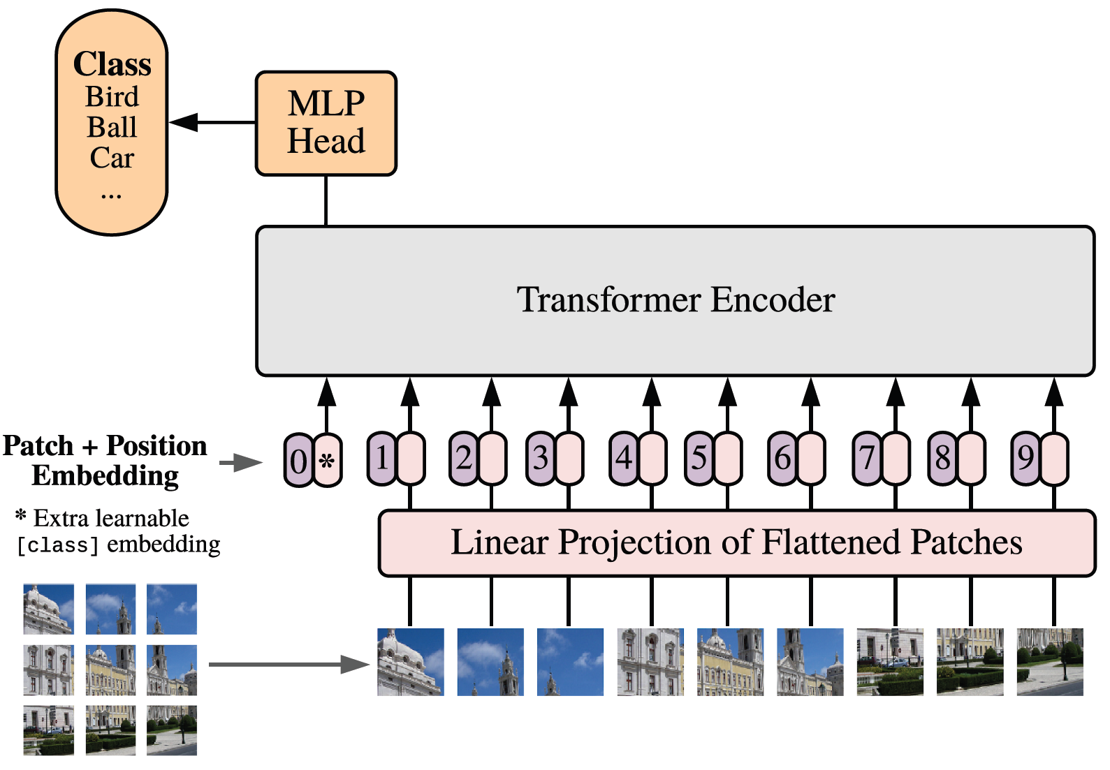
What did we can get from the ViT?
Transformers achieves the competent results in ImageNet with the CNNs.
The time of self-supervision in computer vision is coming with the advent of the transformers: masked patch prediction, 2% improvement than training from scratch.

Slide 3
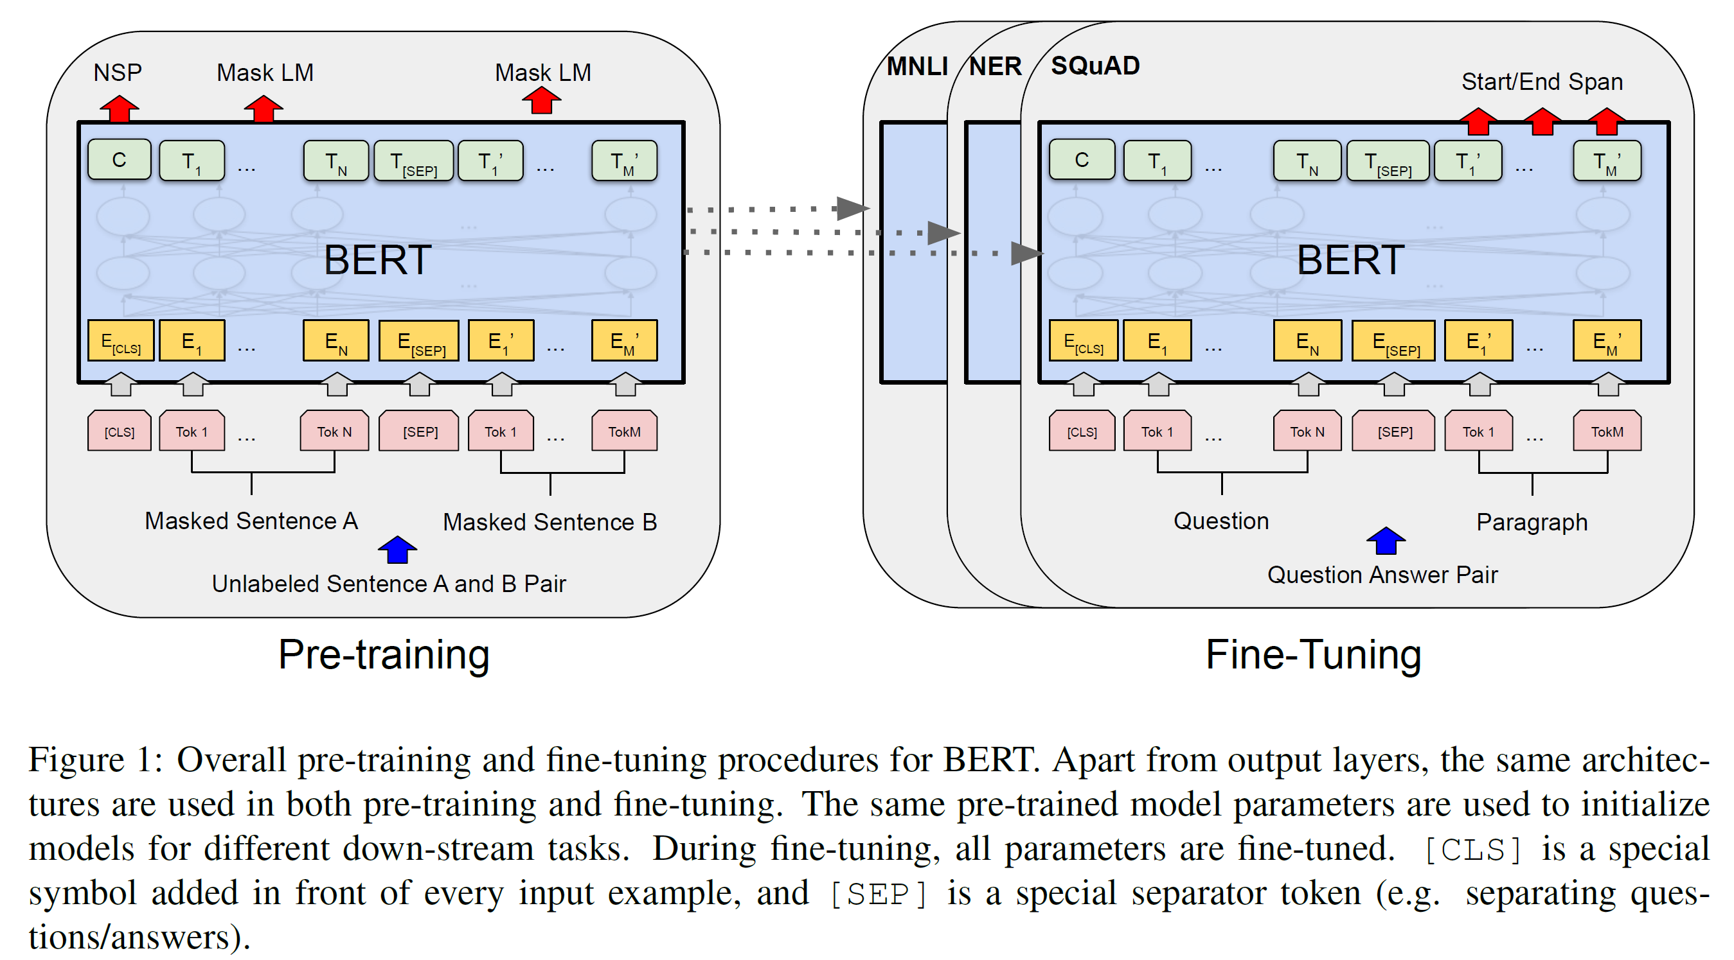
Transformers in NLP
Transformers give enough model capacity to do self-supervised.
Learn a general representation space.

Slide 4
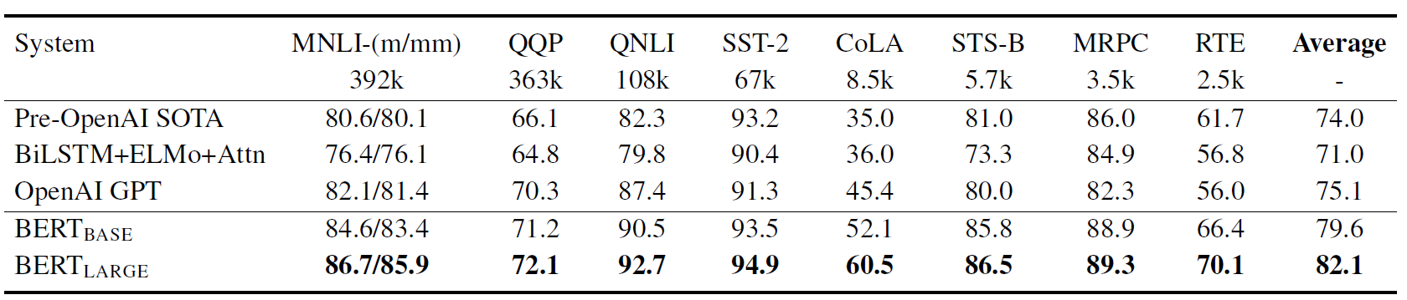

Slide 5
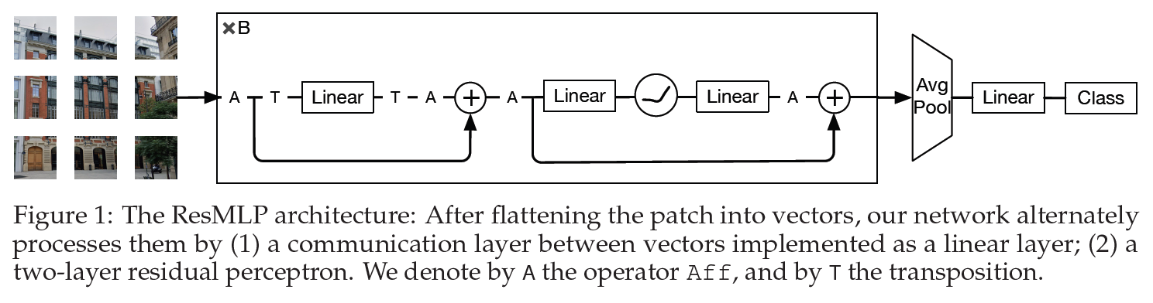
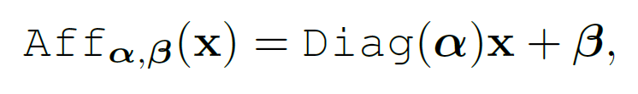
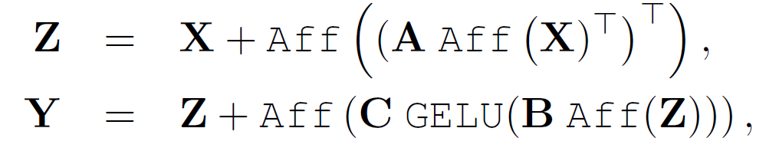
MLP: can we remove the attention?
2021 ResMLP: Feedforward networks for image classification with data-efficient training

Slide 6
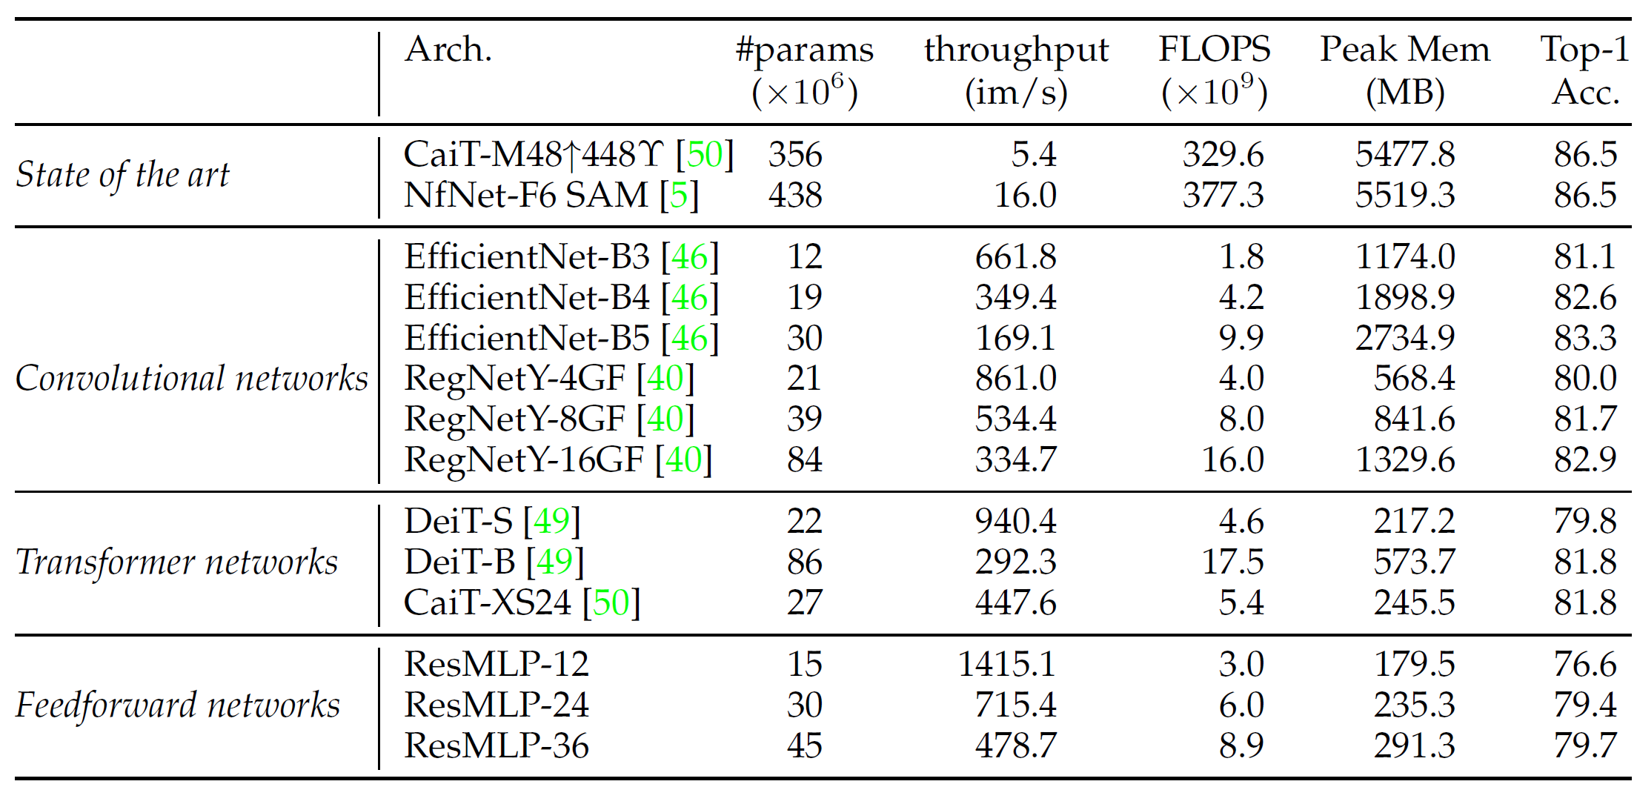
2021 ResMLP: Feedforward networks for image classification with data-efficient training

Slide 7
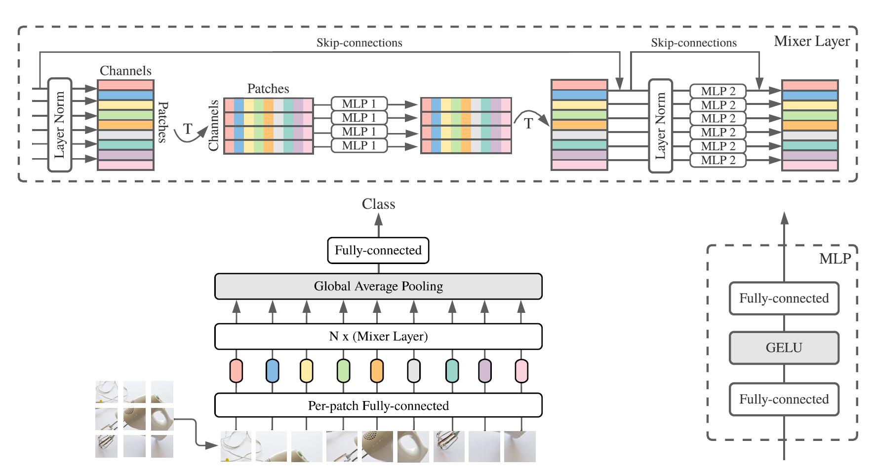
2021 MLP-Mixer An all-MLP Architecture for Vision

Slide 8
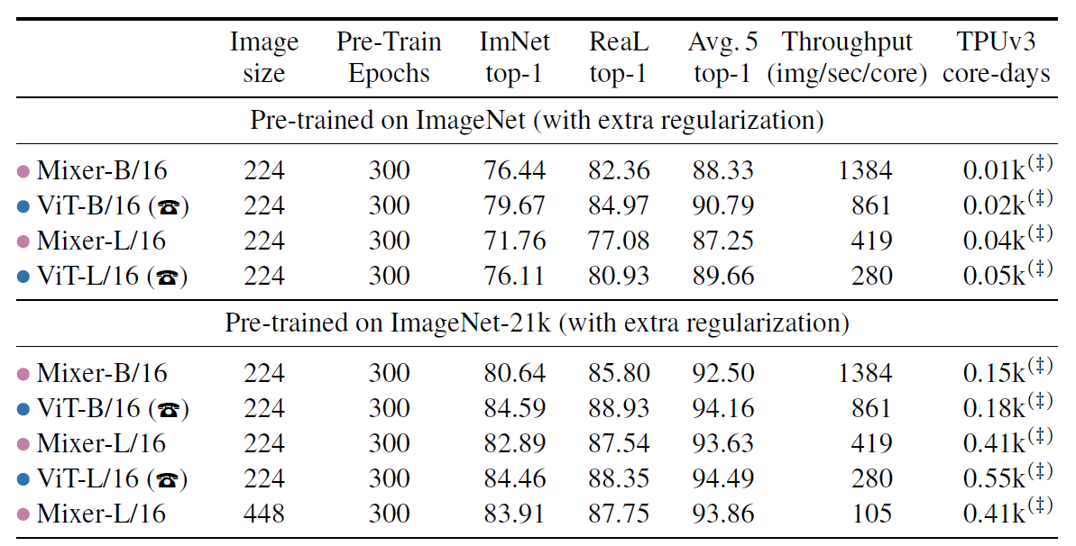
2021 MLP-Mixer An all-MLP Architecture for Vision

Slide 9
The success of MLP suggests that
Neither CNN nor attention are necessary for good performance.

Slide 10
What are the differences between CNN, Transformers, and MLP?
Disadvantages and advantages?
How to choose the architecture for our applications?

Slide 11
One challenge is to fairly compare models in a systematic way.
Different training strategies with different hyperparameters.
Different model environment.
Propose a unified module.
One-stage vs. multi-stage
Mixing block
Two fundamental insights from the CNNs and the Transformers.

Slide 12
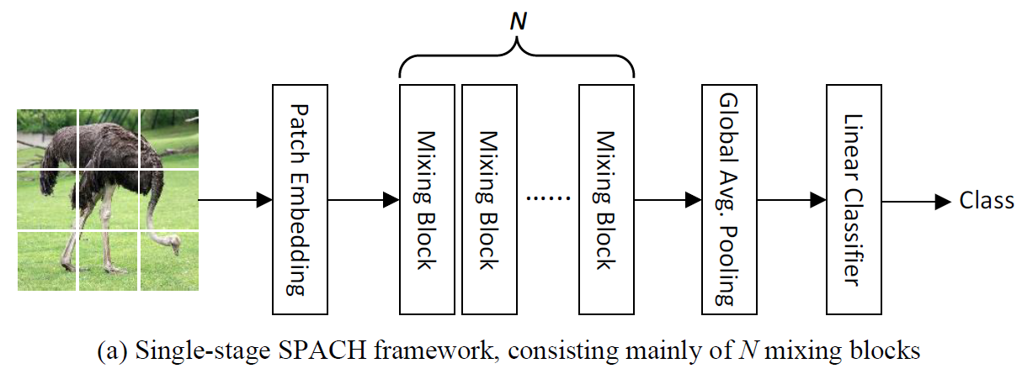
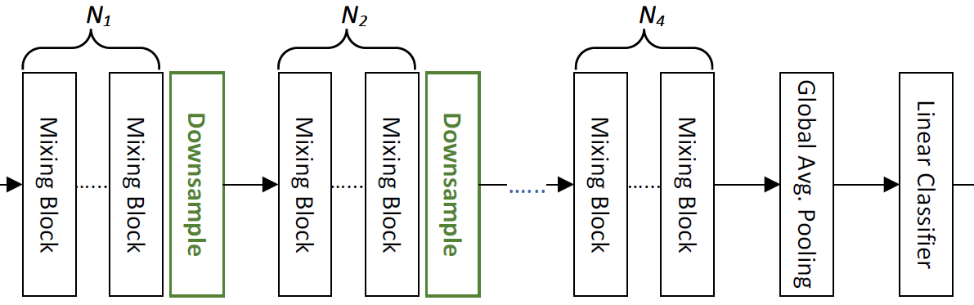
One-Stage vs. Multi-Stage
Stage, pyramid structure.
The ViT uses one stage.

Slide 13
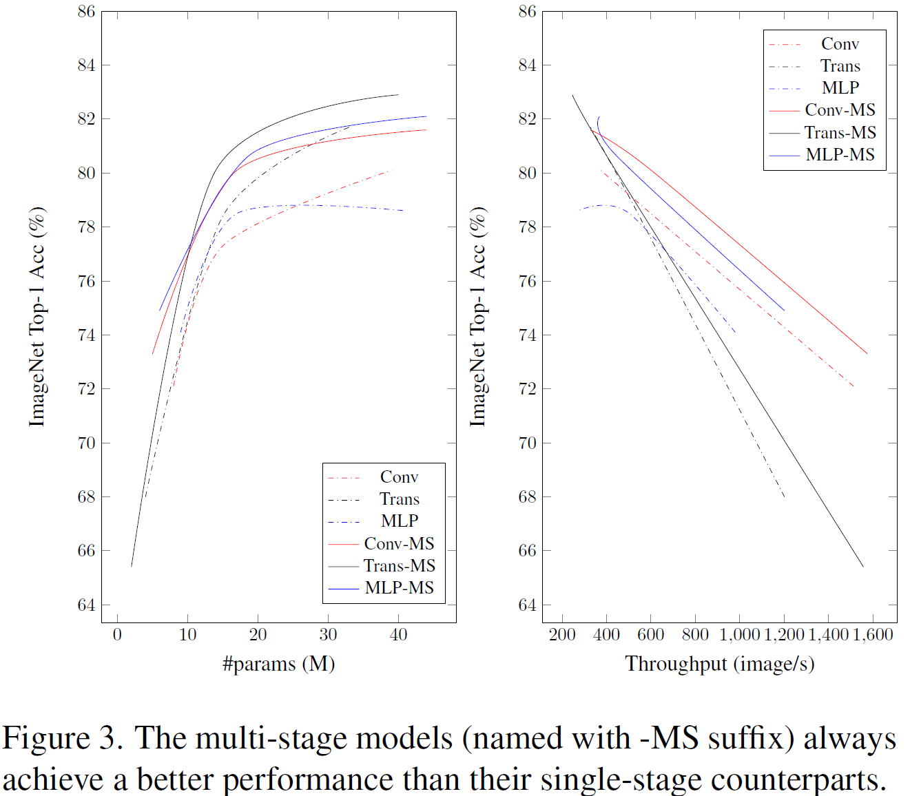

Slide 14
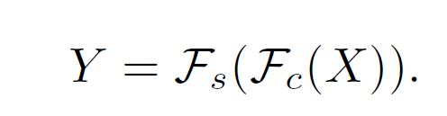
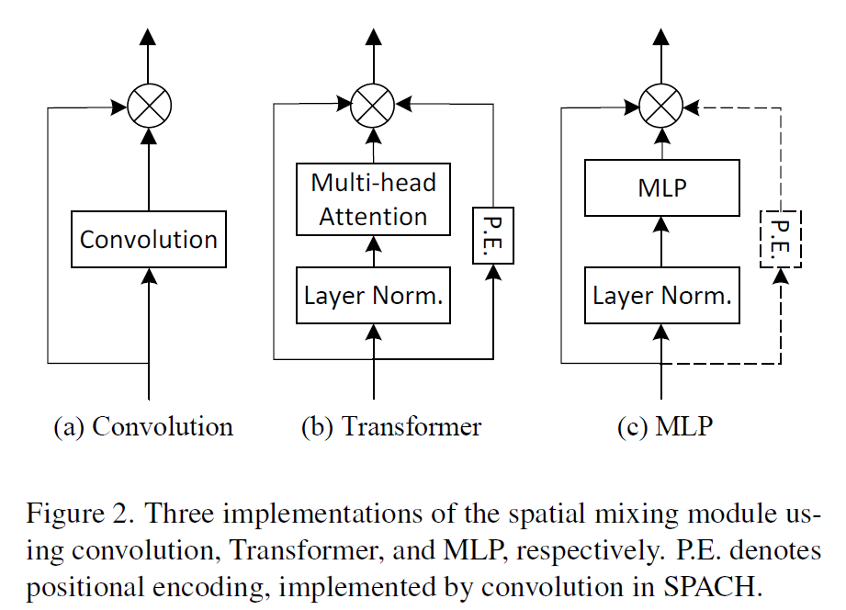
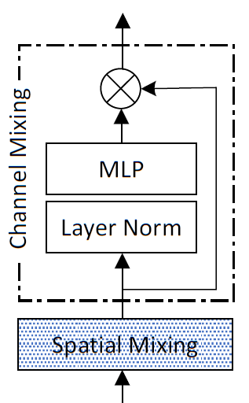
Mixing block: spatial mixing and channel mixing.
Context info and channel info
Personally, they are Attentions,
Spatial attention and channel attention.
P.E: position encoding. Local connection: conv3 to do.

Slide 15
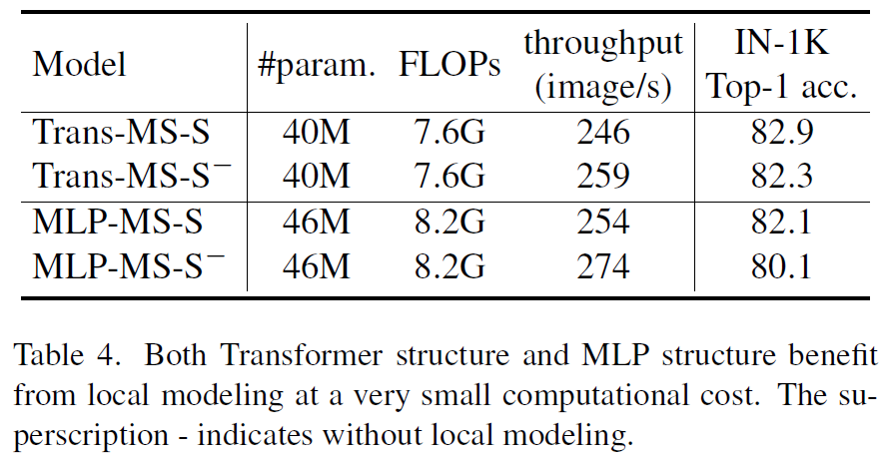
Local connection is useful.
Slightly lower speed
Better performance

Slide 16
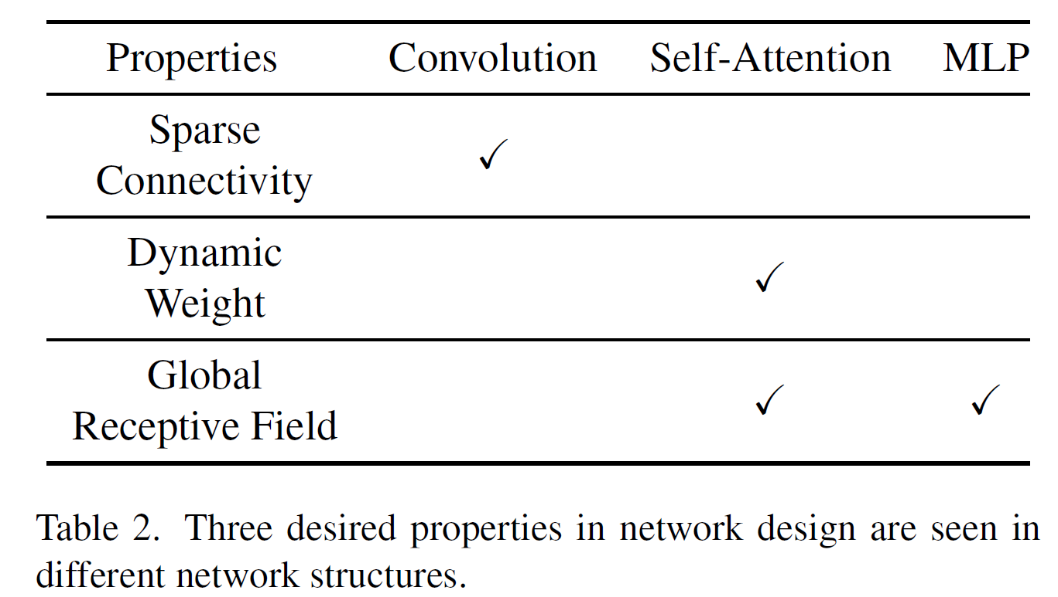
Properties of the three architectures

Slide 17
Experiments Setting
ImageNet-1k, 224*224
AdamW optimizer, 300 epochs,
Learning rate: Cosine decay, 20 epochs of linear warm-up.
8 GPUs, with batch size 128 for each GPU
Data augmentation: rand-augment, random erasing, mixup, cutmix, stochastic depth, repeated augmentation

Slide 18
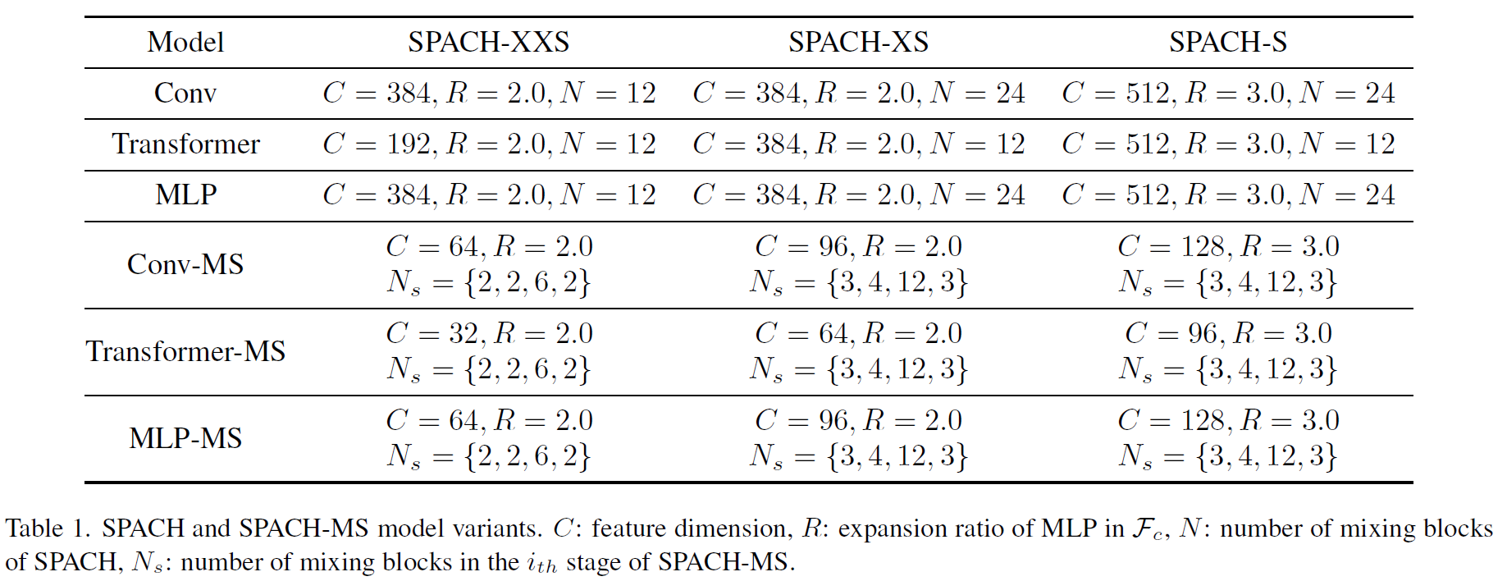
Model Complexity
Number of channels
Number of blocks
Expansion Ratio to combine context info

Slide 19
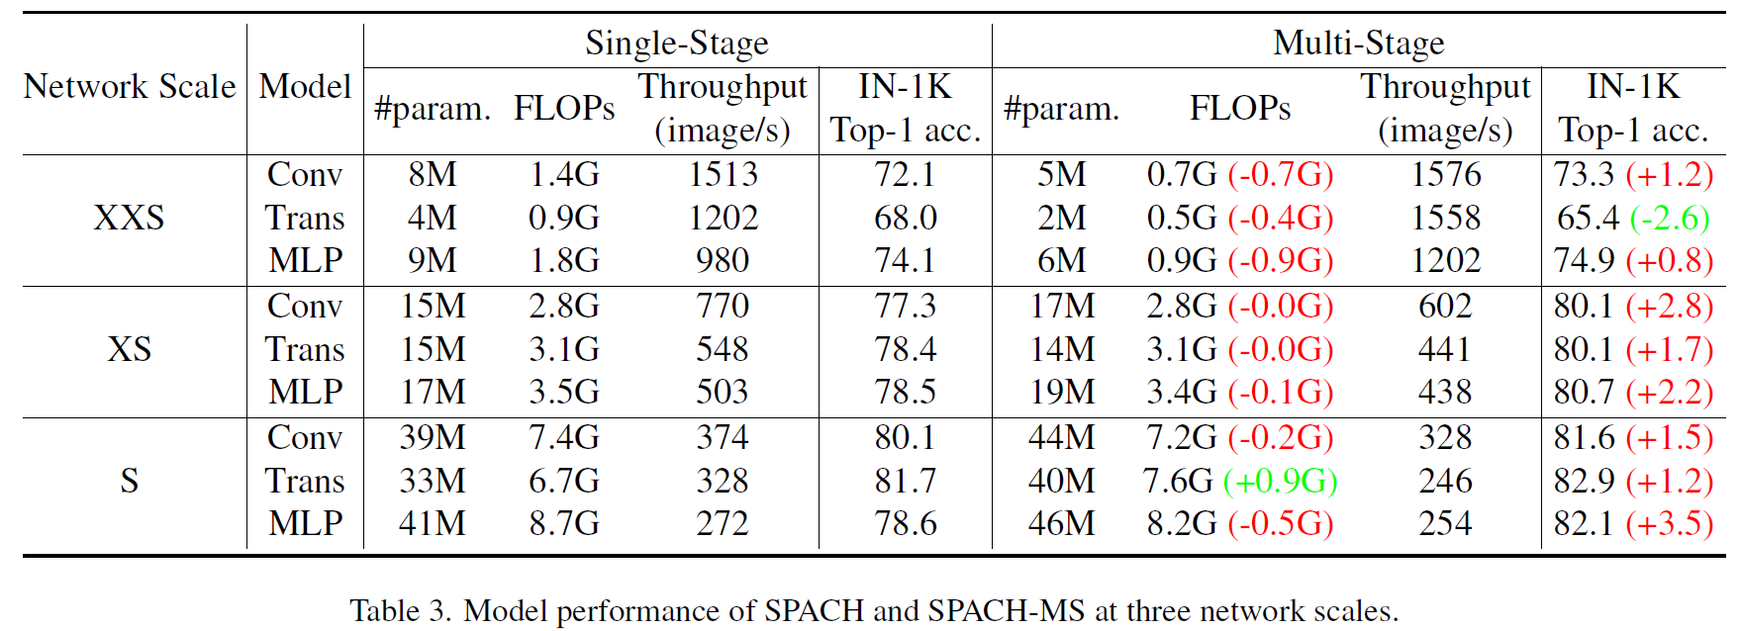

Experiments on MLP
Excessive number of parameters may result in over-fitting.
Multi-stage
Parameter reduction through weight sharing on $F_{s}$, spatial mixing function

Slide 20
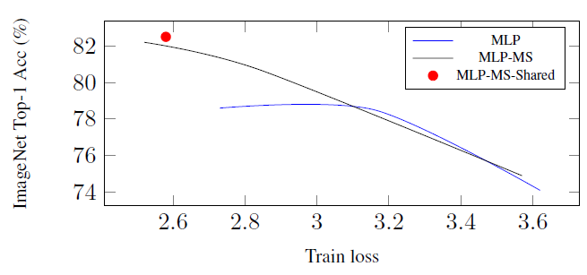
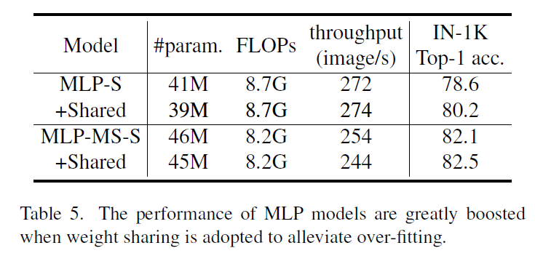

Slide 21
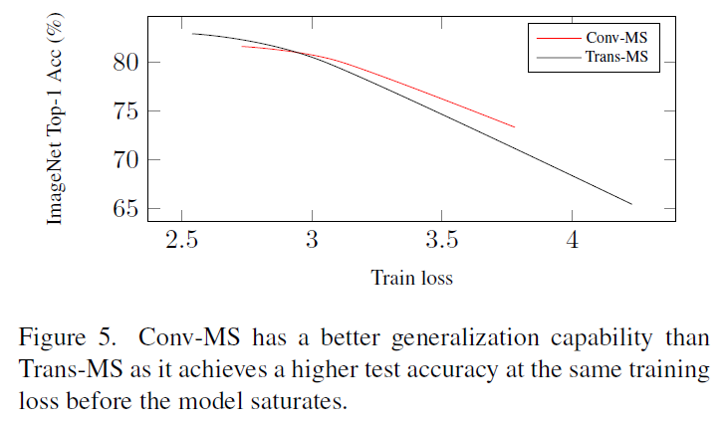
CNN and Transformer
CNN: (local or sparse connection) the best generalization capability
Same loss, better accuracy (before Conv-MS saturates)
Transformer: (dynamic weight) largest model capacity
Can achieve higher accuracy than other two structures when increasing the model size and computations.

Slide 22
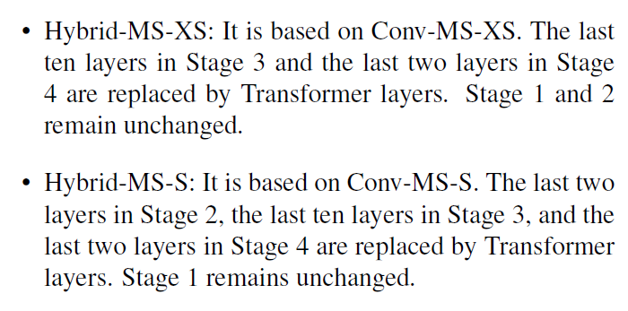
Hybrid Models of CNN and Transformers
Multi-stage CNN model is the base model
Replacing the later stages of the model as transformers blocks.
Local connection
Global connection

Slide 23
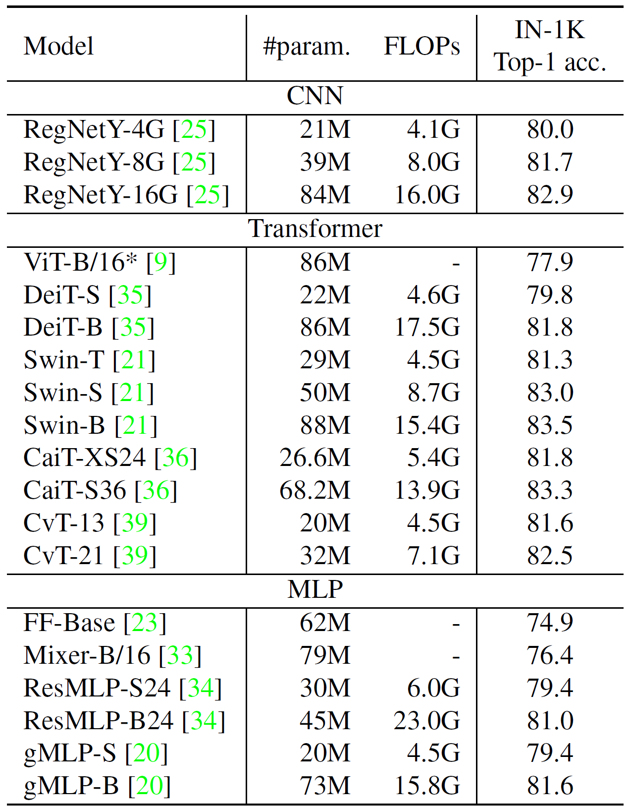
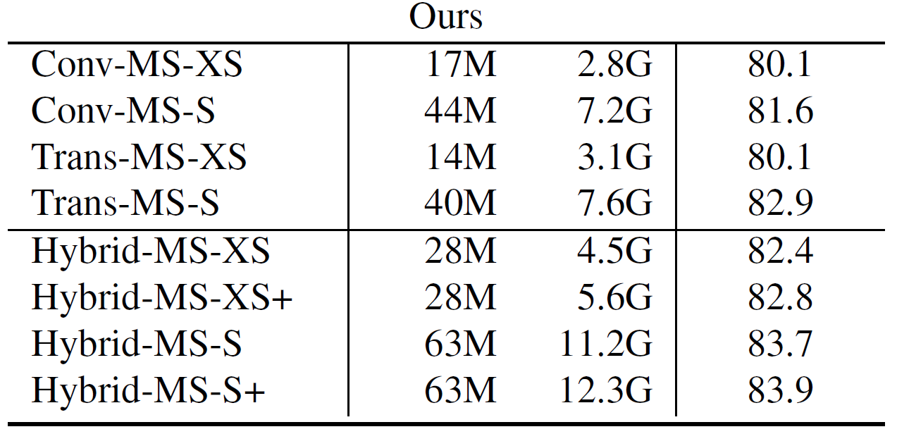

Slide 24
Conclusions
Multi-stage
Local-modeling (only in position encoding)
MLP and overfitting, can we reduce the overfitting for MLP?
Convolution and Transformer are complementary but how to fuse them?

