Slide 1
Slice & dice the Web with XmlPL, The XML Processing Language
A presentation for
Boise Code Camp 2007
Joseph Coffland
Cauldron Development LLC

Slide 2
Presentation Overview
Why XmlPL?
Basic XmlPL Programming
XmlPL for the Web
Other Applications

Slide 3
Why XmlPL?
What is already out there?
What problems exist?
How does XmlPL solve these problems?

Slide 4
Current approaches to XML Processing
APIs
  DOM
  SAX
Languages
  XSLT
  XQuery
  XPath

Slide 5
XML APIs
SAX – Simple API for XML
  Event driven interface
  Parser delivers events to a callback interface
DOM – Document Object Model
  XML tree object tree
  XML is traversed via object methods

Slide 6
SAX
Pros
  Very fast
  Low memory usage
  Available with most XML APIs
  Works well with large XML files
Cons
  More difficult to use than other techniques
  Input only
  No random access

Slide 7
DOM
Pros
  Easier than SAX
  Supported by nearly every XML API
  Allows random access
  Supports both input and output
Cons
  Very high memory usage
  Slow.
  Requires a lot of typing

Slide 8
XML Languages
XSLT
  Extensible Stylesheet Language transformations
  Template processor
  Predecessor of DSSSL
XQuery
  XML Query Language
  semantically similar to SQL
  FLWOR: FOR, LET, WHERE, ORDER BY RETURN
XPath
  XML Path Language

Slide 9
XSLT Pros & Cons
Pros
  Fairly well supported
  Good at template processing
  Currently the best widely available option for translation
Cons
  Verbose
  Somewhat limited to document translation
  Not tree update facility
  Not very fast

Slide 10
XQuery Pros & Cons
Pros
  Less verbose than XSLT
  Perfect for XML databases
Cons
  Mostly limited to querying XML as a database
  No update facility
  Few actual implementations

Slide 11
XPath Pros & Cons
Pros
  Simple syntax
  Powerful
Cons
  Limited to queries
  No programmatic control
  Interpreted

Slide 12

Enter XmlPL

Slide 13
XmlPL Features
Familiar syntax: C + XPath + XML
General purpose XML processing
Efficient internal DOM structure
Gives programmer control over memory
Compiled for speed

Slide 14
Show me the code!

Slide 15
Basic XmlPL Programming
Hello World!
string[] main() {
“Hello World!\n”;
}
or
node[] main() {
<hello world=”!”/>
}

Slide 16
Web Apps with CGI
node[] main() {
string helloString = "Hello World!";
"Content-type: text/html\n\n";
<http>
<head><title>helloString;</title></head>
<body>
<h1>helloString;</h1>
</body>
</http>
}

Slide 17
RSS example
import xmlpl.stdio;
node[] main() {
string url = “http://rss.slashdot.org/Slashdot/slashdotDevelopers”; element firstItem = open(url)/RDF/item[0];
firstItem/title/text();
“\n”;
firstItem/description/node();
}

Slide 18
Reuters RSS Feeds Example
Code:
http://xmlpl.org/CompSci497/Notes_20070202/reuters_feeds.xpl
Application:
http://onyx.boisestate.edu/~jcofflan/cgi-bin/reuters_feeds.cgi

Slide 19
Other applications
XML is not just for the Web
And neither is XmlPL

Slide 20
Possible uses of XmlPL
Transformation
Augmentation
Interpretation
Generation
Extraction
Interface
Integration

Slide 21
Real world Application: SESAME
Simulation of Embedded Systems Architectures for Multi-level Exploration
  Simulation system
  Hardware/Software co-simulation and exploration

Slide 22
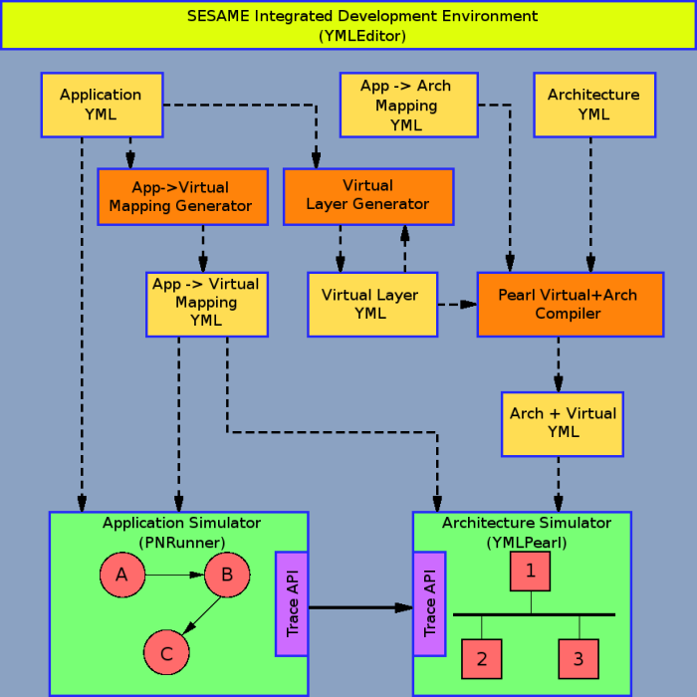

Slide 23
Thank You!
Joseph Coffland
Cauldron Development LLC
Available for Software
Contracting and Consulting
Email: joseph@xmlpl.org
Website: http://xmlpl.org/

