Slide 1
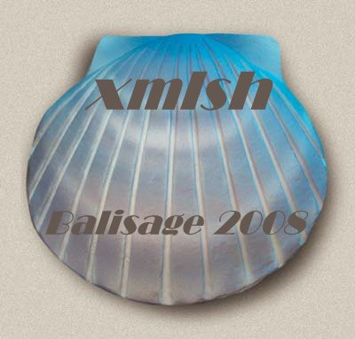

A command line shell for XML
Based on the philosophy
and design of the
Unix Shells
David A. Lee
dlee@calldei.com
www.xmlsh.org

Slide 2
Overview
Motivation
Project
Philosophy
Syntax and Features
Architecture
Demonstration & Examples
Roadmap
Contribute
Feedback / Q&A
www.xmlsh.org

Slide 3
Motivation
Unix and Unix Shells were a radical “Paradigm Shift”
  Vastly simplified access to data and processing
  Set of small simple core tools
  Create complexity with hierarchy instead of linearly.
Almost 40 years later and the core design fundamentals are being eroded
  Predominant data type is no longer byte/line streams
  Tools and shells have not evolved with the data (XML).
  Working with XML is way too complicated !
www.xmlsh.org

Slide 4
Project
Open Source Project
  Open Source / Closed Development
  BSD License “Free Software”
  No commercial restrictions
  Hosted on Sourceforge: xmlsh.sourceforge.net
  Main project site: www.xmlsh.org
Currently “Pre Alpha”
  Ready for experimentation – not for production
  Syntax subject to change
  Internal API’s subject to change
www.xmlsh.org

Slide 5
Project
Pure Java
  Tested on Windows, Mac and Linux
  Should run on any OS that runs Java 1.6
Dependencies
  Saxon 9
  Log4J
  Optional external OS commands
  ( rm , chmod , date ... haven't re-invented the wheel)
www.xmlsh.org

Slide 6
Unix Shells - Philosophy
What's Great about the Unix Shells
  Thrived almost 40 years and many incarnations
  Ideal balance between CLI and Programming language
“Although most users think of the shell as an interactive command interpreter, it is really a programming language in which each statement runs a command. Because it must satisfy both the interactive and programming aspects of command execution, it is a strange language, shaped as much by history as by design.”
– Brian Kernighan & Rob Pike ,
The UNIX Programming Environment", Prentice-Hall (1984).
www.xmlsh.org

Slide 7
Unix Shells – Philosophy
What's Great about the Unix Shells
  All IO is byte streams (or text line streams)
    Core toolkit designed around a simple universal type
    byte or line streams
      wc cat ls sed grep cut paste head read tail awk more ...
    All files and devices are byte/line streams.
    programs consume and produce byte/line streams.
  Core “toolkit” of simple components
  Enables creation of complexity through hierarchal combination of simpler components.
www.xmlsh.org

Slide 8
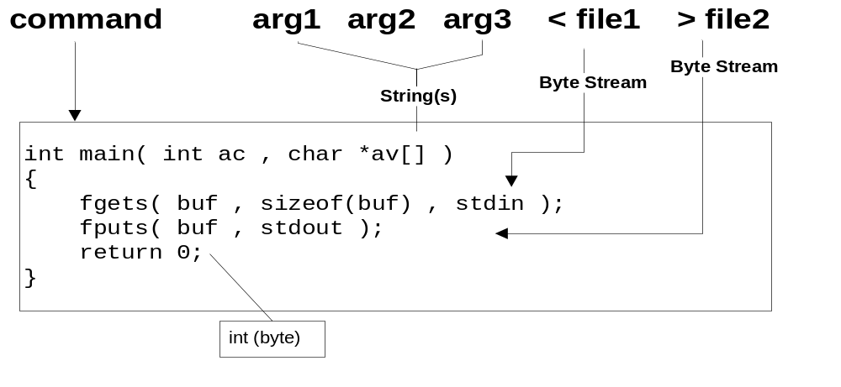
Anatomy of a Unix Shell command
www.xmlsh.org

Slide 9
Unix Shells – Philosophy
What's Wrong with Unix Shells ?
  Today’s data is no longer primarily text (byte/line streams)
  Data is increasingly XML
  Many core commands are not meaningful or
  dont work well with XML
    wc cut grep paste tail head sed awk more cat ...
Why not just new commands ?
  The shell itself is aging ...
  made with the assumption that all data is strings or lines.
    Flow control (for / case / read )
    Variables / Environment / IO streams
    Pipelines / Command input/output
  Desire for a cross platform, portable shell
www.xmlsh.org

Slide 10
xmlsh – Philosophy
Based on the design principles of the Unix Shells
Largely backwards compatible syntax to /bin/sh
  Use cases equivalent to /bin/sh
Where the Unix Shells use strings and byte streams, xmlsh targets XML documents and infoset streams.
Scripting with XML data should be as easy and natural as scripting with text files.
Someday, all data should be XML …
  But until then, intermixing Text and XML is necessary
www.xmlsh.org

Slide 11
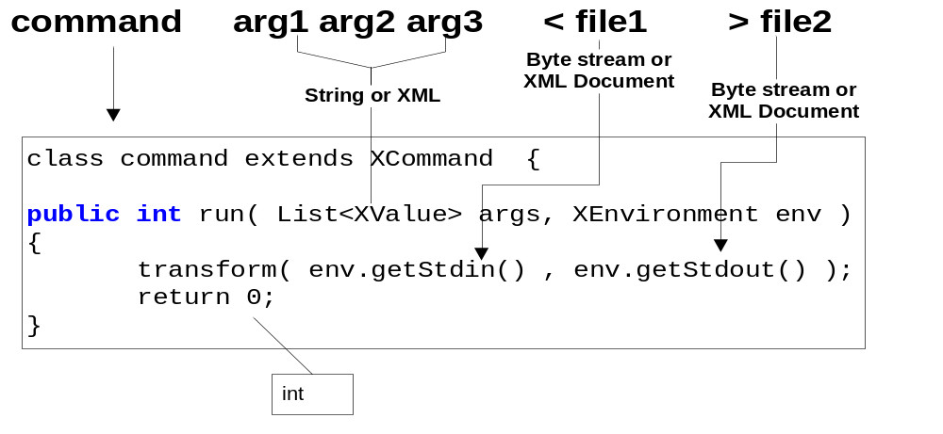
Anatomy of a xmlsh command
www.xmlsh.org

Slide 12
Syntax and Features
Core syntax equivalent to /bin/sh
  if ... then ... else ... fi
  while/until ... do ...
  case ... in
  functions
  variable assignment
  Pipes
  subshells and background processes/threads
  IO redirection
  script and external process execution
www.xmlsh.org

Slide 13
Syntax and Features
New syntax specific to xmlsh
  XML expressions and variables
  <[ xquery expr ]>
  $<( xml producing command )
  Example:
  foo=<[ “hi” , 123 , <elem attr=“attr”>body</elem>]>
  bar=$<(xls)
  for $i in <[1,2,3,<node/>,”hi”]> ; do echo $i ; done
www.xmlsh.org

Slide 14
Syntax and Features
built-in commands similar to /bin/sh
: | exit
set | shift
source (.) | test ([ condition ])
true | false
read | xread
xwhich | xenv
echo | cd
jobs | wait
www.xmlsh.org

Slide 15
Syntax and Features
internal commands (supplied with xmlsh)
xcat | xcmp
xls | xpwd
xpath | xslt
xquery | xsplit
xed | xversion
.... Many more to come ...
www.xmlsh.org

Slide 16
xmlsh Features
User commands
  Can integrate directly to xmlsh and run within the same JVM and participate in internal architecture.
External Commands
  Can execute any external command supported by the OS
  Can pipe into and out of external commands, same as internal commands.
www.xmlsh.org

Slide 17
Architecture
Source is 100% pure Java using JDK 1.6
Parser implemented with javacc
Logging via log4j
XSLT and XQuery from Saxon
  XQuery heavily used internally
www.xmlsh.org

Slide 18
Architecture
Variables
  Dynamically typed variables (text , xml )
  Take on the type of their assignment expression
    x=“foo” # string
    x=<[“foo”]> # xml
  XML type is really a saxon “XdmValue”
    atomic type
    item type
    sequence
    Anything that XQuery can produce
www.xmlsh.org

Slide 19
Architecture
Pipes
  Pipeline commands run as separate threads
  Pipe is a Currently a text pipe
  (XML is text serialized)
    Future – XML native pipes – binary or event serialized
    Suggestions Welcome !
  Internal/builtin commands in separate threads
  External commands in separate processes
www.xmlsh.org

Slide 20
Architecture
Built-in, Internal, and User commands run in the JVM
  Access to native representations for shell environment
  Access to same runtime (saxon, log4j etc)
  XML data held as Saxon trees not text
  Participates in multithreading
    Background threads ( cmd & )
    Piping ( cmd | cmd | cmd )
  Arguments and variables passed in internal form
  (not converted to text)
www.xmlsh.org

Slide 21
Architecture
External commands
  May run any OS command ( cp mv ls chmod gcc ... )
    xmlsh is not a replacement for the OS layer or commands
    External Commands run as a sub process
  Piping to and from external command
  Freely intermix internal and external commands
    xquery | sum
    xls | cat | xcat
www.xmlsh.org

Slide 22
Problems and Limitations
Javacc vs yacc, LL(1) vs LALR(1)
  POSIX sh specs are LALR, challenging to translate to LL
  Some syntax difficult to implement easily/correctly
Java runtime instead of Unix OS layer
  Threading instead of processes
  No real concept of File Descriptor (numbers like 0,1,2,3)
  Console IO is limited
    Cannot run console sub-processes which share stdin.
    No good tty interrupts
www.xmlsh.org

Slide 23
Examples
Basic sh-like syntax
dir=/output
for file in *.xml ; do
xquery –f /path/pass1.xquery -i $file |
xslt -f /path/pass2.xsl –i > $dir/$file
done
Simple xml tools
xcat *.xml | xpath ‘//book[@author=“John Doe”’
www.xmlsh.org

Slide 24
Examples
XML and text Variables
XML construction syntax (XQuery based)
A= ”text”
XVAR=<[
<foo attr= ”bar”>
{$A}
</foo>
]>
echo $XVAR > file.xml
www.xmlsh.org

Slide 25
Examples
Reusable parsed XML Documents
XML Sequences in for loops
xread doc < file.xml
for i in <[for $x in 1 to 1000 return $x]> ; do
xquery –i $doc ’//part[@num=$i]’ > out${i}.xml
xpath –i $doc ’//part[@num=$i]/@title’ >> titles.txt
done
www.xmlsh.org

Slide 26
Roadmap
Currently Pre-Alpha – Started Nov 2007
To go to alpha ...
  Resolve core syntax questions
    Example: should $* be a string or sequence ?
    Example: should echo produce XML or Text ?
  Clarify Philosophy
    What xmlsh Is and Is Not – define scope
    Clarify use cases
  Zero defects in current codebase
    Complete test cases
  Solicit peer comments
www.xmlsh.org

Slide 27
Contribute
Try it out !
Report Bugs
Discuss / Forums
  Use cases
  Design Discussions
  Enhancements
  What do you like ? Why ?
  What don't you like ? Why ?
www.xmlsh.org

Slide 28
Feedback / Q&A / Demo
www.xmlsh.org

