Slide 1









智能大棚系统
CONTRACTED WIND POWERPOINT TEMPLATE DESIGNS CONTRACTED WIND POWERPOINT TEMPLATE DESIGNS CONTRACTED WIND POWERPOINT TEMPLATE DESIGNS CONTRACTED WIND POWERPOINT TEMPLATE DESIGNS

Slide 2

二、成员分工
四、问答环节
录
目
一、功能概述
三、功能演示
summer
Summer a lot of things began to trivial for example, I hide in behind the morning in a hurry to eat text, breathed life back to the story, then through these years of ladder to update a day in and day out of

Slide 3

一、功能概述
Summer a lot of things began to trivial for example, I hide in behind the morning in a hurry to eat text, breathed life back to the story, then through these years of ladder to update a day in and day out of

Slide 4
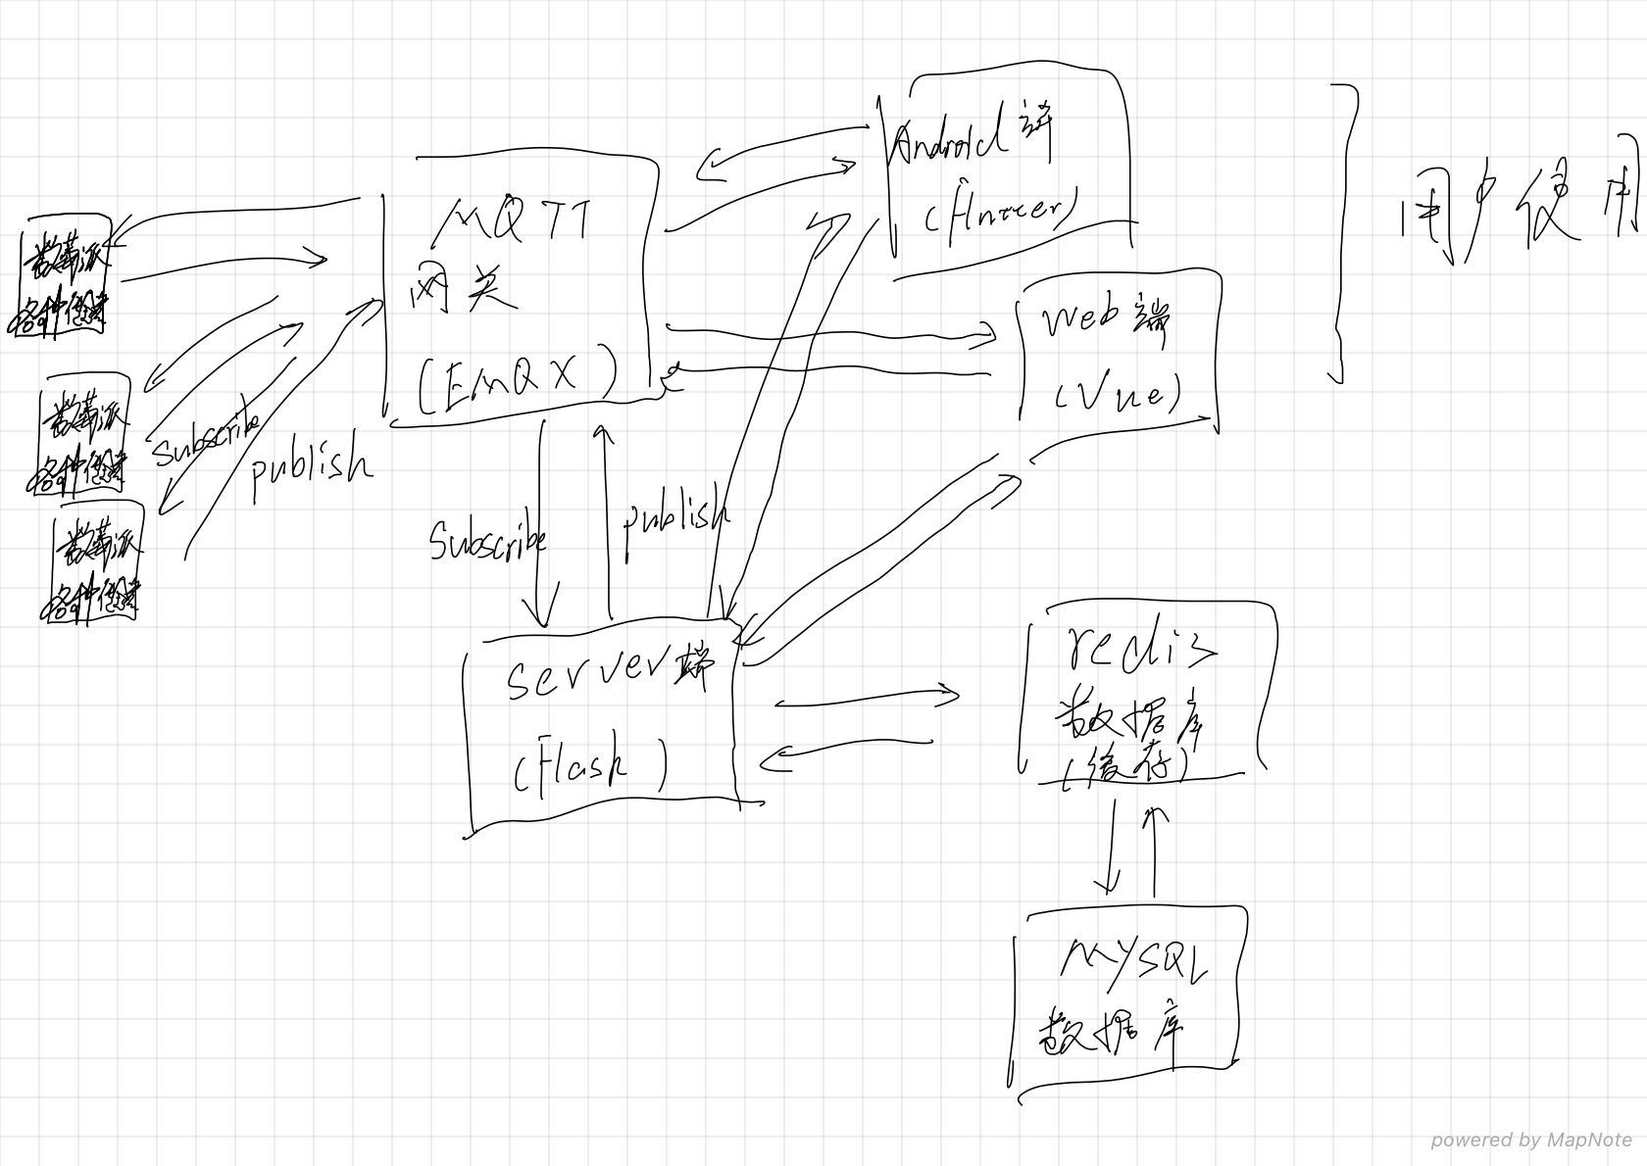
PART
01
THE HEADLINE

Slide 5
二、成员分工
Summer a lot of things began to trivial for example, I hide in behind the morning in a hurry to eat text, breathed life back to the story, then through these years of ladder to update a day in and day out of

Slide 6
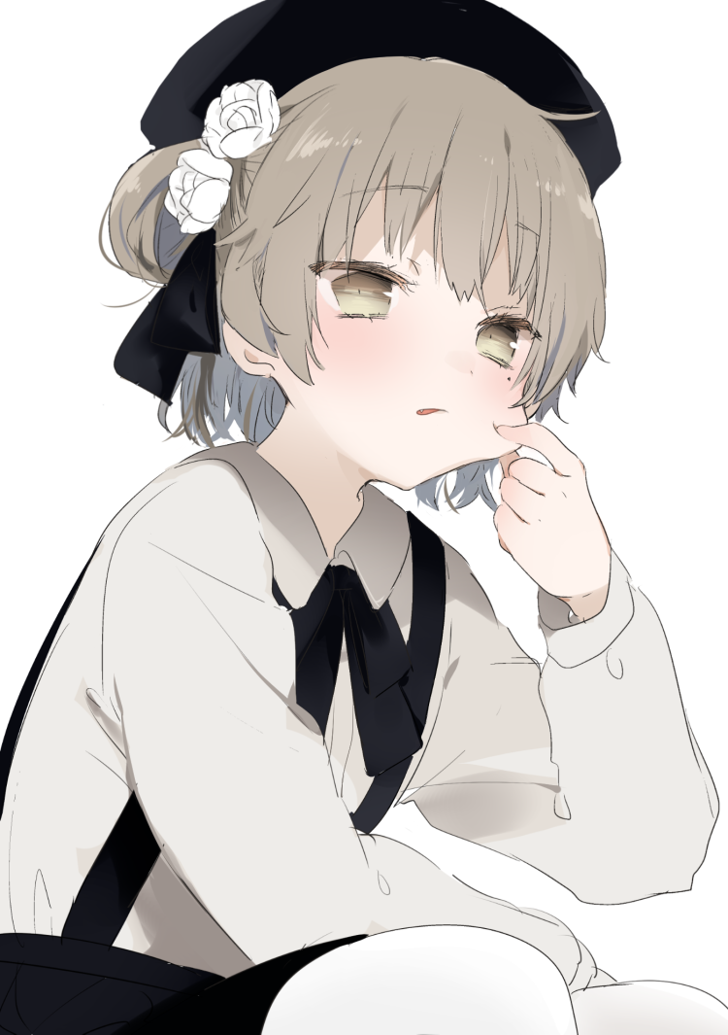
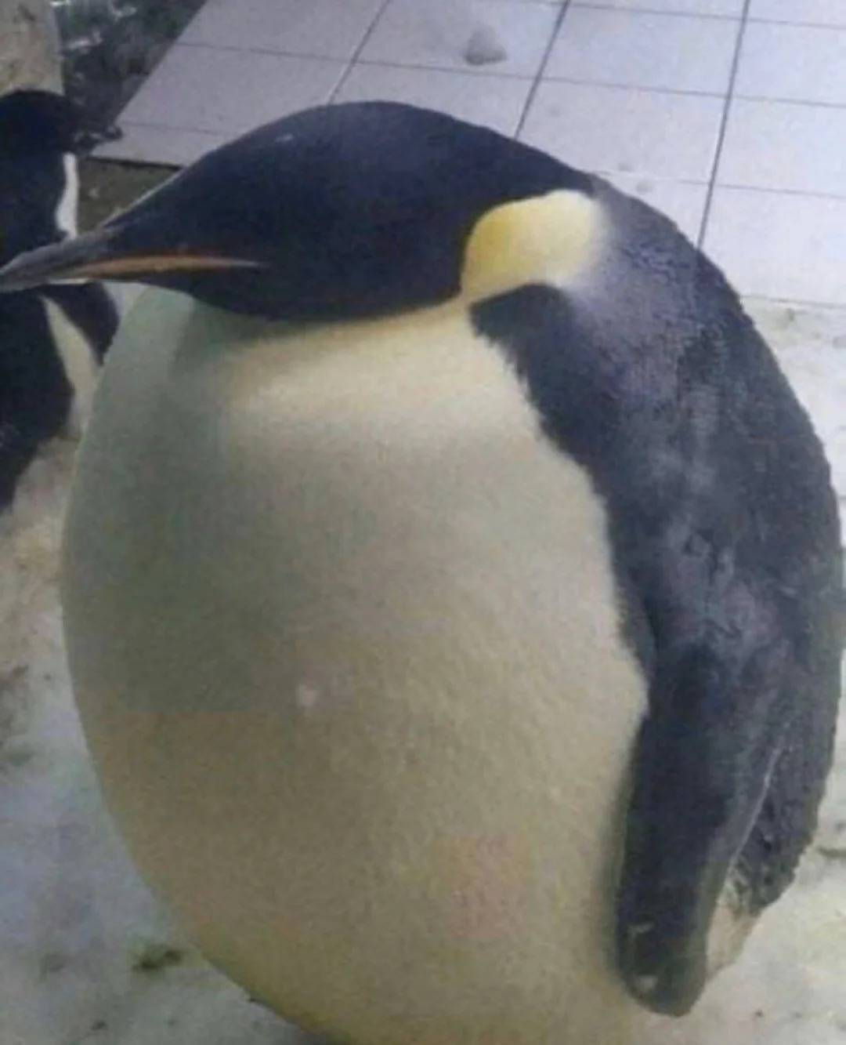
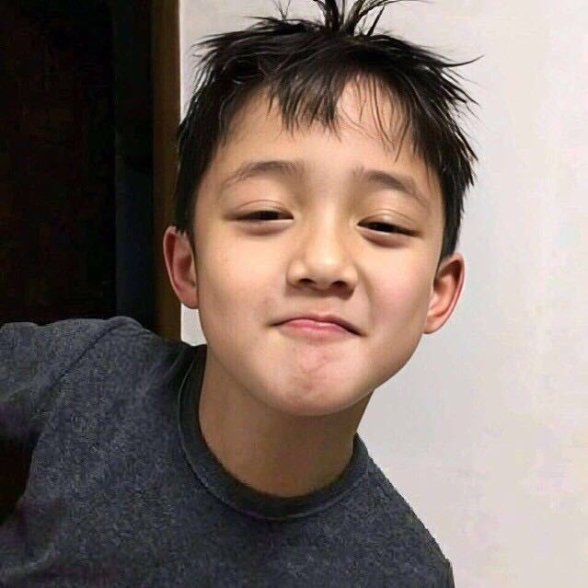
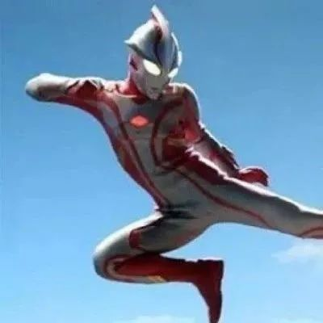
成员分工
m
z
l
f
组长：web端以及全部整合调试
安卓app客户端
硬件部分代码编写及烧录
服务器的搭建

Slide 7
三、功能演示
Summer a lot of things began to trivial for example, I hide in behind the morning in a hurry to eat text, breathed life back to the story, then through these years of ladder to update a day in and day out of

Slide 8
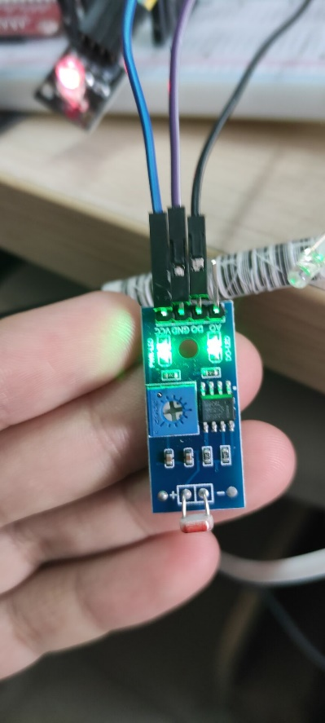
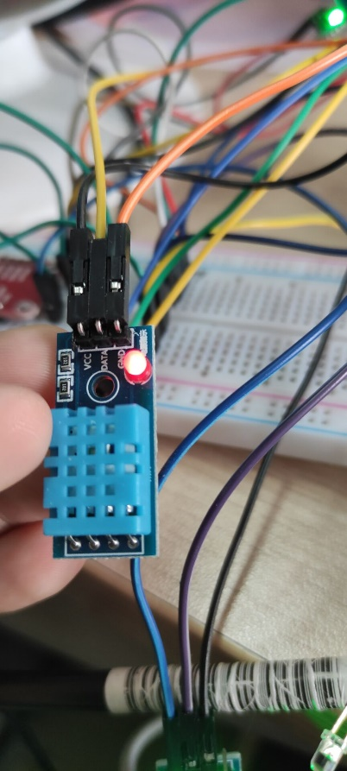
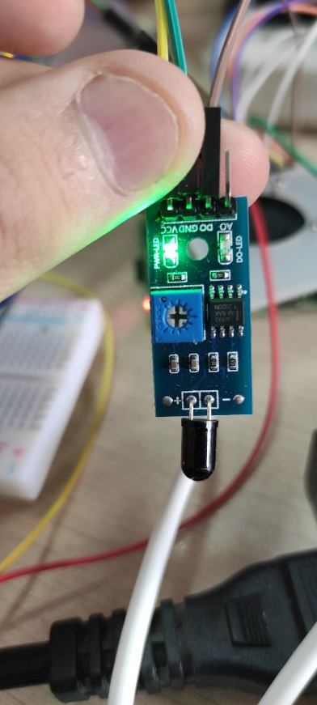
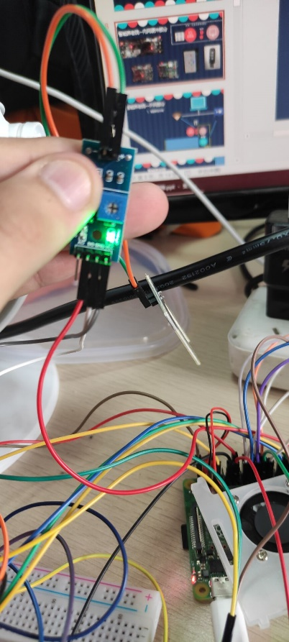
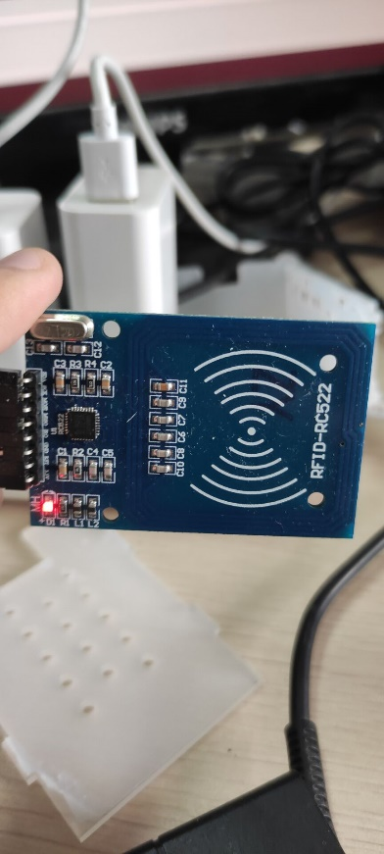
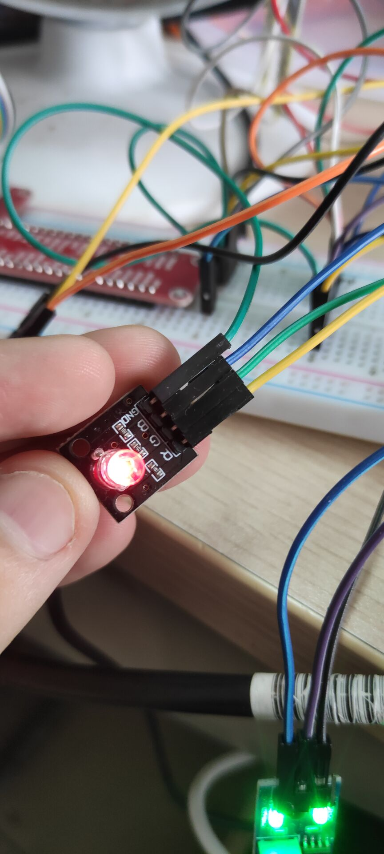
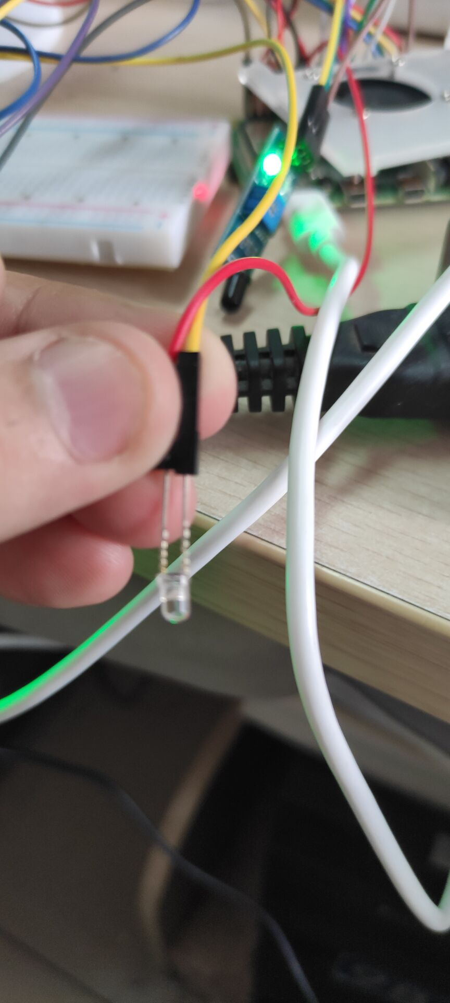
PART
01
Notes:
8

Slide 9
PART
01
THE HEADLINE

Slide 10
问答环节
Summer a lot of things began to trivial for example, I hide in behind the morning in a hurry to eat text, breathed life back to the story, then through these years of ladder to update a day in and day out of

Slide 11
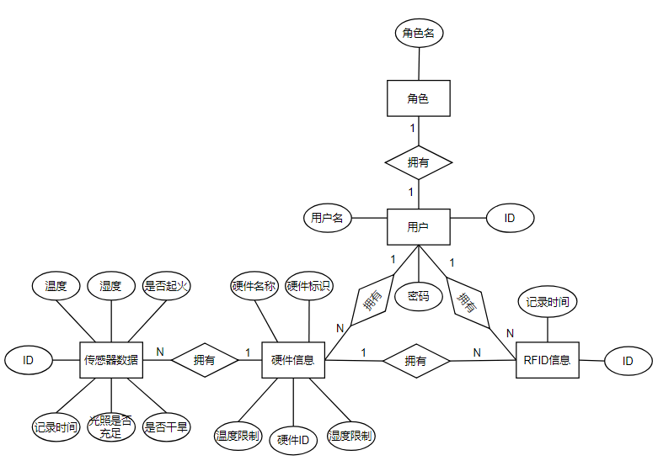
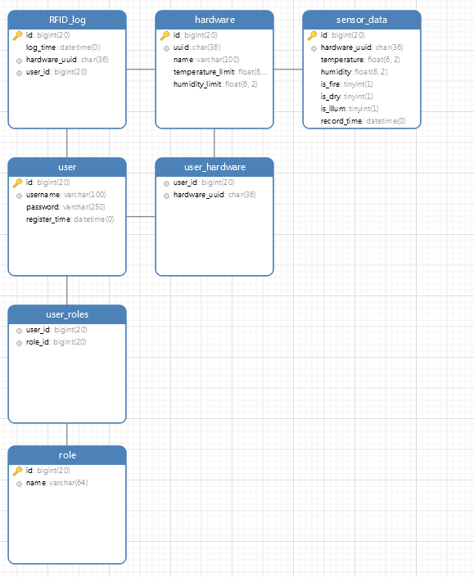
PART
01
Notes:
11

