Slide 1
Cryptography and Identity with .NET Core
Bala Chirtsabesan
Software Engineer, Microsoft
@balachir

Slide 2
.NET Conf 2019
Cryptography 101 [at 00:39:46 in the video]
By Robert Boedigheimer, Microsoft MVP
@boedie
Identity 101 [at 01:36:30 in the video]
By Bobby Johnson, Developer Advocate
@NotMyself
Notes:
My presentation is based on a couple of sessions from .NET Conf 2019

Slide 3
Cryptography

Slide 4
Cryptography
What is Cryptography?
Science of keeping messages secure
Why do you want cryptography?
Confidentiality – protect data from being read
Integrity – verify that data was not modified
Authentication – identify and validate a user
Non-repudiation – sender cannot deny later that he sent a message
System.Security.Cryptography namespace
Don’t write own!!

Slide 5
Cryptography – Building Blocks
Cryptographic Primitive | Use
Hashes | Maps data from any length to a fixed-length byte sequence.
Symmetric Cryptography (secret-key) | Transform data using a single shared key to encrypt and decrypt data
Asymmetric Cryptography (public-key) | Transform data using a pubic/private key pair to encrypt and decrypt data
Digital Signatures | Verify data originates from a specific party by creating a digital signature that is unique to that party.
Cryptographic Primitives
https://docs.microsoft.com/en-us/dotnet/standard/security/cryptographic-services#primitives

Slide 6
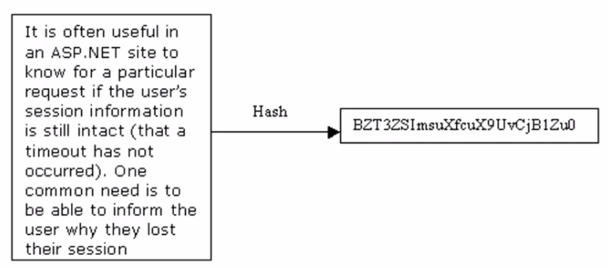
Hashing
Convert variable length input message to fixed-length byte sequence
Easy to compute using a hashing algorithm (eg: SHA) but significantly harder to reverse
Creates a “data fingerprint” (message digest) – unique representation of the data
Ok to see the message, easy to verify that the data hasn’t been tampered with (integrity)
Hashing Algorithms – SHA-2 algorithms (eg: SHA512) are recommended now. MD5 and SHA-1 based algorithms are insecure.
Notes:
Typical use – some websites will include a hash along with the software download, so you can use a hashing algorithm to verify the integrity of the data

Slide 7
Hashing Demo
Notes:
SHA512 part of the SHA 2 family
Cryptographic functions all operate on Byte arrays
UTF8 is a common encoding scheme to take strings and encode them as bytes
Irrespective of length
Common use - if you download from a given site, they provide the hash (eg: SHA256). You can download and compute the hash and verify that the contents haven't been tampered with

Slide 8
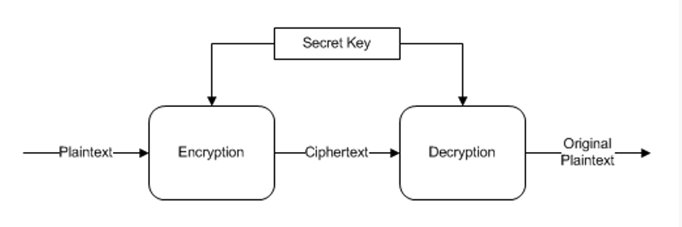
Symmetric Cryptography
Single secret key to encrypt and decrypt data. Keeps the data private (confidentiality)
Block cipher – Algorithm used to encrypt data one block at a time. Eg: DES, Triple DES, AES
Two modes of block cipher
Electronic codebook (ECB) mode – less secure. Key can be compromised if there are duplicate blocks
Cipher-block chaining (CBC) mode – more secure as it uses an Initialization Vector (IV). Primary attack is “brute-force”, i.e. try all possible keys. But it’s infeasible to do.
Disadvantage – key distribution is difficult since key needs to be a secret
Notes:
http://en.wikipedia.org/wiki/Block_cipher_modes_of_operation
ECB – each block encrypted on its own
CBC – uses encrypted data from first block as input into the next block’s encryption
ECB mode is not considered secure, because it does not use an initialization vector to initialize the first plaintext block. For a given secret key k, a simple block cipher that does not use an initialization vector will encrypt the same input block of plaintext into the same output block of ciphertext. Therefore, if you have duplicate blocks in your input plaintext stream, you will have duplicate blocks in your output ciphertext stream. These duplicate output blocks alert unauthorized users to the weak encryption used the algorithms that might have been employed, and the possible modes of attack. The ECB cipher mode is therefore quite vulnerable to analysis, and ultimately, key discovery.

Slide 9
Symmetric Cryptography Demo
Notes:
TODO: Typical uses?

Slide 10
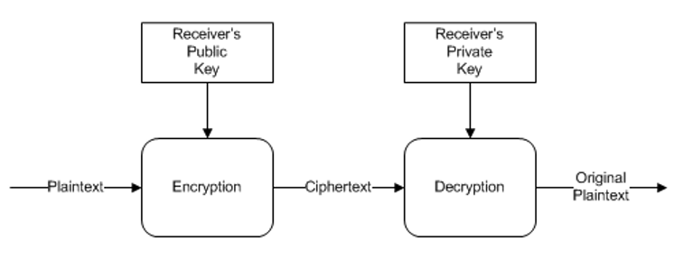
Asymmetric Cryptography
Public key encryption – Two partners, each with their own public / private key pair
Generally, 1000 times slower than symmetric algorithms
Common application – Use public-key (asymmetric) encryption to transfer a secret (symmetric) key and use secret-key encryption for the remainder of their session. Eg: HTTPS / TLS
Algorithms
RSA (Encryption and signing)
DSA (Digital Signatures only)
ECDiffieHelman (Key generation only)
Notes:
Two uses
Data that is encrypted with the public key can be decrypted only with the private key, and
Data that is signed with the private key can be verified only with the public key

Slide 11
Asymmetric Cryptography Demo

Slide 12
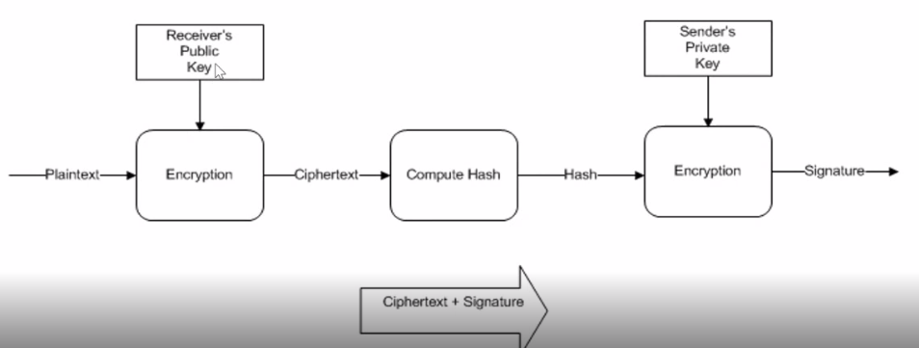
Digital Signatures
Provides integrity and non-repudiation
Hash the contents of the message, sign it (encrypt) with sender’s private key
By default, does not provide confidentiality. To get this, you can encrypt with receiver’s public key before signing.

Slide 13
Cryptography in .NET Core 3.0
Authenticated Encryption
Combines encryption and a MAC (hash)
MAC is Message Authentication Code
Ensures ciphertext was not tampered with
Expanded Cryptographic Key Import/Export
More key format than what we had in the past

Slide 14
Sample Code https://github.com/balachir/ 2019DotNetConf-CryptographyAndIdentity

Slide 15
Identity

Slide 16
Problem of Identity
Deceptively Simple
There exists a resource, give a user access to the resource
But there are many complexities
Authentication
Verify user’s identity
Obtain some sort of credentials from the user for this
Authorization
For an authenticated user, control access to resource
Digital Identity
Each application has certain user attributes that are relavant
Notes:
Accounts can come from variety of sources - Ways to access these resources in multiple ways from multiple devices
Identity is important. When something goes wrong, it can go catastrophically wrong such as multi-million-dollar breach on a social network
Developers want to focus on shipping products. Identity is seen as an infrastructure concern
Depending on the application, user will have different attributes that represent the user - digital identity
Eg: Amazon - credit card, shipping address
Tax system - PAN number, tax return

Slide 17
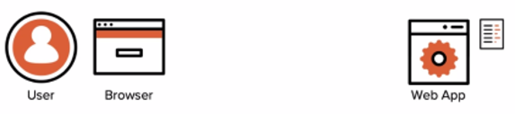
Identity - Username and password
Primitive method – still exists in many places
Notes:
In early days, we had the simple user name and password techniques to verify identity. Still very much relevant today.
With Identity, typically new techniques come along to address new scenarios that weren’t possible before, unless there’s a direct competitor / replacement

Slide 18
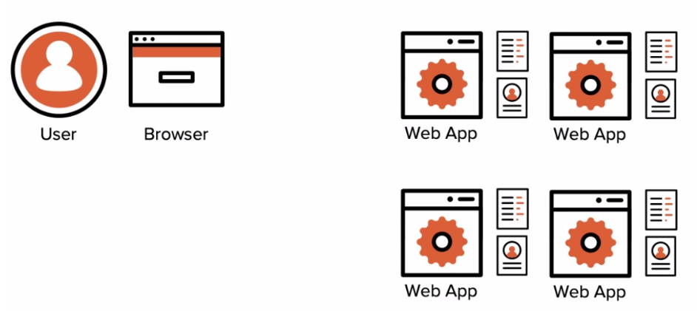
Identity - Directories
When there are many applications in an enterprise,
Username and password does not scale
User needs to remember multiple passwords. Or worse, they use same password for multiple applications
Waste of resources – developers need to duplicate functionality
More complicated for business administrators to manage permission rules across applications
Solution – Active Directories. Eg: Azure Active Directory is a modern example
Centralized repository that performs credential management and digital identity storage
Notes:
Allows enterprises to control access at a higher level. Easy to manage when new users join or leave the company

Slide 19
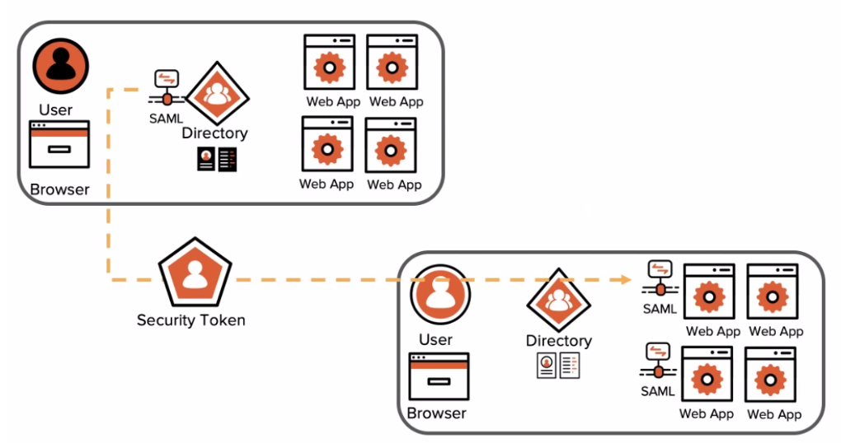
Identity – Cross domain Single Sign-On
Business scenario like retailer – suppliers, warehouse management, corporate customers, end customers
SAML – Software to handle identity management at a higher level of abstraction
Two domains establish a “trust relationship”. Domain on right will trust domain on the left on what it says about its users.
Security Token – proof that user is authenticated with the domain on left (trusted Identity Provider). SAML security token includes XML payload and digital signature.
Claim - Attribute describing a user that travels inside a security token. Attribute combined with a signature asserting that the attribute came from a specific source.
Notes:
Simple directory-based solution no longer works. Solution needs to deal with multiple directories
Imagine there’s web application in the right-domain that a user from the left-domain needs to access. But the right-domain only knows about the users in its domain.
Industry addressed this by raising the level of abstraction. Instead of network level authentication, it is handled at the application level. So it can work on the public internet. This is handled by SAML.
Digital signature provides confidence that the XML payload is truly coming from the trusted IP

Slide 20
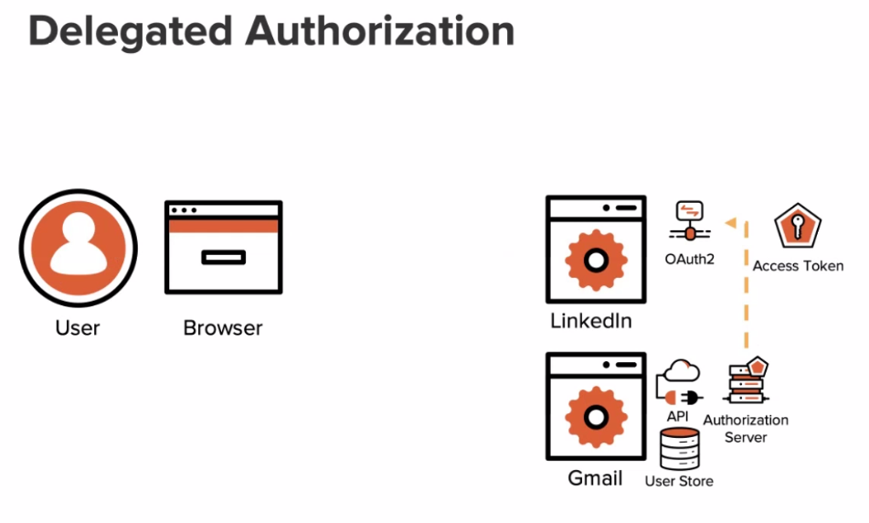
Identity – Consumer Use Cases
OAuth2 – Delegated Authorization
LinkedIn – wants to get access to Gmail contents and permissions to send email on user’s behalf. Registers as an app with Gmail and sends OAuth request to Gmail
Gmail – authenticates user, gets user consent to allow access and generates an authorization code
LinkedIn – uses the authorization code to get access to the resource
Notes:
In the meantime, in the consumer world, services needed access to other services on the user's behalf
OAuth - open standard, delegated authorization protocol. Allows users to delegate authorization from one resource to another resource without revealing user credentials
Standard that exposes 2 endpoints – there is an authorization server with 2 endpoints – authorization endpoint and token endpoint
After authentication, Gmail checks for User consent
Gmail gives auth code to Linked In
Linked In uses auth code to get access token from Gmail (opaque access token)

Slide 21
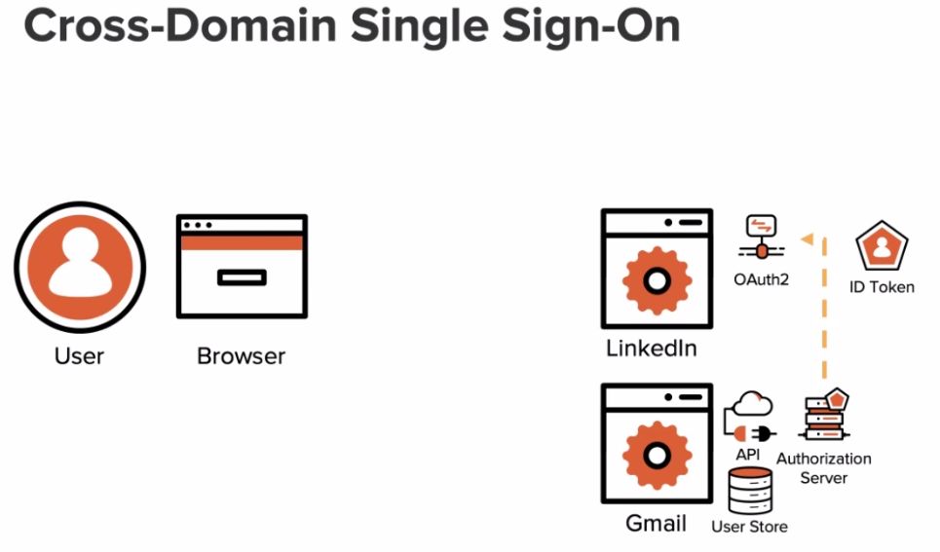
Identity – Consumer Use Cases
OIDC – Delegated Authentication
Open ID Connect (OIDC) – Built on top of OAuth2. Provides similar functionality like SAML for the internet domains

