Slide 1
.NET Today and Tomorrow
Bala Chirtsabesan
Microsoft Visual Studio
@balachir

Slide 2
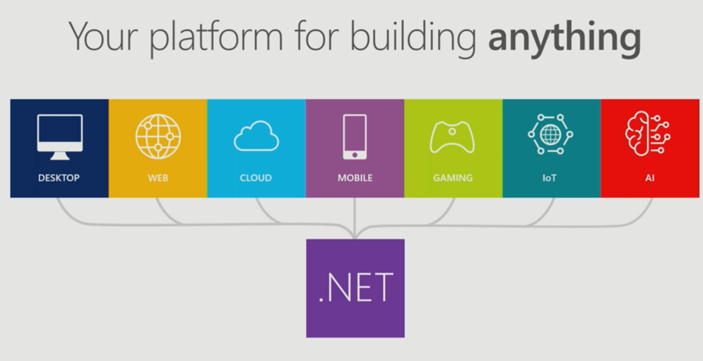
.NET Today
Notes:
So let’s look at the term “.NET” and how it has evolved over the years
It’s easy to associate the term .NET with some of the older technology that was successful with the initial versions of .NET. And many people still do
.NET helping with forms over data. Eg: Win Forms and Web Forms.
Later ASP.NET MVC and WPF got added
And in more recent years, Xamarin joined as part of .NET family
In 2019, “.NET” means a lot of things. We are striving to make .NET your platform of choice for building any type of app, on various platforms. Some of the common examples are:
Desktop application for Windows using WPF and .NET Core 3.0
Mobile app with .NET using Xamarin
.NET Core microservices on Linux in Kubernetes
Gaming app with Unity
Over the past year, we have released libraries supported new workloads such as
Incorporate machine learning in your app with ML.NET
.NET libraries for processing Big Data

Slide 3
.NET is growing
Millions of developers using .NET today
Over 1 million developers on .NET Core alone which got to v1 only in 2016
Tool chains for different platforms
VS / VS for Mac / VS Code
Notes:
It is a great time to be a .NET developer.
You can learn languages like C# that allow you to build applications across a variety of different use-cases
Over 1 million developers on .NET Core
Rate of adoption in 3 years is high
Supported on VS (on Windows) , VS for Mac (on MacOS), VS Code + CLI (Windows / Mac / Linux)

Slide 4
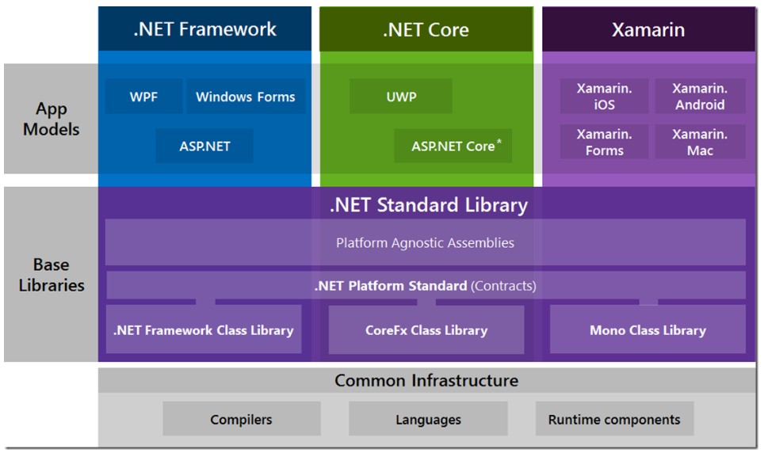
.NET Framework, .NET Core, Xamarin
Blog post (2016) : The “WHAT and WHEN to use it”
Notes:
Nice blog post that explains the architecture on the .NET Family

Slide 5
What’s New with .NET

Slide 6
.NET supports new workloads
.NET support for Apache Spark (dot.net/Spark)
Distributed analytics engine for large datasets, typically terabytes or petabytes
Previously only available for Scala, Java, Python, R. Now .NET as well
ML.NET 1.0 (dot.net/ML)
Create custom ML models using C# or F# without leaving the ecosystem
Automatic predictions using available data
Custom ML made easy with AutoML and ML.NET Model Builder
Notes:
Apache Spark
A free, open-source, and cross-platform big data analytics framework
Apache Spark can be used for processing batches of data, real-time streams, machine learning, and ad-hoc query.
This is now available for .NET as well.
ML.NET
ML.NET gives you the ability to add machine learning to .NET applications. With this capability, you can make automatic predictions using the data available to your application.
AutoML
Automated machine learning is a feature of ML.NET that performs automatic model selection and training. You specify the machine learning task and supply a dataset, and automated ML chooses the model with the best metrics.
ML.NET Model Builder
Simple tool for any developer to go and build some machine learning
Model Builder GIF : in the dot.net/ML home page

Slide 7
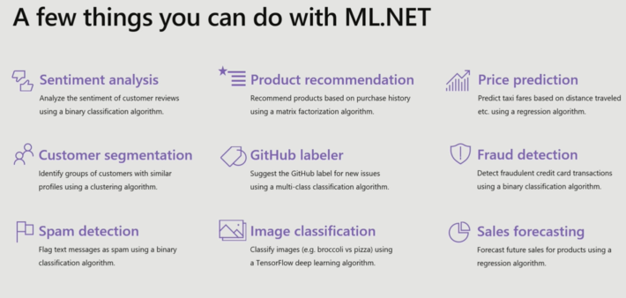

Slide 8
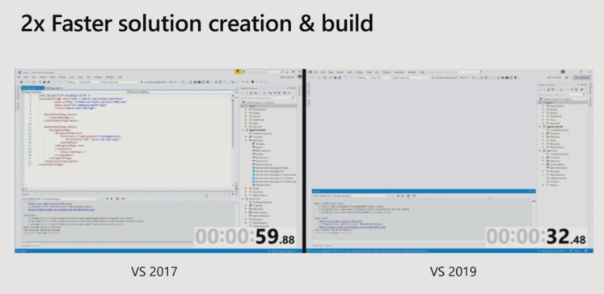
Xamarin in VS 2019
Smaller : VS 2017 : 23 GB. VS 2019 : down to 7 GB
Faster :
Notes:
VS 2019 : install size is greatly reduced
Solution creation and build is faster as well
VS 2019 and Xamarin : Focus has been on fundamentals and perf improvements

Slide 9
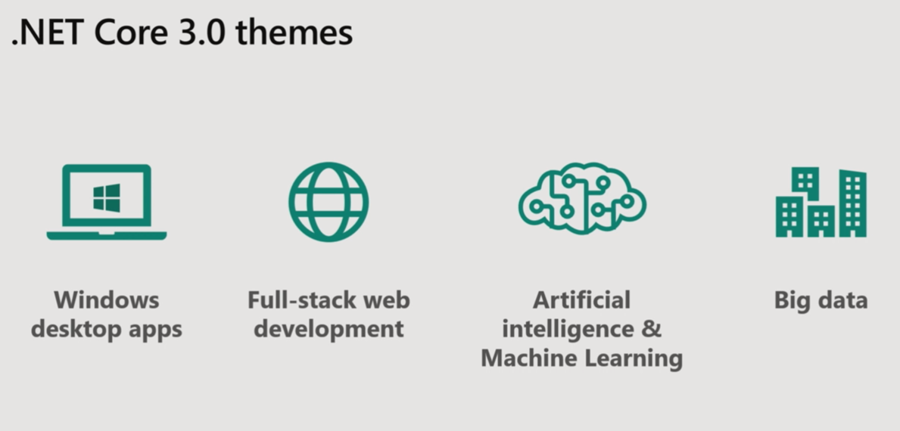
.NET Core 3
3.0 Preview 5 = Available; 3.0 GA = September
Notes:
AI / ML and Big Data
We saw in the previous slides

Slide 10
.NET Core 3
Windows desktop support with WPF and Win Forms, also open source
Full-stack web development with C# and Razor
Significant performance improvements
New C# language features for productivity and less errors

Slide 11
.NET Core 3 : Why Windows Desktop on .NET Core
Deployment Flexibility
Side-by-side support
Machine global or app local framework
Self-contained EXEs
Core runtime and API improvements
First-class support for modern requirements like High-DPI multi-monitor
Performance
Notes:
WinForms developer : why move to .NET Core
SxS
Performance
Self-contained
High DPI support
C# 8.0 support
Winforms designer : preview available.
Customers using existing winforms apps want a way forward
Looks easy but tricky. Process can load only 1 .NET - so the WinForms designer that runs on .NET Core is out-of-proc
XAML islands - so you can slowly evolve your apps

Slide 12
.NET Core 3 : C# 8 Features
Nullable reference types
public string? LastName { get; set; }
Switch expressions
colorBand switch {
Rainbow.Red => new RGBColor(0xFF, 0x00, 0x00),
Rainbow.Orange => new RGBColor(0xFF, 0x7F, 0x00),
};
Indices and ranges
var quickBrownFox = words[1..4];
Console.WriteLine($"The last word is {words[^1]}");

Slide 13
ASP .NET Core 3 : New templates
gRPC template
Worker Service
Web APIs + Identity
Blazor
Notes:
gRPC
open source RPC protocol stack built on top of HTTP2 and Protobuf
gRPC is a language-agnostic high-performance RPC framework. You can make RPC calls across frameworks
Working on a new .NET Core implementation of gRPC
Managed .NET Core gRPC client
Worker Service template
Small worker process : This template is intended to give you a starting point for writing long running services in .NET Core.
Config/ logging / DI on a generic host - class to host generic applications
Eg: You can create a worker and run it as a Windows Service.
Authentication for SPA apps
Blazor
Blazor is a framework for building interactive client-side web UI with .NET:
Blazor hosting models
Client-side Blazor
Server-side Blazor
Blazor applications that render from the server
Client-centric components : web socket connection using SignalR
Enables you to do full stack C# web apps
WASM is for web platform, similar to IL is for .NET

Slide 14
.NET Framework 4.8
Released on April 18th, available on Windows Update later this year
Accessibility improvements
Improved High DPI support for multi-monitor scenarios
General security, performance and reliability improvements

Slide 15
.NET in the future

Slide 16
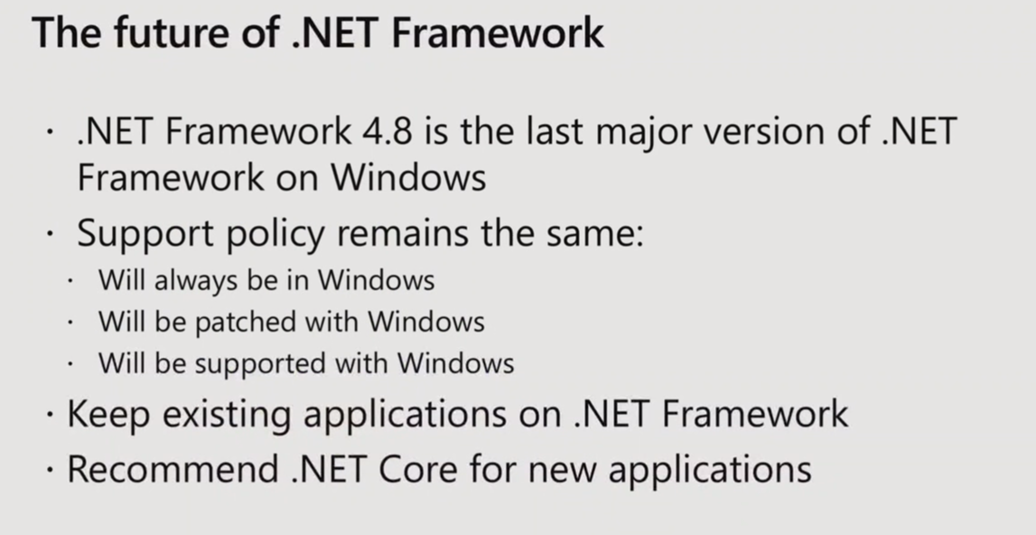
Notes:
.NET Framework is not ‘dead’. Good analogy: Classic ASP exists and ships in Windows today
Also, people don't realize:
VS and many services in Azure and other Microsoft products are built on .NET Framework
Will make your lives easier as we'll quit breaking you

Slide 17
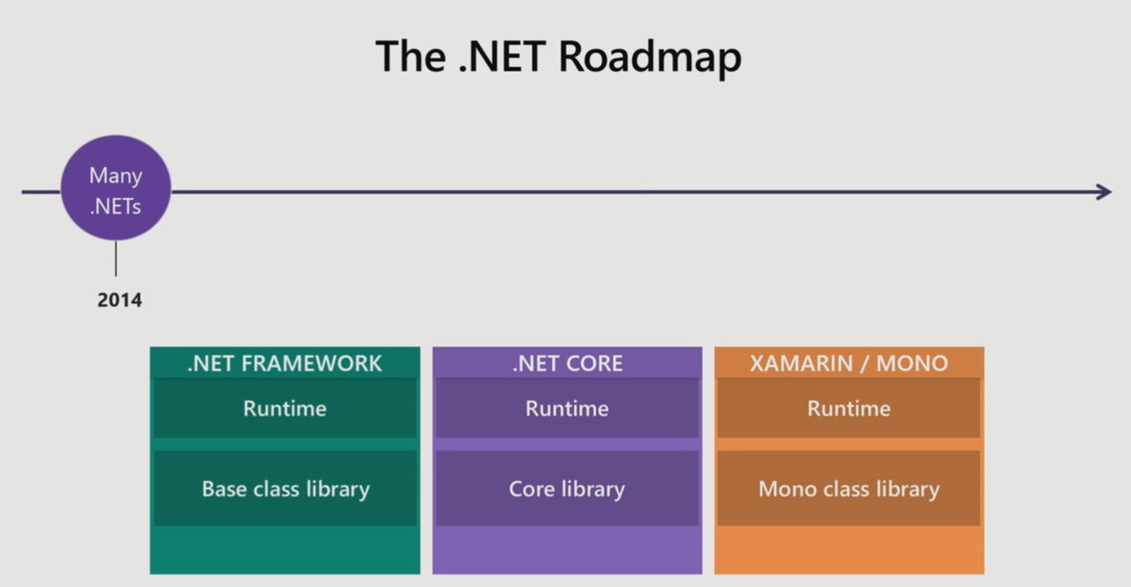

Slide 18
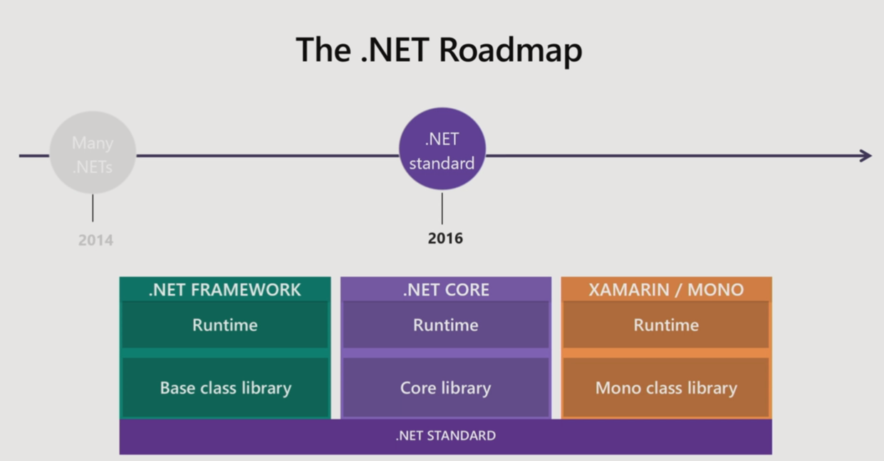

Slide 19
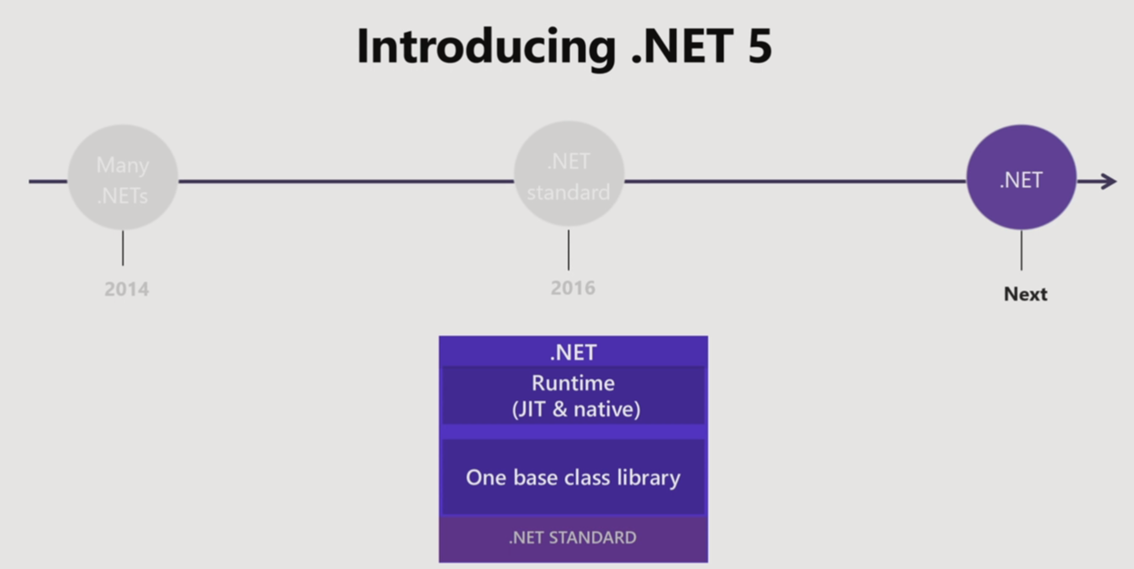

Slide 20
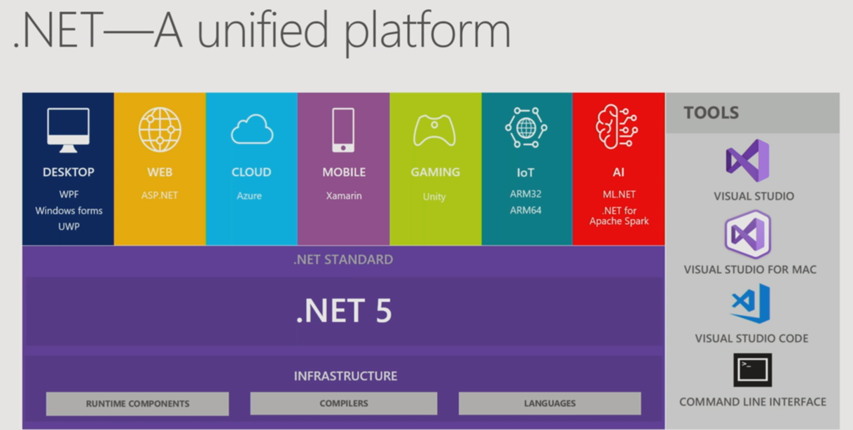
Notes:
We are taking the best of Mono, best of .NET Core : unify and call it .NET 5
.NET Core as the core, and what are we adding?
.NET Core 3 : winForms, WPF, EF6
Mono : wii, PS4, Android/iOS devices
Supports ahead-of-time compile. Compile the app to native code, does not need JIT
Better for smaller devices, startup, more secure in some ways
Unity will be part of .NET 5 as well
BCL will be corefx
we have 3 implementations of BCL today
.NET Fx, .NET Core, Mono

Slide 21
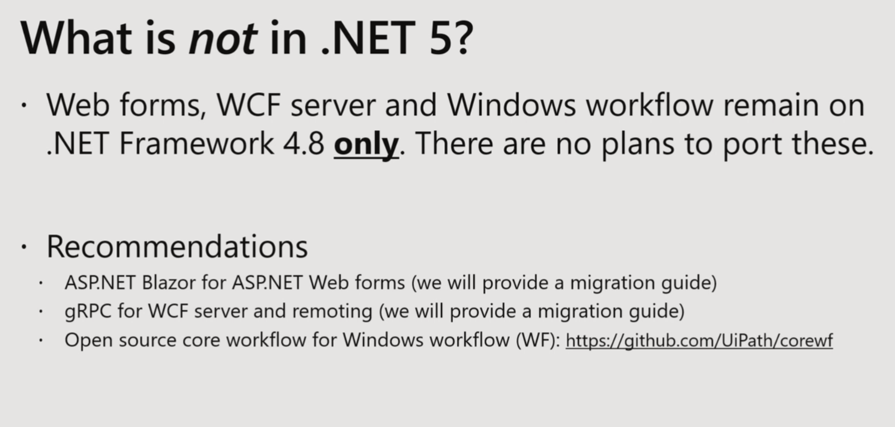
Notes:
Web Forms - why not?
Blog post
System.web existing web stack inside .NET Framework
It won't be compatible. It is heavily tied to IIS, windows-centric and windows-only
Many customers have move to MVC - it's easier to migrate MVC app to ASP.NET Core
Win Forms - huge cost
Telerik/DevExpress need to update their controls to make it work on the designer in Core

Slide 22
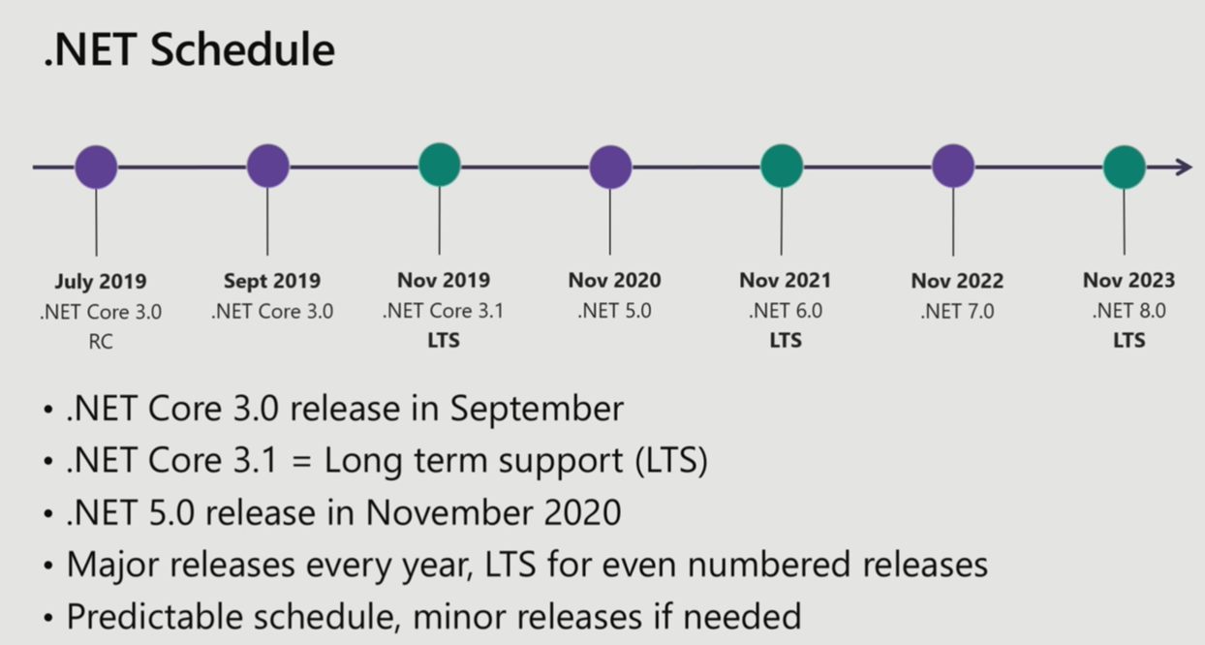
Notes:
LTS vs Current
LTS : if you're on 2.1, you can stay on that for 3 years. We'll continue to give security patches/bug fixes
Current, if you're on 2.2, you need to keep moving forward
JS frameworks : customers consume these and move forward very quickly
We want to make moving from version to version easier in the future
.NET support policy: https://dotnet.microsoft.com/platform/support/policy
New ASP.NET Core 2.2
2.2 (.NET Framework)
2.1 (.NET Framework)
Long term support
2.2 (.NET Core) to 3.0 : will be a simple migration
When should I update target framework?
It's up-to the DevOps process to decide when to update. There's also framework-dependent and self-contained options

Slide 23
