Slide 1
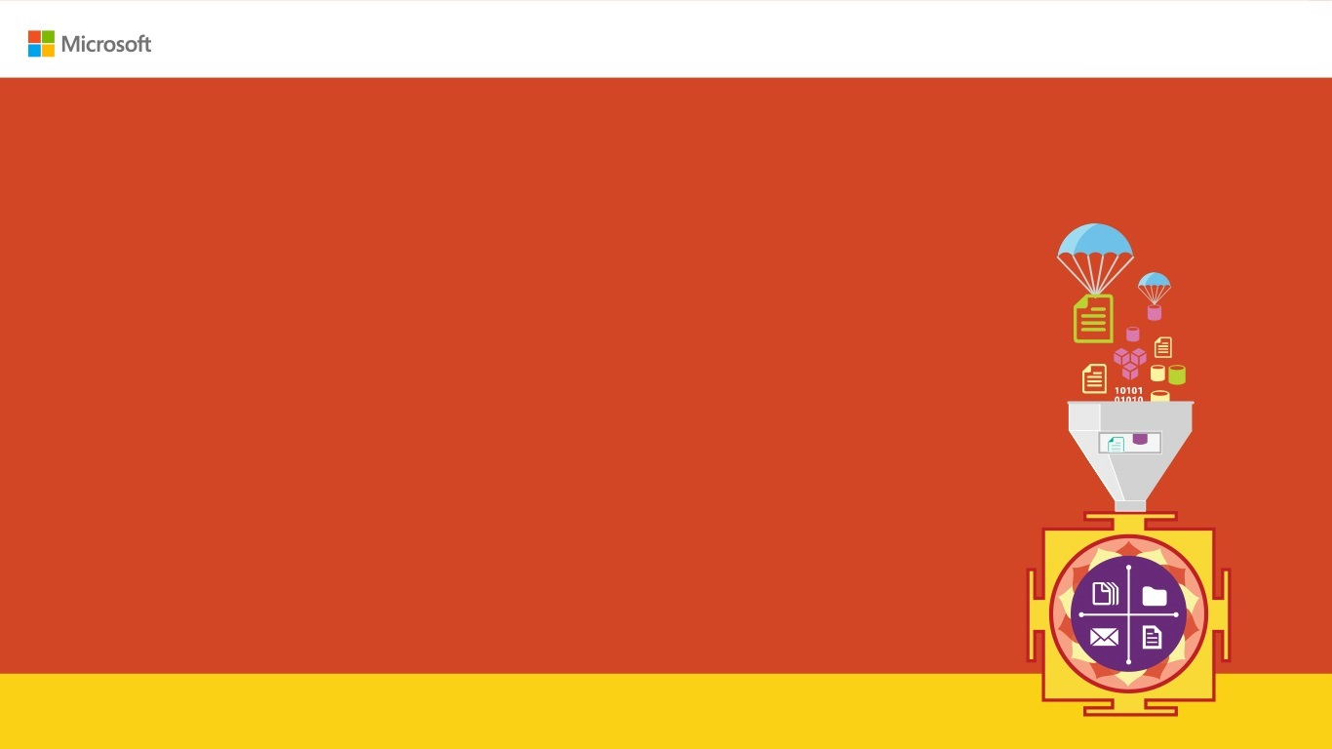
Kubernetes for Klueless
Karthikeyan VK
Twitter: @Karthik3030
Blogs.karthikeyanvk.in
Notes:
https://www.facebook.com/aspiringDotnetArchitects/

Slide 2
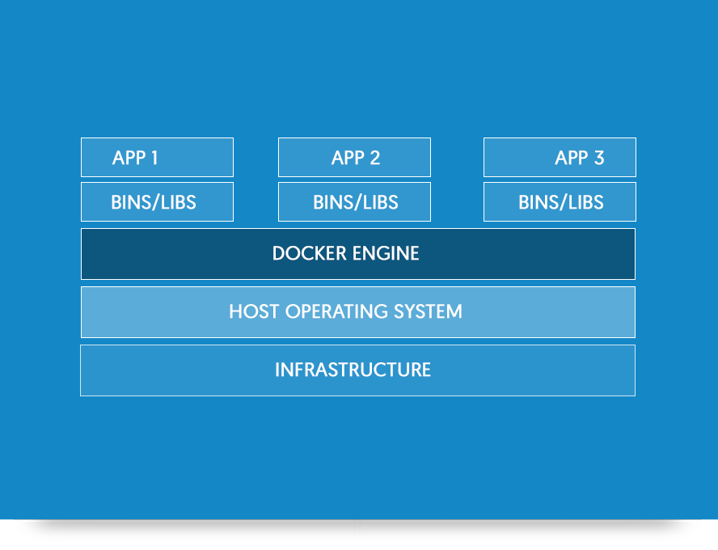
What is a Container?
Windows Containers provide operating system virtualization that allows multiple isolated applications to be run on a single system.

Slide 3
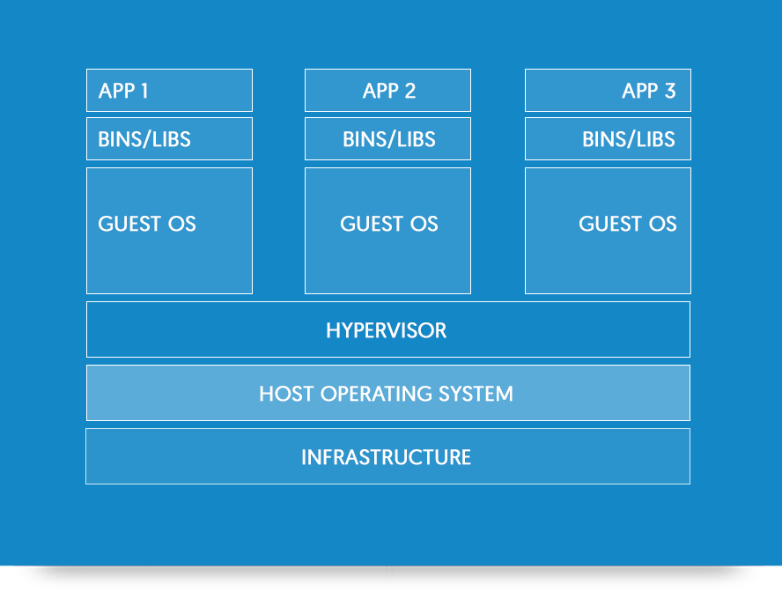
Difference between Containers and VMs

Slide 4
Difference between Containers and VMs
Notes:
Containers :
Containers include the application and all of its dependencies– but share the kernel with other containers, running as isolated processes in user space on the host operating system. Containers are not tied to any specific infrastructure: they run on any computer, on any infrastructure and in any cloud.
Virtual Machines :
Virtual Machines include the application, the necessary binaries and libraries, and an entire operating system.

Slide 5
Why Containers ?

Slide 6
Why Containers?
Transforming existing applications into cloud Is Hard!
Building Hybrid Cloud applications Is Hard!
Think about building solutions that should be deployed in Azure, AWS & GCP at the same time

Slide 7
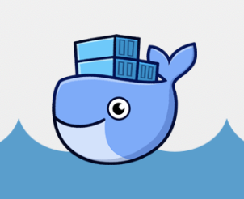
What is Docker ?
Docker is an open platform for developing, shipping, and running applications

Slide 8
DEMO !!!

Slide 9
What is Kubernetes ?
Kubernetes is an open-source system for automating deployment, scaling, and management of containerized applications.
Orchestrator for Containers

Slide 10
What is Kubectl ?
Kubectl is a command line interface for running commands against Kubernetes clusters.

Slide 11
What is Pod?
A Kubernetes pod is a group of containers that are deployed together on the same host.

Slide 12
What is Kubernetes Service?
A Kubernetes Service is an abstraction which defines a logical set of Pods and a policy by which to access them

Slide 13
What is Kubernetes Replica Sets?
Replica Set ensures how many replica of pod should be running. It can be considered as a replacement of replication controller.

Slide 14
What is Azure Kubernetes Service ?
Azure Kubernetes Service (AKS) manages your hosted Kubernetes environment, making it quick and easy to deploy and manage containerized applications without container orchestration expertise.
It eliminates the burden of ongoing operations and maintenance.

Slide 15
DEMO !!!

