Slide 1

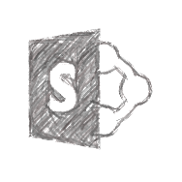






Microsoft365 SharePoint Office 365 SPFX Fabric-UI PnP
Increase the speed of SHAREPOINT FRAMEWORK Implementation
CI/CD with AZURE DEVOPS
Shantha Kumar
Ktskumar
C# Corner MVP | Sr. Tech Lead [ HCL ]

Slide 2
Microsoft365 SharePoint Office 365 SPFX Fabric-UI PnP
AGENDA
Open Source Component
Flexible
Very easy to use
SharePoint Framework
Azure DevOps
Demo
Q & A

Slide 3
Microsoft365 SharePoint Office 365 SPFX Fabric-UI PnP
SHAREPOINT FRAMEWORK
Open Source Component
Flexible
Very easy to use
Modern development
Webparts & Extensions
Toolchains – Node, npm, gulp, Yeoman
Source Repository – Azure Repo , GitHub, etc..

Slide 4
Microsoft365 SharePoint Office 365 SPFX Fabric-UI PnP
SHAREPOINT FRAMEWORK – DEVELOPMENT & DELIVERY PROCESS
Open Source Component
Flexible
Very easy to use
Yeoman Generator – Create SharePoint Framework Project
Install Dependencies
Test Local
Bundle the SharePoint Framework
Package SharePoint Framework
Deploy to App Catalog
Publish the Package

Slide 5
Microsoft365 SharePoint Office 365 SPFX Fabric-UI PnP
DEVOPS ?
Build& Test
Open Source Component
Flexible
Very easy to use
Deploy
DevOps is the union of people, process, and products to enable continuous delivery of value to your end users.
“
Continuous Delivery
Develop
Operate
”
Plan & Track
Monitor & Learn

Slide 6





Microsoft365 SharePoint Office 365 SPFX Fabric-UI PnP
AZURE DEVOPS
Open Source Component
Flexible
Very easy to use
Azure Boards
Azure Repos
Azure Pipelines
Azure Test Plans
Azure Artifacts
An end-to-end solution for organizations looking for an enterprise-grade toolchain
Fully Integrated with end to end traceability
Scalable to any team and project size
Highly available, multi region, hybrid cloud & on-prem
Customer Support
Consistent admin and access control
➔
https://azure.com/devops

Slide 7
Microsoft365 SharePoint Office 365 SPFX Fabric-UI PnP
AZURE PIPELINES – CI / CD
Open Source Component
Flexible
Very easy to use
Continuous integration (CI)
Improve software development quality and speed.
When you use Azure Pipeliens or Jenkins to build apps in the cloud and deploy to Azure, each time you commit code, it’s automatically built and tested and bugs are detected faster.
Continuous Deployment (CD)
By combining continuous integration and infrastructure as code (IaC), you’ll achieve identical deployments and the confidence to deploy to production at any time.
With continuous deployment, you can automate the entire process from code commit to production if your CI/CD tests are successful.

Slide 8
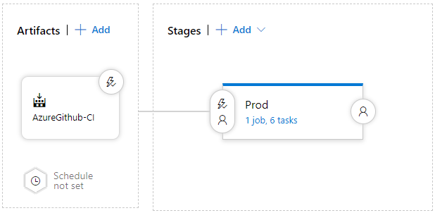
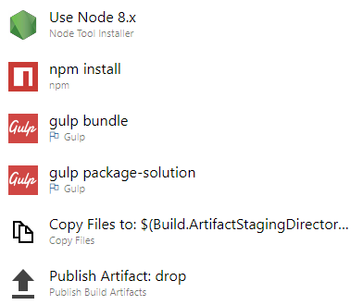
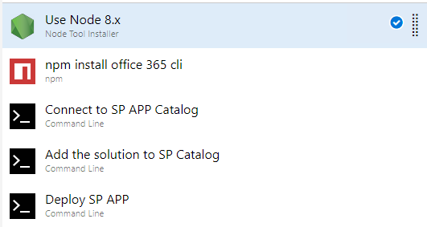
Microsoft365 SharePoint Office 365 SPFX Fabric-UI PnP
SHAREPOINT WITH CI / CD
Continuous Integration – Build
Continuous Deployment - Release
Open Source Component
Flexible
Very easy to use

Slide 9
Microsoft365 SharePoint Office 365 SPFX Fabric-UI PnP
Open Source Component
Flexible
Very easy to use
DEMO

Slide 10
Microsoft365 SharePoint Office 365 SPFX Fabric-UI PnP
Thank you
#msftlocalconnect
Ktskumar.com
Open Source Component
Flexible
Very easy to use
ktskumar
ktskumar
ktskumar
ktskumar
ktskumar

