Slide 1


Slide 2



Who’s this guy?
Harikrishnan
@cn_harikrishnan (https://twitter.com/cn_harikrishnan?s=08)
https://www.linkedin.com/in/hari-krishnan-304a0272
cnharishkrish@gmail.com

Slide 3
Agenda
Why Xamarin?
Xamarin – Growing with you
Xamarin Essentials

Slide 4


Slide 5

Today : Visual Studio 2019 and Xamarin
Native API support:
iOS: 97,749 (from 3,386)
Android 152,632
Code Sharing via .NET Standard 2
Cross-platform frameworks:
Xamarin.Forms
Xamarin Essentials
Use the same tools you know and love
Microsoft Learn (previously Xamarin University)
Reflection Emit, Dynamic, Assembly.Load on iOS
Free!

Slide 6
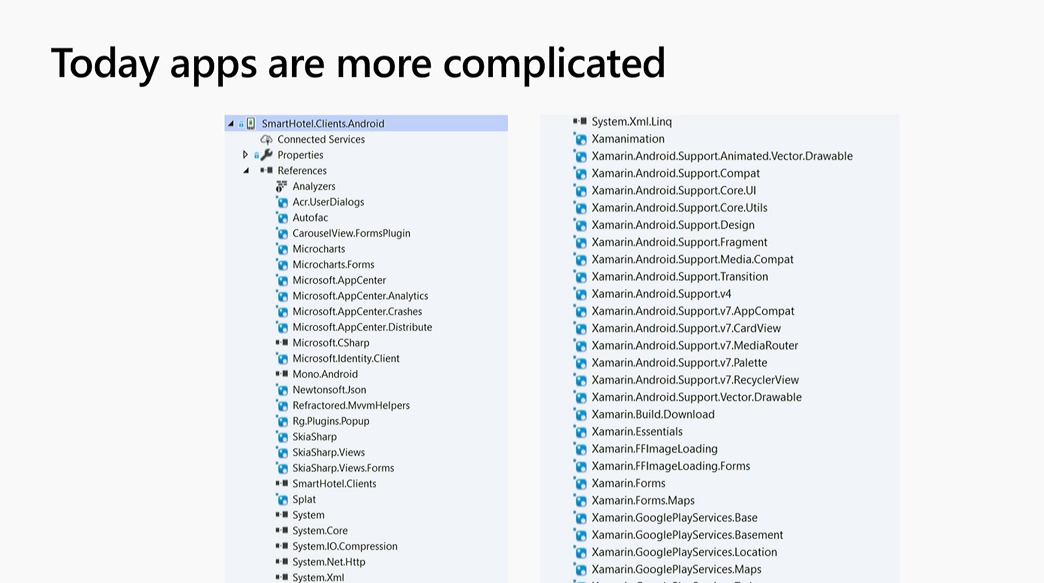
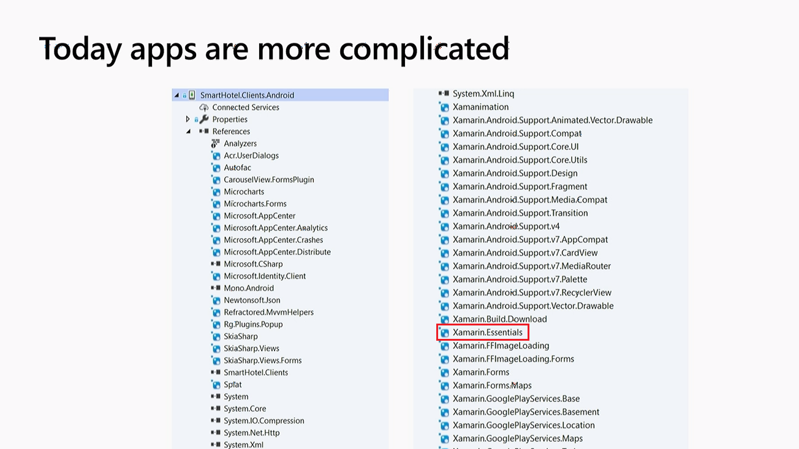

Slide 7
Cross-Platform Access to Platform Services
Xamarin.Essentials 1.2.0 is now available.
Easier than ever to access non-UI platform APIs from shared code.

Slide 8
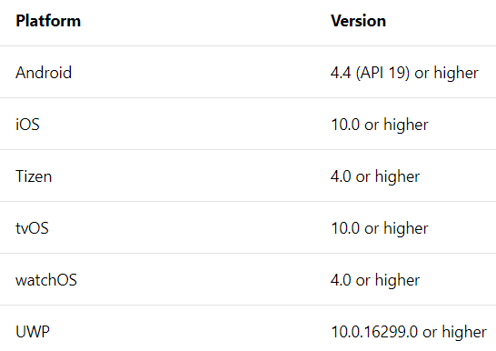
Supported Platforms
Note:
Tizen is officially supported by the Samsung development team.
tvOS & watchOS have limited API coverage, please see the feature guide for more information.
Tizen, tvOS, & watchOS are currently in preview and available in Xamarin.Essentials 1.3-pre

Slide 9
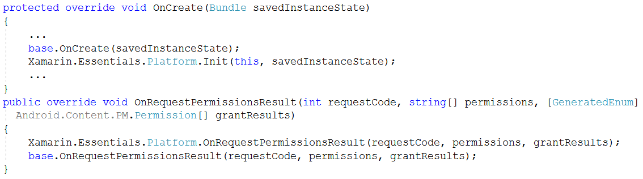
Get Started with Xamarin.Essentials
Add the Xamarin.Essentials NuGet package to each project
Add a reference to Xamarin.Essentials in any C# class to reference the APIs
Android Initialization:

Slide 10
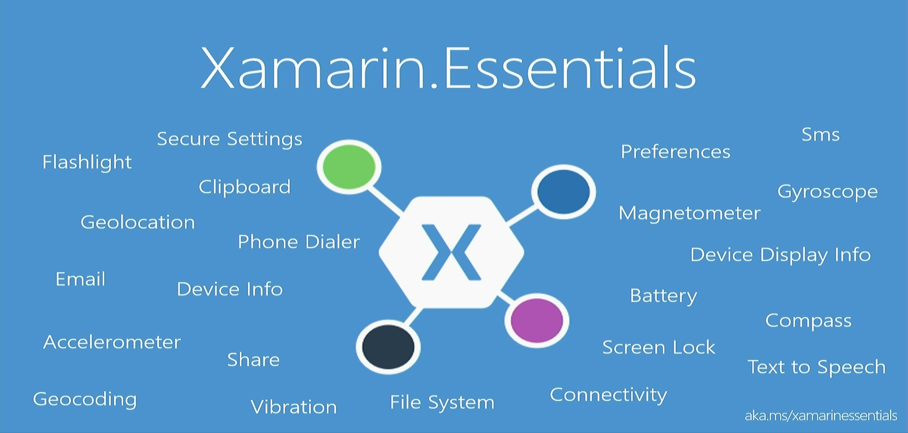

Slide 11
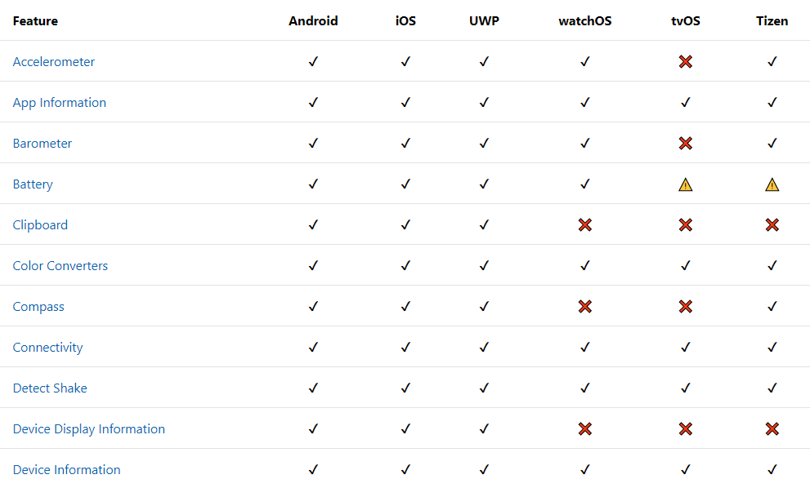
Feature Support

Slide 12
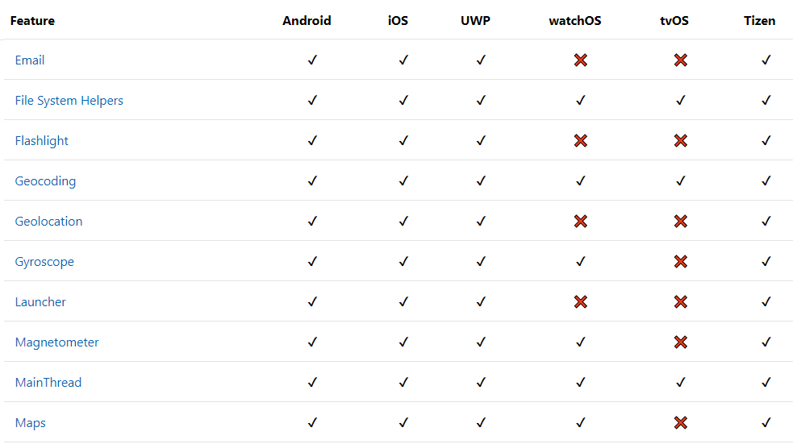
Feature Support

Slide 13
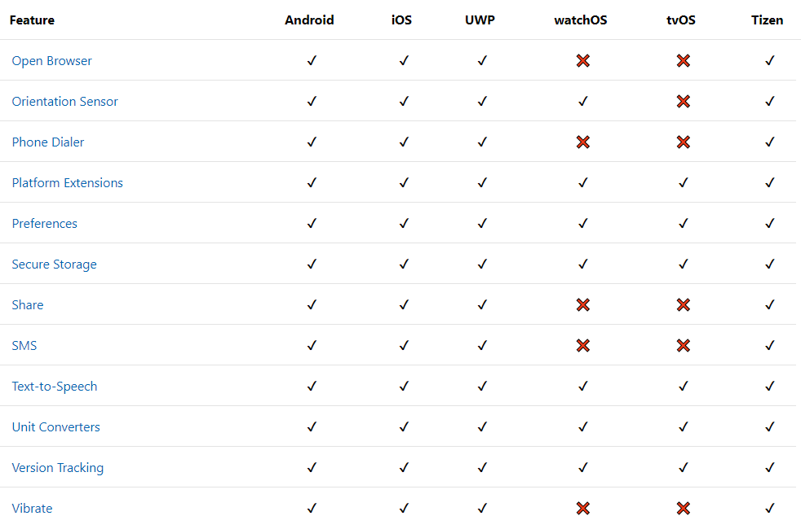
Feature Support

Slide 14
Let's code an Application

Slide 15
Documentation
https://docs.microsoft.com/en-us/xamarin/essentials/
Source code
https://github.com/xamarin/Essentials

Slide 16
Any Queries?
Harikrishnan
@cn_harikrishnan (https://twitter.com/cn_harikrishnan?s=08)
https://www.linkedin.com/in/hari-krishnan-304a0272
cnharishkrish@gmail.com

