Slide 1
OpenMockup
A standard interchange file format and domain model for mockups
By Xavi Montero - april/2016

Slide 2
Think about PNG… JPG…
When we receive an image, we don’t care the program it was made it with.
A standard exists.
This allows for interop, which means productivity.

Slide 3







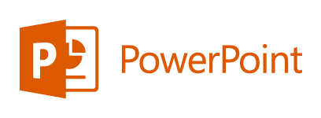







Workflow with standard images
Camera
Presentation
Processing
User screen
Scanner
Everything interops

Slide 4
When we talk about…
Image, PNG (looseless), JPG (loosy).
Audio, AIFF/WAV (looseless), MP3 (loosy).
Web, HTML/XML (data), ECMA/Javascript (scripting), CSS (styles).
API, REST/SOAP (protocol), JSON/XML (data).
Virtual machines, VMDK (virtual disk).
Geo, KML (keyhole markup).
…

Slide 5
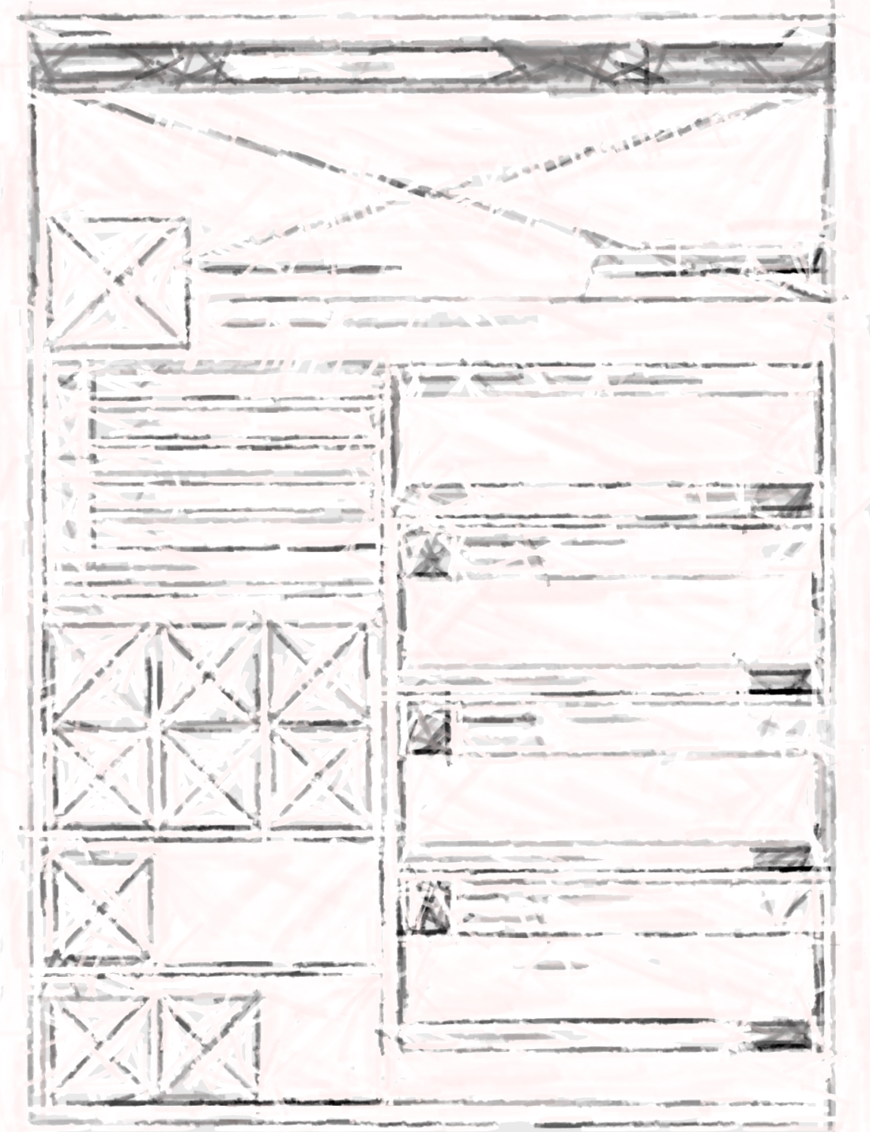
There is a Gap!!!
What about Mockups and Wireframes?

Slide 6






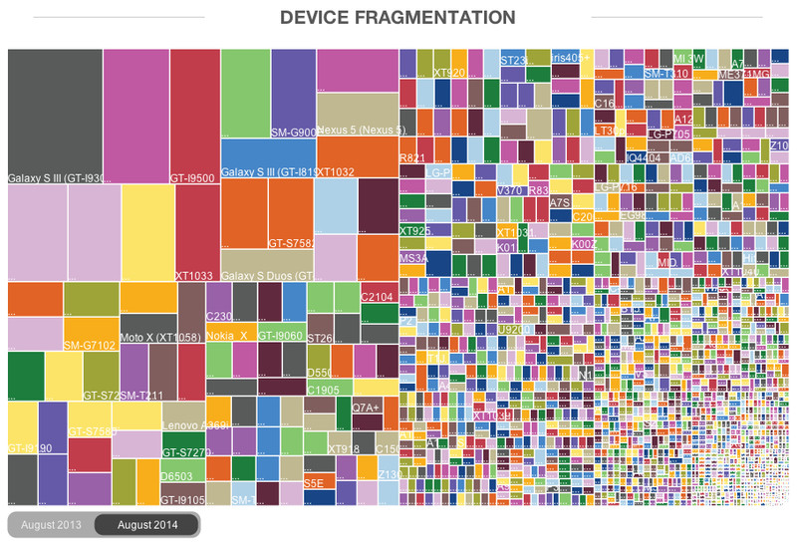
Macro-Trends…
Increasing habit of using mockups in companies.
Increasing number of software solutions.
Problem!! Evolving to fragmentation!!!!!!
To name just a few. There are tons of them and very, very good all of them. We are not engaged with anyone.

Slide 7
Solution
It’s time to create an Standard

Slide 8
Solution
It’s time to create an Standard
OpenMockup
is wants to be
a Standard
Interchange File Format
and Domain Model
for Mockups and Wireframes

Slide 9
OpenMockup features (I)
It will be the first standard. There is no standard now.
Open – No commercial restrictions. OpenSource definition.
Not bound commercially to any party. Slave of nobody.
Friend of all market players and companies.
Developers of mockup and wireframing software.
Companies using mockup software to make their prototypes.
Friend of all users.
Tech-sided guys.
Design-sided guys.
Business-sided guys.

Slide 10
OpenMockup features (II)
Double definition: File-format + Domain Model.
Some aggregate concepts within a Project:
Pages Each instance of something the user views.
Widgets Reusable components. Can be nested.
Templates Layouts that act as decorator containers.
Modals/Popups Reusable catch-all windows.
Styles Same page architecture, different outputs.
Palettes Coded colors “primary color”, “link color”, …
Scripts In-project standardized scripting (C#).

Slide 11
OpenMockup features (III)
CVS friendly (git, subversion, mercurial…)
Multiple .yml files with domain objects (pages, widgets, etc.)
Each file is human-readable. At each commit we know what we change.
Project dependencies (like in composer, bower, etc.)
Third party widgets, version-proof, does not break.
Fonts, assets, etc.
Export to single “.mockup” file for sending/sharing.
Contains all the dependencies, for easy sending over e-mail, dropbox, etc.

Slide 12
OpenMockup features (IV)
Event-Driven. Click, DoubleClick, Rotate, Resize, etc.
Multi-language domain bindings. Scriptable.
Dependency Injection.
Change mockup test data without altering the source files of the mockup.
Testing a 1024-long-email in a field can’t break “the project” as the source of the project is untouched.

Slide 13
OpenMockup features (V)
Scriptable + Dependency-Injection => Testable!!!
Automated tests on the Mockups.
Functional => tests pages
Unit => tests widgets
If some designer leaves a page as “non-reachable” it can be “catched” in an automatic manner.
NEW WORKFLOW IN THE WORLD!!! Stop the “We have the rule that if it is not designed, it does not enter in the sprint, but for this time, we’ll make an exception”.
Boolean QA for the design team before inserting a UserStory in the Backlog the same manner now we do QA in code before deploy.
The QA runs the functional-tests and says if the “mockup” is “ready to be passed to developers”. Green Light => Story can enter. Red Light => No.

Slide 14
OpenMockup features (VI)
Same project, multiple view modes:
Hi-Res style A, Hi-Res style B for user A/B testing, etc.
Wireframe for communicating concepts, etc.
Support for transparent hot-spots for high-res images.
Bundled with basic standardized widgets:
Line, label, text-input, button, scrollbar, etc.

Slide 15
OpenMockup features (VII)
Community of free and open projects
Reusable complex widgets
Templates for different devices
Presentation styles, and many more…
Roles:
Communicators Active in forums, groups, communities.
Domain modelers Help in creating the domain-model.
Thinkers Contributors to the standard.
Validators Check your current design is supported.
Advocates Just spread the word if you love the idea!!!
Many more.
I need help
to build
the community!!!

Slide 16


Thanks!!!
If you like the idea, even if just “a little bit”…
Please, help me to create the community! – Spread the word!
Share this OpenMockup.net
Follow this (low traffic) @OpenMockup

Slide 17
Credits:
Original OpenMockup idea and presentation content:
Xavi Montero – xmontero@dsitelecom.com
Acknowledgements:
Presentation template from:
http://www.free-power-point-templates.com/free-3d-cubes-powerpoint-template/
Logos and Trade Marks:
Obtained via Google Images.
CreativeCommons Mockup from here:
https://www.flickr.com/photos/mockupbuilder
Fragmentation image from:
http://www.androidcentral.com/another-android-fragmentation-report-misses-point

