Slide 1





GENI Exploring Networks of the Future
www.geni.net

Slide 2
Outline
What is GENI?
How is GENI being used?
Key GENI Concepts
Demo: A simple experiment using GENI

Slide 3
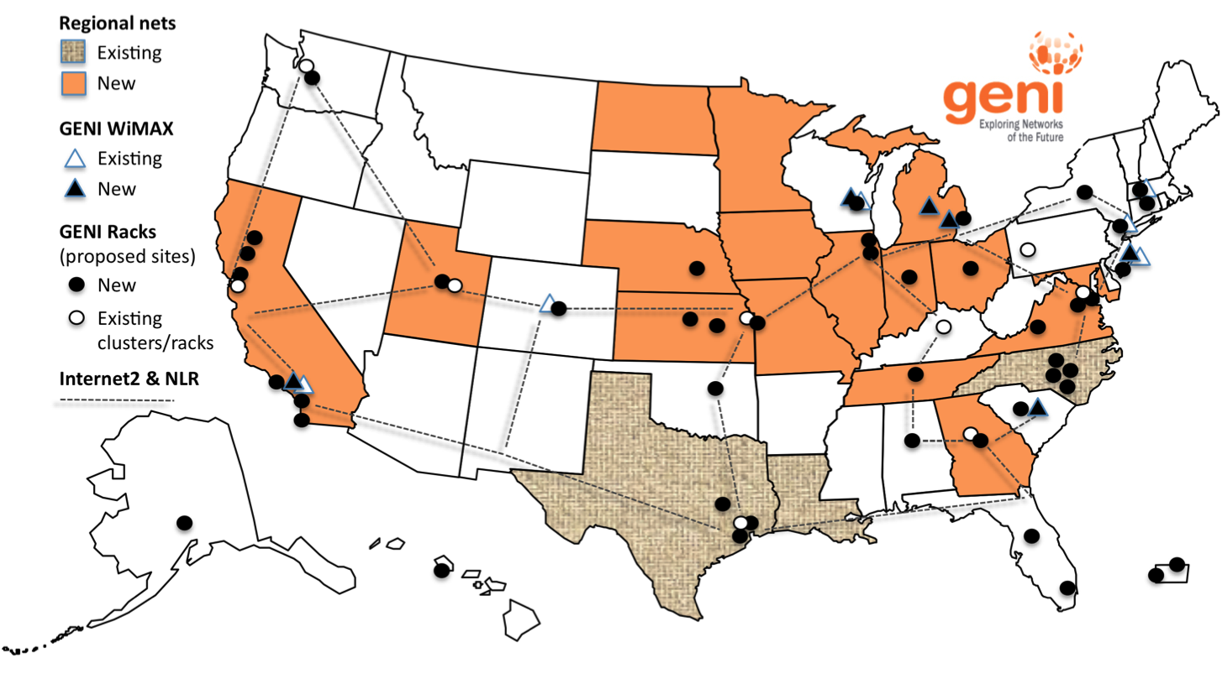
GENI: Infrastructure for Experimentation
GENI provides compute resources that can be connected in experimenter specified Layer 2 topologies.
Notes:
GENI is a nationwide suite of infrastructure for “at scale” experiments in networking, distributed systems, security, and novel applications.
GENI opens up huge new opportunities
Leading-edge research in next-generation internets
Rapid innovation in novel, large-scale applications
Key GENI concept: slices & deep programmability
Internet: open innovation in application programs
GENI: open innovation deep into the network

Slide 4
GENI: Infrastructure for Experimentation
GENI provides compute resources that can be connected in experimenter specified Layer 2 topologies.
Notes:
GENI is a nationwide suite of infrastructure for “at scale” experiments in networking, distributed systems, security, and novel applications.
GENI opens up huge new opportunities
Leading-edge research in next-generation internets
Rapid innovation in novel, large-scale applications
Key GENI concept: slices & deep programmability
Internet: open innovation in application programs
GENI: open innovation deep into the network

Slide 5

Multiple GENI Experiments run Concurrently
Experiments live in isolated “slices”
Resources can be shared between slices

Slide 6

GENI is “Deeply Programmable”
I install software I want throughout my network slice (into routers, switches, …) or control switches using OpenFlow
OpenFlow part of the experiment not only the infrastructure
Notes:
Experimenters set up custom:
topologies
protocols
forwarding

Slide 7
Federation GENI grows by GENI-enabling heterogeneous infrastructure
My experiment runs across the evolving GENI federation.
GENI Rack
Commercial
Clouds
Backbone #1
Campus
My GENI Slice
Access #1
Corporate
GENI suites
Research
Testbed
Regional
Non-US
Testbeds
This approach looks remarkably familiar . . .
GENI Rack
Avoid technology “lock in” and grow quickly by incorporating existing infrastructure
Notes:
7

Slide 8
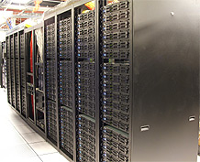
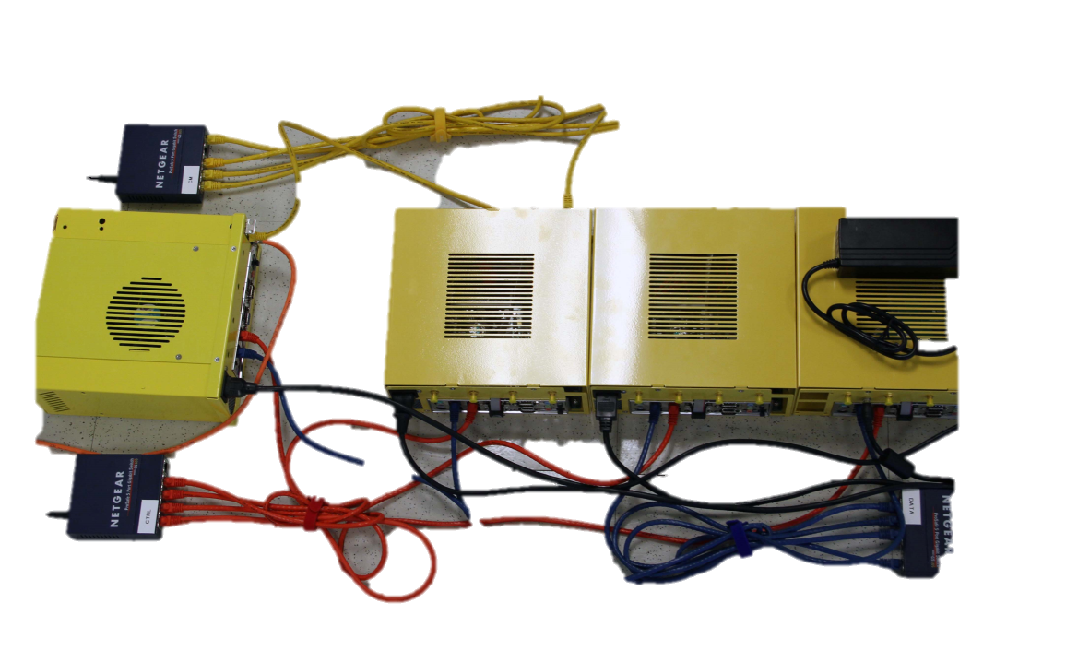
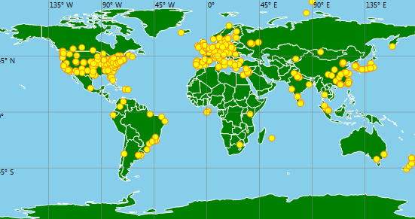
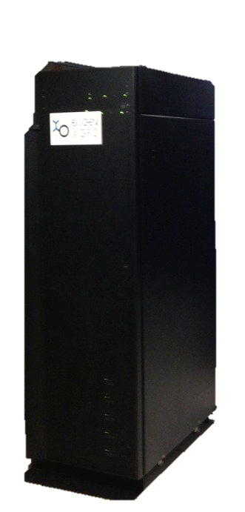
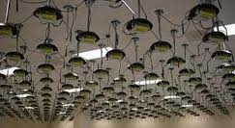
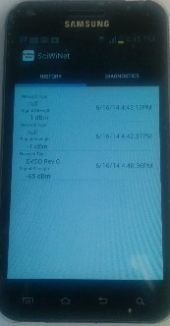
GENI Compute Resources
Emulab
GENI Racks
GENI Wireless compute nodes
Planetlab
ORBIT
Existing Testbeds

Slide 9

GENI Operations
GMOC: GENI Meta-operation Center
Keeps track of outages
Notification system for resource reservation
Monitors most GENI Aggregates
GMOC Google Calendar keeps track of reservations/outages

Slide 10
Outline
What is GENI?
How is GENI being used?
Key GENI Concepts
Demo: A simple experiment using GENI

Slide 11

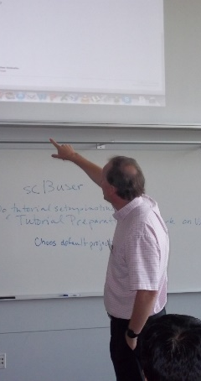
How is GENI being Used?
Research
Future Internet architectures
Software defined networking
Large scale evaluation of smart grid protocols
Education
Over 50 classes using GENI in all levels
Networking and Distributed systems classes
Cloud computing classes
WiMAX classes

Slide 12
Outline
What is GENI?
How is GENI being used?
Key GENI Concepts
Demo: A simple experiment using GENI

Slide 13
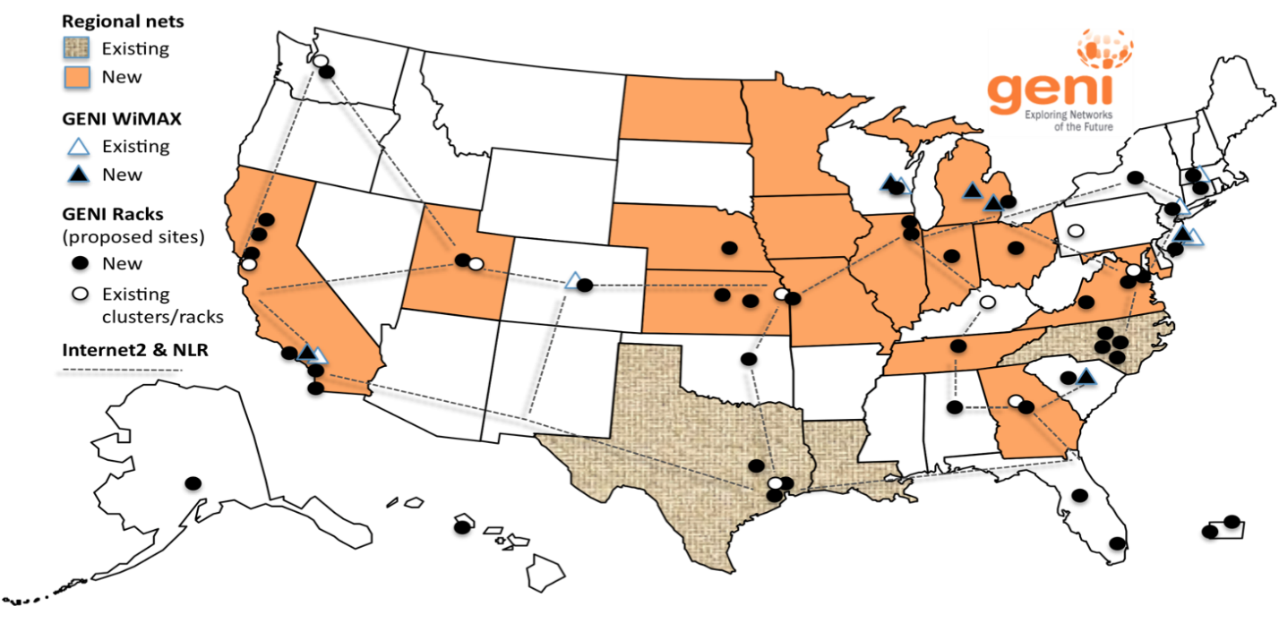
GENI: Terms and Definitions
Slice
Abstraction for a collection of resources capable of running experiments
An experiment uses resources in a slice
Slices isolate experiments
Experimenters are responsible for their slices

Slide 14
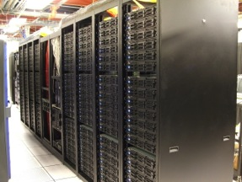
Clearinghouse and Aggregates
Create & Register Slice
users
projects
slices
Slice credentials
clearinghouse
Aggregate Manager API
- listResources
- createSliver
…
Researcher
Tool
Aggregate
Manager
Aggregate Resources
Clearinghouse: Manages users, projects and slices
Standard credentials shared via custom API or new Common CH API
GENI supported accounts: GENI Portal/CH, PlanetLab CH, ProtoGENI CH
Aggregate: Provides resources to GENI experimenters
Typically owned and managed by an organization
Speaks the GENI AM API
Examples: PlanetLab, Emulab, GENI Racks on various campuses

Slide 15
GENI: Terms and Definitions
A slice : One or more resources provided by an aggregate
E.g. Bare machines, virtual machines, VLANs
GENI Rack #3
My slice contains slivers from many aggregates.
Commercial
Clouds
Backbone #1
GENI Rack
#1
My GENI Slice
Access #1
Corporate
GENI suites
Research
Testbed
Backbone #2
Other-Nation
Projects
GENI Rack #2

Slide 16
Resource Specifications (RSpecs)
RSpecs: Lingua franca for describing and requesting resources
“Machine language” for negotiating resources between experiment and aggregate
Experimenter tools eliminate the need for most experimenters to write or read RSpec
<?xml version="1.0" encoding="UTF-8"?>
<rspec xmlns="http://www.protogeni.net/resources/rspec/2"
xmlns:xsi="http://www.w3.org/2001/XMLSchema-instance"
xsi:schemaLocation="http://www.protogeni.net/resources/rspec/2
http://www.protogeni.net/resources/rspec/2/request.xsd"
type="request" >
<node client_id="my-node"
exclusive="true">
<sliver_type name="raw-pc" />
</node>
</rspec>
RSpec for requesting a single node

Slide 17

Resource Reservation using RSpecs and the AM API
Advertisement RSpec: What does an aggregate have?
Request RSpec: What does the experimenter want?
Manifest RSpec: What does the experimenter have?
ListResources(…)
Advertisement RSpec
Client
CreateSliver(Request RSpec, …)
Aggregate
Manager
Manifest RSpec
ListResources(SliceName, …)
Manifest RSpec

Slide 18
Outline
What is GENI?
How is GENI being used?
Key GENI Concepts
Demo: A simple experiment using GENI

Slide 19
Questions?

Slide 20
Current GMOC Operational Support
Monitor and triage problem resolution on the GENI Integrate OpenFlow Core network (Mesoscale)
Emergency Stop
GENI Experimenter Support
Manage network/systems alarms, outages, maintenances,
Mesoscale provisioning, maintenance freezes, demo reservations and disruptive experiment reservations (and post-mortem)
Notifications, Escalation and Reporting
Engineering configuration (Internet2, MOXI, Indiana) and new Aggregate site, regional and GENI rack turn-up
GMOC Measurement API for GENI Aggregates
Develop new tools for network monitoring and measurement
^{Modified slide from:} http://groups.geni.net/geni/attachment/wiki/GEC18Agenda/RackOpsAndMeasurement/GEC18%20GMOC%20Presentation.pdf

