Slide 1
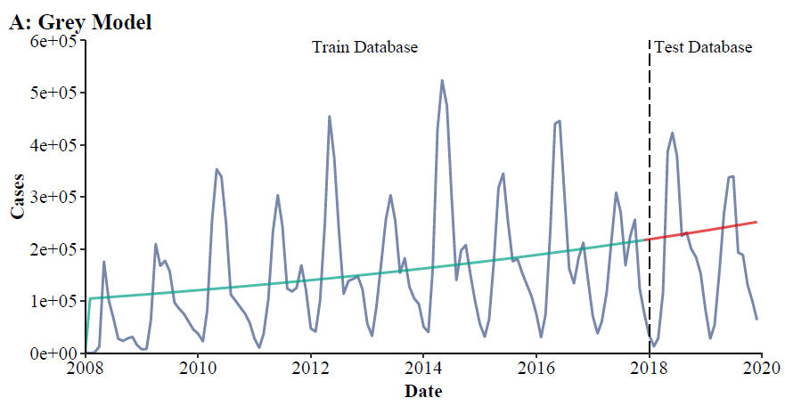
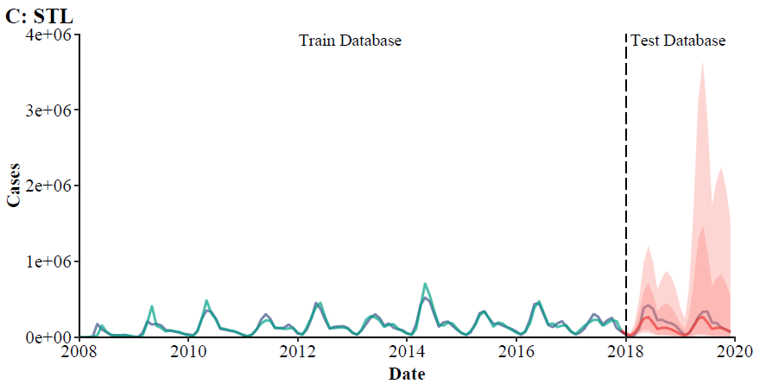
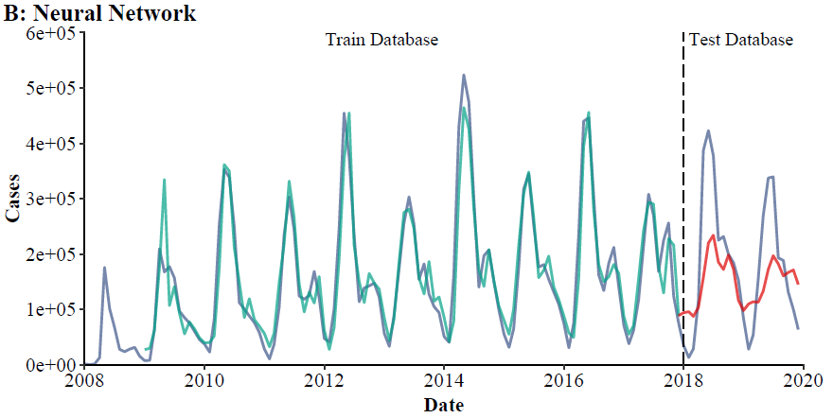
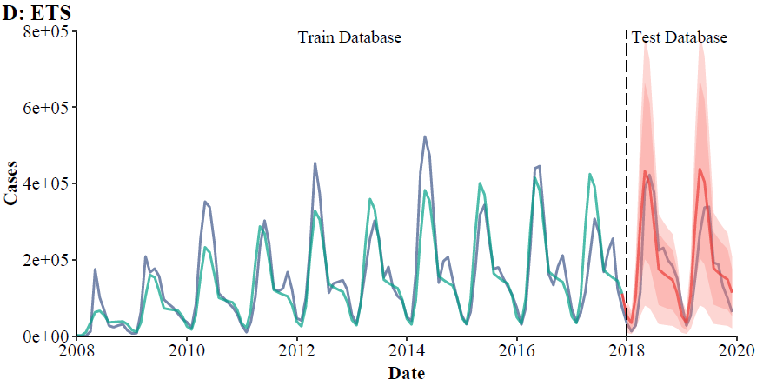
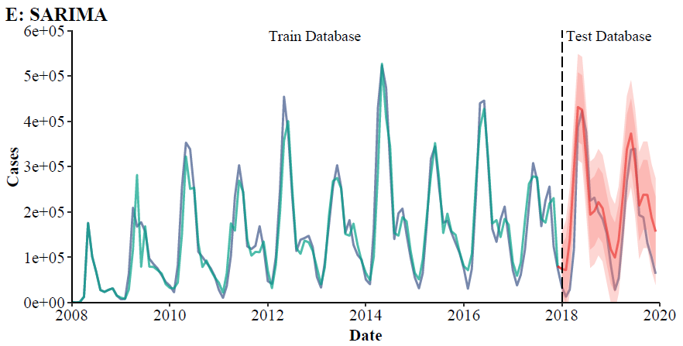
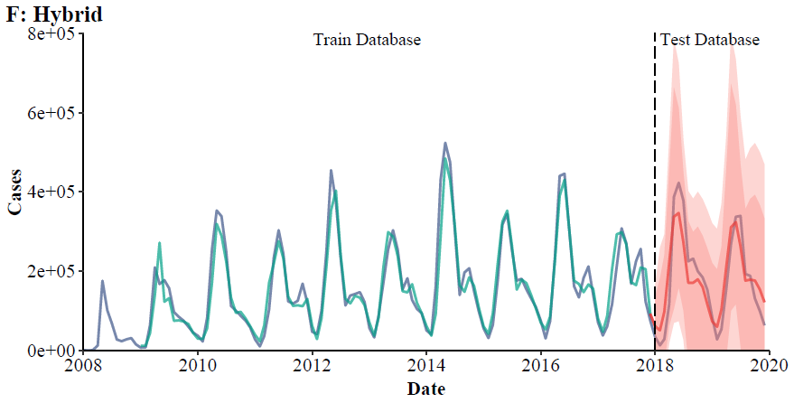
Train database
2007-2017
Build models
Test models
Test database
2018-2019
Compare database 2020-2022
within COVID-19
Compare
Forecast
2020-2022
without COVID-19
Find best model
Forecast
2023-2025
without COVID-19
Compare
Forecast
2023-2025
within COVID-19

Slide 2
Train database
2008-2017
Build models
Test models
Test database
2018-2019
Compare database 2020-2022.5
within COVID-19
Compare
Forecast
2020-2022.5
without COVID-19
Find best model
Forecast
2022.6-2023.5
without COVID-19
Compare
Forecast
2022.6-2023.5
within COVID-19
Find best model
Train database
2008-2022.5
Build models
Test models
Test database
2007-2022.5

