Slide 1



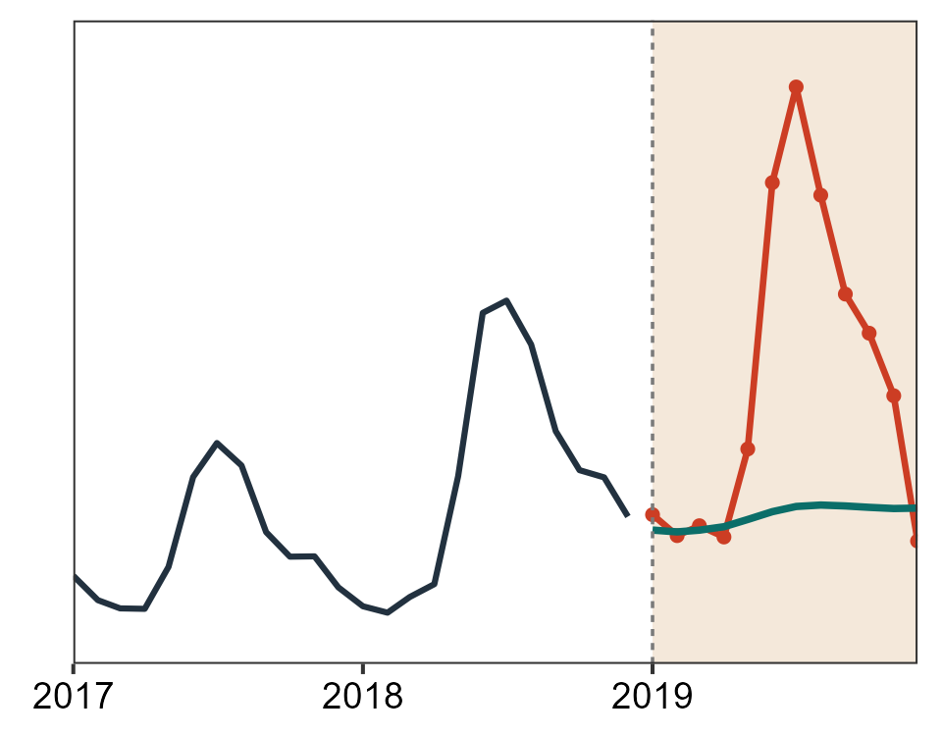
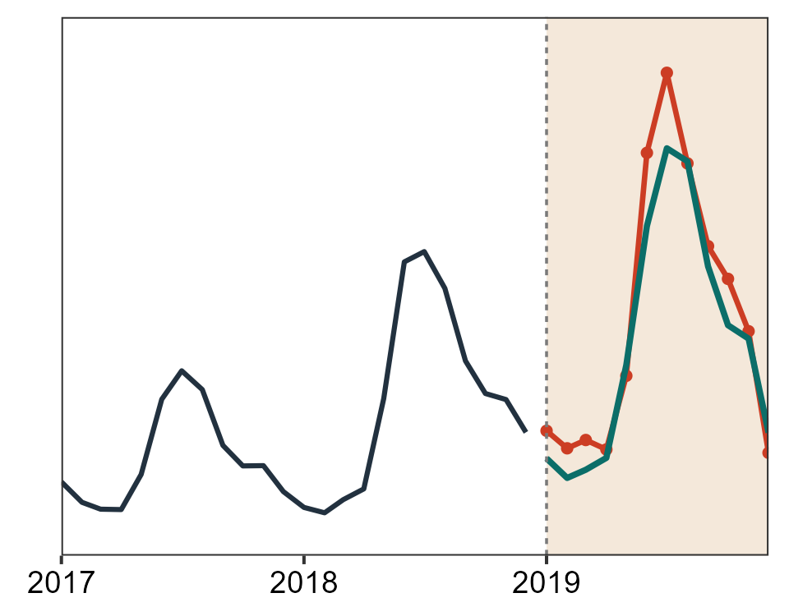
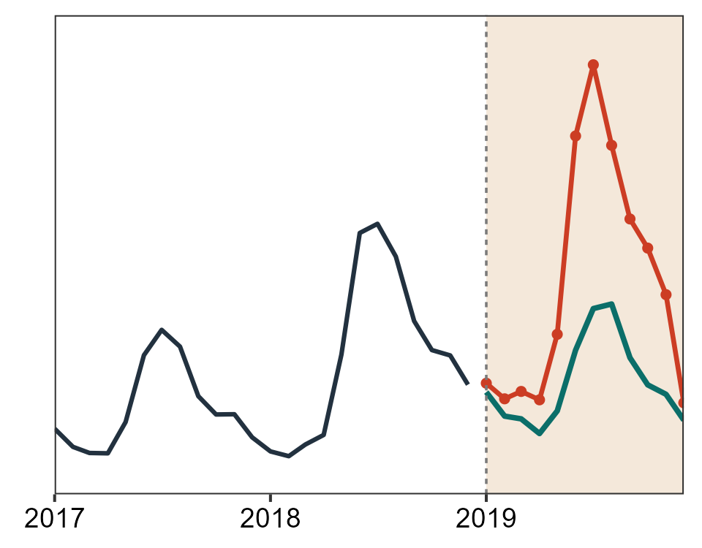
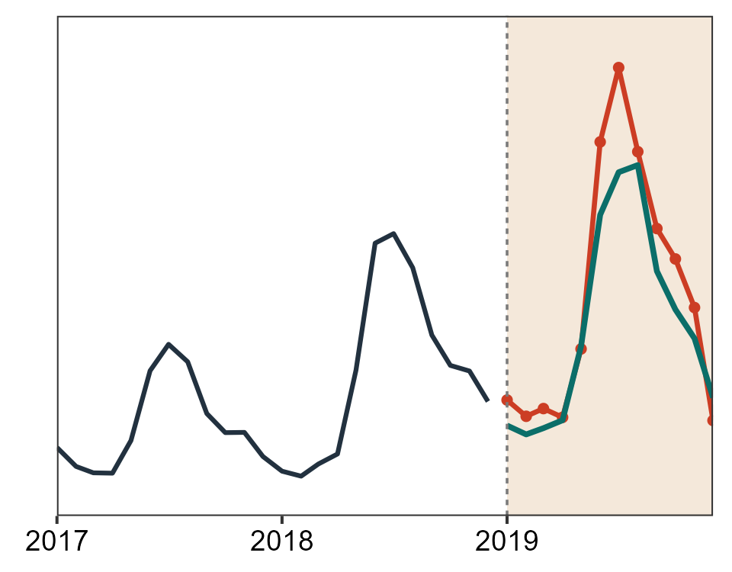
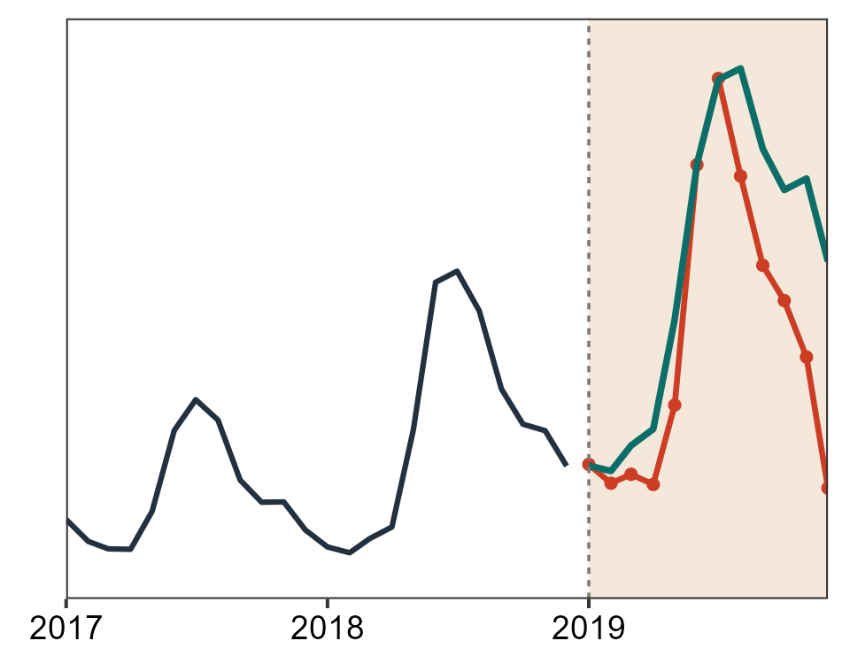
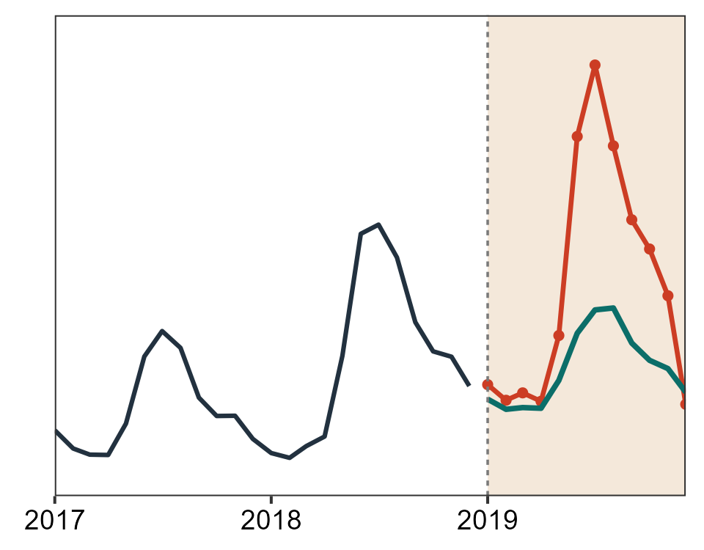
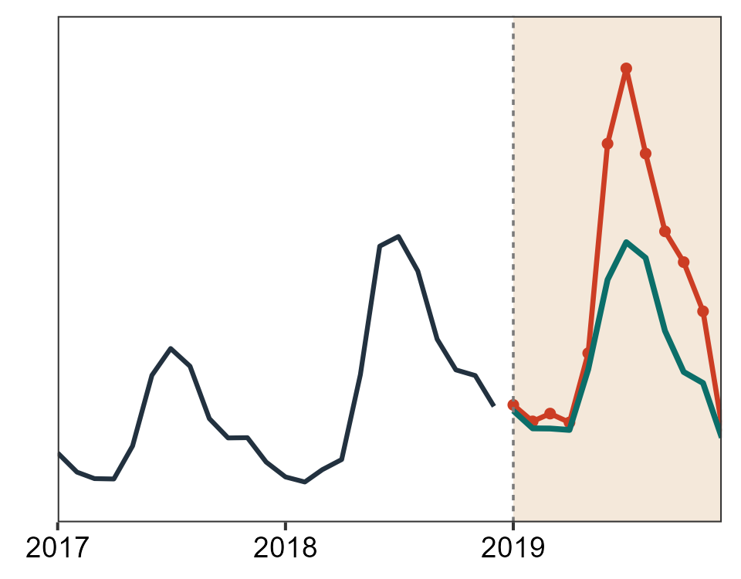
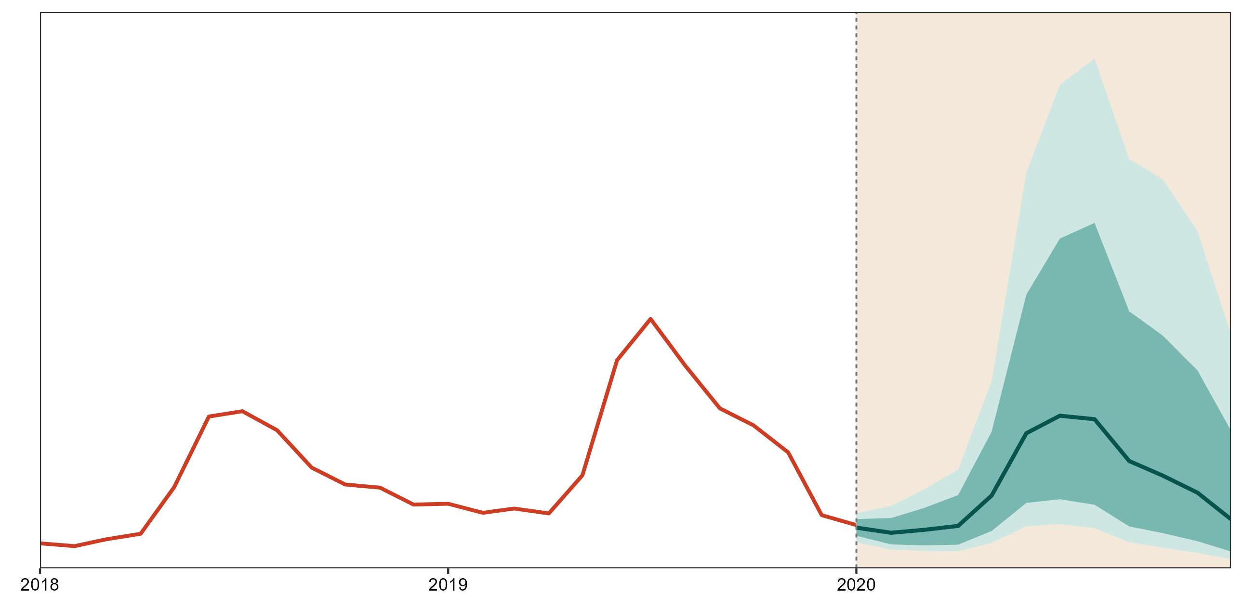








Data Pre-processing & Validation
Thailand Surveillance Data
(2008-2025)
Data Preparation:
72 monitored series
Validated Series:
43 Descriptive
24 Counterfactual
Data Disaggregation
Forecasting Engine
sMAPE, RMSE, MASE
3 rolling splits
NNAR
ETS
SARIMA
TBATS
BSTS
Hybrid
ARIMA(Fourier)
Counterfactual Simulation
Best Model Refit on
2008-2019
80% and 95% Predicted Intervals (PIs)
5000 Simulated Forecast Paths
Analytical Model
Interactive Review Layer
1. Recovery
Classification
2. Phenotype Probabilities
3. Alternative Endpoints
4. Seasonal Detection
5. Contextual Triangulation
6. Operational Synthesis

