Slide 1
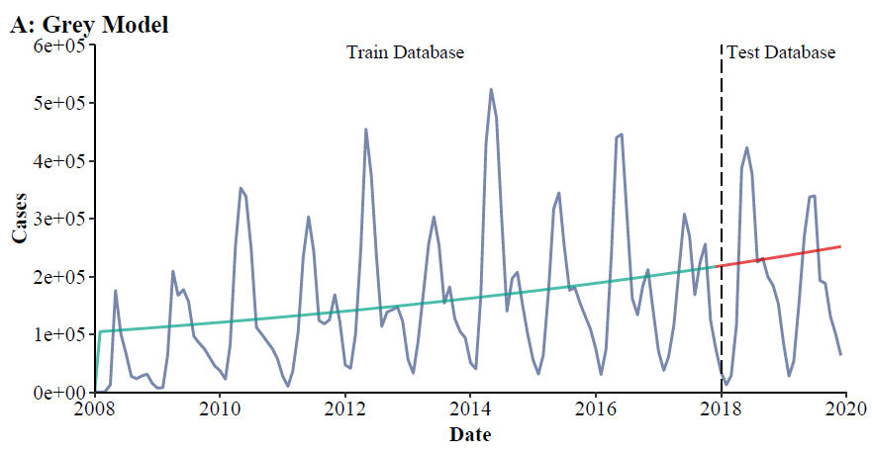
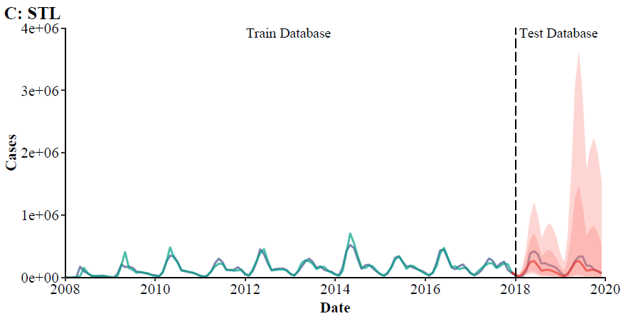
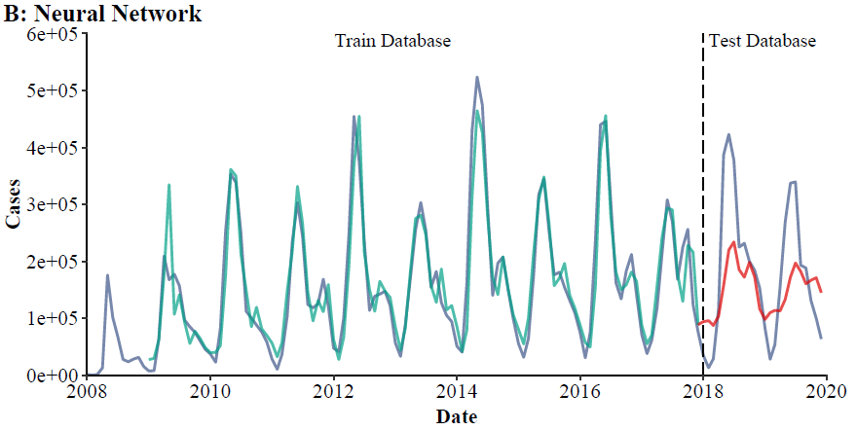
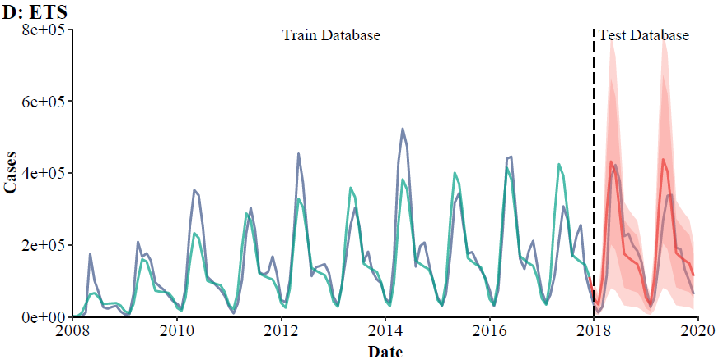
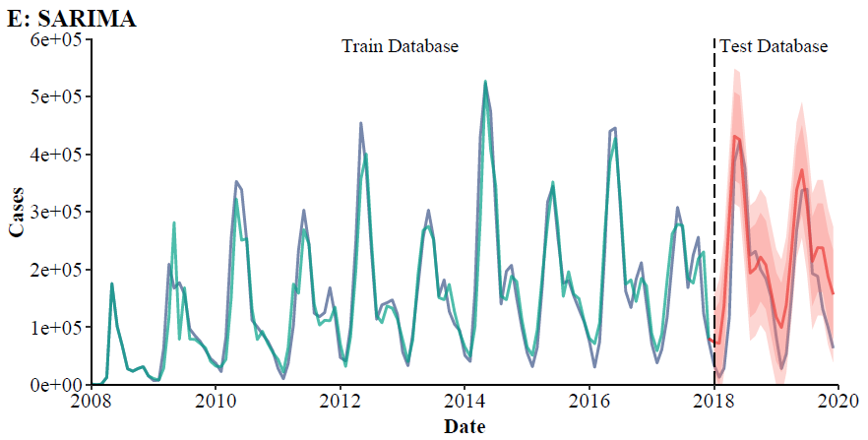
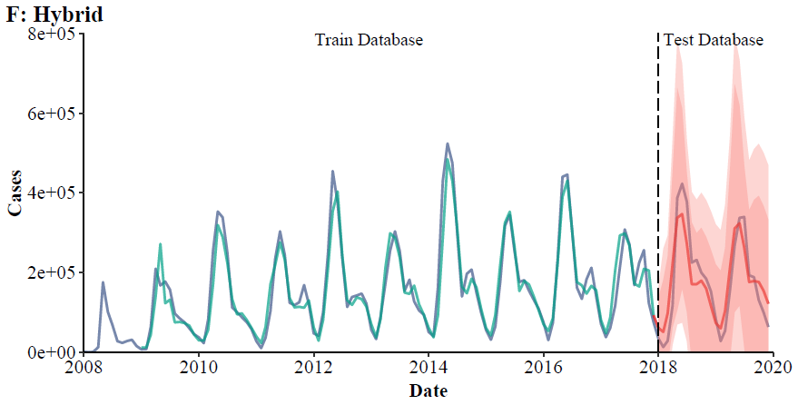
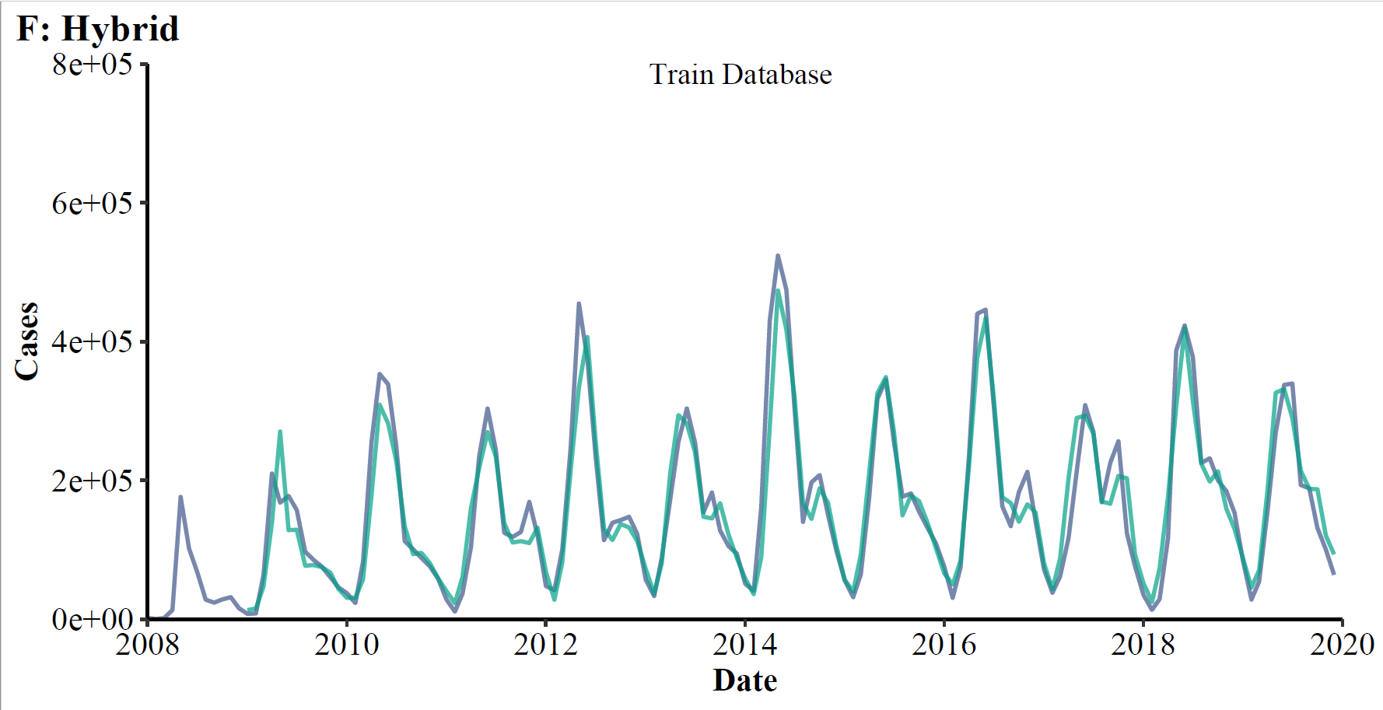
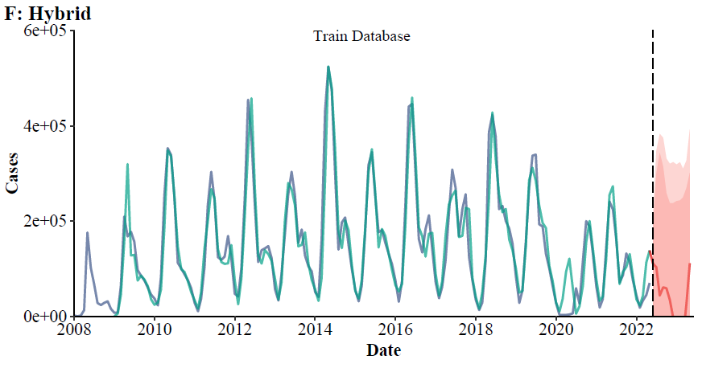
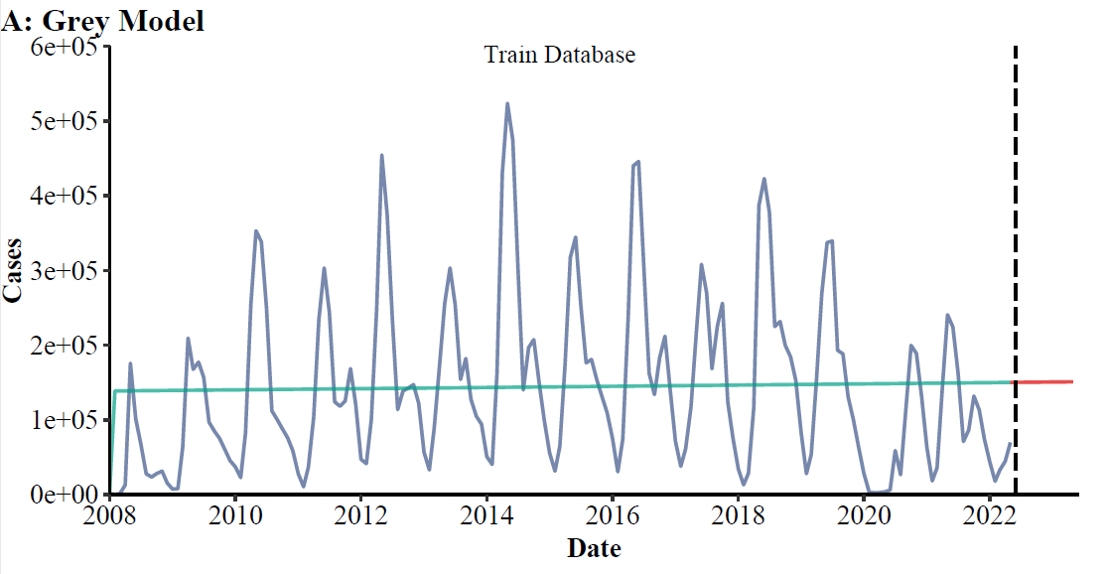
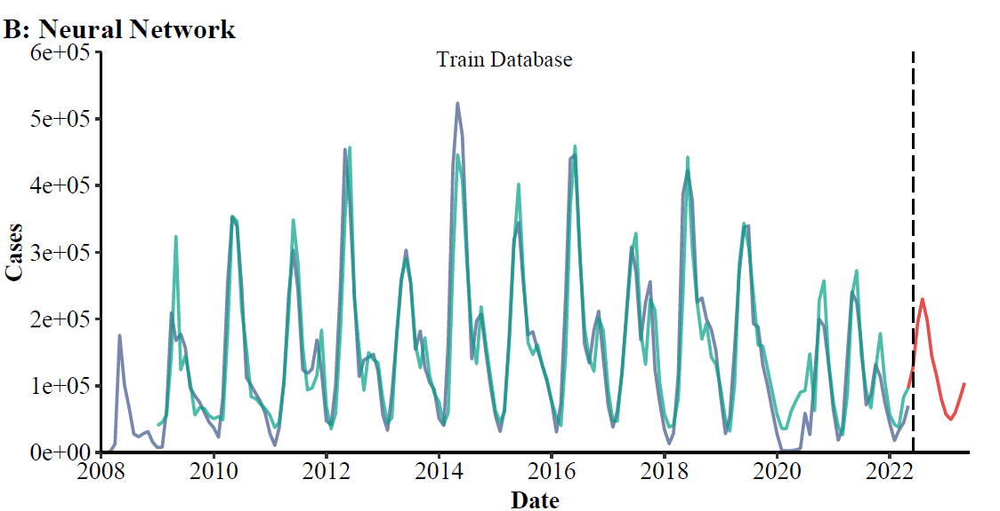
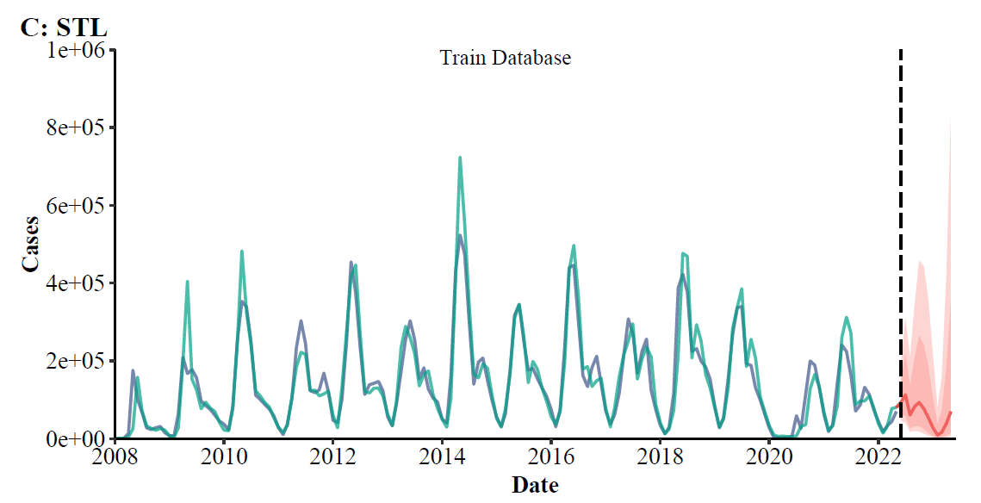
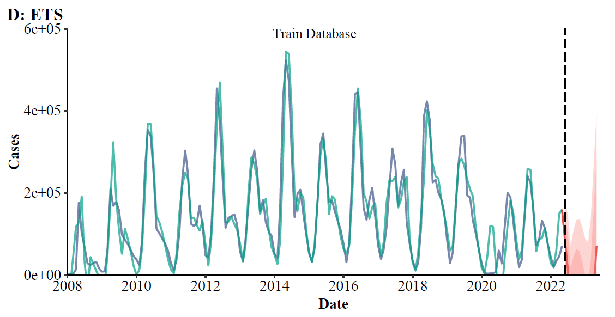
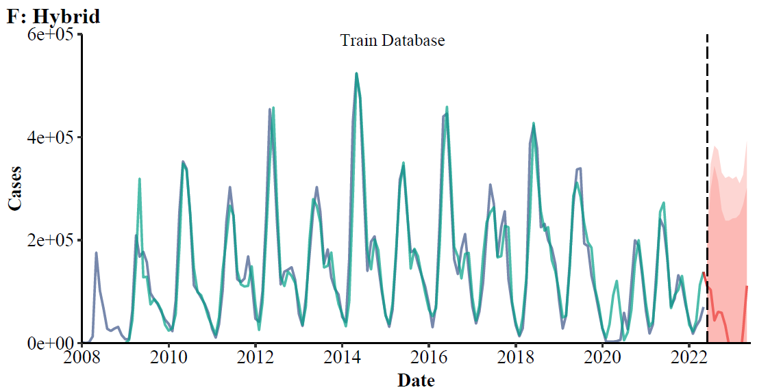
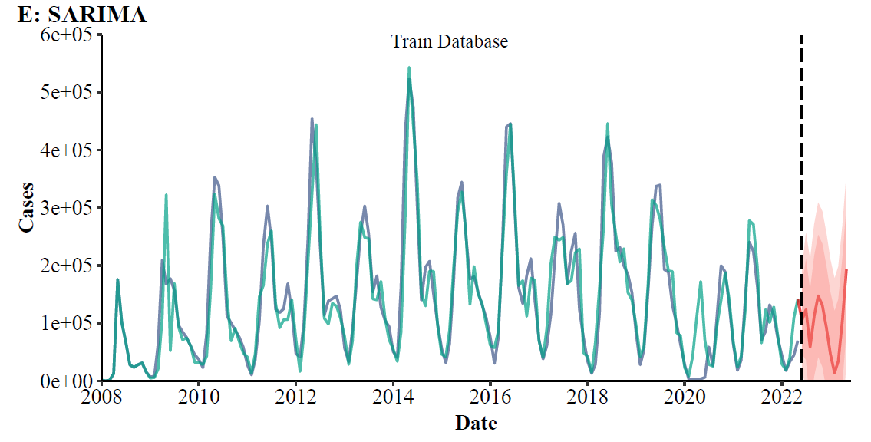
Without COVID-19
Train database
2008-2017
Train models
Test models
Test database
2018-2019
Find the best model
Forecast
2020-2022.5
without COVID-19
Retrain database
2008-2019
Grey Model
Neural Network
STL
ETS
SARIMA
Hybrid
Retrain model
Compare
Actual
2020-2022.5
within COVID-19
Forecast
2022.6-2025.5
without COVID-19
Compare
Forecast
2022.6-2025.5
within COVID-19
Within COVID-19
Train database
2008-2022.5
Train models
Test models
Test database
2008-2022.5
Find the best model
Blood borne and sexually transmitted diseases
AIDS

Slide 2
Train database
2007-2017
Build models
Test models
Test database
2018-2019
Compare database 2020-2022
within COVID-19
Compare
Forecast
2020-2022
without COVID-19
Find best model
Forecast
2023-2025
without COVID-19
Compare
Forecast
2023-2025
within COVID-19

