Slide 1
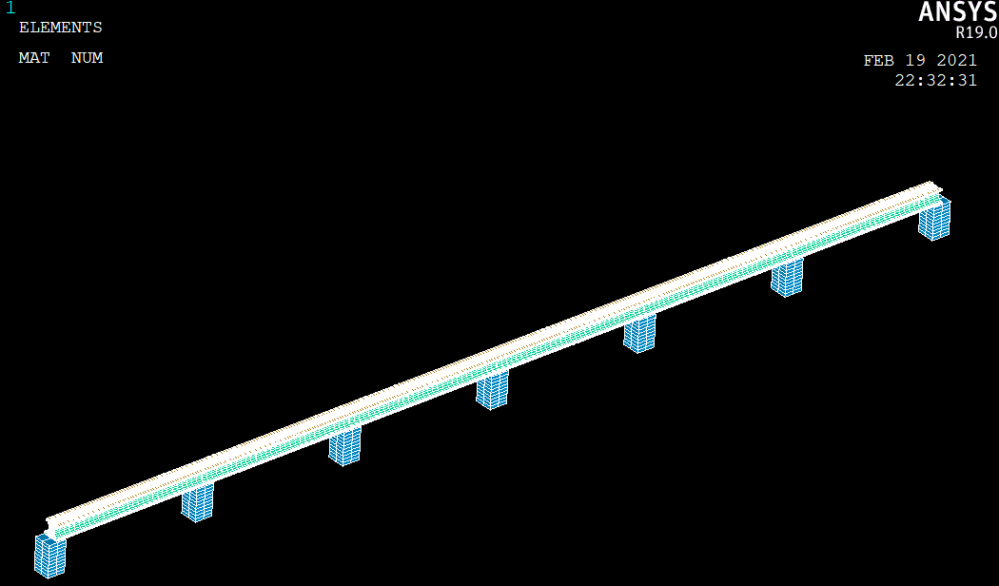
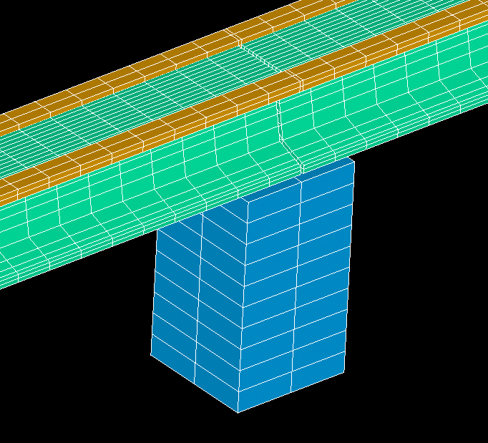
Guideway
Girder
Expansion Joint
Pier

Slide 2
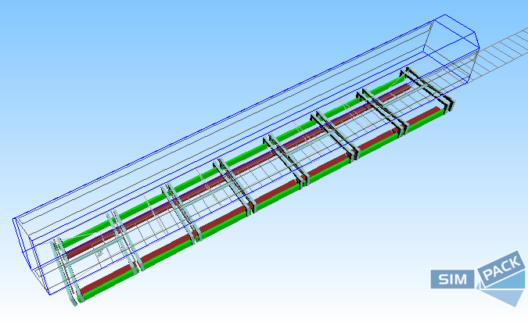
Car body
Bogy
Guide Electro-Magnet
Levitation Electro-Magnet
Guideway
Expansion Joint
Girder
Pier

Slide 3
Begin
Set i = 1
Calculate the displacement under
force element
for all j
Calculate the corresponding of
Calculate interaction force
according to the vehicle system
Whether end
No
Yes
End

Slide 4
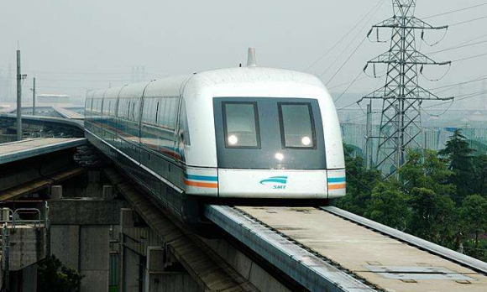

Slide 5
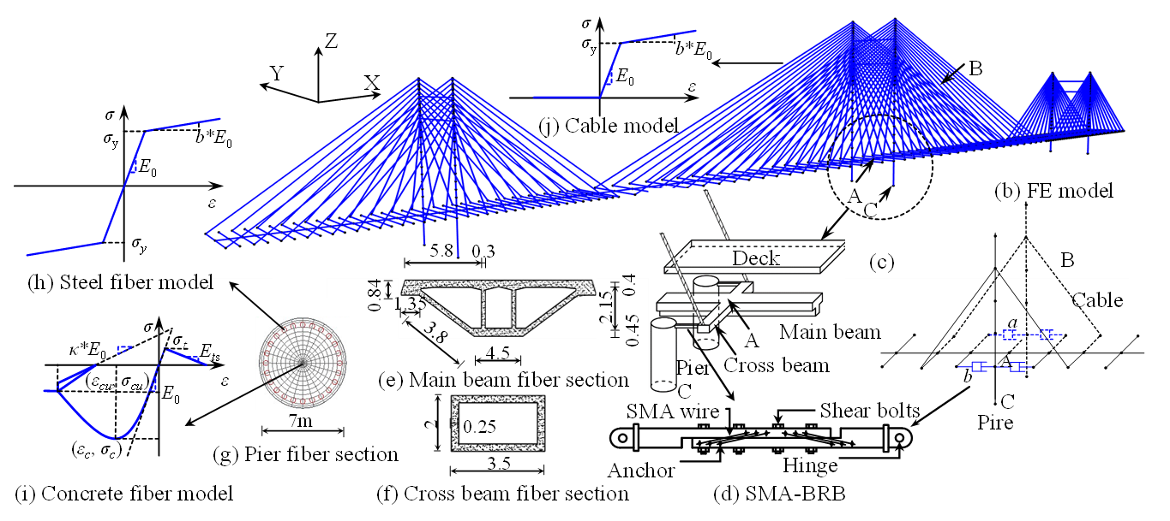


Slide 6
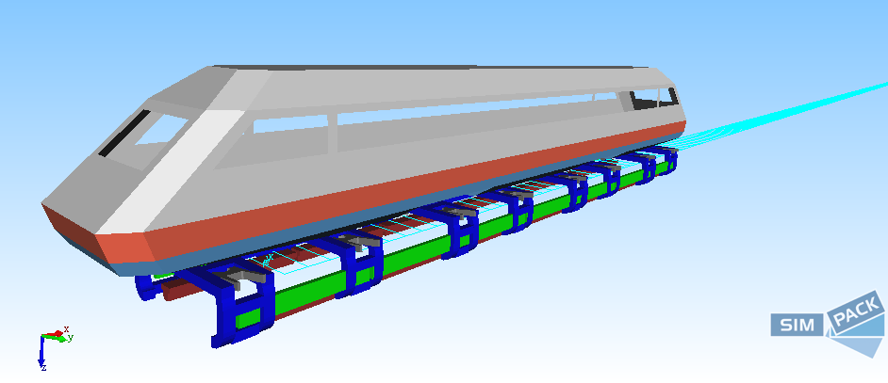
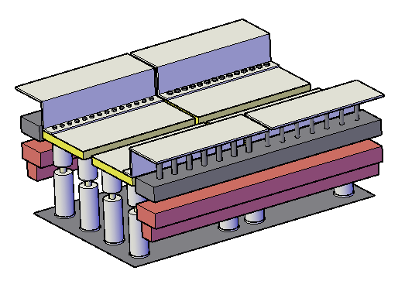
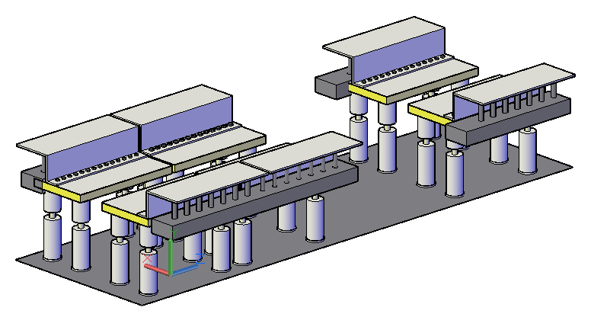

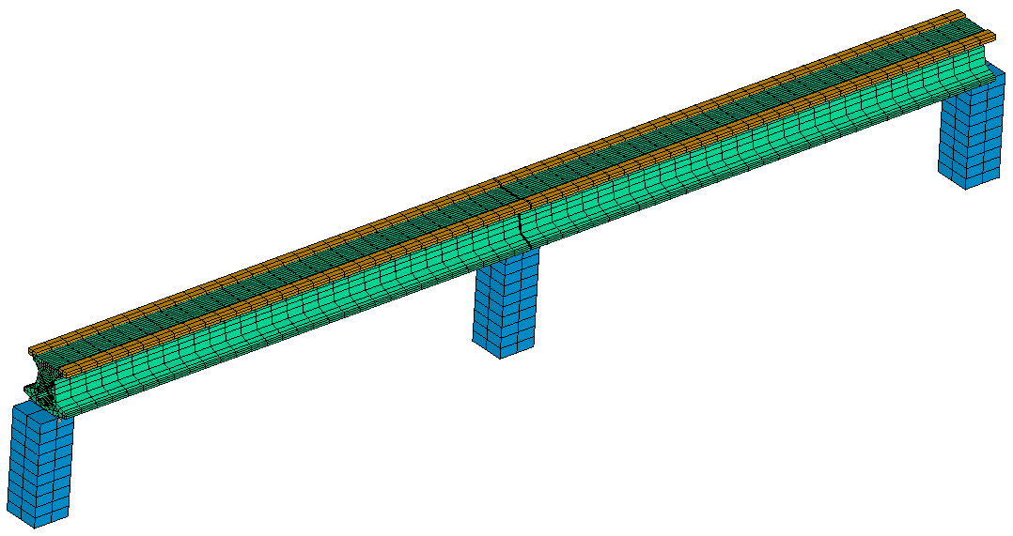
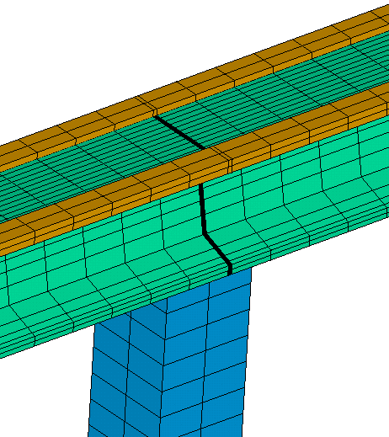
Bridge System
Displacement under
force element
Shake Table
Displacement
Velocity
Acceleration
Force
Numerical system
Reproduced signals, including
displacement, velocity, accelerate
Driving Signal
1. Position of force element
2. The force’s value (replaced
by last time step)
Vehicle System
Physical system
Shaking tables
Force
Displacement
Forces
Rails
Girder
Expansion Joint
Pier

Slide 7
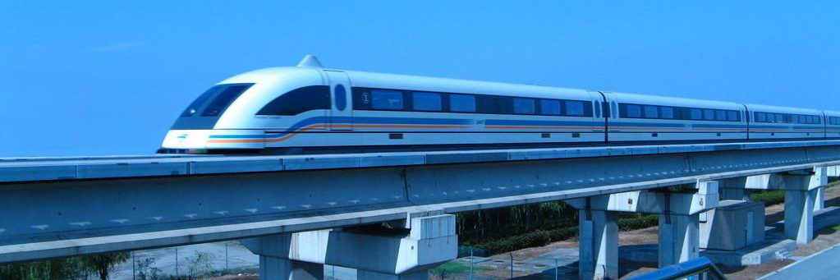
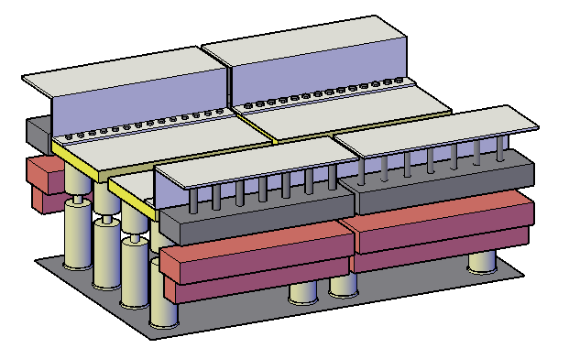
z
x
y

