Slide 1
Diploma work 4 cp
Mingyue Xie

Slide 2
Datasets
UN Comtrade
Rollingsale_bronx.xls(time-stamped dataset)
Datasource:
https://comtrade.un.org/data/
Number of instances/rows : 1556
Number of fields : 35
For example,
34 categorical fields are the follows:
Classification
Year
Period
Period desc
Reporter
...
1 measurable fields are the follows:
Trade value
Datasource:
https://mran.microsoft.com/documents/data/
Number of instances/rows : 1702
Number of fields: 21
For example,
14 categorical field(s) is/are the follows:
Building class at time of sale
Sale date
Building class category
Nigheborhood
....
7 measurable attributes/fields/variables are the follows:
Residential units
Commercial units
Gross square Feet
Sale price
....
* Fields have synonymes like attributes, columns and variables

Slide 3
Insights
UN Comtrade
Rollingsale_bronx(time-stamped dataset)
Pivot table
used fields: Trade value, Trade flow, Year, Period
Matrix
used fields: Trade Flow, Trade value, period
Narrative
used fields: Reporter, year, Trade value
Micro chart
used fields: Year, Trade Flow, Trade Value
Association
used fields: Trade Flow , Trade Flow Code
Clusters
used fields: Reporter code, Trade value
Correlations
used fields: Period , Trade Value
Smoothing splines
used fields: Trade value, Period
Scatter plots
used fields: Period, Reporter, Trade value
Pivot table
used fields: Tax class at time of sale, lot , sale price
Matrix
used fields: Year built, sale price, tax class at time of sale
Narrative
used fields: Gross square feet, sale price
Micro chart
used fields: tax class at time of sale, year built, sale price
Association
used fields: land square feet, lot, sale price, sale date, tax class at time of sale
Clusters
used fields: sale price, total units, lot
Forecasts
used fields: sale date, sale price
Correlations
used fields: year built, sale price, tax class at time of sale, lot
Smoothing splines
used fields: gross feet square, sale price
Scatter plots
used fields: tax at time of sale, sale price
* Remove the insights you did not make from the datasets

Slide 4
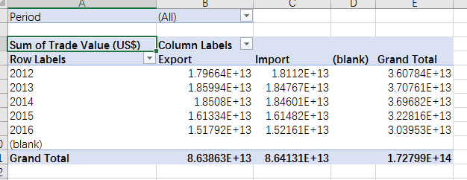
Picture(s) of the insights from the set 1
1. Pivot table
We can see from the pivot table that there are totally around 1.72E+14 US$ trade value, and export trade value is higher than import trade value in total. From year 2012 to 2013, the export and import trade value are increasing, than from 2014 to 2016, they are both decreasing.

Slide 5
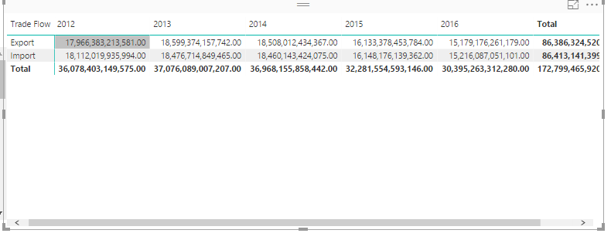
Picture(s) of the insights from the set 1
2. Matrix
We can see that there are 2 kinds of trade flow, export and import, and 4 years of trade value records. Basically the total trade value for each year is around 30 T us$, total for those years are around 172 T us$

Slide 6
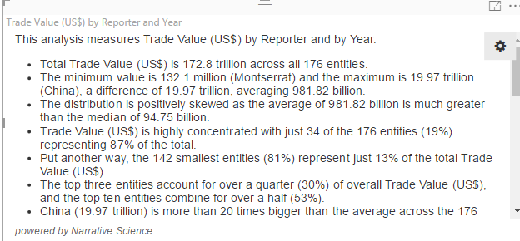
Picture(s) of the insights from the set 1
3. Narrative
We can see from the narrative that the total trade value is 172.6 trillion, which can be validated from the second fig. The minimum value is 132.1 million (Montserrat) and the maximum is 19.97 trillion (China), The top three entities account for over a quarter (30%) of overall Trade Value (US$), which are China, USA and Germany.

Slide 7
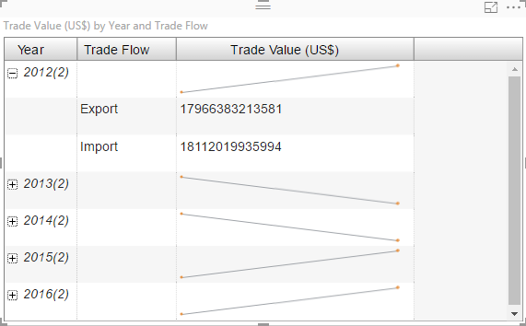
Picture(s) of the insights from the set 1
4. Micro chart
In this figure, we can see that this micro chart clearly shows comparison between two kinds of trade flow: Export and import, for 2012, 2015, and 2016, the export trade value is lower than import trade value, and for 2013 and 2014, the export trade value is high than import trade value.

Slide 8
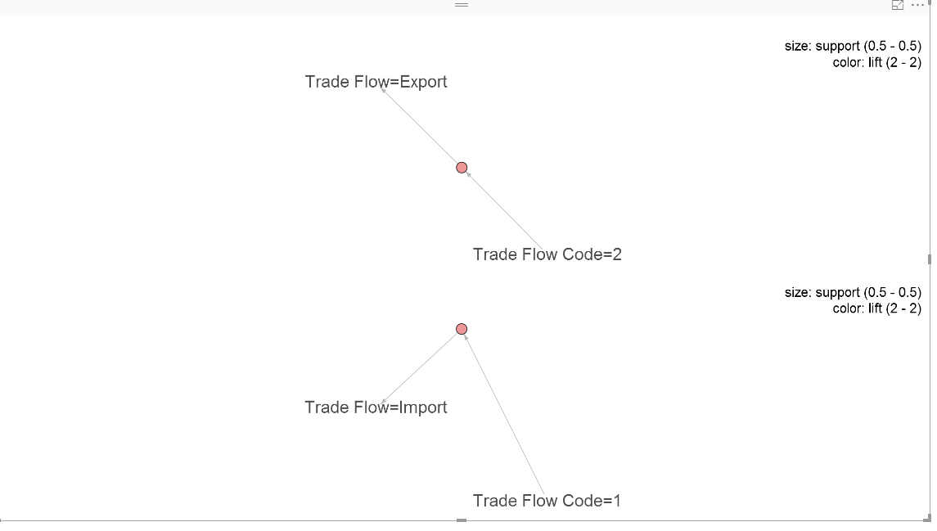
Picture(s) of the insights from the set 1
5. Association
As can be seen from the figure, when the trade flow code = 2, is is more likely belong to the export, when the trade flow code = 1, it is more likely belong to import trade.

Slide 9
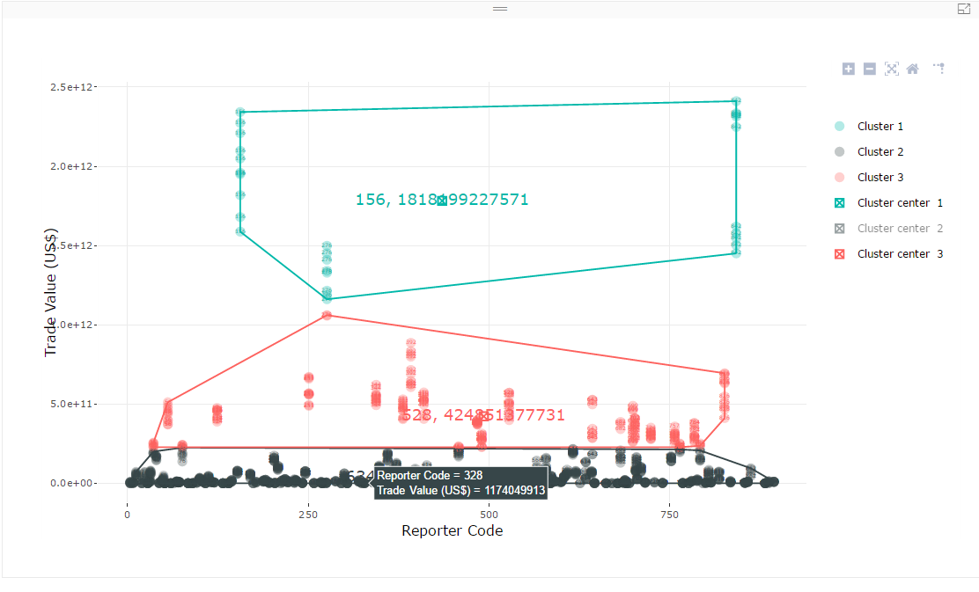
Picture(s) of the insights from the set 1
6. Cluster
We can see that there are 3 clusters, cluster1 has the highest trade value, we can see the center of this cluster is reporter code: 156, which represents China, then the red cluster has second highest trade value, its center is reporter code: 528, which represents Netherlands, the lowest trade value is Reporter code : 634, which is Qatar.

Slide 10
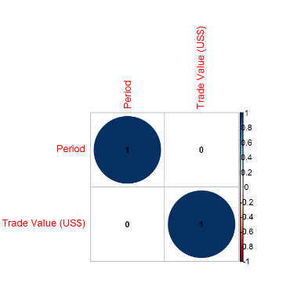
Picture(s) of the insights from the set 1
7. Correlation
We can find that the correlation value between Reporter code and Trade values is 0.1, it means when the reporter code increase, the trade value has the trend to increase, and the trade value has no correlation with Trade Flow, which means no matter it is export or import, the trade value has no correlation with its type.

Slide 11
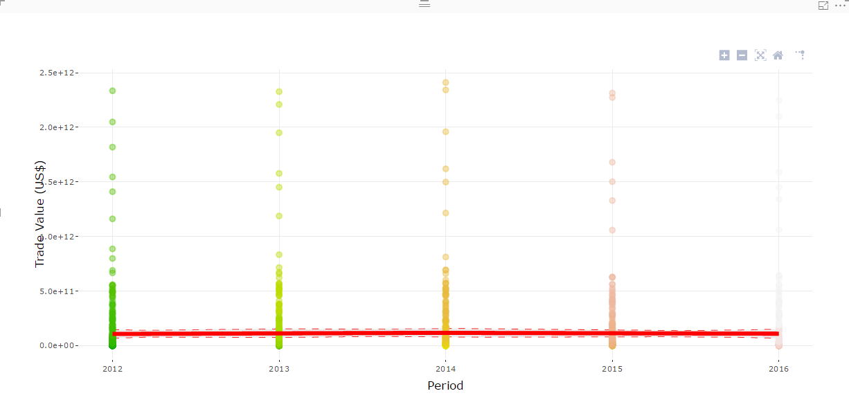
Picture(s) of the insights from the set 1
8. Smoothing spline
This figure helps to visualize and understand noisy scatter plot, as can be seen from the figure, the value for trade value is located on the red line, and no matter the change of the period, the trade value is most distributed in the value around 11 billion.

Slide 12
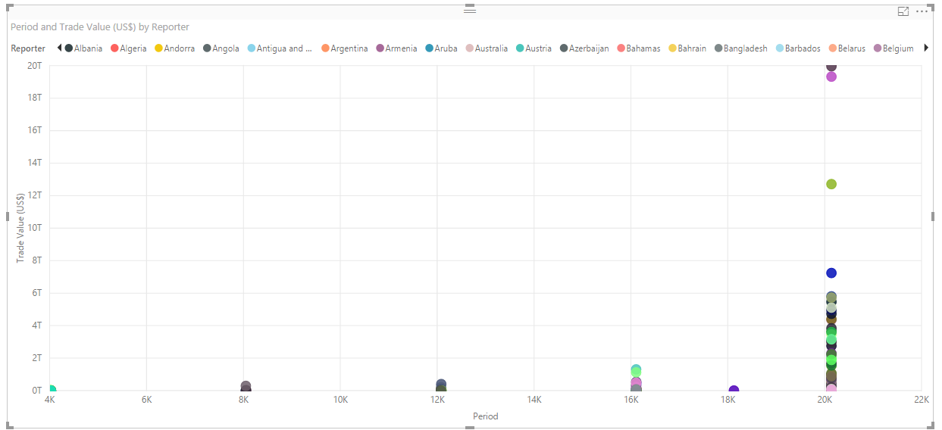
Picture(s) of the insights from the set 1
9. Scatter plot
As can be seen from the figure, most of the reporter has trade with UN when the period is 2014, and we can see the highest point is Reporter: China, the period is in 2014, and the trade value is 19T(us $)

Slide 13
Picture(s) of the insights from the set 2

Slide 14
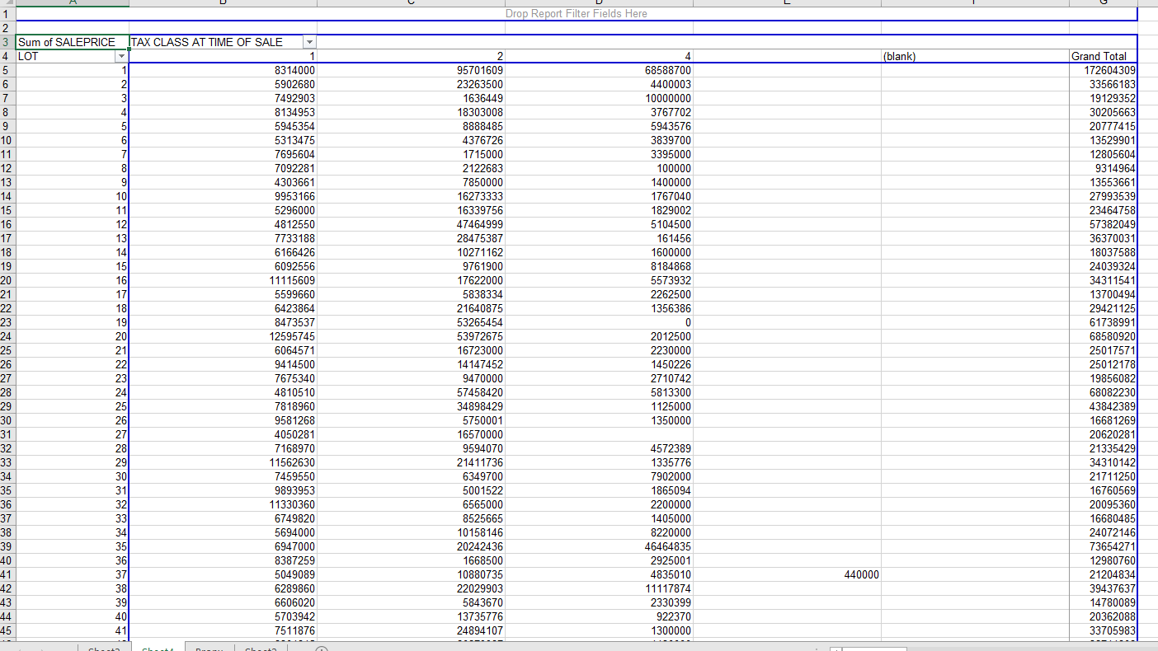
Picture(s) of the insights from the set 2
1. Pivot table
We can see from this pivot table that there are 3 class of tax class at time of sale; also we noticed that different lot has different sale prices; we can go further to figure the relationship between sale price and other variables.
In the grand total, we can find the highest sale price corresponds to the tax class2, the price is around 15 billion.

Slide 15
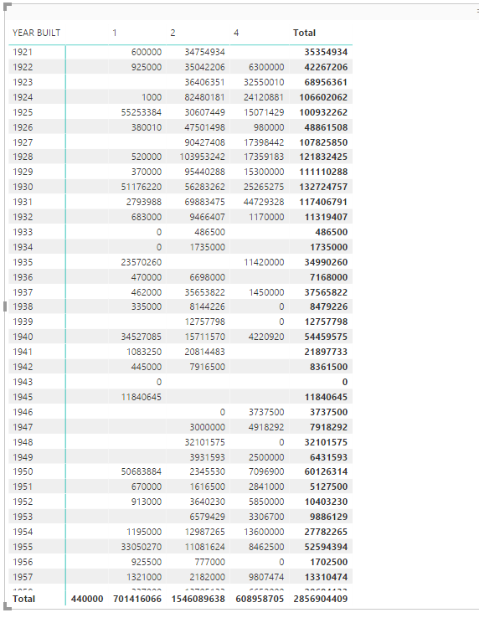
Picture(s) of the insights from the set 2
2. Matrix
We can see that from year of 1800 to 2013, there are records of the building which were sold out, in this figure, we can find the total sold price for all the building are around 2.8 billion; at the same time, the columns are taxes at time of sale, so we can see that there are 1,2,4 class of taxes, class 2 of taxes corresponds to the highest sold price building, class 1 takes the lowest sold price.

Slide 16
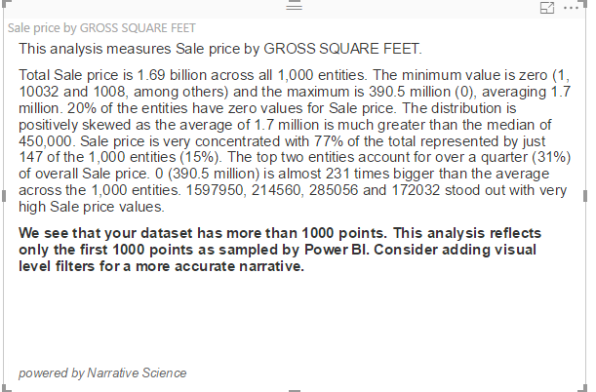
Picture(s) of the insights from the set 2
3. Narrative
This is the Narrative used to measure the sale price by Gross square feet of building, we can see that it clearly illustrates the max, min, ave value of sale price.

Slide 17
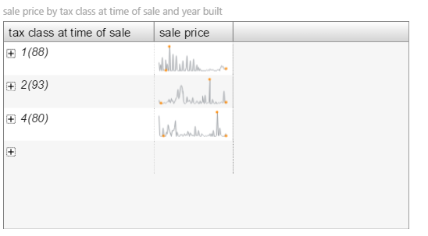
Picture(s) of the insights from the set 2
4. Micro chart
We can see that for tax class1 , the highest sale price is around 80 billion $ in 1920, the lowest price is 0 in 1900; for class 2 the highest sale price is 1.5 billion $ in 1974, lowest one is 0 in 2012; for class 4, the highest price is 68 billion $ in 1999, and the lowest price is 0 in 2010. So, class 1 tax has the highest price over 3 kinds of tax classes.

Slide 18
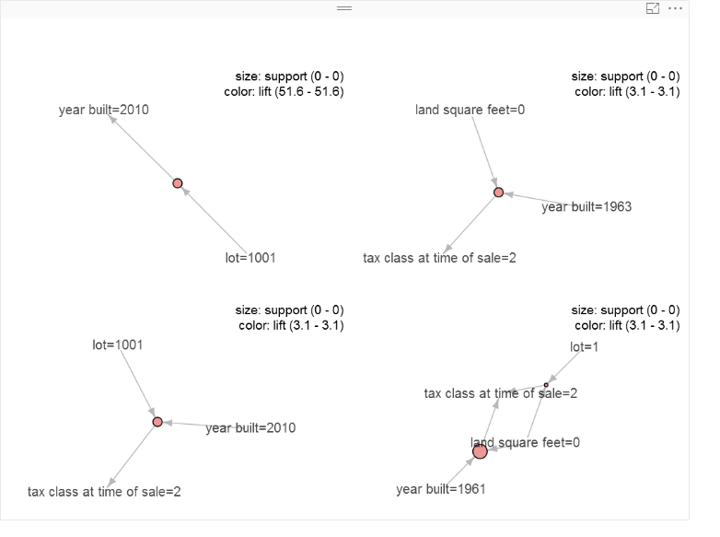
Picture(s) of the insights from the set 2
5. Association
We can see that: when the lot = 1001, the year built is very likely to be 2010; when the land square feet = 0 and year built = 1963, the tax class at time of sale is very likely to be 2; when the lot = 1001 and year built = 2010, the tax class at time of sale is very likely to be 2; and when year built = 1961, the land square feet is likely to be 0, the tax class at time of sale is very likely to be 2, if these 3 conditions are met, the lot is very likely to be 1.

Slide 19
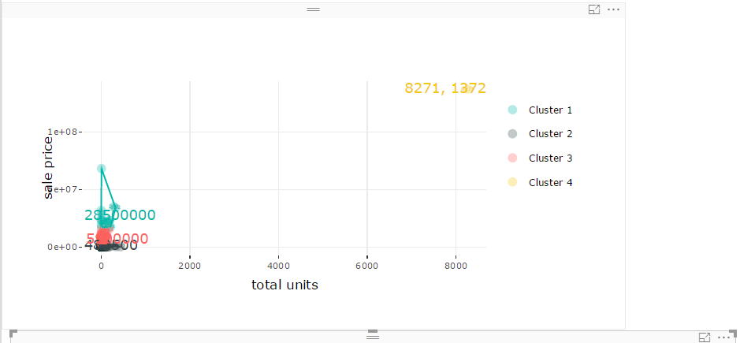
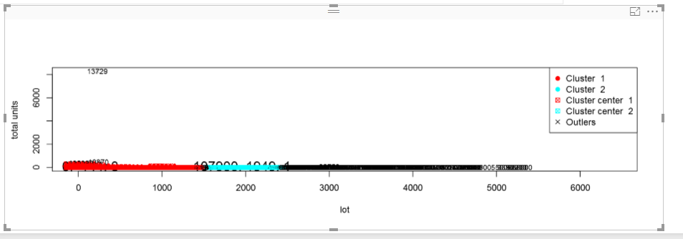
Picture(s) of the insights from the set 2
6. Cluster
We can see for the first figure, cluster4 corresponds to the highest sale price, the center of it is 83billion $, cluster 2 has the lowest sale price.
In the second figure, there are 2 clusters, cluster1 has the total units from around 0 to 1500, and cluster 2 has the total units from 1500 to 2500, cluster1 and cluster2 have different sale prices.

Slide 20
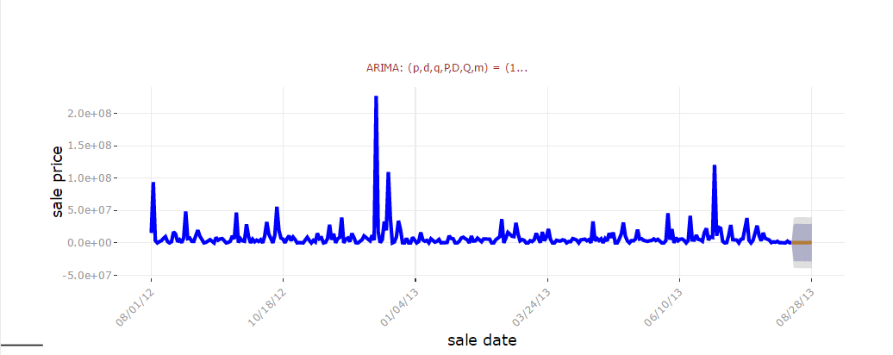
Picture(s) of the insights from the set 2
7. Forecast
We can see that after 2013, August, the sale price will stay around 330000, the upper price is around 29 billion and the lowest price will be around -30 billion, which mean price could be 0 as the lowest price.

Slide 21
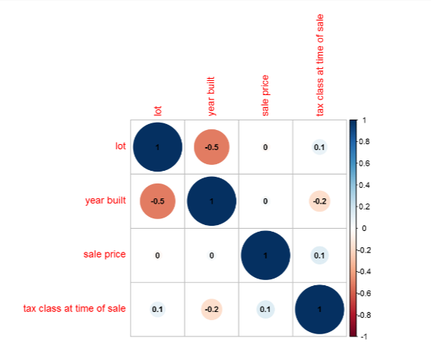
Picture(s) of the insights from the set 2
8. Correlation
We can see from this figure that: with the developing of year to built the building, there are less and less lot; sale price has no correlation with lot and year built, but it has the correlation with tax class at time of sale; with the increasing of tax class at time of sale, there are more lot and higher sale price; with the increasing of year built, the tax class at time of sale is decreasing.

Slide 22
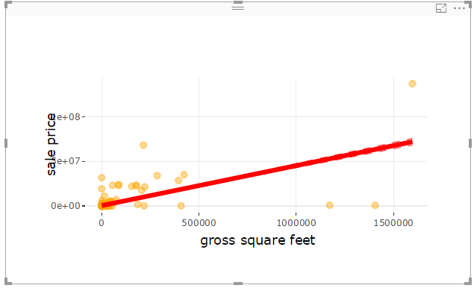
Picture(s) of the insights from the set 2
9. Smoothing spline
We can see from this figure that: when the gross square feet increasing, the sale price with increase too.

Slide 23
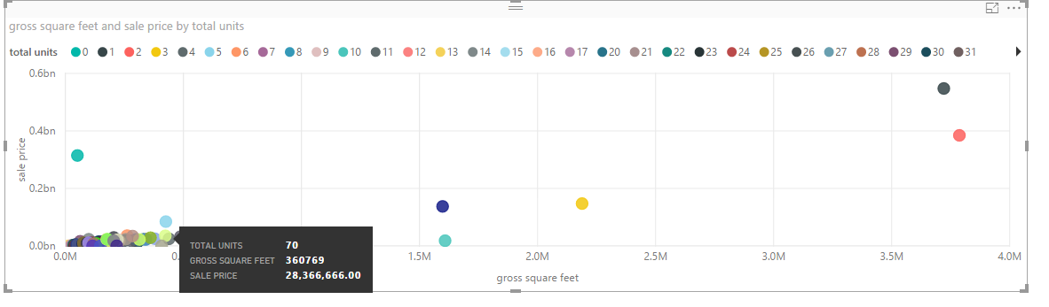
Picture(s) of the insights from the set 2
10. Scatter plot
We can find that most of the gross square feet are from 0.0M to 0.6M, and the sale prices locate around 0.045bn, there are little sale prices that are high than 0.4bn.

Slide 24
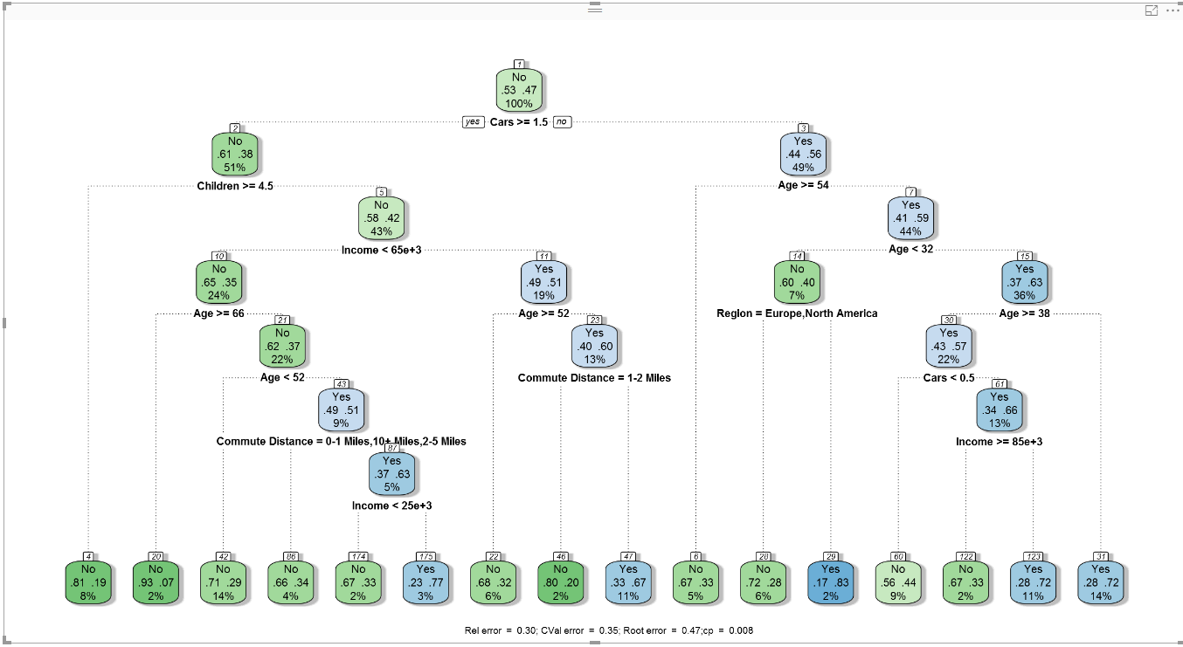
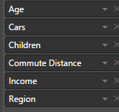
Classifier by decision tree
Picture of the classifier
Selected fields: Age, Cars, Children, Commute Distance, Income, Region
Accuracy: (a+d)/(a+b+c+d)=63.9%
 | Classified buyers | Classified non-buyers
Actual buyers | a = 224 | b=146
Actual non-buyers | c=95 | d=320

Slide 25
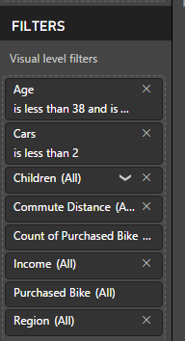
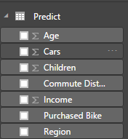
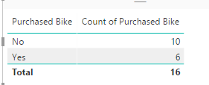
Bike buyers by decision tree
Number of the potential bike buyers: 319
Explanation of how the number was calculate:
When applying the decision tree, we can get the data by exporting data from PowerBI decision tree graph, then load the predicted data, we can apply filter to change the conditions according to generated leaf node, then we get table of actual buy and actual non buyer, then we can calculate the accuracy parameter: a,b,c,d, finally, we can calculate: accuracy = (a+b)/(a+b+c+d)
calculate
accuracy=(a+b)/(a+b+c+d)
a
b
c
d
Predicted data
There are 16 tables

Slide 26
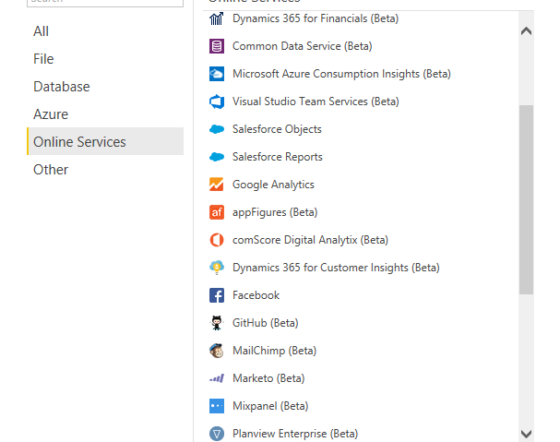
First API
Picture of the insight by the selected API
Selected API:
Used dataset:
Explanation of how the API use was made and how it was used successfully: By Get Data from Online Service-> Facebook->Posts -> Load data, then we can use facebook API to get related data.

Slide 27
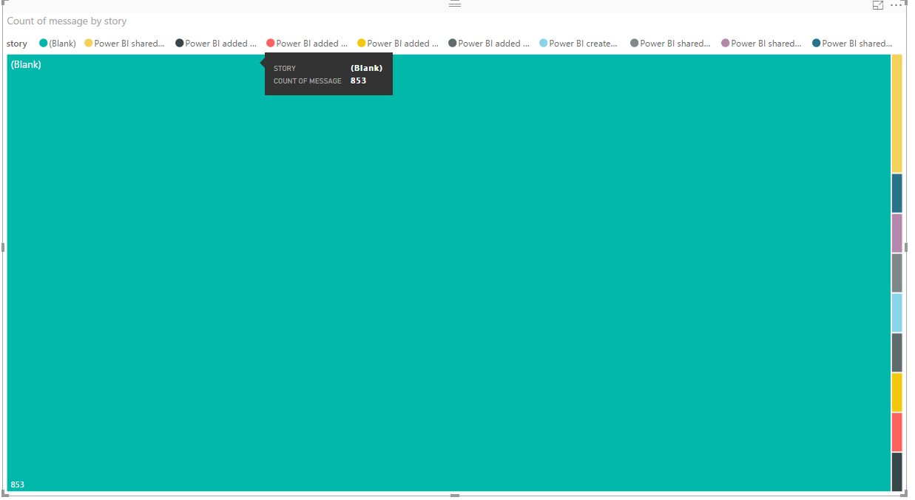
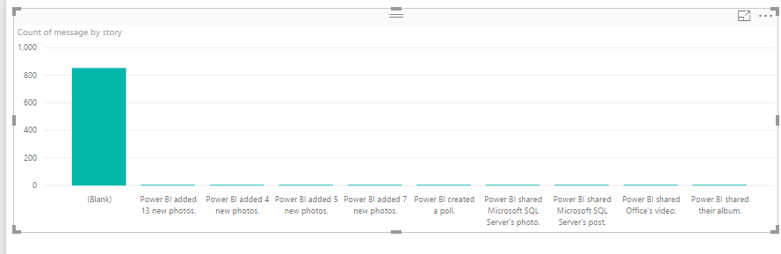
First API
Picture of the insight by the selected API
When the story is ‘Blank’, the count of message takes the most space, then there are PowerBI shared Microsoft SQL server’s photo, PowerBI created a poll and so on stories are much less than story ‘blank’

Slide 28
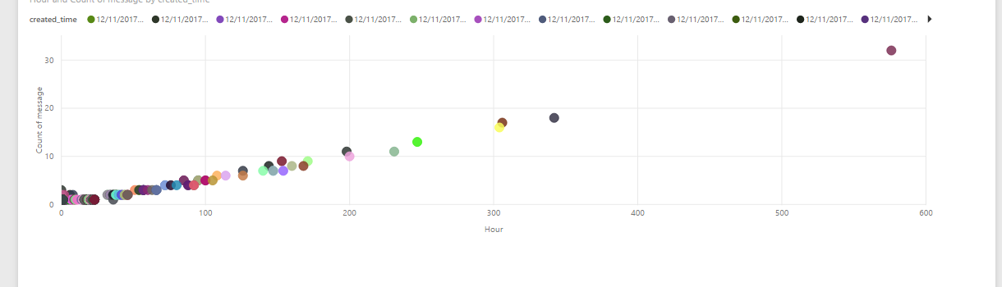
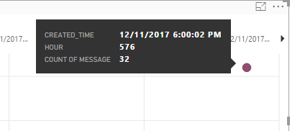
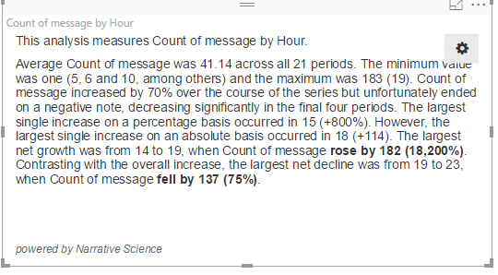
First API
Picture of the insight by the selected API
With the increasing of hours, the count of messages are increasing, the highest point corresponds to the 12/11/2017 6:00:02 AM, there are totally 576 hours and 32 messages.

Slide 29
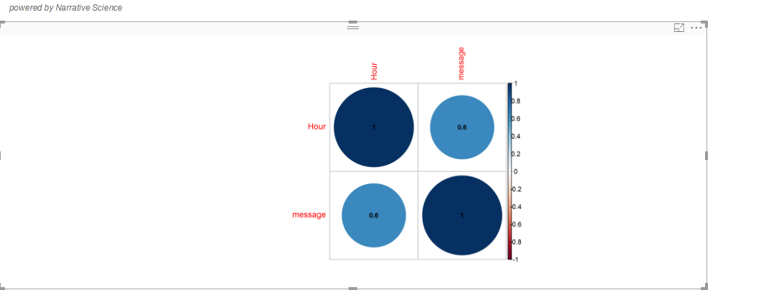
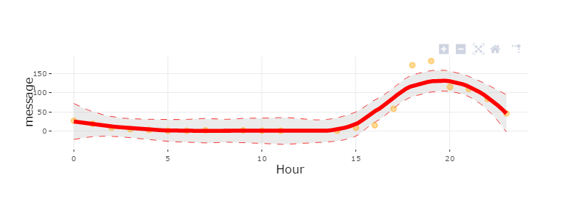
First API
Picture of the insight by the selected API
We can see that when the hours are more than 20, there is a decrease of count of messages. The largest amount of messages happens when the hours are around 20.

Slide 30
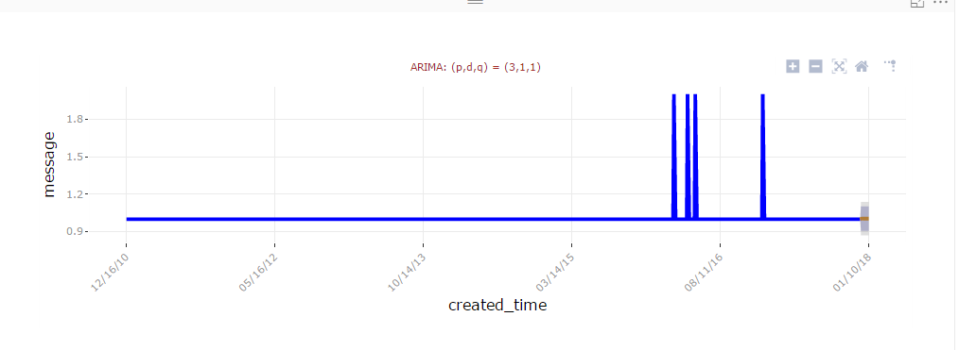
First API
Picture of the insight by the selected API
We can see from this figure that there is some heaps when the created time is around year o 2016, November, also, it can be forecast that in 01/10/2018, the amount of messages are still low, and no change.

