Slide 1
Prediction of Ideal Neighborhoods to Open New Coffee Shops

Slide 2
Coffee shop is the most popular venue in Toronto
Law of supply and demand
An ideal location to open a new coffee shop is in a neighborhood have lower than expect number of shop

Slide 3
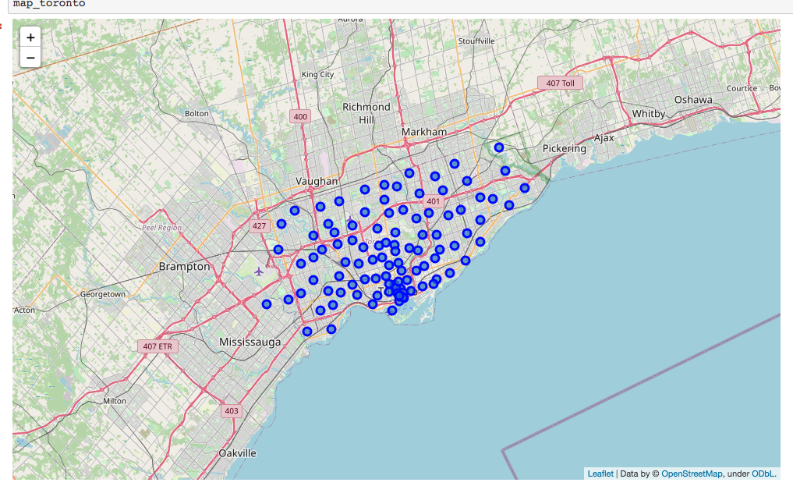
Distribution of 103 postal code neighbor hood in Toronto

Slide 4
FourSquare API found 2123 venues in Tronoto
 | Neighborhood | Neighborhood Latitude | Neighborhood Longitude | Venue | Venue Latitude | Venue Longitude | Venue Category
0 | Parkwoods | 43.753259 | -79.329656 | Brookbanks Park | 43.751976 | -79.332140 | Park
1 | Parkwoods | 43.753259 | -79.329656 | TTC stop #8380 | 43.752672 | -79.326351 | Bus Stop
2 | Parkwoods | 43.753259 | -79.329656 | Sun Life | 43.754760 | -79.332783 | Construction & Landscaping
3 | Parkwoods | 43.753259 | -79.329656 | Variety Store | 43.751974 | -79.333114 | Food & Drink Shop
4 | Victoria Village | 43.725882 | -79.315572 | Victoria Village Arena | 43.723481 | -79.315635 | Hockey Arena

Slide 5
Number of venus vary greatly in different neighborhood
 | Neighborhood Latitude | Neighborhood Longitude | Venue | Venue Latitude | Venue Longitude | Venue Category
Neighborhood
Agincourt | 4 | 4 | 4 | 4 | 4 | 4
Alderwood, Long Branch | 8 | 8 | 8 | 8 | 8 | 8
Bathurst Manor, Wilson Heights, Downsview North | 24 | 24 | 24 | 24 | 24 | 24
Bayview Village | 4 | 4 | 4 | 4 | 4 | 4
Bedford Park, Lawrence Manor East | 27 | 27 | 27 | 27 | 27 | 27
Berczy Park | 57 | 57 | 57 | 57 | 57 | 57
Birch Cliff, Cliffside West | 4 | 4 | 4 | 4 | 4 | 4

Slide 6
Different venue preference vary by neighborhood
 | Neighborhood | 1st Most Common Venue | 2nd Most Common Venue | 3rd Most Common Venue | 4th Most Common Venue | 5th Most Common Venue | 6th Most Common Venue | 7th Most Common Venue | 8th Most Common Venue | 9th Most Common Venue | 10th Most Common Venue
0 | Berczy Park | Coffee Shop | Cocktail Bar | Bakery | Cheese Shop | Restaurant | Seafood Restaurant | Pharmacy | Beer Bar | Farmers Market | Hotel
1 | CN Tower, King and Spadina, Railway Lands, Har... | Airport Lounge | Airport Service | Airport Terminal | Coffee Shop | Rental Car Location | Boat or Ferry | Airport | Airport Food Court | Airport Gate | Sculpture Garden
2 | Central Bay Street | Coffee Shop | Café | Sandwich Place | Italian Restaurant | Salad Place | Bubble Tea Shop | Burger Joint | Japanese Restaurant | Korean Restaurant | Indian Restaurant
3 | Christie | Grocery Store | Café | Park | Baby Store | Italian Restaurant | Nightclub | Candy Store | Restaurant | Coffee Shop | American Restaurant
4 | Church and Wellesley | Coffee Shop | Japanese Restaurant | Sushi Restaurant | Gay Bar | Restaurant | Yoga Studio | Pub | Hotel | Fast Food Restaurant | Mediterranean Restaurant

Slide 7
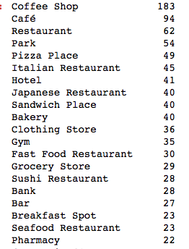
Top 20 venue categories in Toronto

Slide 8
One-hot dataframe of each categories
K-fold validation for splitting the train/test set due to small sample size
Multi-linear regression (scikit-learn)
Metrics: Coefficient of determination,(R2) Mean squared error and coefficeincy to determine if multiple linear regression is suitable for predicting the number of a specific category.

Slide 9
Use multi-linear regression for predicting different categories number
 | name | r2 | mse | coef
0 | Coffee Shop | 0.631204 | 3.228614 | 3.228614
18 | Seafood Restaurant | 0.419422 | 0.266531 | 0.266531
1 | Café | 0.269827 | 1.332593 | 1.332593
9 | Bakery | 0.107140 | 0.467728 | 0.467728
8 | Sandwich Place | -0.058658 | 0.439785 | 0.439785
12 | Fast Food Restaurant | -0.160709 | 0.358247 | 0.358247
2 | Restaurant | -0.260870 | 0.968311 | 0.968311
6 | Hotel | -0.349577 | 1.136891 | 1.136891
5 | Italian Restaurant | -0.454025 | 1.226595 | 1.226595
7 | Japanese Restaurant | -0.485812 | 0.673359 | 0.673359
19 | Pharmacy | -0.545532 | 0.288691 | 0.288691
3 | Park | -0.614441 | 0.708853 | 0.708853
14 | Sushi Restaurant | -0.712241 | 0.762295 | 0.762295
4 | Pizza Place | -0.745298 | 1.023304 | 1.023304
15 | Bank | -1.067827 | 0.551912 | 0.551912
11 | Gym | -1.141358 | 0.827415 | 0.827415
17 | Breakfast Spot | -1.347859 | 0.603516 | 0.603516
16 | Bar | -1.605440 | 0.656598 | 0.656598
13 | Grocery Store | -1.807140 | 0.822999 | 0.822999
10 | Clothing Store | -12.434890 | 2.082187 | 2.082187

Slide 10
Training model to predict coffee shop number in each neighborhood
R2 score: 0.8719796647644302
coefficiency: [-0.05698575 0.36527995 0.49928682 0.06049385 0.6038981 0.61981172 0.43625695 0.82013551 0.44346885 0.34628185 -0.05717205 -0.55038192 -0.10135574 0.18406391 0.71333691 0.15898316 0.49716479 0.61669379 -0.61514679]
intercept: -0.1697859631662182

Slide 11
Rank most favorable place for opening a coffee shop (predict number – existing number)
 | Neighborhood | Coffee Shop | predict | diff
89 | University of Toronto, Harbord | 0 | 4.252432 | 4.252432
18 | Davisville | 2 | 4.685824 | 2.685824
19 | Davisville North | 0 | 2.269935 | 2.269935
88 | Toronto Dominion Centre, Design Exchange | 11 | 12.575825 | 1.575825
27 | Downsview West | 0 | 1.459938 | 1.459938
39 | Guildwood, Morningside, West Hill | 0 | 1.405996 | 1.405996
38 | Golden Mile, Clairlea, Oakridge | 0 | 1.216439 | 1.216439
37 | Glencairn | 0 | 1.209227 | 1.209227
46 | India Bazaar, The Beaches West | 0 | 1.205436 | 1.205436

Slide 12
Conclusion
University of Toronto, Harbord, Davisville and Davisville North are neighborhood are neighborhoods that ideal for open new coffee shop.

