Slide 1
Comparative Analysis OF the Kanji MNIST Dataset
Matthew Boyer

Slide 2
Purpose
Explore and evaluate the performance of SVC, KNN, and CNN models
Application: Classification of handwritten Kanji characters in the Kanji MNIST dataset

Slide 3
Significance
Advancing automated handwriting recognition for non-Latin scripts like Kanji
Contributing to the development of more accurate character recognition systems

Slide 4
Research Questions
How do SVC, KNN, and CNN models perform in classifying handwritten Kanji characters?
Which model demonstrates the highest accuracy and efficiency at predicting Kanji characters?

Slide 5
Dataset Description
あ | い | う | え | お | か | き
く | け | こ | さ | し | す | せ
そ | た | ち | つ | て | と | な
に | ぬ | ね | の | は | ひ | ふ
へ | ほ | ま | み | む | め | も
や | ゆ | よ | ら | り | る | れ
ろ | わ | ゐ | ゑ | を | ん | ゝ
49 labels
784 pixels each

Slide 6
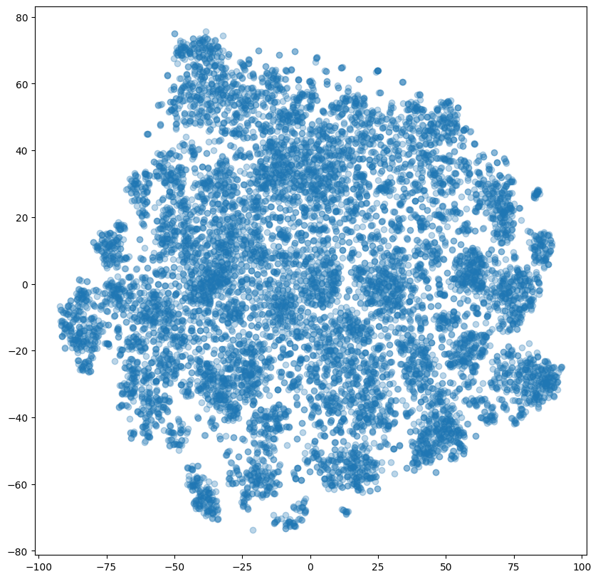
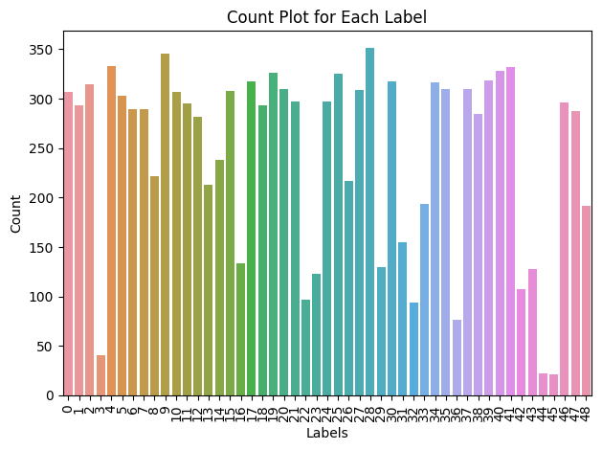
EDA

Slide 7
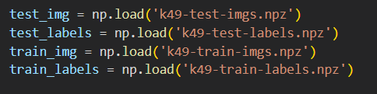
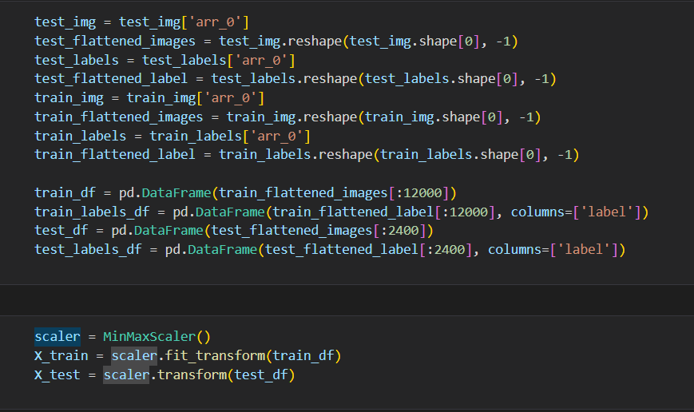
Data splitting
Splitting not necessary as data was already split in the Kanji Dataset.

Slide 8
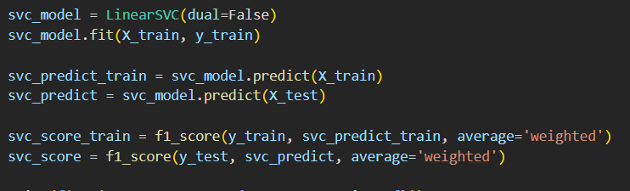
Model Building: SVC

Slide 9
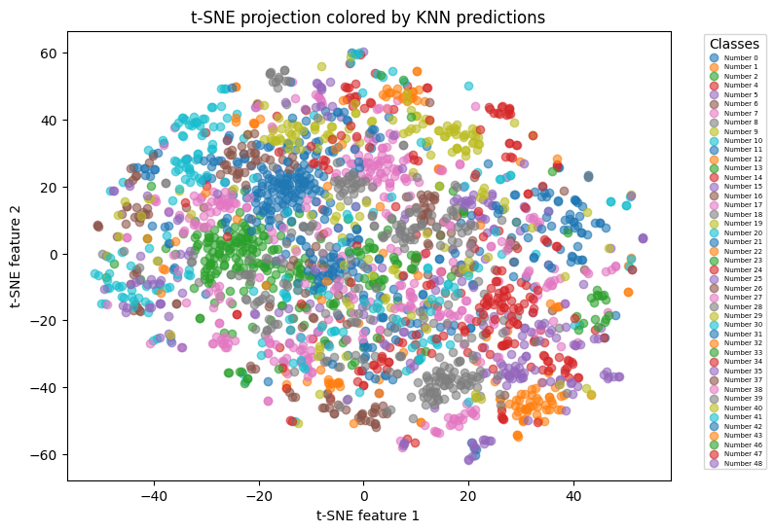
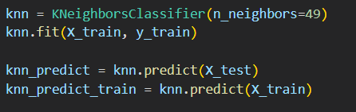
Model Building: KNN

Slide 10
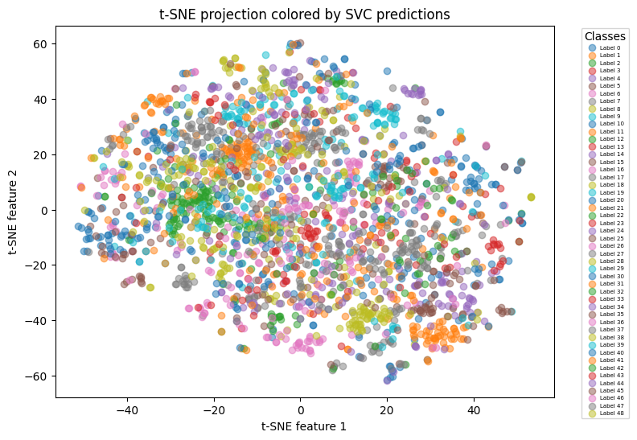
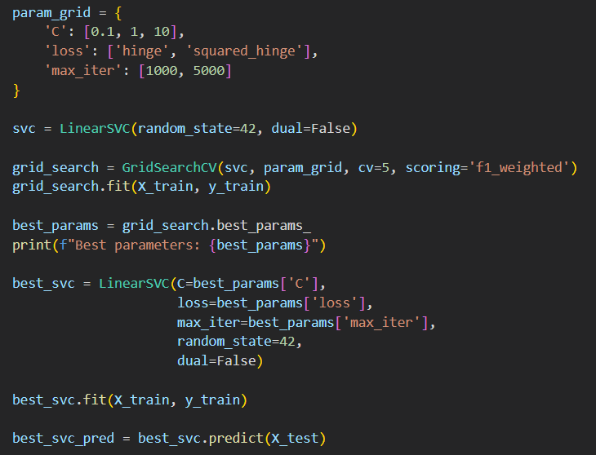
Model optimization: SVC

Slide 11
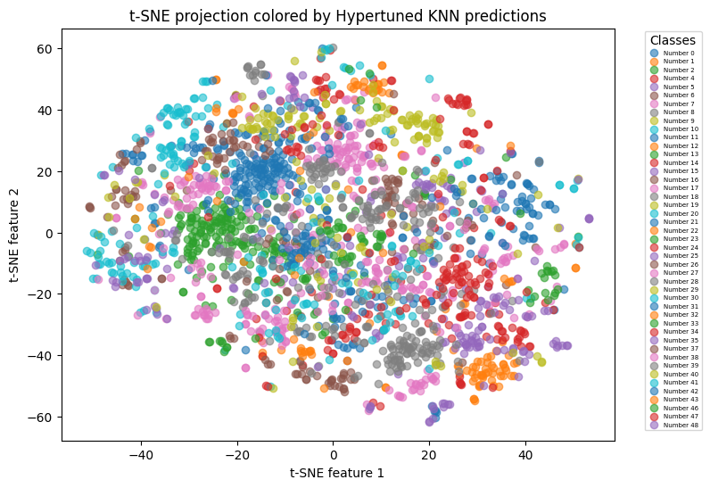
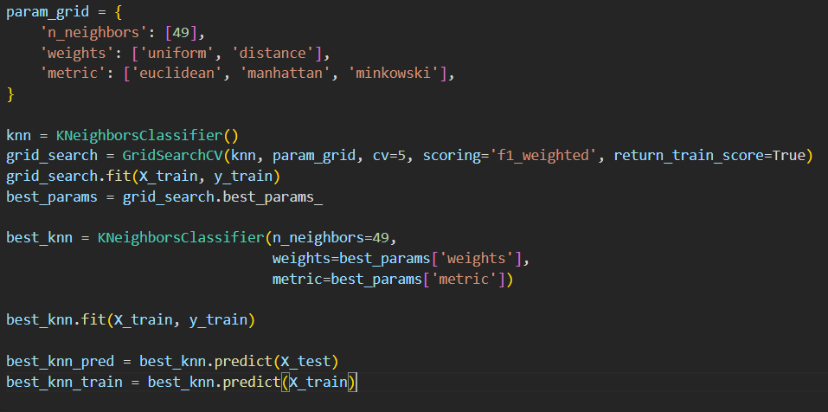
Model optimization: KNN

Slide 12
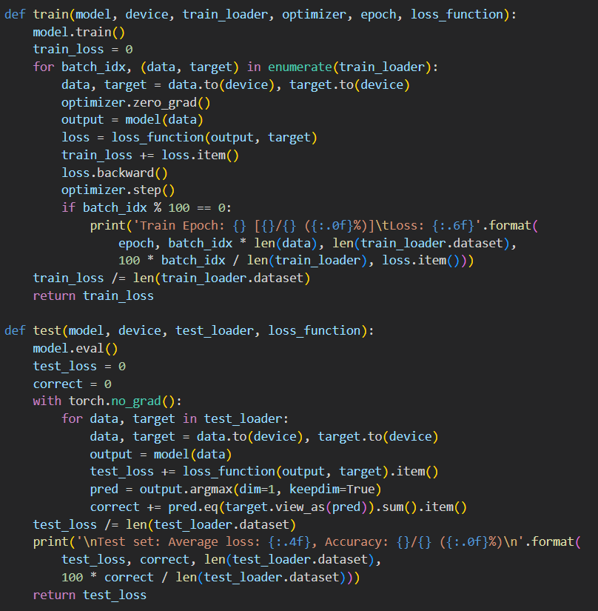
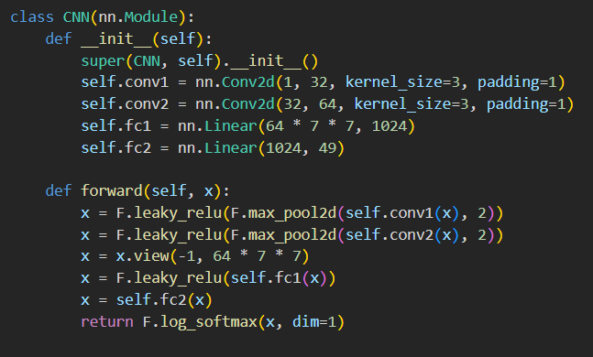
CNN

Slide 13
Model Comparison

Slide 14
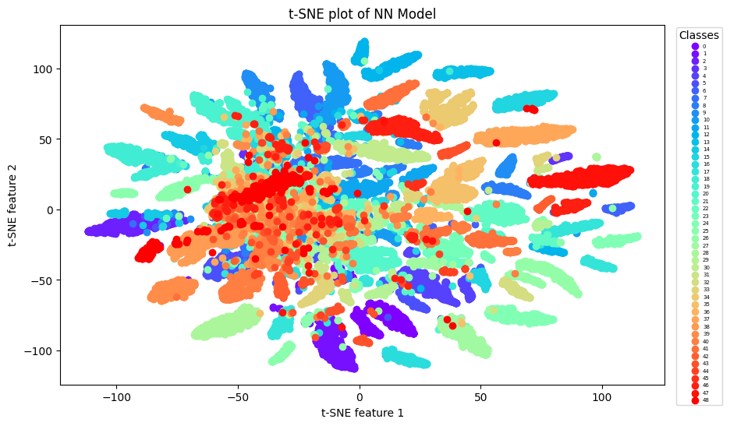
Model Comparison

Slide 15
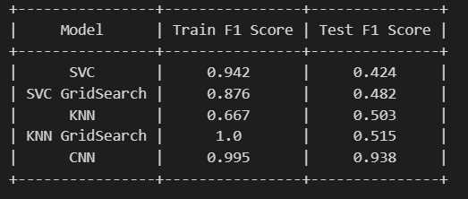
Model Comparison

Slide 16
Conclusion
CNN outperforms SVC and KNN in this study
Importance of data preprocessing and model tuning
Recommendation to use CNN for image recognition tasks
Suggestions for future research: transfer learning, dataset expansion, and exploring varied writing styles, add more Kanji characters to expand model robustness

Slide 17
THANK YOU
Matthew Boyer

