Slide 1

Examining factors associated with Electric Vehicle (EV) adoption
Presented By: Anand Shankar, Anjuli Gairola, Ariel Jones, Brendan Trafford

Slide 2



Electric Vehicle (EV)
Either partially or fully powered on electric power
Types
All-EV- charged battery, driving ranges from 150 to 400 miles
Plug-In Hybrid EV- 15 to 60-plus miles
Hybrid Electric Vehicles (US Department of Energy)

Slide 3
Factors affecting EV adoption
Fuel cost – 18.2% ↑ in the past year (US Labor Department’s Bureau of Labor Statistics, Oct 13, 2022)
Climate- transportation is responsible for 14% of global greenhouse gas emissions (Project drawdown, 2022)
Policy support – carbon neutrality, tax credits, EV Readiness (US Dept of Energy)
Infrastructure availability
Technological growth
Cost – 54.3% ↑vs 10.1% for gas cars in past 18 months (iSeeCars pricing study, Aug 2022)

Slide 4

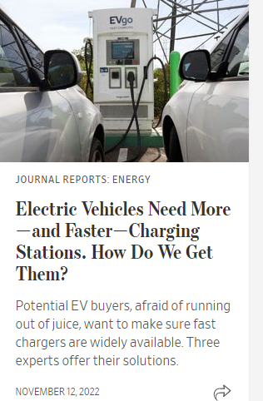
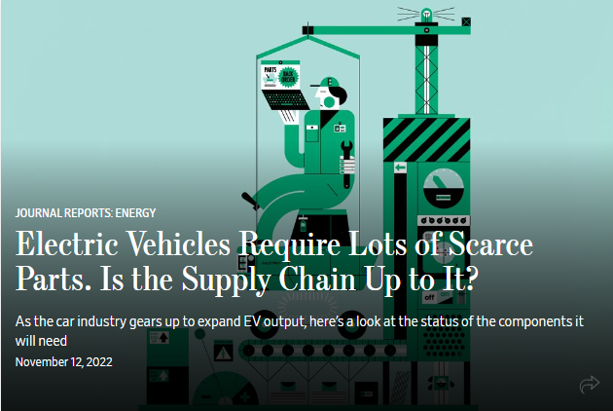
Project significance
Relevance
Applicability

Slide 5
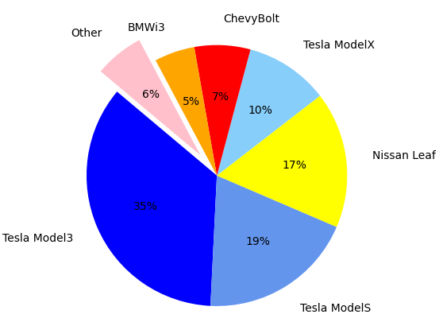
Total sales in top ten EV models 2015-2019
VW e-Golf
Fiat 500E
Ford Focus EV
Smart ED
*
*2017-2019

Slide 6
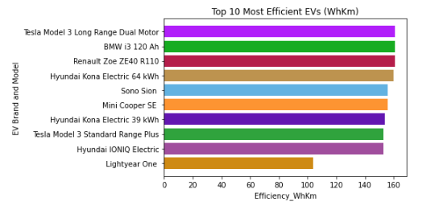
Most energy-efficient EVs – 102 cars specifications data
Efficiency = Wh/Km

Slide 7
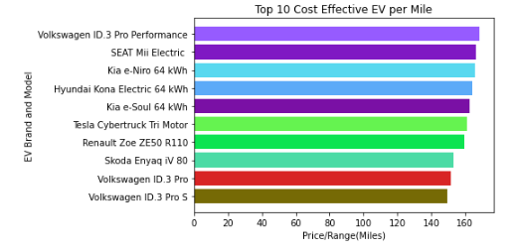
Most cost-efficient EVs
Price/Range (miles) = Sale price of car/total miles per charge

Slide 8
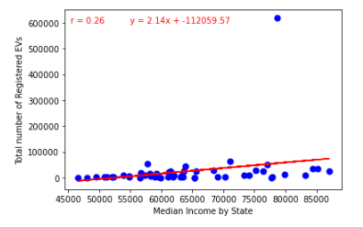
Relationship between median income and EV adoption 2016-2020

Slide 9
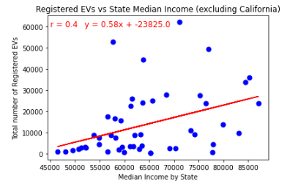
Median income vs EV adoption 2016-2020 (excluding California)

Slide 10
Relationship between EV sales and charging infrastructure
 | 2016 | 2017 | 2018 | 2019 | 2020
Correlation values | r=0.96 | r=0.96 | r=0.97 | r=0.96 | r=0.97

Slide 11
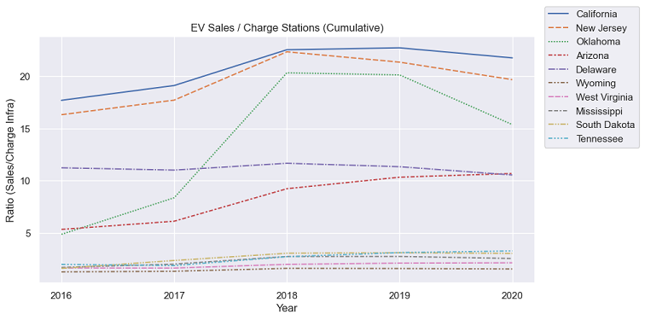
Ratio of EV sales to charge infrastructure

Slide 12
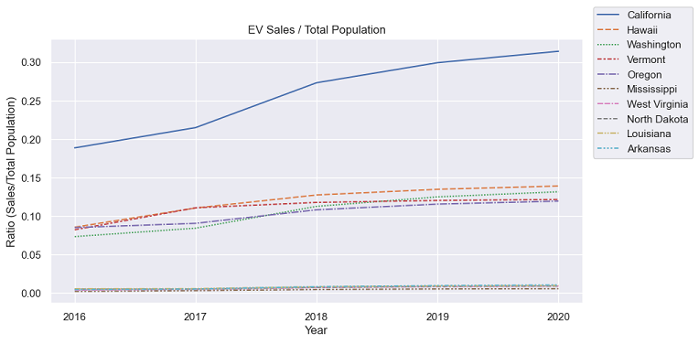
Number of EVs per capita

Slide 13
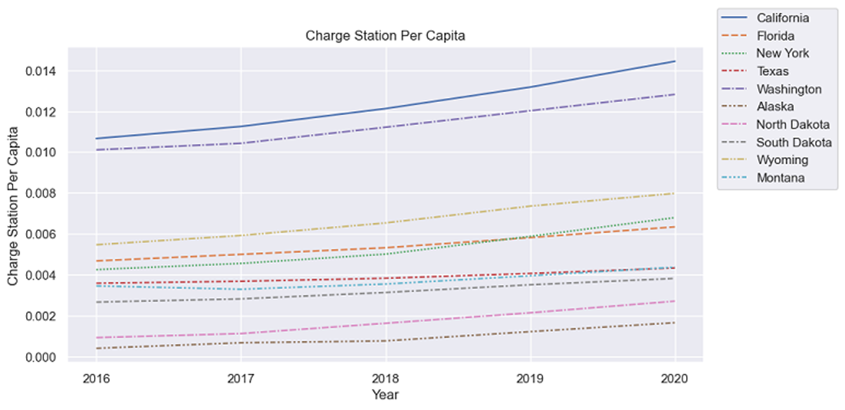
Charge stations per capita

Slide 14
Conclusions
Tesla Model 3 has the highest total sale – 39% - 2015-2019
59% of total EV sales -Tesla models
The most energy-efficient EV in US is Tesla Model 3
Volkswagen ID3 is the most cost-effective EV
There is a trend that suggests EV adoption is related to income.
Positive and high association between EV sales and charging infrastructure (r=0.96-97) from 2016-2020
↑ in charging infrastructure has a direct impact on the EV sales
In some states observed saturation point in charging infrastructure

Slide 15
Thank you Questions please

