Slide 1
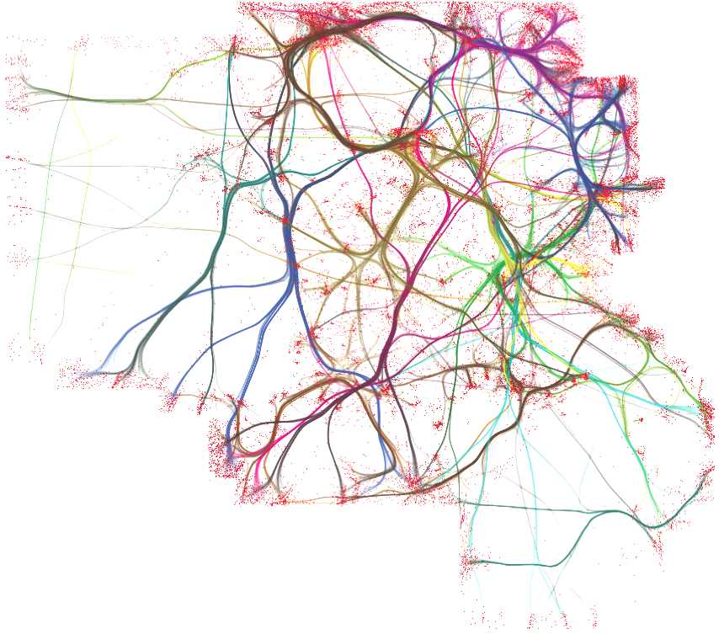


Danbury AI

Slide 2

Machine Learning With TensorFlow
TensorFlow™ is an open source software library for numerical computation using data flow graphs. Nodes in the graph represent mathematical operations, while the graph edges represent the multidimensional data arrays (tensors) communicated between them. The flexible architecture allows you to deploy computation to one or more CPUs or GPUs in a desktop, server, or mobile device with a single API. TensorFlow was originally developed by researchers and engineers working on the Google Brain Team within Google's Machine Intelligence research organization for the purposes of conducting machine learning and deep neural networks research, but the system is general enough to be applicable in a wide variety of other domains as well.
Presented By: Andrew & Mike

Slide 3
Overview
Introduction
Deep Learning Framework Space
TensorFlow Basics
Installing TensorFlow with Virtualenv.
Graph Visualization with TensorBoard
A Single Neuron
Interactive Sessions and Ipython
MNIST Walkthrough
TF Learn
TensorFlow GPU Processing
Sliding window and MINST walkthrough.

Slide 4

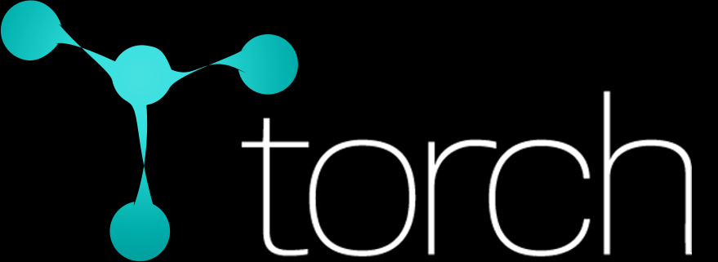

Deep Learning Framework Space
Caffe (2014)
(+) Great Model Zoo
TensorFlow ( 2015 )
(+) Good deployment infrastructure.
(+) Support for heterogeneous distributed systems
(+) Mobile Friendly
(+) Python and C++ Interfaces
Theano ( 2007 )
(+) Deep learning frameworks built on top ( Keras, Lasagne and Blocks )
(+) Long academic history
(+) Python + Numpy
Torch (2012)
(+) Abundance of pretrained models
(+/-) Lua
(+) Used by Facebook and Twitter
Notes:
Deep learning requires extensive computation.

Slide 5
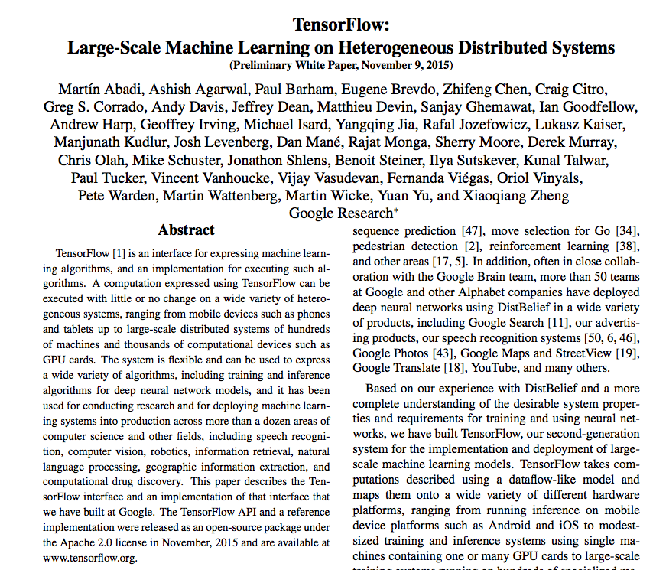
What is TensorFlow?
TensorFlow is an open source software library for numerical computation using data flow graphs.
Predecessor of Google’s Deepmind DistBelief.
Nodes in the graph represent mathematical operations, while the graph edges represent the multidimensional data arrays (tensors) that flow between them.
Lets you deploy computation to one or more CPUs or GPUs in a desktop, server, or mobile device without rewriting code.
TensorBoard, a data visualization toolkit.

Slide 6
TensorFlow Features
Auto-Differentiation
You define the computational architecture of your predictive model, combine that with your objective function, and just add data -- TensorFlow handles computing the derivatives for you.
Research and Production Environment
At Google, research scientists experiment with new algorithms in TensorFlow, and product teams use TensorFlow to train and serve models live to real customers.
Portability
Runs on CPUs or GPUs, and on desktop, server, or mobile computing platforms.
Flexibility
TensorFlow isn't a rigid neural networks library. If you can express your computation as a data flow graph, you can use TensorFlow. Defining handy new compositions of operators is as easy as writing a Python function and costs you nothing in performance. And if you don't see the low-level data operator you need, write a bit of C++ to add a new one.
Language Options
Comes with an easy to use Python interface and a no-nonsense C++
interface to build and execute your computational graphs. SWIG extensions.

Slide 7
The Data Flow Graph
A TensorFlow computation is described by a directed graph, which is composed of a set of nodes.
Each node has zero or more inputs and zero or more outputs and represents the instantiation of an operation.
Some kinds of nodes maintain and update persistent state for branching and looping control. (i.e. variables)
An operation has a name and represents some abstract computation ( e.g. matrix multiply, add ).
A kernel is a particular implementation of an operation that can be run on a particular device ( e.g. CPU, GPU ).
A TensorFlow binary defines the sets of operations and kernels available via a registration mechanism and can be extended.
Tensors are arbitrary dimensionality arrays that flow along normal edges in the graph (from outputs to inputs). z
Control dependencies are special edges that indicate the source node for the control dependence must finish executing before the destination node.

Slide 8
Data Flow Graph Efficiency
To do efficient numerical computing in Python, we typically use libraries like NumPy that do expensive operations such as matrix multiplication outside Python, using highly efficient code implemented in another language. Unfortunately, there can still be a lot of overhead from switching back to Python every operation. This overhead is especially bad if you want to run computations on GPUs or in a distributed manner, where there can be a high cost to transferring data.
TensorFlow also does its heavy lifting outside Python, but it takes things a step further to avoid this overhead. Instead of running a single expensive operation independently from Python, TensorFlow lets us describe a graph of interacting operations that run entirely outside Python. This approach is similar to that used in Theano or Torch.
The role of the Python code is therefore to build this external computation graph, and to
dictate which parts of the computation graph should be run.

Slide 9
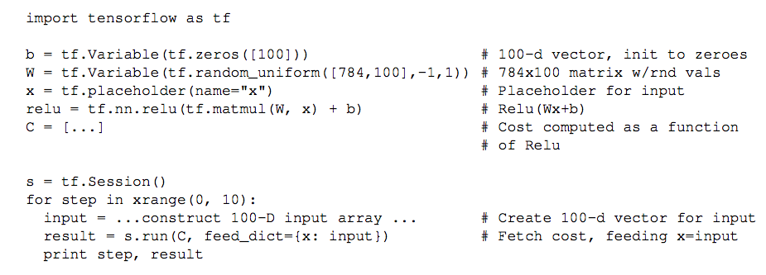
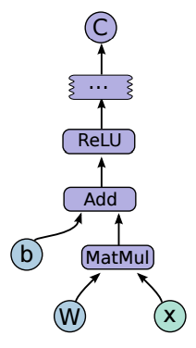
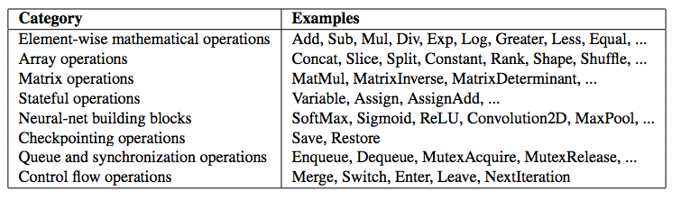
Graph Example

Slide 10
Installing TensorFlow ( Python 2 )
Install pip and Virtualenv.
# Ubuntu/Linux 64-bit $ sudo apt-get install python-pip python-dev python-virtualenv # Mac OS X $ sudo easy_install pip $ sudo pip install --upgrade virtualenv
Create a Virtualenv environment.
$ virtualenv --system-site-packages ~/tensorflow

Slide 11
Installing TensorFlow ( Python 2 )
Activate the Virtualenv environment and install TensorFlow in it.
$ source ~/tensorflow/bin/activate # If using bash $ source ~/tensorflow/bin/activate.csh # If using csh (tensorflow)$ # Your prompt should change # Ubuntu/Linux 64-bit, CPU only: (tensorflow)$ pip install --upgrade https://storage.googleapis.com/tensorflow/linux/cpu/tensorflow-0.8.0-cp27-none-linux_x86_64.whl # Ubuntu/Linux 64-bit, GPU enabled. Requires CUDA toolkit 7.5 and CuDNN v4. For # other versions, see "Install from sources" below. (tensorflow)$ pip install --upgrade https://storage.googleapis.com/tensorflow/linux/gpu/tensorflow-0.8.0-cp27-none-linux_x86_64.whl # Mac OS X, CPU only: (tensorflow)$ pip install --upgrade
https://storage.googleapis.com/tensorflow/mac/tensorflow-0.8.0-py2-none-any.whl

Slide 12
Installing TensorFlow ( Python 2 )
After the install you will activate the Virtualenv environment each time you want to use TensorFlow.
$ source ~/tensorflow/bin/activate # If using bash. $ source ~/tensorflow/bin/activate.csh # If using csh. (tensorflow)$ # Your prompt should change. # Run Python programs that use TensorFlow. ... # When you are done using TensorFlow, deactivate the environment. (tensorflow)$ deactivate

Slide 13
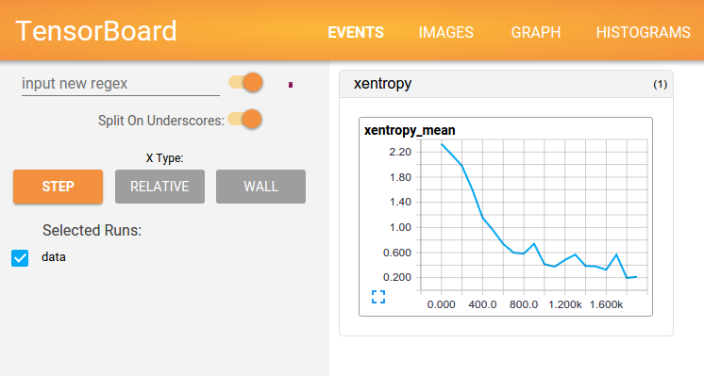
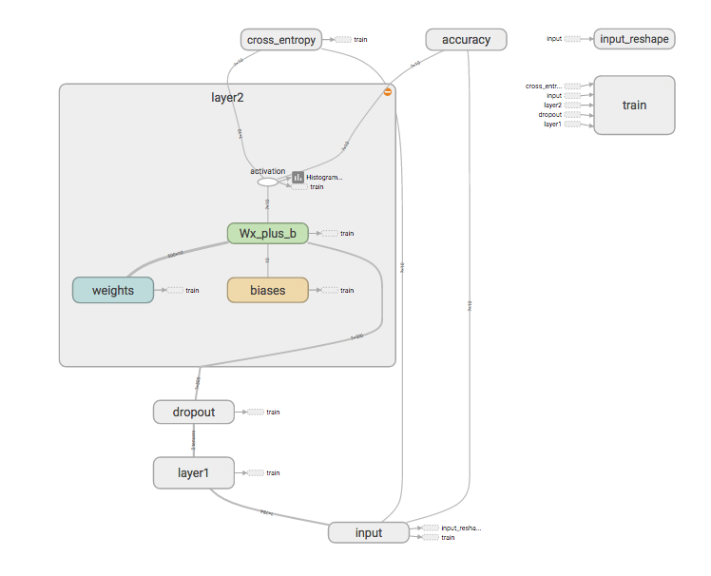
TensorBoard
Interactive visualization tool baked into TensorFlow.
TensorBoard operates by reading TensorFlow events files, which contain summary data that you can generate when running TensorFlow.
Denote nodes with summary operations for output to event files.
Great example:
https://github.com/DanburyAI/DanburyAITensorFlowPresentationAug2016/blob/master/mnist_with_summaries.py
Live demo: https://www.tensorflow.org/tensorboard/index.html

Slide 14
A Single Neuron
DEMO
See “Beginner MINST.ipynb” on repo
https://github.com/DanburyAI/DanburyAITensorFlowPresentationAug2016/blob/master/Beginner%20MNIST.ipynb

Slide 15
MNIST Walkthrough
DEMO
See “Beginner MINST.ipynb” on repo
https://github.com/DanburyAI/DanburyAITensorFlowPresentationAug2016/blob/master/Beginner%20MNIST.ipynb

Slide 16
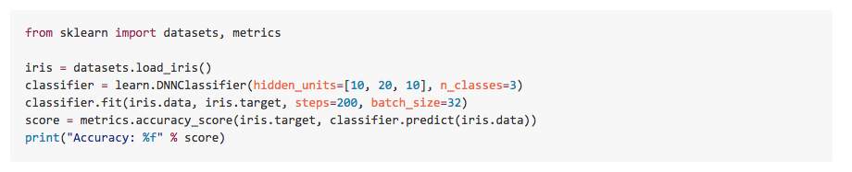
TF Learn
To smooth the transition from the Scikit Learn world of one-liner machine learning into the more open world of building different shapes of ML models. You can start by using fit/predict and slide into TensorFlow APIs as you are getting comfortable.
http://tflearn.org/installation/

Slide 17
TensorFlow GPU Processing
GPU > CPU
Matrix multiplication, convolution, and large element-wise operations.
GPU RAM should be ‘saturated’ otherwise the overhead required to transfer data to the GPU will cancel out computation speedup
GPU = CPU
Indexing, dimension-shuffling and constant-time reshaping
GPU < CPU
Summation over rows/columns

Slide 18
Sliding Window MNIST
DEMO

Slide 19
Resources and Sources
TF Learn ( formely Scikit Flow )
https://github.com/tensorflow/tensorflow/tree/master/tensorflow/contrib/learn/python/learn
http://terrytangyuan.github.io/2016/03/14/scikit-flow-intro/
https://github.com/tensorflow/tensorflow/tree/master/tensorflow/examples/skflow
http://tflearn.org/installation/
TensorBoard Graph Visualization
https://www.tensorflow.org/versions/r0.10/how_tos/graph_viz/index.html
Simple TF Tutorials
https://github.com/nlintz/TensorFlow-Tutorials

Slide 20
Resources & Sources
Comparison of Deep Learning Frameworks ( Simple )
http://deeplearning4j.org/compare-dl4j-torch7-pylearn.html
Tensor Flow Advantages
https://www.packtpub.com/books/content/picking-tensorflow-can-now-pay-dividends-sooner
TF Model Zoo
https://github.com/tensorflow/models
TF Mooc
https://www.udacity.com/course/deep-learning--ud730
TF Whitepaper
http://download.tensorflow.org/paper/whitepaper2015.pdf
Saving Trained Models
https://www.tensorflow.org/versions/r0.9/how_tos/variables/index.html
TF Setup
https://github.com/tensorflow/tensorflow/blob/master/tensorflow/g3doc/get_started/os_setup.md
Latest ML Research with TF Implementation
https://github.com/LeavesBreathe/tensorflow_with_latest_papers

Slide 21
Resources & Sources
Installing TensorFlow
https://www.tensorflow.org/versions/r0.8/get_started/os_setup.html#test-the-tensorflow-installation
Deep MINST ( Advanced )
https://www.tensorflow.org/versions/r0.8/tutorials/mnist/pros/index.html#deep-mnist-for-experts
Beginner MINST
https://www.tensorflow.org/versions/r0.8/tutorials/mnist/beginners/index.html
ORiley - Hello TensorFlow
https://www.oreilly.com/learning/hello-tensorflow
TensorBoard
https://www.tensorflow.org/versions/r0.8/how_tos/graph_viz/index.html
Softmax Regression
http://ufldl.stanford.edu/tutorial/supervised/SoftmaxRegression/
Ipython Tutorial
http://cs231n.github.io/ipython-tutorial/
TensorFlow Resources ( Gthub List )
https://github.com/jtoy/awesome-tensorflow
Comparison of Deep Learning Frameworks ( Academic )
http://arxiv.org/abs/1511.06435

Slide 22


QUESTIONS& COMMMENTS
Presented By: Andrew Ribeiro
And Michael Rogowski
FIND THIS PRESENTATION ONLINE:
https://github.com/DanburyAI/DanburyAITensorFlowPresentationAug2016

Slide 23
UNUSED SLIDES

Slide 24
TensorBoard: class tf.train.SummaryWriter
The SummaryWriter class provides a mechanism to create an event file in a given directory and add summaries and events to it. The class updates the file contents asynchronously. This allows a training program to call methods to add data to the file directly from the training loop, without slowing down training.

Slide 25
Softmax Regression Model
Softmax regression (or multinomial logistic regression) is a generalization of logistic regression to the case where we want to handle multiple classes. In logistic regression we assumed that the labels were binary: y(i)∈{0,1}y(i)∈{0,1}. We used such a classifier to distinguish between two kinds of hand-written digits. Softmax regression allows us to handle y(i)∈{1,…,K}y(i)∈{1,…,K} where K is the number of classes.
When K = 2, Softmax == Logistic Regression.

