Slide 1

Spring RESTful API File Services
By
Pichet Limvajiranan

Slide 2







SPA Running Environment
https:/host.domain/..
Server Side
Front-End App
Front-End
HTTP
Reverse Proxy
VM/Container
HTTP
VM/Container
REST API Service
HTTP
VM
VM/Container
https:/host.domain/api/..

Slide 3

File Storage Architectures (1)
Server Side
Front-End App
Front-End
HTTP
Reverse Proxy
VM/Container
HTTP
VM/Container
REST API + File
Service
HTTP
VM
VM/Container

Slide 4
File Storage Architectures (2)
Server Side
Front-End App
Front-End
HTTP
Reverse Proxy
VM/Container
HTTP
VM/Container
REST API + File
Service
HTTP
VM
VM/Container
File/Storage Server
VM/Container

Slide 5

File Storage Architectures (3)
Server Side
Front-End App
Front-End
HTTP
Reverse Proxy
VM/Container
HTTP
VM/Container
REST API
HTTP
VM
VM/Container
File
Services
VM/Container

Slide 6






File Storage Architectures (4)
Server Side
Front-End App
Front-End
HTTP
Reverse Proxy
VM/Container
HTTP
VM/Container
REST API
HTTP
VM
VM/Container
Cloud
Services

Slide 7
File Operation
Upload
Send file – Form Data (Multipart) / File Only (FE)
Read file data from Http Request (BE)
Write file to storage (BE)
Download
Return file URL / File content
Delete
Read file name from Http Request
Remove file from storage

Slide 8
Configuring Server and File Storage Properties
## MULTIPART (MultipartProperties)
# Enable multipart uploads
spring.servlet.multipart.enabled=true
# Max file size.
spring.servlet.multipart.max-file-size=10MB
# Max Request Size
spring.servlet.multipart.max-request-size=80MB
## File Storage Properties # All files uploaded through the REST API will be stored in this directory
file.upload-dir=/public/classicmodels/uploads
# Threshold after which files are written to disk. spring.servlet.multipart.file-size-threshold=4KB
## File Storage Properties # All files uploaded through the REST API will be stored in this directory
file.upload-dir=./product-images

Slide 9
Automatically binding properties to a POJO class
Spring Boot has an awesome feature called @ConfigurationProperties using which you can automatically bind the properties defined in the application.properties file to a POJO class.
Let’s define a POJO class called FileStorageProperties inside based-package.properties package to bind all the file storage properties.
file.upload-dir=./product-images
@ConfigurationProperties(prefix = "file")
@Getter
@Setter
public class FileStorageProperties {
private String uploadDir;
}
@SpringBootApplication @EnableConfigurationProperties({ FileStorageProperties.class }) public class DemoApplication { public static void main(String[] args) {

Slide 10
Binding properties to a POJO class
Create Configuration property class: FileStorageProperties.java (package based-package.properties
@ConfigurationProperties(prefix = "file")
@Getter
@Setter
public class FileStorageProperties {
private String uploadDir;
}
Register Configuration Property ( into ApplicationConfig.java or ClassicmodelServiceApplication.java )
@EnableConfigurationProperties({ FileStorageProperties.class })

Slide 11
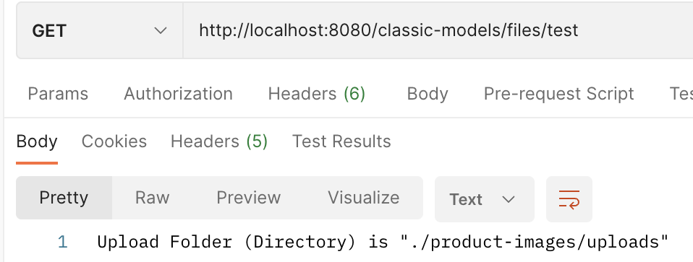
Test properties/POJO binding
@RestController @RequestMapping("/files") public class FileController { @Autowired FileStorageProperties fileStorageProperties; @GetMapping("/test") public ResponseEntity<Object> testPropertiesMapping() { return ResponseEntity.ok("Upload Folder (Directory) is \"" + fileStorageProperties.getUploadDir()+ "\""); } }
“

Slide 12
FileService : Initialize
import java.io.IOException; import java.net.MalformedURLException; import java.nio.file.Files; import java.nio.file.Path; import java.nio.file.Paths; import java.nio.file.StandardCopyOption;
@Service @Getter public class FileService { private final Path fileStorageLocation;
@Autowired public FileService(FileStorageProperties fileStorageProperties) { this.fileStorageLocation = Paths.get(fileStorageProperties
.getUploadDir()).toAbsolutePath().normalize(); try { if (! Files.exists(this.fileStorageLocation)) { Files.createDirectories(this.fileStorageLocation); } } catch (IOException ex) { throw new RuntimeException(
"Could not create the directory where the uploaded files will be stored.", ex); } }

Slide 13
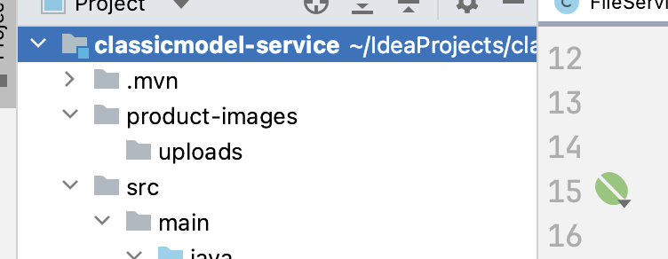
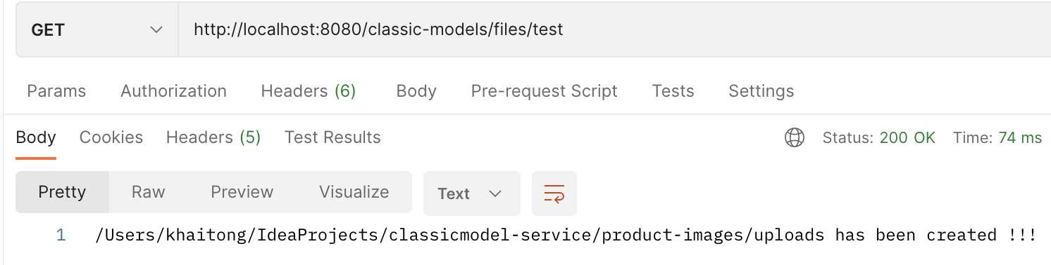
Modify FileController to Test FileService - Initialize
@RestController @RequestMapping("/files") public class FileController { @Autowired FileService fileService; @GetMapping("/test") public ResponseEntity<Object> testPropertiesMapping() { return ResponseEntity.ok(fileService.getFileStorageLocation()+ " has been created !!!"); } }

Slide 14
FileService: Storing File (add this method to FileService)
public String store(MultipartFile file) { // Normalize file name String fileName = StringUtils.cleanPath(file.getOriginalFilename()); try { // Check if the file's name contains invalid characters if (fileName.contains("..")) { throw new RuntimeException("Sorry! Filename contains invalid path sequence " + fileName); } // Copy file to the target location (Replacing existing file with the same name) Path targetLocation = this.fileStorageLocation.resolve(fileName); Files.copy(file.getInputStream(), targetLocation, StandardCopyOption.REPLACE_EXISTING); return fileName; } catch (IOException ex) { throw new RuntimeException("Could not store file " + fileName + ". Please try again!", ex); } }

Slide 15
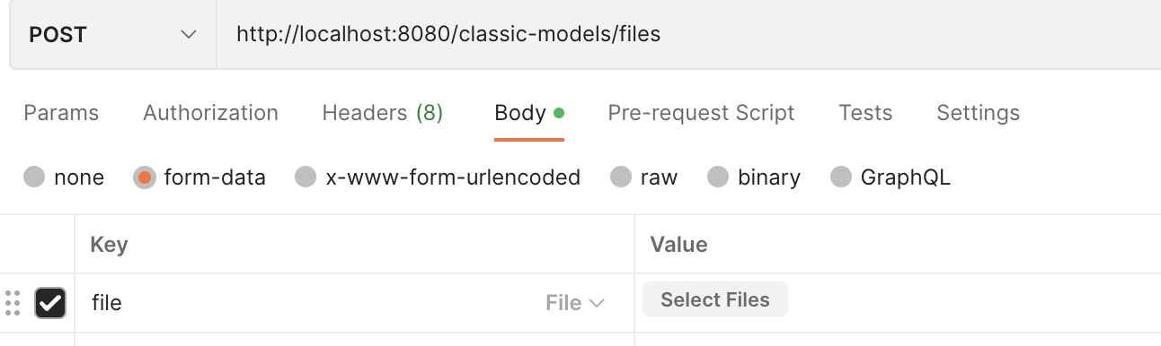
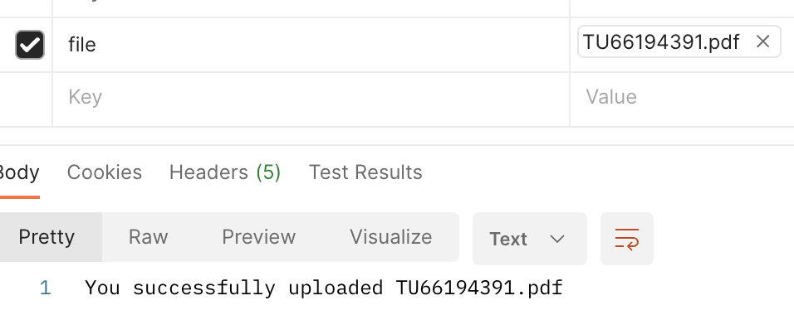

Add this method to FileController - Test FileService – Storing File
@PostMapping("") public ResponseEntity<Object> fileUpload(@RequestParam("file") MultipartFile file) { fileService.store(file); return ResponseEntity.ok("You successfully uploaded ” + file.getOriginalFilename()); }

Slide 16
FileService: LoadFile
public Resource loadFileAsResource(String fileName) { try { Path filePath = this.fileStorageLocation.resolve(fileName).normalize(); Resource resource = new UrlResource(filePath.toUri()); if (resource.exists()) { return resource; } else { throw new RuntimeException("File not found " + fileName); } } catch (MalformedURLException ex) { throw new RuntimeException("File operation error: " + fileName, ex); } }

Slide 17
File Controller
@GetMapping("/{filename:.+}") @ResponseBody public ResponseEntity<Resource> serveFile(@PathVariable String filename) { Resource file = fileService.loadFileAsResource(filename); return ResponseEntity.ok().contentType(MediaType.IMAGE_JPEG).body(file); }

