Slide 1

Spring Data JPA Query Creation

Slide 2
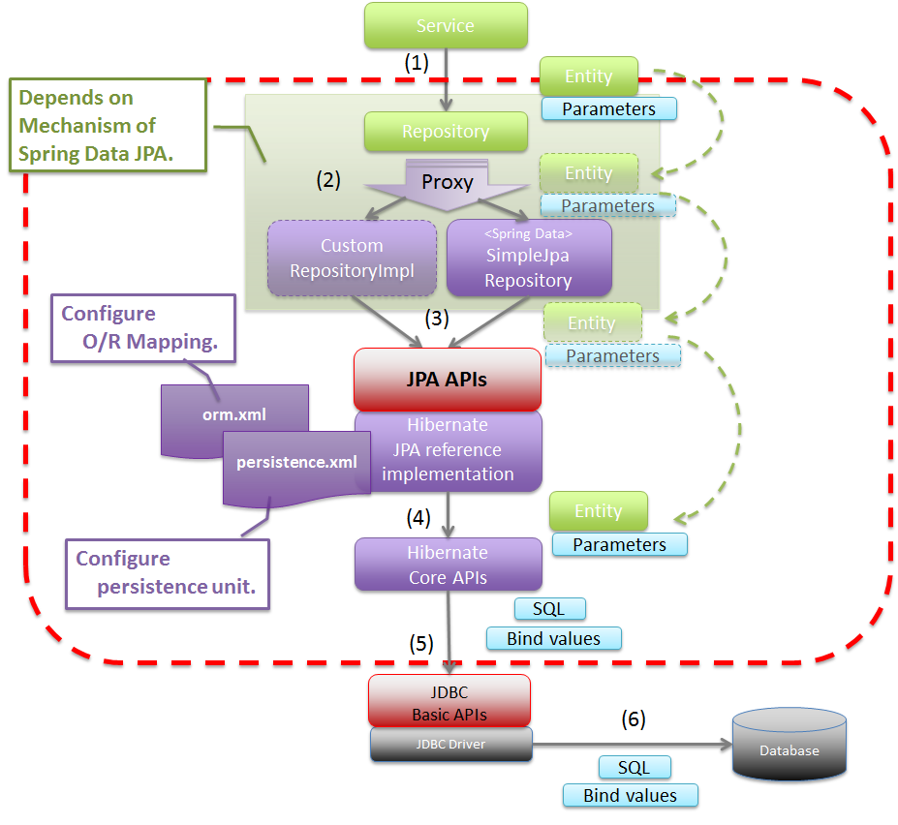
Basic Spring Data JPA Flow

Slide 3
JPA Repository Example
@Getter @Setter @NoArgsConstructor @AllArgsConstructor @ToString @Entity public class Student { @Id private Integer id; private String name; private Double gpax; }
import org.springframework.data.jpa.repository.JpaRepository; import sit.int204.demo.entities.Student; public interface StudentRepository extends JpaRepository<Student, Integer> { List<Student> findByNameContainsOrGpaxBetweenOrderByGpaxDesc( String name, double low, double high); }
Query methods

Slide 4
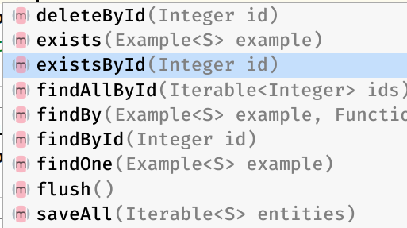
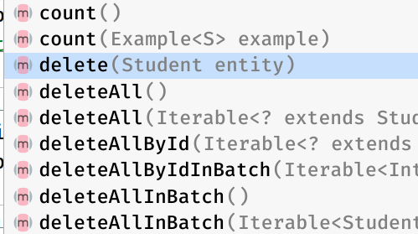
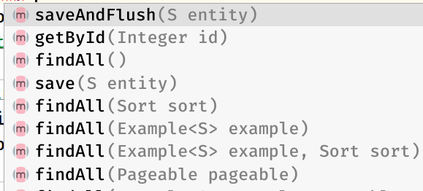
Jpa Repository default methods
public class AppController { @Autowired private final StudentRepository studentRepository;

Slide 5
Examples & Exercises: saveAll(Iterable<S> entities)
@Entity
@Data
@AllArgsConstructor
@NoArgsConstructor
public class Customer {
@Id
@GeneratedValue(strategy = GenerationType.AUTO)
private Long id;
private String firstName;
private String lastName;
}
public interface CustomerRepository extends JpaRepository<Customer, Long> { }
@Service
public class CustomerService {
@Autowired CustomerRepository customerRepository;
public List<Customer> insertCustomers(List<Customer> customers) {
return customerRepository.saveAll(customers);
}
}

Slide 6
Query Creation
Generally, the query creation mechanism for JPA works as described in “Query Methods”. The following example shows what a JPA query method translates into:
Example: Query creation from method names
public interface UserRepository extends Repository<User, Long> {
List<User> findByEmailAddressAndLastname(String emailAddress, String lastname);
}
We create a query using the JPA criteria API from this, but, essentially, this translates into the following query:
select u from User u where u.emailAddress = ?1 and u.lastname = ?2.
Spring Data JPA does a property check and traverses nested properties, as described in “Property Expressions”.

Slide 7
Supported keywords inside method names
Keyword | Sample | JPQL snippet
Distinct | findDistinctByLastnameAndFirstname | select distinct …​ where x.lastname = ?1 and x.firstname = ?2
And | findByLastnameAndFirstname | … where x.lastname = ?1 and x.firstname = ?2
Or | findByLastnameOrFirstname | … where x.lastname = ?1 or x.firstname = ?2
Is, Equals | findByFirstname,findByFirstnameIs,findByFirstnameEquals | … where x.firstname = ?1
Between | findByStartDateBetween | … where x.startDate between ?1 and ?2
LessThan | findByAgeLessThan | … where x.age < ?1
LessThanEqual | findByAgeLessThanEqual | … where x.age <= ?1

Slide 8
Supported keywords inside method names (2)
Keyword | Sample | JPQL snippet
GreaterThan | findByAgeGreaterThan | … where x.age > ?1
GreaterThanEqual | findByAgeGreaterThanEqual | … where x.age >= ?1
After | findByStartDateAfter | … where x.startDate > ?1
Before | findByStartDateBefore | … where x.startDate < ?1
IsNull, Null | findByAge(Is)Null | … where x.age is null
IsNotNull, NotNull | findByAge(Is)NotNull | … where x.age not null
Like | findByFirstnameLike | … where x.firstname like ?1
NotLike | findByFirstnameNotLike | … where x.firstname not like ?1

Slide 9
Supported keywords inside method names (3)
Keyword | Sample | JPQL snippet
StartingWith | findByFirstnameStartingWith | … where x.firstname like ?1 (parameter bound with appended %)
EndingWith | findByFirstnameEndingWith | … where x.firstname like ?1 (parameter bound with prepended %)
Containing | findByFirstnameContaining | … where x.firstname like ?1 (parameter bound wrapped in %)
OrderBy | findByAgeOrderByLastnameDesc | … where x.age = ?1 order by x.lastname desc
NotIn | findByAgeNotIn(Collection<Age> ages) | … where x.age not in ?1
True | findByActiveTrue() | … where x.active = true
False | findByActiveFalse() | … where x.active = false

Slide 10
Query Method Example
public interface CustomerRepository extends JpaRepository<Customer, Integer> { public List<Customer> findAllByCustomerNameContaining(String name); public List<Customer> findAllByCityContainsOrderByCountry(String name); public List<Customer> findAllByCreditLimitBetween(Double lower, Double upper); public List<Customer> findAllByCustomerNameBetween(String lower, String upper); }

Slide 11
Exercise 1:
Create REST API service for Products as end-points below
URI | HTTP verb | Description
/products | GET | Get all products filter by price between and product name contains
/products/product-line/{id} | GET | Get products by product line
/products/{id} | GET | Get product by product id
/products | POST | Add new product
/products/{id} | PUT | Update product

Slide 12
JPA Named Queries
Using named queries to declare queries for entities is a valid approach and works fine for a small number of queries.
As the queries themselves are tied to the Java method that runs them, you can actually bind them directly by using the Spring Data JPA @Query annotation rather than annotating them to the domain class.
This frees the domain class from persistence specific information and co-locates the query to the repository interface.
public interface UserRepository extends JpaRepository<User, Long> {
@Query("select u from User u where u.emailAddress = ?1")
User findByEmailAddress(String emailAddress);
}

Slide 13
Native Queries
The @Query annotation allows for running native queries by setting the nativeQuery flag to true, as shown in the following example:
Declare a native query at the query method using @Query
public interface UserRepository extends JpaRepository<User, Long> {
@Query(value = "SELECT * FROM USERS WHERE EMAIL_ADDRESS = ?1", nativeQuery = true)
User findByEmailAddress(String emailAddress);
}

Slide 14
Exercise 2:
Using Name Query instead Query Method for REST service in exercise 1
URI | HTTP verb | Description
/products | GET | Get all products filter by price between and product name contains
/products/line/{product-line} | GET | Get products by product line
/products/{id} | GET | Get product by product id
/products | POST | Add new product
/products/{id} | PUT | Update product

Slide 15
Spring Data REST: Pagination and Sorting
The PagingAndSortingRepository is an extension of CrudRepository to provide additional methods to retrieve entities using the pagination and sorting abstraction. It implicitly provides two methods:
Page<T> findAll(Pageable pageable) returns a Page of entities meeting the paging restriction provided in the Pageable object.
Pageable firstPageTwoElements = PageRequest.of(0, 2); Pageable secondPageFiveElements = PageRequest.of(1, 5);
Iterable<T> findAll(Sort sort) returns all entities sorted by the given options. No paging is applied here.
Sort sortedByName = Sort.by("name");
Pagination & Sorting
Pageable sortedByPriceDescNameAsc = PageRequest.of(0, 5, Sort.by("price").descending().and(Sort.by("name")));

Slide 16
Spring Data Sort and Order
The Sort class provides sorting options for database queries with more flexibility in choosing single/multiple sort columns and directions (ascending/descending).
we use by(), descending(), and() methods to create Sort object and pass it to Repository.findAll()
You can sort results by Sort and Order object with one or more specified variables.
Sorting can be done in ascending or descending order.
@Service
:
: public List<Customer> getAllCustomers(String sortBy) { return repository.findAll(Sort.Direction.DESC, Sort.by(sortBy));
}

Slide 17
Sort & Order object example
// order by 'published' column - ascending
List<Tutorial> tutorials = tutorialRepository.findAll(Sort.by("published"));
// order by 'published' column, descending
tutorialRepository.findAll(Sort.by("published").descending());
// order by 'published' column - descending, then order by 'title' - ascending
tutorialRepository.findAll(Sort.by("published").descending().and(Sort.by("title")));
List<Sort.Order> orders = new ArrayList();
Sort.Order order1 = new Sort.Order(Sort.Direction.DESC, "published");
orders.add(order1);
Sort.Order order2 = new Sort.Order(Sort.Direction.ASC, "title");
orders.add(order2);
List<Tutorial> tutorials = tutorialRepository.findAll(Sort.by(orders));

Slide 18
JpaRepository with Pagination
findAll(Pageable pageable): returns a Page of entities meeting the paging condition provided by Pageable object.
Pagination can be added by creation of PageRequest object which is implementation of Pageable interface.
Similar to sorting adding pagination depends from type of Repository extended by our interface.
@Service
: public Page<Customer> getAllCustomers(int page, int pageSize) {
Pageable pageable = PageRequest.of(page, pageSize); return repository.findAll(pageable); }

Slide 19
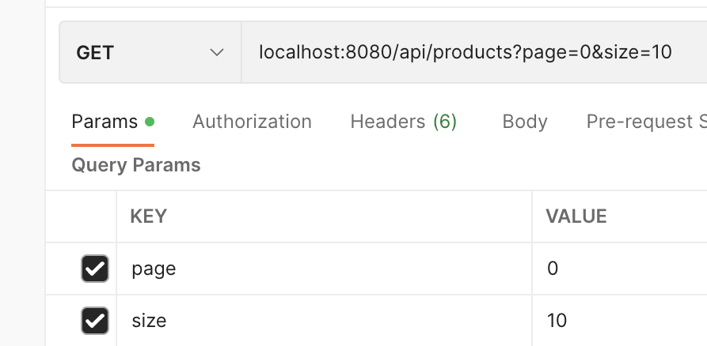
Accepting Page and Sort Parameters
Generally, paging and sorting parameters are optional and thus part of the request URL as query parameters. If any API supports paging and sorting, ALWAYS provide default values to these parameters – to be used when the client does not choose to specify any paging or sorting preferences.
Example:
@GetMapping("") public List<Customer> getAllCustomers( @RequestParam(defaultValue = "id") String sortBy, @RequestParam(defaultValue = "0") Integer page, @RequestParam(defaultValue = "10") Integer pageSize) {
Page<Customer> customers = service.findAll(sortBy, page, pageSize); return customers.getContent(); }

Slide 20
Page<T> Object
"offset": 5,
"pageSize": 5,
"pageNumber": 1,
"unpaged": false,
"paged": true
},
"last": false,
"totalPages": 25,
"totalElements": 122,
"size": 5,
"number": 1,
"sort": {
"empty": false,
"sorted": true,
"unsorted": false
},
"numberOfElements": 5,
"first": false,
"empty": false
}
{
"content": [
{
"id": 323,
"customerName": "Down Under Souveniers, Inc",
"contactLastName": "Graham",
"contactFirstName": "Mike",
"phone": "+64 9 312 5555",
"addressLine1": "162-164 Grafton Road",
"addressLine2": "Level 2",
:
]
"pageable": {
"sort": {
"empty": false,
"sorted": true,
"unsorted": false
},

Slide 21
Service - Paging & Sorting
@Service public class CustomerService { @Autowired private CustomerRepository repository; public Page<Customer> getAllCustomers(
String sortBy, int page, int pageSize) { Pageable pageble = PageRequest.of(page, pageSize);
Page<Customer> customers = repository.findAll(pageble); return customers; }
}
{
"content " : {
{ },
{ },
{ }
},
"page": {
"size": 20,
"totalElements": 11,
"totalPages": 1,
"number": 0
}
}

Slide 22

Controller - Paging & Sorting
@RestController @RequestMapping("/api/customers") public class CustomerController { @Autowired private CustomerService service; @GetMapping("") public List<Customer> getAllCustomers( @RequestParam(defaultValue = "id") String sortBy, @RequestParam(defaultValue = "0") Integer page, @RequestParam(defaultValue = "10") Integer pageSize) { return service.findAll(sortBy, page, pageSize).getContent(); }
}
localhost:port/api/customers?sortBy=id&page=0&pageSize=10
JSON
Controller
Presentation
Entity
Business Logic (Service Class)
Entity
Persistence (Repository Class)

