Slide 1

Spring RESTful API Pagination & Sorting
By
Pichet Limvajiranan

Slide 2
Spring Data REST: Pagination and Sorting
The PagingAndSortingRepository is an extension of CrudRepository to provide additional methods to retrieve entities using the pagination and sorting abstraction. It implicitly provides two methods:
Page<T> findAll(Pageable pageable) returns a Page of entities meeting the paging restriction provided in the Pageable object.
Pageable firstPageTwoElements = PageRequest.of(0, 2); Pageable secondPageFiveElements = PageRequest.of(1, 5);
Iterable<T> findAll(Sort sort) returns all entities sorted by the given options. No paging is applied here.
Sort sortedByName = Sort.by("name");
Pagination & Sorting
Pageable sortedByPriceDescNameAsc = PageRequest.of(0, 5, Sort.by("price").descending().and(Sort.by("name")));

Slide 3
Spring Data Sort and Order
The Sort class provides sorting options for database queries with more flexibility in choosing single/multiple sort columns and directions (ascending/descending).
we use by(), descending(), and() methods to create Sort object and pass it to Repository.findAll()
You can sort results by Sort and Order object with one or more specified variables.
Sorting can be done in ascending or descending order.
@Service
:
: public List<Customer> getAllCustomers(String sortBy) { return repository.findAll(Sort.Direction.DESC, Sort.by(sortBy));
}

Slide 4
Sort & Order object example
// order by 'published' column - ascending
List<Tutorial> tutorials = tutorialRepository.findAll(Sort.by("published"));
// order by 'published' column, descending
tutorialRepository.findAll(Sort.by("published").descending());
// order by 'published' column - descending, then order by 'title' - ascending
tutorialRepository.findAll(Sort.by("published").descending().and(Sort.by("title")));
List<Sort.Order> orders = new ArrayList();
Sort.Order order1 = new Sort.Order(Sort.Direction.DESC, "published");
orders.add(order1);
Sort.Order order2 = new Sort.Order(Sort.Direction.ASC, "title");
orders.add(order2);
List<Tutorial> tutorials = tutorialRepository.findAll(Sort.by(orders));

Slide 5
Exercise 1:
Create REST API service for Products as end-points below
URI | HTTP verb | Description
/products | GET | Get all products filter by price between and product name contains sorting as request specify

Slide 6
public interface ProductRepository extends JpaRepository<Product, String> { List<Product> getProductsByPriceBetweenAndProductNameContains( Double lower, Double upper, String partOfName, Sort sort); Product findFirstByOrderByPriceDesc(); }
@Service public class ProductService { @Autowired ProductRepository repository; public List<Product> getAllProducts(Double lower, Double upper, String partOfName, String sortBy, String direction) { if (upper==0 && lower==0) { upper = repository.findFirstByOrderByPriceDesc().getPrice(); } if(sortBy.isEmpty()) { sortBy = "productCode" ; } Sort.Order sortOrder = new Sort.Order((direction.equalsIgnoreCase("asc")?
Sort.Direction.ASC : Sort.Direction.DESC), sortBy); return repository.getProductsByPriceBetweenAndProductNameContains(
lower, upper, partOfName, Sort.by(sortOrder)); } }

Slide 7
@RestController @RequestMapping("/products") public class ProductController { @Autowired ProductService service; @GetMapping("") public List<Product> getAllProducts( @RequestParam(defaultValue = "") String partOfProductName, @RequestParam(defaultValue = "0") Double lower, @RequestParam(defaultValue = "0") Double upper, @RequestParam(defaultValue = "") String sortBy, @RequestParam(defaultValue = "ASC") String sortDirection ) { return service.getAllProducts(lower, upper, partOfProductName, sortBy, sortDirection); } }

Slide 8
JpaRepository with Pagination
findAll(Pageable pageable): returns a Page of entities meeting the paging condition provided by Pageable object.
Pagination can be added by creation of PageRequest object which is implementation of Pageable interface.
Similar to sorting adding pagination depends from type of Repository extended by our interface.
@Service
: public Page<Customer> getAllCustomers(int page, int pageSize) {
Pageable pageable = PageRequest.of(page, pageSize); return repository.findAll(pageable); }

Slide 9
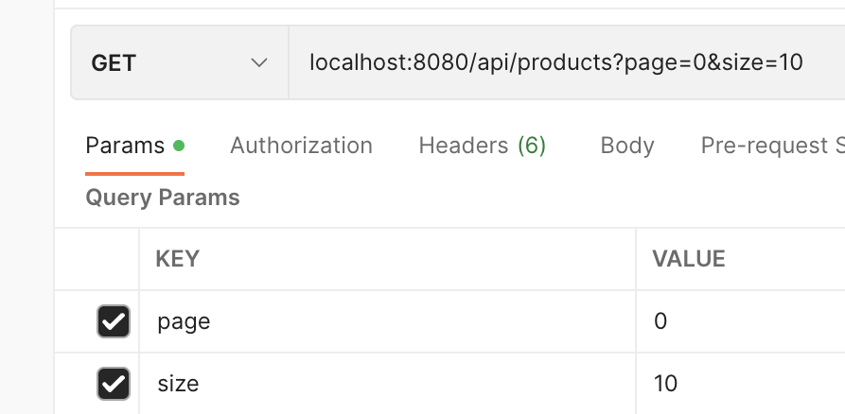
Accepting Page and Sort Parameters
Generally, paging and sorting parameters are optional and thus part of the request URL as query parameters. If any API supports paging and sorting, ALWAYS provide default values to these parameters – to be used when the client does not choose to specify any paging or sorting preferences.
Example:
@GetMapping("") public List<Customer> getAllCustomers( @RequestParam(defaultValue = "id") String sortBy, @RequestParam(defaultValue = "0") Integer page, @RequestParam(defaultValue = "10") Integer pageSize) {
Page<Customer> customers = service.findAll(sortBy, page, pageSize); return customers.getContent(); }

Slide 10
Page<T> Object
"offset": 5,
"pageSize": 5,
"pageNumber": 1,
"unpaged": false,
"paged": true
},
"last": false,
"totalPages": 25,
"totalElements": 122,
"size": 5,
"number": 1,
"sort": {
"empty": false,
"sorted": true,
"unsorted": false
},
"numberOfElements": 5,
"first": false,
"empty": false
}
{
"content": [
{
"id": 323,
"customerName": "Down Under Souveniers, Inc",
"contactLastName": "Graham",
"contactFirstName": "Mike",
"phone": "+64 9 312 5555",
"addressLine1": "162-164 Grafton Road",
"addressLine2": "Level 2",
:
]
"pageable": {
"sort": {
"empty": false,
"sorted": true,
"unsorted": false
},

Slide 11
Service - Paging & Sorting
@Service public class CustomerService { @Autowired private CustomerRepository repository; public Page<Customer> getAllCustomers(
String sortBy, int page, int pageSize) { Pageable pageble = PageRequest.of(page, pageSize);
Page<Customer> customers = repository.findAll(pageble); return customers; }
}
{
"content " : {
{ },
{ },
{ }
},
"page": {
"size": 20,
"totalElements": 11,
"totalPages": 1,
"number": 0
}
}

Slide 12

Controller - Paging & Sorting
@RestController @RequestMapping("/api/customers") public class CustomerController { @Autowired private CustomerService service; @GetMapping("") public List<Customer> getAllCustomers( @RequestParam(defaultValue = "id") String sortBy, @RequestParam(defaultValue = "0") Integer page, @RequestParam(defaultValue = "10") Integer pageSize) { return service.findAll(sortBy, page, pageSize).getContent(); }
}
localhost:port/api/customers?sortBy=id&page=0&pageSize=10
JSON
Controller
Presentation
Entity
Business Logic (Service Class)
Entity
Persistence (Repository Class)

Slide 13
Exercise 2:
Create REST API service for Products as end-points below
URI | HTTP verb | Description
/products | GET | Get all products filter by price between and product name contains sorting as request specify with pagination

Slide 14
Add New Query Method to support pagination
public interface ProductRepository extends JpaRepository<Product, String> { List<Product> getProductsByPriceBetweenAndProductNameContains( Double lower, Double upper, String partOfName, Sort sort); Product findFirstByOrderByPriceDesc();
Page<Product> getProductsByPriceBetweenAndProductNameContains( Double lower, Double upper, String partOfName, Pageable pageable); }

Slide 15
Overload service method to support pagination
public Page<Product> getAllProducts(Double lower, Double upper, String partOfName, String sortBy, String direction, int pageNo, int pageSize) { if (upper == 0 && lower == 0) { upper = repository.findFirstByOrderByPriceDesc().getPrice(); } if (sortBy.isEmpty()) { sortBy = "productCode"; } Sort.Order sortOrder = new Sort.Order( (direction.equalsIgnoreCase("asc") ? Sort.Direction.ASC : Sort.Direction.DESC), sortBy); Pageable pageable = PageRequest.of(pageNo, pageSize, Sort.by(sortOrder)); return repository.getProductsByPriceBetweenAndProductNameContains(lower, upper, partOfName, pageable); }

Slide 16
Controller: Create new end-point/Modify method to support pagination
@RestController @RequestMapping("/products") public class ProductController { @Autowired ProductService service; @GetMapping("") public Page<Product> getAllProducts( @RequestParam(defaultValue = "") String partOfProductName, @RequestParam(defaultValue = "0") Double lower, @RequestParam(defaultValue = "0") Double upper, @RequestParam(defaultValue = "") String sortBy, @RequestParam(defaultValue = "ASC") String sortDirection, @RequestParam(defaultValue = ”0") int pageNo, @RequestParam(defaultValue = "10") int pageSize ) { return service.getAllProducts(lower, upper, partOfProductName, sortBy, sortDirection, pageNo, pageSize); } }

