Slide 1

Spring RESTful API DTO
By
Pichet Limvajiranan

Slide 2

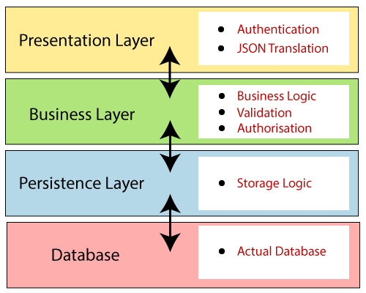
Spring Boot Layer Architectures
JSON
Presentation
Controller
Entity
Business Logic (Service Class)
Entity
Persistence (Repository Class)

Slide 3

DTO: Data Transfer Object
DTOs normally are created as POJOs.
The data is mapped from the domain models to the DTOs.
By using DTOs, we can provide as many different versions (with different structures) of our entities as we want.
Front-end
Customer
Type 2
Controller
DTO
Customer
Type 1
Customer
Type n
Service
mapper
Entity
Repository
Customer
Entity
Entity

Slide 4
DTO: Data Transfer Object
Front-end
DTO is a design pattern conceived to reduce the number of calls when working with remote interfaces.
CustomerInfo
Controller
mapper
Service
Customer
Employee
Payment
Repository
Another advantage of using DTOs on RESTful APIs is that they can help hiding implementation details of domain objects (aka. entities). Exposing entities through endpoints can become a security issue if we do not carefully handle what properties can be changed through what operations.

Slide 5
Service Layer
@Getter @Setter public class SimpleCustomerDTO { private String customerName; private String phone; private String city; private String country; private String salesPerson; }
@Service public class CustomerService { @Autowired private CustomerRepository repository; public SimpleCustomerDTO getSimpleCustomerById(Integer id) { return repository.findById(id) .map(customer -> convertEntityToDto(customer)) .orElseThrow(()->new ResponseStatusException( HttpStatus.NOT_FOUND, id +" Does Not Exist !!!" )); } private SimpleCustomerDTO convertEntityToDto(Customer customer) { SimpleCustomerDTO simpleCustomerDTO = new SimpleCustomerDTO(); simpleCustomerDTO.setCustomerName(customer.getCustomerName()); : simpleCustomerDTO.setSalesPerson(customer.getSalesRepEmployee().getFirstName() + ' '+ customer.getSalesRepEmployee().getLastName()); return simpleCustomerDTO; } }
@GetMapping("/{id}") public SimpleCustomerDTO getCustomerById (@PathVariable Integer id) { return customerService.getSimpleCustomerById(id); }

Slide 6
Model Mapper Library
To avoid having to write cumbersome/boilerplate code to map DTOs into entities and vice-versa, we are going to use a library called ModelMapper.
The goal of ModelMapper is to make object mapping easy by automatically determining how one object model maps to another.
This library is quite powerful and accepts a whole bunch of configurations to streamline the mapping process, but it also favors convention over configuration by providing a default behavior that fits most cases.
<dependency> <groupId>org.modelmapper</groupId> <artifactId>modelmapper</artifactId> <version>3.2.0</version> </dependency>

Slide 7

ModelMapper: How it works?
ModelMapper consists of two separate processes
The matching process
Identifying eligible properties, transforming and tokenizing their names.
AccessLevels and NamingConventions (Type Mapping).
Methods are eligible based on configured
Eligible methods take precedence over fields with the same transformed property name.
Only source methods with zero parameters and a non-void return type are eligible.
The mapping process
Matched property values are converted from a source to destination object.
If a TypeMap exists for the source and destination types, mapping will occur according to the Mappings defined in the TypeMap.
Else if a Converter exists that is capable of converting the source object to the destination type, mapping will occur using the Converter.

Slide 8
Customer to SimpleCutomerDTO
@Entity
public class Customer { @Id private Integer id; private String customerName; :
: private String postalCode; private String country; private BigDecimal creditLimit; @JsonIgnore @ManyToOne(fetch = FetchType.EAGER) @JoinColumn(name = "salesRepEmployeeNumber") private Employee salesRepEmployee; @OneToMany(mappedBy = "customer") private Set<Payment> payments = new LinkedHashSet<>(); @OneToMany(mappedBy = "customerNumber") private Set<Order> orders = new LinkedHashSet<>(); }
@Getter
@Setter public class SimpleCustomerDTO { private String customerName; private String phone; private String city; private String country; }

Slide 9
Eligible methods
@Entity
public class Customer { @Id private Integer id; private String customerName; :
: private String postalCode; private String country; private BigDecimal creditLimit; @JsonIgnore @ManyToOne(fetch = FetchType.EAGER) @JoinColumn(name = "salesRepEmployeeNumber") private Employee salesRepEmployee; @OneToMany(mappedBy = "customer") private Set<Payment> payments = new LinkedHashSet<>(); @OneToMany(mappedBy = "customerNumber") private Set<Order> orders = new LinkedHashSet<>(); }
@Getter
@Setter public class SimpleCustomerDTO { private String customerName; private String phone; private String city; private String country;
public String getCountry() {
return “Something”;
}
}

Slide 10
Using ModelMapper
modelMapper.map(entityObject, DTOClass.class);
@Autowired
private CustomerService service;
@GetMapping("/{id}") public SimpleCustomerDTO getCustomerById (@PathVariable Integer id) { return service.getSimpleCustomerById(id); }
@Service public class CustomerService { @Autowired private CustomerRepository repository; @Autowired private ModelMapper modelMapper; public SimpleCustomerDTO getCustomer(int customerId) { Customer customer = repository.findById(customerId) .orElseThrow(()->new ResponseStatusException( HttpStatus.NOT_FOUND, customerId+ " does not exist !!!")); return modelMapper.map(customer, SimpleCustomerDTO.class); }

Slide 11
Deep/Nested Mappings
@Setter @Getter public class SimpleEmployeeDTO { private String lastName; private String firstName;
}
{
"customerName": "Atelier graphique",
"phone": "40.32.2555",
"city": "Nantes",
"country": "France",
"salesRepEmployee": {
"lastName": "Hernandez",
"firstName": "Gerard"
}
}
public class SimpleCustomerDTO { private String customerName; private String phone; private String city; private String country; private SimpleEmployeeDTO salesRepEmployee; }

Slide 12
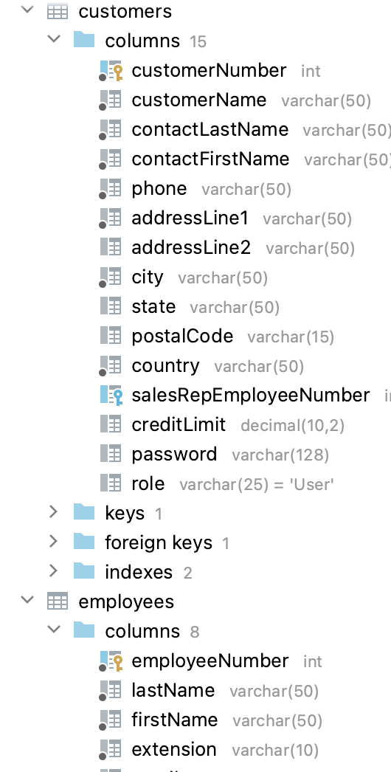
Deep Mappings (2)
@Setter @Getter public class SimpleEmployeeDTO { private String lastName; private String firstName;
}
{
"customerName": "Atelier graphique",
"phone": "40.32.2555",
"city": "Nantes",
"country": "France",
"salesRepEmployeeFirstName": "Gerard",
"salesRepEmployeeLastName": "Hernandez"
}
public class SimpleCustomerDTO { private String customerName; private String phone; private String city; private String country; private String salesRepEmployeeFirstName; private String salesRepEmployeeLastName;
}

Slide 13
Deep Mappings (3)
@Setter @Getter public class SimpleEmployeeDTO { private String lastName; private String firstName; public String getName() { return firstName + " "+ lastName; } }
{
"customerName": "Atelier graphique",
"phone": "40.32.2555",
"city": "Nantes",
"country": "France",
"salesPerson": "Gerard Hernandez"
}
public class SimpleCustomerDTO { private String customerName; private String phone; private String city; private String country;
@JsonIgnore private SimpleCustomerDTO salesRepEmployee; public String getSalesPerson() { return salesRepEmployee==null ? "-": salesRepEmployee.getName(); } }

Slide 14

Exercise

Slide 15
(1) Create Customer DTO
package sit.int204.classicmodelsservice.dtos
@Getter @Setter public class SimpleCustomerDTO { private String customerName; private String phone; private String city; private String country; private String salesPerson; }

Slide 16
Setup Model Mapper
Add Dependency to Maven
Defined Bean for ModelMapper (in base package)
<dependency> <groupId>org.modelmapper</groupId> <artifactId>modelmapper</artifactId> <version>3.1.1</version> </dependency>
@Configuration public class ApplicationConfig { @Bean public ModelMapper modelMapper() { return new ModelMapper(); } }

Slide 17
Using ModelMapper instead custom mapper
@Service public class CustomerService { @Autowired private CustomerRepository repository; public Customer getCustomerById(Integer customerId) { return repository.findById(customerId).orElseThrow(()->new ResponseStatusException( HttpStatus.NOT_FOUND, "Customer id "+ customerId+ "Does Not Exist !!!")); } }
{
"customerName": "Blauer See Auto, Co.",
"phone": "+49 69 66 90 2555",
"city": "Frankfurt",
"country": "Germany",
"salesPerson": null
}
@RestController public class CustomerController { @Autowired private CustomerService service; @Autowired private ModelMapper modelMapper;
@GetMapping(“/{customerId}”) public SimpleCustomerDTO getSimpleCustomerById(@PathVariable Integer customerId) { return modelMapper.map(service.getCustomerById(customerId), SimpleCustomer.class); } }

Slide 18
Deep Mapping (Testing for each DTO)
1
2
@Setter @Getter public class SimpleEmployeeDTO { private String lastName; private String firstName; }
@Setter @Getter public class SimpleEmployeeDTO { private String lastName; private String firstName; public String getName() { return firstName + " "+ lastName; } }
3
@Setter public class SimpleEmployeeDTO { private String lastName; private String firstName;
public String getName() { return firstName + " "+ lastName; } }
@Getter @Setter public class SimpleCustomerDTO { private String customerName; : private SimpleEmployeeDTO salesRepEmployee; }

Slide 19
Modify SimpleCustomerDTO
@Getter @Setter public class SimpleCustomerDTO { private String customerName; : private String salesRepEmployeeFirstName;
private String salesRepEmployeeLastName; }
@Getter @Setter public class SimpleCustomerDTO { private String customerName; : @JsonIgnore private SimpleEmployeeDTO sales; public String getSalesPerson() { return sales == null ? "-" : sales.getName(); } }

Slide 20
Collection Mapping

Slide 21
Mapping Lists with ModelMapper
List<EmployeeDTO> dtos = employees .stream() .map(employee -> modelMapper.map(employee, EmployeeDTO.class)) .collect(Collectors.toList());
@GetMapping("") public List<EmployeeDTO> getEmployees() { List<Employee> employeeList = repository.findAll(); return employeeList.stream() .map(e -> modelMapper.map( e, EmployeeDTO.class)) .collect(Collectors.toList()); }

Slide 22
General-purpose parameterized method
@GetMapping("") public List<EmployeeDTO> getEmployees() { List<Employee> employeeList = repository.findAll(); return return mapList(employeeList, EmployeeOfficeDTO.class);
}
public static <S, T> List<T> mapList(List<S> source, Class<T> targetClass) { return source.stream() .map(entity -> modelMapper.map(entity, targetClass)) .collect(Collectors.toList()); }

Slide 23
Convert DTO to Entity
@Getter @Setter @NoArgsConstructor @AllArgsConstructor public class EmployeeDTO { private Integer id; private String lastName; private String firstName; private String extension; private String email; private String jobTitle; private String officeId; }
@Entity @Table(name = "employees") public class Employee { @Id @Column(name = "employeeNumber", nullable = false) private Integer id; @Column(name = "lastName", nullable = false, length = 50) private String lastName;
@PostMapping("") public Employee create(@RequestBody EmployeeDTO newEmployee) { Employee employee = modelMapper.map(newEmployee, Employee.class); return repository.saveAndFlush(employee); }

Slide 24
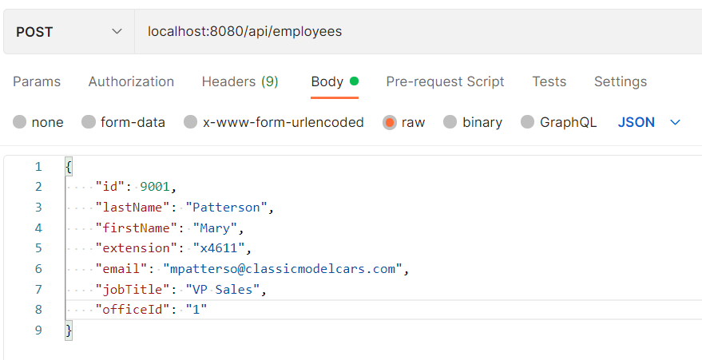
Request Example

Slide 25
Exercise

Slide 26
Mapping Lists with ModelMapper
List<EmployeeDTO> dtos = employees .stream() .map(employee -> modelMapper.map(employee, EmployeeDTO.class)) .collect(Collectors.toList());
@GetMapping("") public List<EmployeeDTO> getEmployees() { List<Employee> employeeList = repository.findAll(); return employeeList.stream() .map(e -> modelMapper.map( e, EmployeeDTO.class)) .collect(Collectors.toList()); }

Slide 27
General-purpose parameterized method
@GetMapping("") public List<EmployeeDTO> getEmployees() { List<Employee> employeeList = repository.findAll(); return return mapList(employeeList, EmployeeOfficeDTO.class, modelMapper);
}
public static <S, T> List<T> mapList(List<S> source, Class<T> targetClass, ModelMapper modelMapper) { return source.stream() .map(entity -> modelMapper.map(entity, targetClass)) .collect(Collectors.toList()); }

Slide 28
Generic PageDTO Example
{
"content": [
{
"productCode": "S10_1678",
"productName": "1969 Harley Davidson Ultimate Chopper",
"productLine": "Motorcycles",
"productScale": "1:10",
"price": 95.7
},
:
:
{
"productCode": "S10_1949",
"productName": "1952 Alpine Renault 1300",
"productLine": "Classic Cars",
"productScale": "1:10",
"price": 214.3
}
],
"first": true,
"totalPages": 12,
"totalElements": 111,
"size": 10,
"page": 0
}
@Getter @Setter @NoArgsConstructor @AllArgsConstructor public class PageDTO<T> { private List<T> content; private Boolean last; private Boolean first; private Integer totalPages; private Integer totalElements; private Integer size; @JsonIgnore private Integer number; public Integer getPage() { return number; } }

Slide 29
Create Singleton ListMapper Service
package sit.int204.classicmodelsservice.utils
public class ListMapper { private static final ListMapper listMapper = new ListMapper(); private ListMapper() { } public <S, T> List<T> mapList(List<S> source, Class<T> targetClass, ModelMapper modelMapper) { return source.stream().map(entity -> modelMapper.map(entity, targetClass)) .collect(Collectors.toList()); } public static ListMapper getInstance() { return listMapper; } public <S, T> PageDTO<T> toPageDTO(Page<S> source, Class<T> targetClass, ModelMapper modelMapper) { PageDTO<T> page = modelMapper.map(source, PageDTO.class); page.setContent(mapList(source.getContent(), targetClass, modelMapper)); return page; } }

Slide 30
Create EmployeeDTO & Modify Application config
@Getter @Setter @NoArgsConstructor @AllArgsConstructor public class EmployeeDTO { private Integer id; private String lastName; private String firstName; private String extension; private String email; private String jobTitle; private String officeId; }
@Configuration public class ApplicationConfig { :
@Bean public ListMapper listMapper() { return ListMapper.getInstance(); } }
@Entity @Table(name = "offices") public class Office { @Id @Column(name = "officeCode") private String id; @Column(name = "city", nullable = false, length = 50)

Slide 31
Create Employee Controller & Service
@Service
public class EmployeeService { @Autowired private EmployeeRepository repository; public Employee save(Employee employee) { return repository.saveAndFlush(employee); } }
@Autowired private ModelMapper modelMapper; @Autowired private ListMapper listMapper; :
@PostMapping("") public Employee create(@RequestBody EmployeeDTO newEmployee) {
Employee e = modelMapper.map(newEmployee, Employee.class); return employeeService.save (e); }

