Slide 1

What is RESTful API ?
Learning by Doing

Slide 2

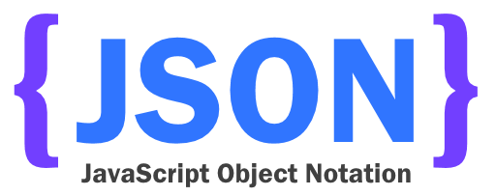
MVC Web Application Architectures (spa)
Web/Http
Server
API Server
Client
XMLHttpRequest
Database
Server
Front-End
Data Access Engine
url mapping /
Router
Database
HTML/CSS /JavaScript Framework
Controller
Model
HttpResponse

Slide 3
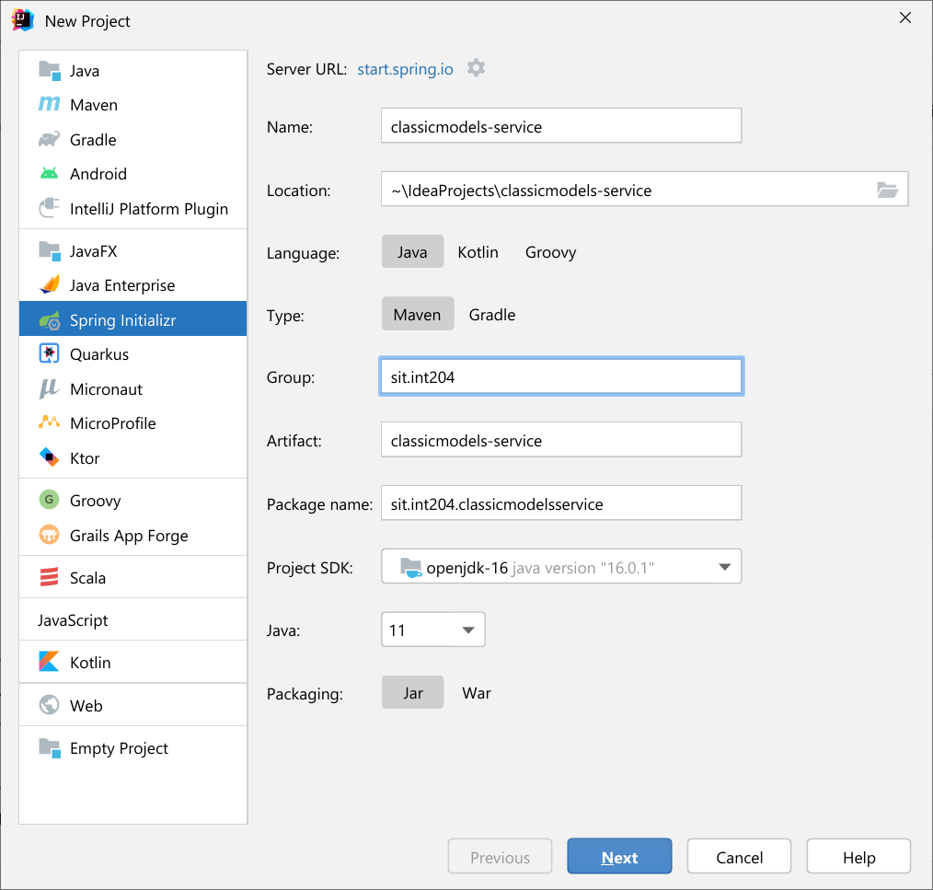
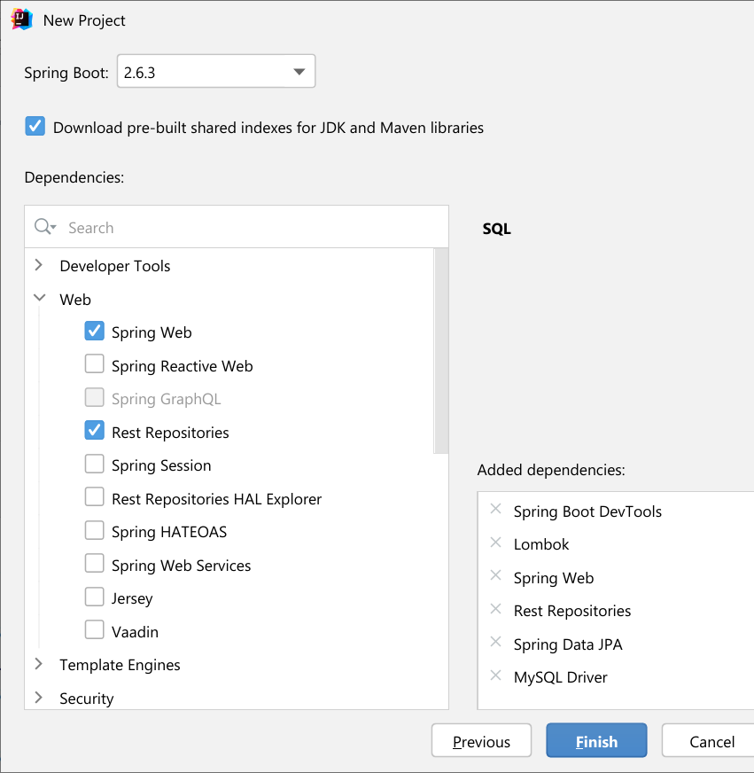
Step 1: Initializing a Spring Boot Project
3.2.1
17 ^
17

Slide 4
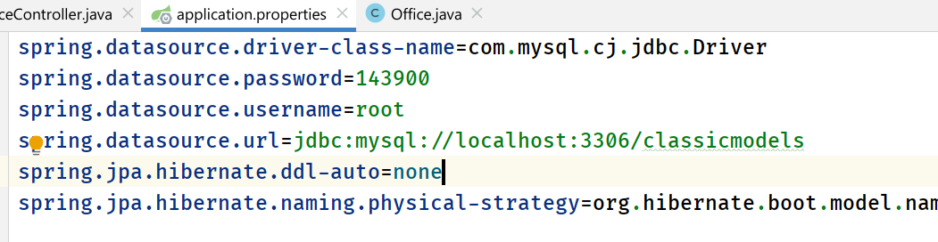
Step 2: Connecting Spring Boot to the Database
org.hibernate.boot.model.naming.PhysicalNamingStrategyStandardImpl
ถ้าไม่กำหนด spring.jpa.hibernate.naming.physical-strategy
จะใช้ convention ดังนี้
การระบุ @Column(name) ใน enitity clase ต้องพิมพ์เป็นตัวเล็กหมด หรือถ้าระบุคอลัมน์เป็น camel case ชื่อฟิลด์ ใน ตารางต้องแยกคำด้วย ขีดล่าง ( _ )

Slide 5
Step 3: Creating an Office Model (1)
@Getter @Setter @Entity @Table(name = "offices") public class Office { @Id @Column(name = "officeCode", nullable = false, length = 10) private String officeCode; @Column(name = "city", nullable = false, length = 50) private String city; @Column(name = "phone", nullable = false, length = 50) private String phone; @Column(name = "addressLine1", nullable = false, length = 50) private String addressLine1;

Slide 6
Step 3: Creating an Office Model (2)
@Column(name = "addressLine2", length = 50) private String addressLine2;
@Column(name = "state", length = 50) private String state; @Column(name = "country", nullable = false, length = 50) private String country; @Column(name = "postalCode", nullable = false, length = 15) private String postalCode; @Column(name = "territory", nullable = false, length = 10) private String territory; @JsonIgnore @OneToMany(mappedBy = "office") private Set<Employee> employees = new LinkedHashSet<>();

Slide 7
Step 3: Creating an Employee Model (1)
@Getter @Setter @Entity @Table(name = "employees") public class Employee { @Id @Column(name = "employeeNumber", nullable = false) private Integer id;
@JsonIgnore @ManyToOne @JoinColumn(name = "office") private Office office;
@Column(name = "lastName", nullable = false, length = 50)

Slide 8
Step 3: Creating an Employee Model (2)
private String lastName; @Column(name = "firstName", nullable = false, length = 50) private String firstName;
@Column(name = "extension", nullable = false, length = 10) private String extension; @Column(name = "email", nullable = false, length = 100) private String email;
@JsonIgnore @ManyToOne @JoinColumn(name = "reportsTo") private Employee employees;
@Column(name = "jobTitle", nullable = false, length = 50) private String jobTitle;

Slide 9
Step 4: Creating Repository Interface
public interface OfficeRepository extends JpaRepository<Office, String> {
}
public interface EmployeeRepository extends JpaRepository<Employee, Integer> {
}
public interface CustomerRepository extends JpaRepository<Customer, Integer> {
}

Slide 10

Step 5: Creating Service Class
@Service
public class OfficeService { @Autowired private OfficeRepository repository; public List<Office> getAllOffice() { return repository.findAll(); } public Office getOffice(String officeCode) { return repository.findById(officeCode).orElseThrow( () -> new HttpClientErrorException(HttpStatus.NOT_FOUND, "Office Id " + officeCode + " DOES NOT EXIST !!!") { } ); }
@Transactional
public Office createNewOffice(Office office) { return repository.save(office); }
JSON
Controller
Presentation
FE
Entity
Business Logic (Service Class)
Entity
Persistence (Repository Class)

Slide 11
Step 5: Creating Service Class (cont.)
@Transactional
public void removeOffice(String officeCode) { Office office = repository.findById(officeCode).orElseThrow( () -> new HttpClientErrorException(HttpStatus.NOT_FOUND, "Office Id " + officeCode + " DOES NOT EXIST !!!") ); repository.delete(office); } @Transactional public Office updateOffice(String officeCode, Office office) { if(office.getOfficeCode()!=null && !office.getOfficeCode().trim().isEmpty()) { if (!office.getOfficeCode().equals(officeCode)) { throw new HttpClientErrorException(HttpStatus.BAD_REQUEST, "Conflict Office code !!! (" + officeCode + " vs " + office.getOfficeCode() + ”)"); } } Office existingOffice = repository.findById(officeCode).orElseThrow( () -> new HttpClientErrorException(HttpStatus.NOT_FOUND, "Office Id " + officeCode + " DOES NOT EXIST !!!")); return repository.save(office); }
}
JSON
FE
Controller
Presentation
Entity
Business Logic (Service Class)
Entity
Persistence (Repository Class)

Slide 12
Step 6: Creating Controller
@RestController @RequestMapping("/api/offices")
public class OfficeController { @Autowired private OfficeService service; @GetMapping("") public List<Office> getAllOffices() { return service.getAllOffice(); } @GetMapping("/{officeCode}") public Office getOfficeById(@PathVariable String officeCode) { return service.getOffice(officeCode); }
@PostMapping("") public Office addNewOffice(@RequestBody Office office) { return service.createNewOffice(office); }
JSON
Controller
Presentation
Entity
Business Logic (Service Class)
Entity
Persistence (Repository Class)

Slide 13
Step 6: Creating Controller (cont.)
@PutMapping("/{officeCode}") public Office updateOffice(@RequestBody Office office, @PathVariable String officeCode) { return service.updateOffice(officeCode, office); }
@DeleteMapping("/{officeCode}") public void removeOffice(@PathVariable String officeCode) { service.removeOffice(officeCode); }
}
JSON
Controller
Presentation
Entity
Business Logic (Service Class)
Entity
Persistence (Repository Class)

Slide 14
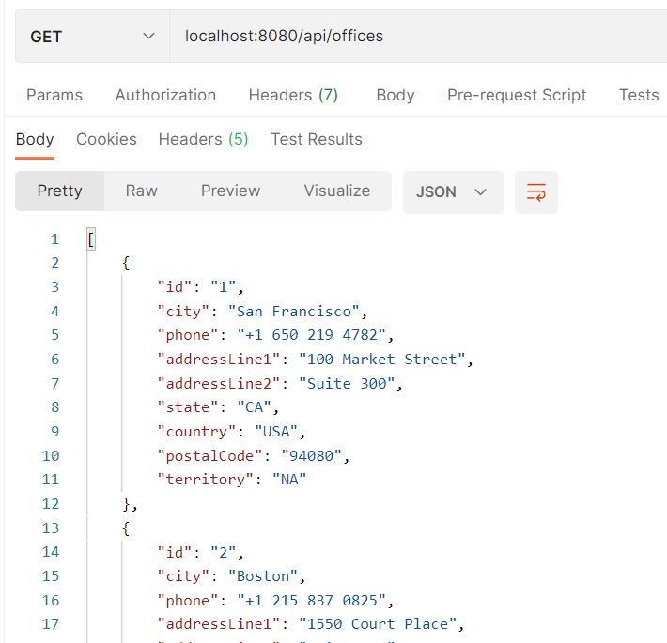
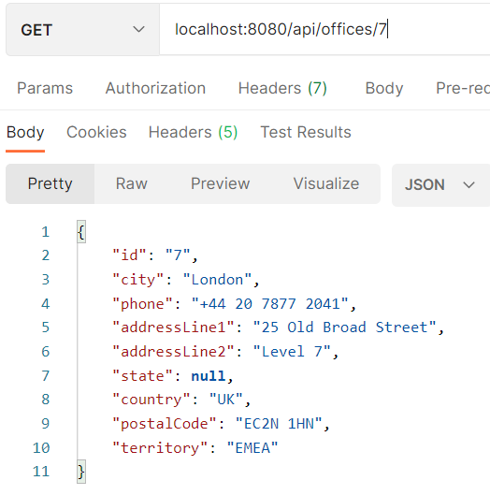
Step 6: Testing the APIs (GET)

Slide 15
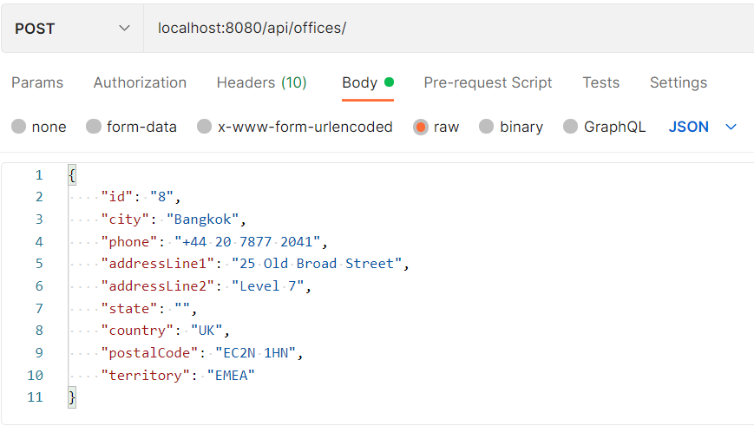
Step 7: Testing the APIs (POST)

Slide 16
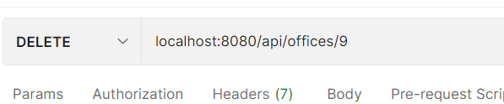
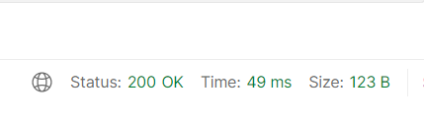
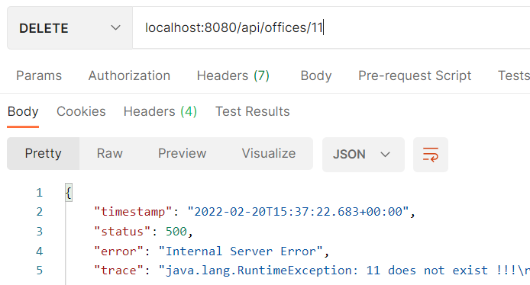
Step 8: Testing the APIs (DELETE)

Slide 17
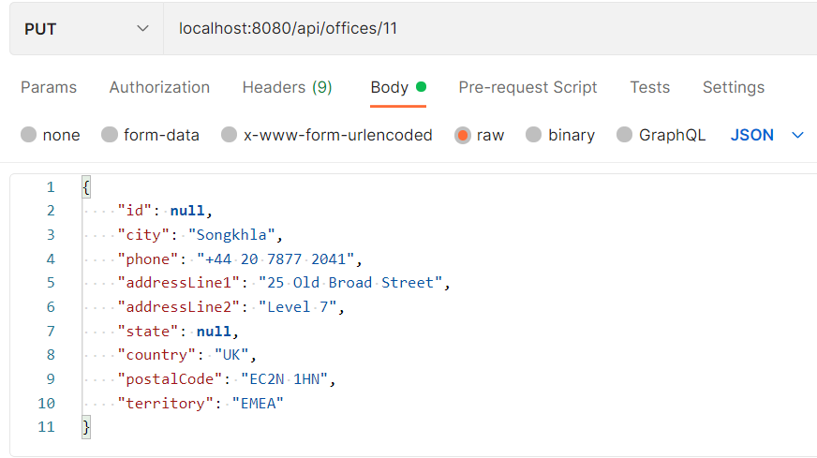
Step 8: Testing the APIs (PUT)

Slide 18

Summary

Slide 19
JSON : JavaSrcipt Object Notation
A lightweight data-interchange format.
Easy for humans to read and write.
Easy for machines to parse and generate.
Based on a subset of the JavaScript Programming Language Standard ECMA-262 3rd Edition - December 1999.
JSON is a text format that is completely language independent but uses conventions that are familiar to programmers of the C-family of languages, including C, C++, C#, Java, JavaScript, Perl, Python, and many others.
https://www.json.org/json-en.html
https://education.launchcode.org/js-independent-track/chapters/fetch-json/index.html

Slide 20
RESTful Resource
URI | HTTP Verb | Description
api/offices | GET | Get all office
api/offices/1 | GET | Get an office with id = 1
api/offices/1/employees | GET | Get all employee for office id = 1
api/offices | POST | Add new office
api/offices/1 | PUT | Update an office with id = 1
api/offices/1 | DELETE | Delete an office with id = 1

Slide 21
REST API (also known as RESTful API)
REST stands for REpresentational State Transfer and was created by computer scientist Roy Fielding.
An application programming interface (API or web API) that conforms to the constraints of REST architectural style and allows for interaction with RESTful web services.
In REST architecture, a REST Server simply provides access to resources and REST client accesses and modifies the resources.
Each resource is identified by URIs/ global IDs.
REST uses various representation to represent a resource like text, JSON, XML. JSON is the most popular one.

Slide 22
Rules of REST API
There are certain rules which should be kept in mind while creating REST API endpoints.
REST is based on the resource or noun instead of action or verb based. It means that a URI of a REST API should always end with a noun. Example: /api/users is a good example.
HTTP verbs are used to identify the action. Some of the HTTP verbs are – GET, PUT, POST, DELETE, PATCH.
A web application should be organized into resources like users and then uses HTTP verbs like – GET, PUT, POST, DELETE to modify those resources. And as a developer it should be clear that what needs to be done just by looking at the endpoint and HTTP method used.

Slide 23
RESTful Resource Example
URI | HTTP verb | Description
api/users | GET | Get all users
api/users/new | GET | Show form for adding new user
api/users | POST | Add a user
api/users/1 | PUT | Update a user with id = 1
api/users/1/edit | GET | Show edit form for user with id = 1
api/users/1 | DELETE | Delete a user with id = 1
api/users/1 | GET | Get a user with id = 1
Always use plurals in URL to keep an API URI consistent throughout the application.
Send a proper HTTP code to indicate a success or error status.

Slide 24
RESTFul Principles and Constraints
RESTFul Client-Server
Server will have a RESTful web service which would provide the required functionality to the client.
The client send’s a request to the web service on the server. The server would either reject the request or comply and provide an adequate response to the client.
Stateless
Statelessness mandates that each request from the client to the server must contain all of the information necessary to understand and complete the request.
The server cannot take advantage of any previously stored context information on the server.
For this reason, the client application must entirely keep the session state.

Slide 25
RESTFul Principles and Constraints (2)
Interface/Uniform Contract
This is the underlying technique of how RESTful web services should work. RESTful basically works on the HTTP web layer and uses the below key verbs to work with resources on the server.
POST – To create a resource on the server
GET – To retrieve a resource from the server
PUT – To change the state of a resource or to update it
DELETE – To remove or delete a resource from the server
Code on demand (optional)
REST also allows client functionality to extend by downloading and executing code in the form of applets or scripts.
Servers can provide part of features delivered to the client in the form of code, and the client only needs to execute the code.

Slide 26
RESTFul Principles and Constraints (3)
Cacheable
The cacheable constraint requires that a response should implicitly or explicitly label itself as cacheable or non-cacheable.
If the response is cacheable, the client application gets the right to reuse the response data later for equivalent requests and a specified period.
Layered system
The layered system style allows an architecture to be composed of hierarchical layers by constraining component behavior.
For example, in a layered system, each component cannot see beyond the immediate layer they are interacting with.

Slide 27




Layered System
Controller
Presentation Layer
Front-End
Entity Object
Service
Business Logic Layer
Entity Object
Repository
Persistence Layer

Slide 28
Controller
In Spring’s approach to building RESTful web services, HTTP requests are handled by a controller. These components are identified by the @RestController annotation, the data returned by each method will be written straight into the response body instead of rendering a template.
@RestController @RequestMapping("/api/offices")
public class OfficeController { @Autowired private OfficeService service; @GetMapping("") public List<Office> getAllOffices() { return service.getAllOffice(); } @GetMapping("/{officeCode}") public Office getOfficeById(@PathVariable String officeCode) { return service.getOffice(officeCode); }
@PostMapping("") public Office addNewOffice(@RequestBody Office office) { return service.createNewOffice(office); }
You can use the @RequestMapping annotation to map requests to controllers methods. It has various attributes to match by URL, HTTP method, request parameters, headers, and media types. You can use it at the class level to express shared mappings or at the method level to narrow down to a specific endpoint mapping.
An annotation used in Spring Boot to enable automatic dependency injection. It allows the Spring container to provide an instance of a required dependency when a bean is created. This annotation can be used on fields, constructors, and methods to have Spring provide the dependencies automatically

Slide 29

What is a Postman
Postman is an API platform for building and using APIs. Postman simplifies each step of the API lifecycle and streamlines collaboration so you can create better APIs—faster.

Slide 30

Creating a Spring Boot REST API Project
Step 1: Initializing a Spring Boot Project
Step 2: Connecting Spring Boot to the Database
Step 3: Creating a User Model
Step 4: Creating Repository Interface (Persistence Layer)
Step 5: Creating Service Classes (Business Layer)
Step 6: Creating a Rest Controller (Presentation Layer)
Step 7: Compile, Build and Run
Step 8: Testing the APIs

