Slide 1

Spring Boot Overview + Introduction to Auto Configuration & Spring Data JPA
By
Pichet Limvajiranan

Slide 2
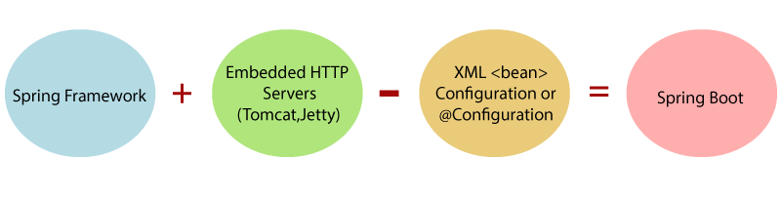
What is Spring Boot?
Spring Boot is a project that is built on the top of the Spring Framework.
It provides an easier and faster way to set up, configure, and run both simple and web-based applications.
It allows us to build a stand-alone application with minimal or zero configurations.
It is better to use if we want to develop a simple Spring-based application or RESTful services.

Slide 3
Spring Boot Features
Create stand-alone Spring applications
Embed Tomcat, Jetty or Undertow directly (no need to deploy WAR files)
Provide opinionated 'starter' dependencies to simplify your build configuration
Automatically configure Spring and 3rd party libraries whenever possible
Provide production-ready features such as metrics, health checks, and externalized configuration
Absolutely no code generation and no requirement for XML configuration

Slide 4
Why should we use Spring Boot Framework?
We should use Spring Boot Framework because:
The dependency injection approach is used in Spring Boot.
It contains powerful database transaction management capabilities.
It simplifies integration with other Java frameworks like JPA/Hibernate ORM, Struts, etc.
It reduces the cost and development time of the application.

Slide 5
Spring Boot: Auto Configuration
The problem with Spring and Spring MVC is the amount of configuration that is needed
Spring Boot solves this problem through a combination of Auto Configuration and Starter Projects.
Spring Boot looks at Frameworks available on the CLASSPATH then Existing configuration for the application.
Based on these, Spring Boot provides basic configuration needed to configure the application with these frameworks.
This is called Auto Configuration.
<bean class="org.springframework.web.servlet.view.InternalResourceViewResolver">
<property name="prefix"><value>/WEB-INF/views/</value></property>
<property name="suffix"><value>.jsp</value> </property>
</bean>
<mvc:resources mapping="/webjars/**" location="/webjars/"/>

Slide 6
Spring Boot: Starter Projects
Starters are a set of convenient dependency descriptors that you can include in your application.
You get a one-stop-shop for all the Spring and related technology that you need, without having to hunt through sample code and copy paste loads of dependency descriptors.
example starter - Spring Boot Starter Web.
<dependency>
<groupId>org.springframework.boot</groupId>
<artifactId>spring-boot-starter-web</artifactId>
</dependency>

Slide 7
Spring Boot Starter Project Options
spring-boot-starter-web-services - SOAP Web Services
spring-boot-starter-web - Web & RESTful applications
spring-boot-starter-test - Unit testing and Integration Testing
spring-boot-starter-jdbc - Traditional JDBC
spring-boot-starter-hateoas - Add HATEOAS features to your services
spring-boot-starter-security - Authentication and Authorization using Spring Security
spring-boot-starter-data-jpa - Spring Data JPA with Hibernate
spring-boot-starter-cache - Enabling Spring Framework’s caching support
spring-boot-starter-data-rest - Expose Simple REST Services using Spring Data REST

Slide 8
Auto Configuration & Property Default Value example
Add com.h2database dependency to classicmodels-service project & reload maven
Comment all properties in application.properties
Run/Test all end-point with postman
/api/offices POST
/api/offices GET
/api/offices/{id} GET
/api/offices/{id} PUT
/api/offices/{id} DELETE
<dependency> <groupId>com.h2database</groupId> <artifactId>h2</artifactId> <version>2.2.224</version> <scope>runtime</scope> </dependency>
#spring.datasource.driver-class-name=com.mysql. #spring.datasource.username=root #spring.datasource.password=143900 #spring.datasource.url=jdbc:mysql://localhost:

Slide 9
Creating Spring Boot Projects
Using Spring Initializr
A great web to bootstrap your Spring Boot projects.
https://start.spring.io
Using the Spring Tool Suite (STS)
The Spring Tool Suite (STS: https://spring.io/tools/sts) is an extension of the Eclipse IDE with lots of Spring framework related plugins.
Using IDE Bundled tool.
Maven Wrapper:
mvnw dependency:tree
mvnw spring-boot:run

Slide 10
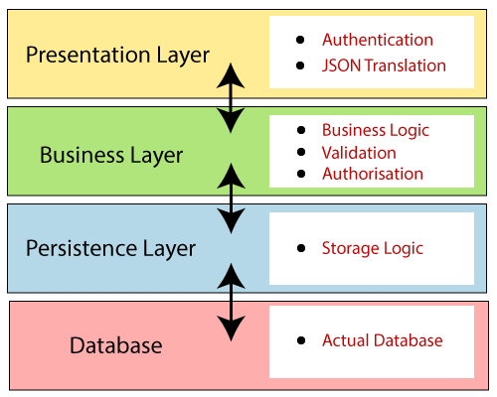
Spring Boot Architecture
Spring Boot follows a layered architecture in which each layer communicates with the layer directly below or above (hierarchical structure) it.
Presentation Layer
Business Layer
Persistence Layer
Database Layer

Slide 11
Spring Boot Layers
Presentation Layer:
Handles the HTTP requests, translates the JSON parameter to object, and authenticates the request and transfer it to the business layer. In short, it consists of views i.e., frontend part.
Business Layer:
Handles all the business logic. It consists of service classes and uses services provided by data access layers. It also performs authorization and validation.
Persistence Layer:
Contains all the storage logic and translates business objects from and to database rows.
Database Layer:
Perform CRUD (create, retrieve, update, delete) operations.

Slide 12
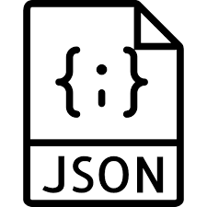

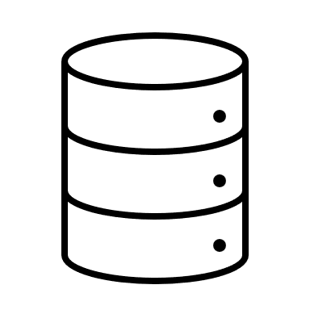

Spring Boot Flow Architecture
Spring Boot uses all the modules of Spring-like Spring MVC, Spring Data, etc.
Creates a data access layer and performs CRUD operation.
The client makes the HTTP requests (GET or POST).
The request goes to the controller, and the controller maps that request and handles it. After that, it calls the service logic if required.
In the service layer, all the business logic performs. It performs the logic on the data that is mapped to JPA with model classes.
A HTTP Response is returned to the user if no error occurred.
Controller
Presentation Layer
Front-End
Entity Object
Service
Business Logic Layer
Entity Object
Repository
Persistence Layer

Slide 13
Spring Framework Annotations
Basically, there are 6 types of annotation available in the whole spring framework.
Spring Web Annotations
Spring Core Annotations
Spring Boot Annotations
Spring Scheduling Annotations
Spring Data Annotations
Spring Bean Annotations

Slide 14
1) Spring Web Annotations
Present in the org.springframework.web.bind.annotation
Some of the annotations that are available in this category are:
@RequestMapping รับewquestทุกmethod
@RequestBody
@PathVariable
@RequestParam
Response Handling Annotations
@ResponseBody @ExceptionHandler @ResponseStatus
@Controller
@RestController
@ModelAttribute
@CrossOrigin

Slide 15
Spring Web Annotation example
@RestController @RequestMapping("/api/offices")
public class OfficeController { : : @GetMapping("/{officeCode}") public Office getOfficeById(@PathVariable String officeCode) { return service.getOffice(officeCode); }
@PostMapping("") public Office addNewOffice(@RequestBody Office office) { return service.createNewOffice(office); }

Slide 16
Practice
Create API service for calculate student grade as following requirements:
input
{ “id” : 1001,
“name” : “Somchai”,
“score” : 78
}
output
{ “id” : 1001,
“name” : “Somchai”,
“score” : 78,
“grade” : “B”
}
TO DO:
Specify URI & Method
Create Entity
Create Service
Create Controller & method
Business rule :
Score is 80 and up, A
Score 70 to 79, B
Score 60 to 69, C
Score 50 to 59, D
Score is 49 and lower, F

Slide 17
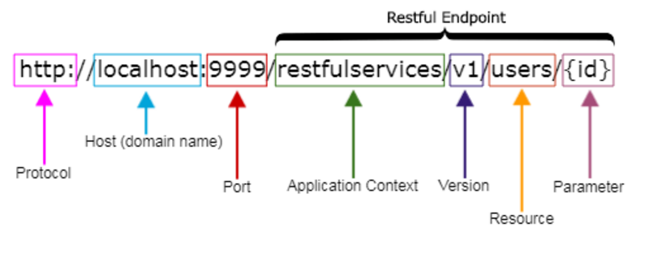
REST API URI Naming Conventions and Best Practices
Singleton and Collection Resources
Sub-collection Resources
Best Practices
https://medium.com/@nadinCodeHat/rest-api-naming-conventions-and-best-practices-1c4e781eb6a5
https://restfulapi.net/resource-naming
/customers // is a collection resource
/customers/{id} // is a singleton resource
/customers/{id}/orders // is a sub-collection resource

Slide 18
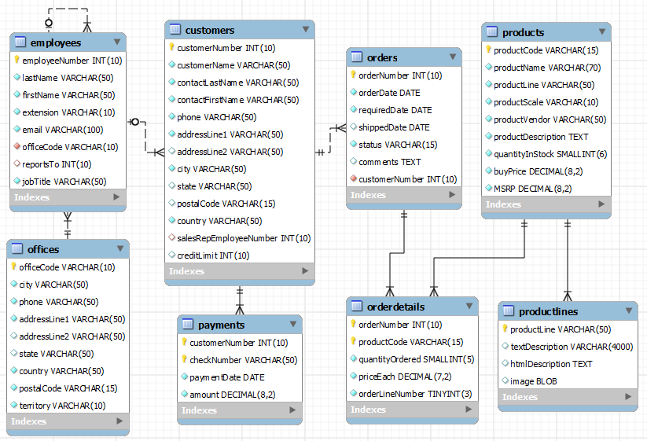
Excercise
Design REST Resources representation for the Classicmodels

Slide 19
Spring Core annotations
Spring Core annotations are present in the 2 packages
org.springframework.beans.factory.annotation
org.springframework.context.annotation
We can divide them into two broad categories:
DI-Related Annotations
@Autowired @Qualifier @Primary
@Bean @Lazy @Required
@Value @Scope
@Lookup, etc.
Context Configuration Annotations
@Profile @Import
@ImportResource @PropertySource, etc.

Slide 20
@Autowired
We use @Autowired to mark the dependency that will be injected by the Spring container.
Applied to the fields, setter methods, and constructors. It injects object dependency implicitly.
public class OfficeService { private final OfficeRepository repository; @Autowired public OfficeService(OfficeRepository repository) { this.repository = repository; }
public class OfficeService { @Autowired private OfficeRepository repository;
public class OfficeService { private final OfficeRepository repository; @Autowired public void setRepository(OfficeRepository repository) { this.repository = repository; }

Slide 21
Spring Boot Annotations
@SpringBootApplication Combination of three annotations
@EnableAutoConfiguration
@ComponentScan
@Configuration.
@SpringBootApplication
public class ClassicmodelServiceApplication { public static void main(String[] args) { SpringApplication.run(ClassicmodelServiceApplication.class, args); } }

Slide 22
Spring Bean Annotations
Some of the annotations that are available in this category are:
@ComponentScan
@Configuration
Stereotype Annotations
@Component
@Service
@Repository
@Controller
@Service: We specify a class with @Service to indicate that they’re holding the business logic. Besides being used in the service layer, there isn’t any other special use for this annotation. The utility classes can be marked as Service classes.
@Repository: We specify a class with @Repository to indicate that they’re dealing with CRUD operations, usually, it’s used with DAO (Data Access Object) or Repository implementations that deal with database tables.
@Controller: We specify a class with @Controller to indicate that they’re front controllers and responsible to handle user requests and return the appropriate response. It is mostly used with REST Web Services.

Slide 23
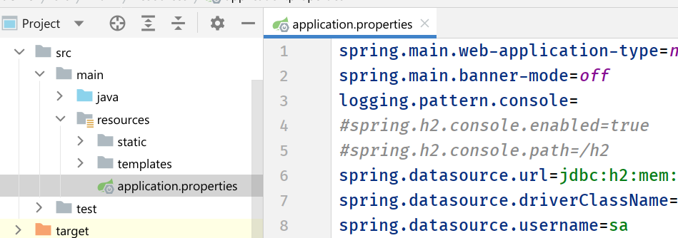
Spring Boot Application Properties
Spring Boot Framework comes with a built-in mechanism for application configuration using a file called application.properties.
It is located inside the src/main/resources folder.
The properties have default values.
We can set a property(s) for the Spring Boot application.

Slide 24
Spring Web MVC
The Spring Web MVC framework provides Model-View-Controller (MVC) architecture and ready components that can be used to develop flexible and loosely coupled web applications.
The MVC pattern results in separating the different aspects of the application (input logic, business logic, and UI logic), while providing a loose coupling between these elements.
A Spring MVC provides an elegant solution to use MVC in spring framework by the help of DispatcherServlet.
In Spring Web MVC, the DispatcherServlet class works as the front controller. It is responsible to manage the flow of the Spring MVC application.

Slide 25
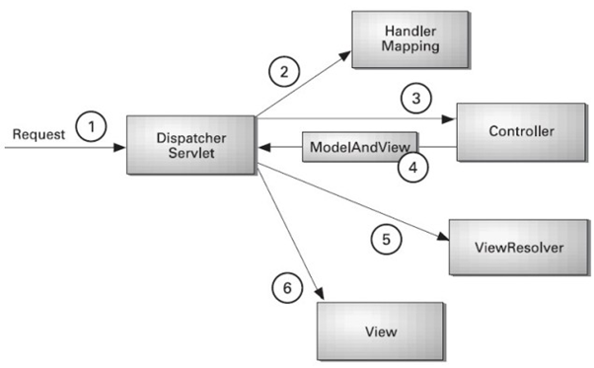
The DispatcherServlet and Flow of Spring Web MVC
(Front Controller)

Slide 26
Defining a Controller
The DispatcherServlet delegates the request to the controllers to execute the functionality specific to it.
The @Controller annotation indicates that a particular class serves the role of a controller.
The @RequestMapping @GetMapping @PostMapping annotation is used to map a URL to either an entire class or a particular handler method.
@Controller
public class HelloController {
@RequestMapping("/hello")
public String printHello(ModelMap model) {
model.addAttribute("message", "Hello Spring MVC Framework!");
return "hello";
}
}

Slide 27
Spring Boot Controller example
@Controller public class AppController { @Autowired private final StudentRepository studentRepository;
@RequestMapping("/home") public String home() { return "home"; } @GetMapping("/student-listing") public String students(Model model) { model.addAttribute("students", studentRepository.findAll()); return "student-list"; } @GetMapping("/student-list-plain-text") public ResponseEntity<String> students_list(Model model) { return new ResponseEntity<>(studentRepository.findAll()
.toString(), HttpStatus.OK); }

Slide 28
Spring View Technology
The Spring web framework is built around the MVC (Model-View-Controller) pattern, which makes it easier to separate concerns in an application.
This allows for the possibility to use different view technologies, from the well established JSP technology to a variety of template engines.
Java Server Pages
Thymeleaf
FreeMarker
Groovy Markup Template Engine

Slide 29
Thymeleaf Template Engine example
<!DOCTYPE html> <html lang="en“ xmlns=http://www.w3.org/1999/xhtml
xmlns:th="http://www.thymeleaf.org"> <body> <div class="container p4 m4"> <h2>Student List:</h2><hr> <div class="row"> <div class="col-2">Student Id</div> <div class="col-4">Name</div> <div class="col-2">GPAX</div> </div> <div class="row" th:each="student : ${students}"> <div class="col-2" th:text="${student.id}"/> <div class="col-4" th:text="${student.name}"/> <div class="col-2" th:text="${student.gpax}"/> </div> </div>

Slide 30
Spring Data JPA
Managing data between java classes or objects and the relational database is a very cumbersome and tricky task.
The DAO (Data Access Object) layer usually contains a lot of boilerplate code that should be simplified in order to reduce the number of lines of code and make the code reusable.
Spring Data JPA:
This provides spring data repository interfaces which are implemented to create JPA repositories.
Spring Data JPA provides a solution to reduce a lot of boilerplate code.
Spring Data JPA provides an out-of-the-box implementation for all the required CRUD operations for the JPA entity so we don't have to write the same boilerplate code again and again.
public class CustomerRepository { private static final int PAGE_SIZE = 10; private EntityManager getEntityManager()
public List<Customer> findAll() {..}
public void save(Customer c) {..}
public Product find(Integer cid) {..}
}
public class ProductRepository { private static final int PAGE_SIZE = 50; private EntityManager getEntityManager()
public List<Product> findAll() {..}
public void save(Product p) {..}
public Product find(String pid) {..}
}

Slide 31
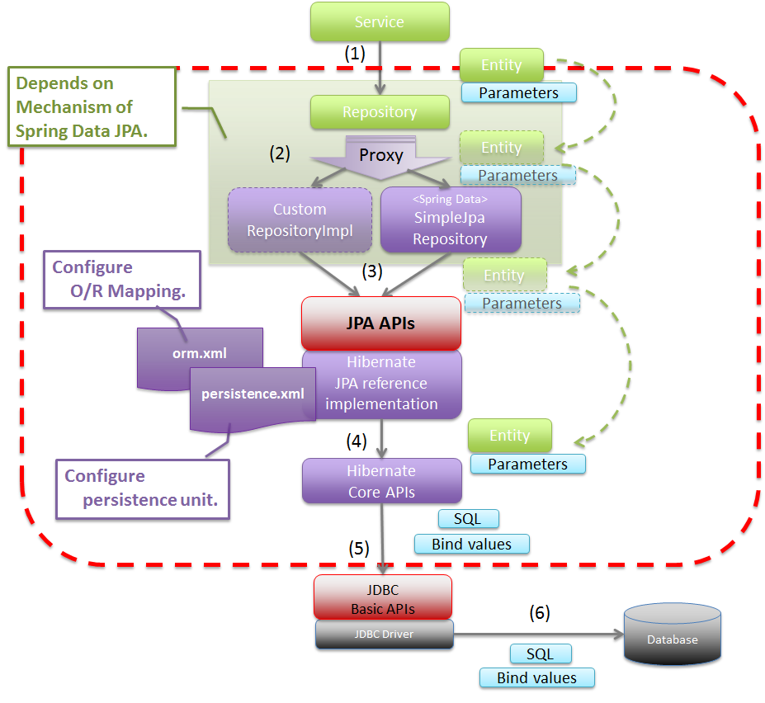
Basic Spring Data JPA Flow

Slide 32
JPA Repository Example
@Getter @Setter @NoArgsConstructor @AllArgsConstructor @ToString @Entity public class Student { @Id private Integer id; private String name; private Double gpax; }
import org.springframework.data.jpa.repository.JpaRepository; import sit.int204.demo.entities.Student; public interface StudentRepository extends JpaRepository<Student, Integer> { List<Student> findByNameContainsOrGpaxBetweenOrderByGpaxDesc( String name, double low, double high); }
Query methods

Slide 33
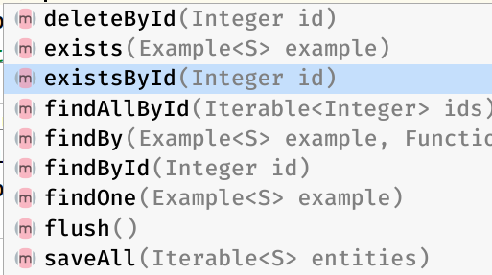
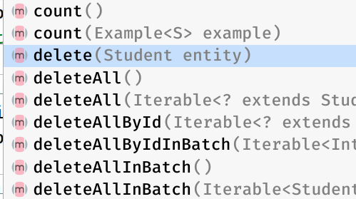
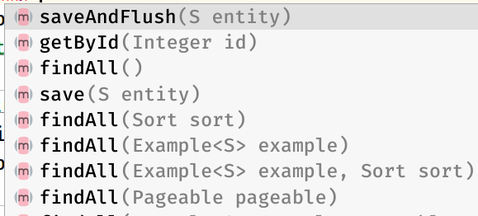
Jpa Repository default methods
public class AppController { @Autowired private final StudentRepository studentRepository;

