Slide 1

Spring Boot + Introduction to Spring Framework Annotations & Spring Data JPA
By
Pichet Limvajiranan

Slide 2
Spring Framework Annotations
Basically, there are 6 types of annotation available in the whole spring framework.
Spring Web Annotations
Spring Core Annotations
Spring Boot Annotations
Spring Scheduling Annotations
Spring Data Annotations
Spring Bean Annotations

Slide 3
1) Spring Web Annotations
Present in the org.springframework.web.bind.annotation
Some of the annotations that are available in this category are:
@RequestMapping
@RequestBody
@PathVariable
@RequestParam
Response Handling Annotations
@ResponseBody @ExceptionHandler @ResponseStatus
@Controller
@RestController
@ModelAttribute
@CrossOrigin

Slide 4
Spring Web Annotation example
@RestController @RequestMapping("/api/offices")
public class OfficeController { : : @GetMapping("/{officeCode}") public Office getOfficeById(@PathVariable String officeCode) { return service.getOffice(officeCode); }
@PostMapping("") public Office addNewOffice(@RequestBody Office office) { return service.createNewOffice(office); }

Slide 5
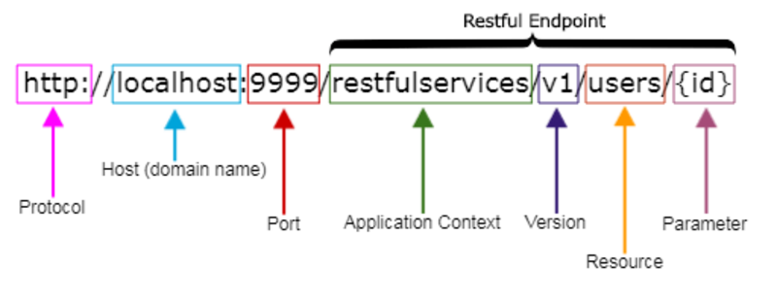
REST API URI Naming Conventions and Best Practices
Singleton and Collection Resources
Sub-collection Resources
Best Practices
https://medium.com/@nadinCodeHat/rest-api-naming-conventions-and-best-practices-1c4e781eb6a5
https://restfulapi.net/resource-naming
/customers // is a collection resource
/customers/{id} // is a singleton resource
/customers/{id}/orders // is a sub-collection resource

Slide 6
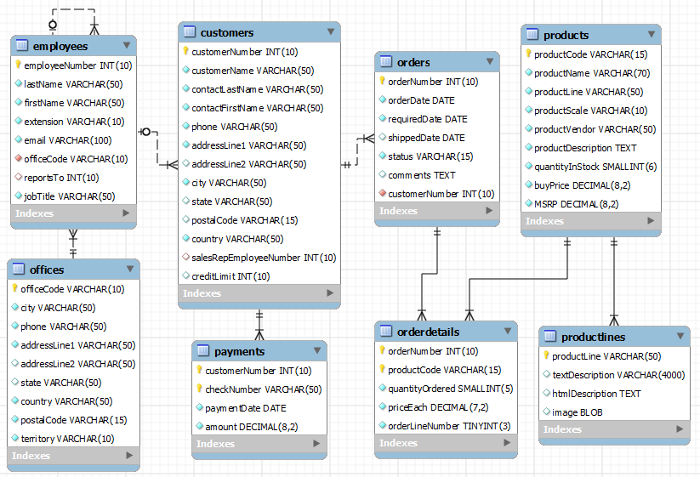
Excercise
Design REST Resources representation for the Classicmodels

Slide 7
2) Spring Core annotations
Spring Core annotations are present in the 2 packages
org.springframework.beans.factory.annotation
org.springframework.context.annotation
We can divide them into two broad categories:
DI-Related Annotations
@Autowired @Qualifier @Primary
@Bean @Lazy @Required
@Value @Scope
@Lookup, etc.
Context Configuration Annotations
@Profile @Import
@ImportResource @PropertySource, etc.

Slide 8
@Autowired
We use @Autowired to mark the dependency that will be injected by the Spring container.
Applied to the fields, setter methods, and constructors. It injects object dependency implicitly.
public class OfficeService { private final OfficeRepository repository; @Autowired public OfficeService(OfficeRepository repository) { this.repository = repository; }
public class OfficeService { @Autowired private OfficeRepository repository;
public class OfficeService { private final OfficeRepository repository; @Autowired public void setRepository(OfficeRepository repository) { this.repository = repository; }

Slide 9
3) Spring Boot Annotations
@SpringBootApplication Combination of three annotations
@EnableAutoConfiguration
@ComponentScan
@Configuration.
@SpringBootApplication public class ClassicmodelServiceApplication { public static void main(String[] args) { SpringApplication.run(ClassicmodelServiceApplication.class, args); } }

Slide 10
5) Spring Data Annotations
Spring Data provides an abstraction over data storage.
Common Spring Data Annotations
@Transactional
@NoRepositoryBean
@Param
@Id
@Transient
@CreatedBy, @LastModifiedBy, @CreatedDate, @LastModifiedDate
Spring Data JPA Annotations
@Query
@Procedure
@Lock
@Modifying
@EnableJpaRepositories
Spring Data Mongo Annotations
@Document
@Field
@Query
@EnableMongoRepositories

Slide 11
6) Spring Bean Annotations
Some of the annotations that are available in this category are:
@ComponentScan
@Configuration
Stereotype Annotations
@Component
@Service
@Repository
@Controller
@Service: We specify a class with @Service to indicate that they’re holding the business logic. Besides being used in the service layer, there isn’t any other special use for this annotation. The utility classes can be marked as Service classes.
@Repository: We specify a class with @Repository to indicate that they’re dealing with CRUD operations, usually, it’s used with DAO (Data Access Object) or Repository implementations that deal with database tables.
@Controller: We specify a class with @Controller to indicate that they’re front controllers and responsible to handle user requests and return the appropriate response. It is mostly used with REST Web Services.

Slide 12
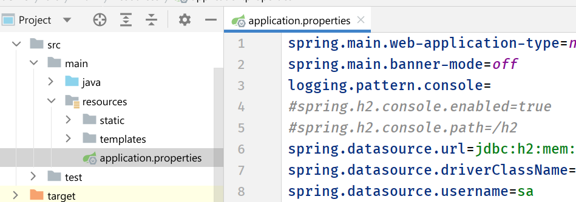
Spring Boot Application Properties
Spring Boot Framework comes with a built-in mechanism for application configuration using a file called application.properties.
It is located inside the src/main/resources folder.
The properties have default values.
We can set a property(s) for the Spring Boot application.

Slide 13
Spring Boot Application Properties - Examples
spring.main.banner-mode
CONSOLE Print the banner to System.out.
LOG Print the banner to the log file.
OFF Disable printing of the banner.
logging.level.<logger-name>=<level>
where level is one of TRACE, DEBUG, INFO, WARN, ERROR, FATAL, or OFF.
Example
logging.level.root=warn
logging.level.org.springframework.web=off
logging.level.org.hibernate=error
server.error.include-stacktrace
ALWAYS Always add stacktrace information.
NEVER Never add stacktrace information.
ON_PARAM Add stacktrace attribute when the appropriate request parameter is not "false".
https://docs.spring.io/spring-boot/docs/current/reference/html/application-properties.html

Slide 14
Spring Web MVC
The Spring Web MVC framework provides Model-View-Controller (MVC) architecture and ready components that can be used to develop flexible and loosely coupled web applications.
The MVC pattern results in separating the different aspects of the application (input logic, business logic, and UI logic), while providing a loose coupling between these elements.
A Spring MVC provides an elegant solution to use MVC in spring framework by the help of DispatcherServlet.
In Spring Web MVC, the DispatcherServlet class works as the front controller. It is responsible to manage the flow of the Spring MVC application.

Slide 15
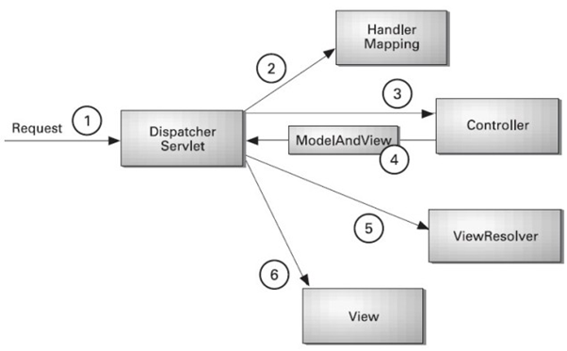
The DispatcherServlet and Flow of Spring Web MVC
(Front Controller)

Slide 16
Defining a Controller
The DispatcherServlet delegates the request to the controllers to execute the functionality specific to it.
The @Controller annotation indicates that a particular class serves the role of a controller.
The @RequestMapping @GetMapping @PostMapping annotation is used to map a URL to either an entire class or a particular handler method.
@Controller
public class HelloController {
@RequestMapping("/hello")
public String printHello(ModelMap model) {
model.addAttribute("message", "Hello Spring MVC Framework!");
return "hello";
}
}

Slide 17
Spring Boot Controller example
@Controller public class AppController { @Autowired private final StudentRepository studentRepository;
@RequestMapping("/home") public String home() { return "home"; } @GetMapping("/student-listing") public String students(Model model) { model.addAttribute("students", studentRepository.findAll()); return "student-list"; } @GetMapping("/student-list-plain-text") public ResponseEntity<String> students_list(Model model) { return new ResponseEntity<>(studentRepository.findAll()
.toString(), HttpStatus.OK); }

Slide 18
Spring View Technology
The Spring web framework is built around the MVC (Model-View-Controller) pattern, which makes it easier to separate concerns in an application.
This allows for the possibility to use different view technologies, from the well established JSP technology to a variety of template engines.
Java Server Pages
Thymeleaf
FreeMarker
Groovy Markup Template Engine

Slide 19
Thymeleaf Template Engine example
<!DOCTYPE html> <html lang="en“ xmlns=http://www.w3.org/1999/xhtml
xmlns:th="http://www.thymeleaf.org"> <body> <div class="container p4 m4"> <h2>Student List:</h2><hr> <div class="row"> <div class="col-2">Student Id</div> <div class="col-4">Name</div> <div class="col-2">GPAX</div> </div> <div class="row" th:each="student : ${students}"> <div class="col-2" th:text="${student.id}"/> <div class="col-4" th:text="${student.name}"/> <div class="col-2" th:text="${student.gpax}"/> </div> </div>

Slide 20
Spring Data JPA
Managing data between java classes or objects and the relational database is a very cumbersome and tricky task.
The DAO (Data Access Object) layer usually contains a lot of boilerplate code that should be simplified in order to reduce the number of lines of code and make the code reusable.
Spring Data JPA:
This provides spring data repository interfaces which are implemented to create JPA repositories.
Spring Data JPA provides a solution to reduce a lot of boilerplate code.
Spring Data JPA provides an out-of-the-box implementation for all the required CRUD operations for the JPA entity so we don't have to write the same boilerplate code again and again.
public class CustomerRepository { private static final int PAGE_SIZE = 10; private EntityManager getEntityManager()
public List<Customer> findAll() {..}
public void save(Customer c) {..}
public Product find(Integer cid) {..}
}
public class ProductRepository { private static final int PAGE_SIZE = 50; private EntityManager getEntityManager()
public List<Product> findAll() {..}
public void save(Product p) {..}
public Product find(String pid) {..}
}

Slide 21
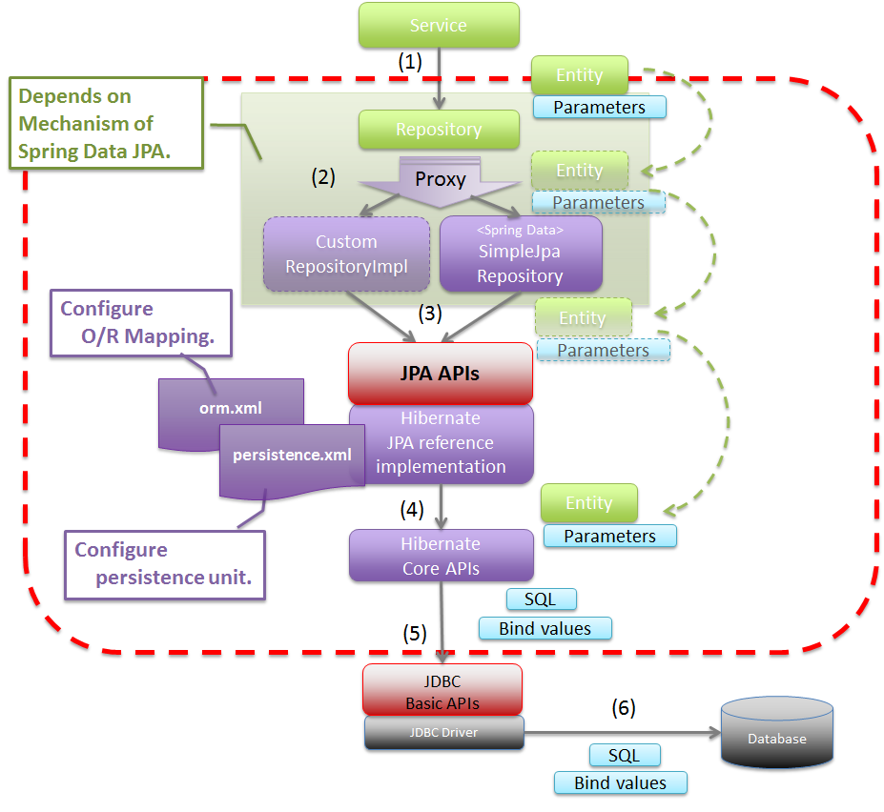
Basic Spring Data JPA Flow

Slide 22
JPA Repository Example
@Getter @Setter @NoArgsConstructor @AllArgsConstructor @ToString @Entity public class Student { @Id private Integer id; private String name; private Double gpax; }
import org.springframework.data.jpa.repository.JpaRepository; import sit.int204.demo.entities.Student; public interface StudentRepository extends JpaRepository<Student, Integer> { List<Student> findByNameContainsOrGpaxBetweenOrderByGpaxDesc( String name, double low, double high); }
Query methods

Slide 23
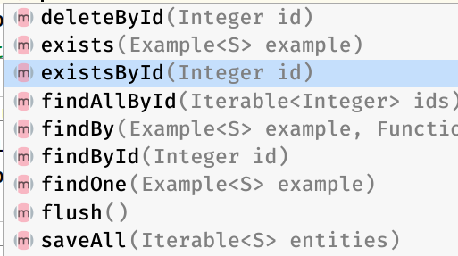
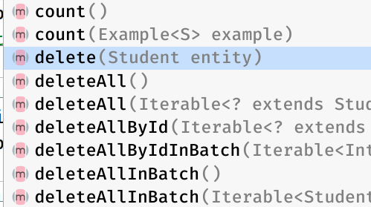
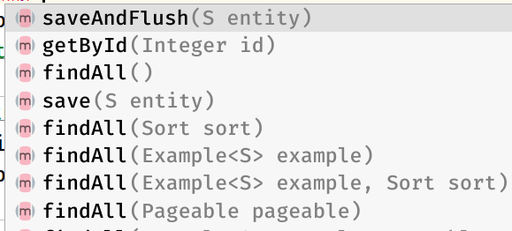
Jpa Repository default methods
public class AppController { @Autowired private final StudentRepository studentRepository;

Slide 24
Example: Data Jpa - count()
@GetMapping("/count") public Count getOfficesCount() { return new Count(service.getOfficeCount()); }
OfficeController
public Long getOfficeCount() { return repository.count(); }
OfficeService
@Getter @Setter class Count { private long count; public Count(long n) { this.count = n; } }

Slide 25
Exercise: Create REST API service for resources below
URI | HTTP Verb | Description
/customers | GET | Get all customers
/customers/{id} | GET | Get a customer with id
/customers/{id}/orders | GET | Get all orders for customer id
/customers | POST | Add new customers
/customers/{id} | PUT | Update a customers with id
/customers/{id} | DELETE | Delete a customers with id

