Slide 1

Apache Airflow, Day 2
Iuliia Volkova, xnuinside@gmail.com

Slide 2
Agenda (Day 2)
Macros, User Defined Marcos, Xcom
SLAs, Alerts, Retries
BranchOperator, TriggerRules
Hooks, Connections
Executors
Configuration (let’s add Celery Executor & PostgreSQL)
Workers & Flower
Variables, Run DAG with Params
Backfill
Customization: UI plugins
Airflow in clouds: Google Compose (Airflow in GCP), Astronomer.io
Q&A session
CONFIDENTIAL | © 2019 EPAM Systems, Inc.
© 2020 EPAM Systems, Inc.

Slide 3
DAG – Directed Acyclic Graph
Task 4
Create new customer
Task 1
Task 2
Task 3
Get new data
Parse file
Check if
customer in DB
Task 5
Update existed
CONFIDENTIAL | © 2019 EPAM Systems, Inc.
3
© 2020 EPAM Systems, Inc.

Slide 4
What is a Task
Action to do
Process to execute
Some atomic step of work that must be done
4

Slide 5
Example of task
Read the file
Execute the SQL query
Upload the file
Download the file
etc
5

Slide 6
Type of tasks in Airflow
Operator – DO something
Sensor – wait until something will be True
6

Slide 7
FileSensor
from datetime import datetime from airflow import DAG from airflow.operators.dummy_operator import DummyOperator from airflow.contrib.sensors.file_sensor import FileSensor with DAG( dag_id="consume_new_data_from_pos_read_and_parse", start_date=datetime(2020, 12, 1), schedule_interval="0 * * * *" ) as dag: get_new_data = FileSensor(task_id="get_new_data", filepath="../shop123/${current_date}/${hour}/data.json")
If File ="../shop123/${current_date}/${hour}/data.json” was found – Run next task
7

Slide 8
High-level overview of Apache Airflow components
Cli
Control
UI
If you work with CeleryExecutor
run servers,
run dags, add params and etc
WebServer
Worker
Celery Worker
REST API (experimental since v1.7)
$AIRFLOW_HOME/dags
Metadata DB
Monitor for CeleryWorkers
Execute tasks
Flower
Decide what to run
Scheduler
Executor
8

Slide 9

Executors
Execute tasks
Sequential Executor
Debug Executor (can be used from IDE for debug)
Local Executor (parallel execution with Python multiprocessing)
Executor
https://airflow.apache.org/docs/apache-airflow/stable/executor/index.html
9

Slide 10
Executors
Execute tasks
Sequential Executor (parallel execution with Python multiprocessing)
Debug Executor (can be used from IDE for debug)
Local Executor (parallel execution with Python multiprocessing)
Dask Executor - https://dask.org/
Executor
https://airflow.apache.org/docs/apache-airflow/stable/executor/index.html
10

Slide 11
Executors
Execute tasks
Sequential Executor (parallel execution with Python multiprocessing)
Debug Executor (can be used from IDE for debug)
Local Executor (parallel execution with Python multiprocessing)
Dask Executor - https://dask.org/
Celery Executor
Kubernetes Executor
Scaling Out with Mesos (community contributed)
Executor
https://airflow.apache.org/docs/apache-airflow/stable/executor/index.html
11

Slide 12
Celery Executor
https://docs.celeryproject.org/en/stable/getting-started/introduction.html
Python Open Source Server for distributing work across threads or machines.
https://github.com/xnuinside/airflow_in_docker_compose – we will use Docker Compose
12

Slide 13
Airflow.cfg
https://airflow.apache.org/docs/apache-airflow/stable/configurations-ref.html
Need to setup executor= & sql_alchemy_conn=
13

Slide 14
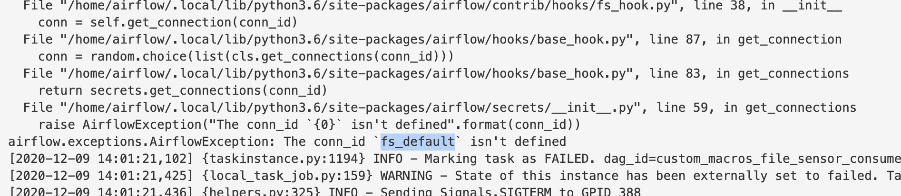
Default Connections (no exists in Docker version)
14

Slide 15
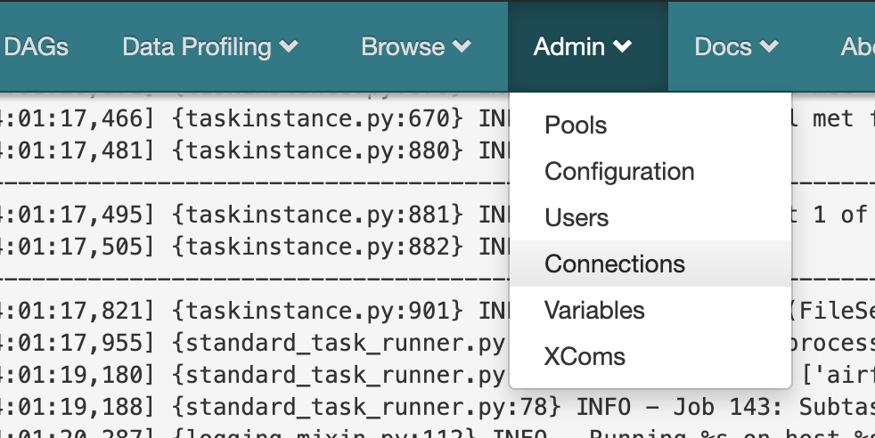
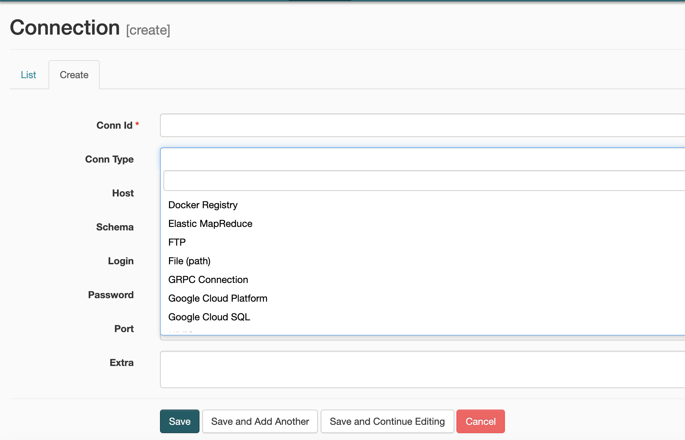
Connections & Hooks
https://airflow.apache.org/docs/apache-airflow/1.10.12/howto/connection/index.html
15

Slide 16
Connections & Hooks
Hooks defines API how to connect/work/talk with third-party systems
One Hook can be used in Multiple Operators/Sensors
16

Slide 17
Connections & Hooks
Hooks defines API how to connect/work/talk with third-party systems
One Hook can be used in Multiple Operators/Sensors
For example:
MySqlHook(DbApiHook) implements:
get_conn, get_autocommit, get_iam_token
DbApiHook implements:
get_sqlalchemy_engine
get_records
get_first & etc.
17

Slide 18
Connections -> Hooks -> Operators/Sensors
Connections
Hooks
Stor password, user, URI,
some additional params
Implements
base API
Operators
Sensors
Do some action
using Hooks
(if we connect to
third-party system)
Check some statement using
Hooks
(if we connect
to third-party system)
18

Slide 19
Example
Connections
PostgresHook
PostgreSQL conncetion
self.run
self.get_records
class PostgresOperator
SqlSensor
hook.run(self.sql … )
hook.get_records(self.sql,
self.parameters
19

Slide 20
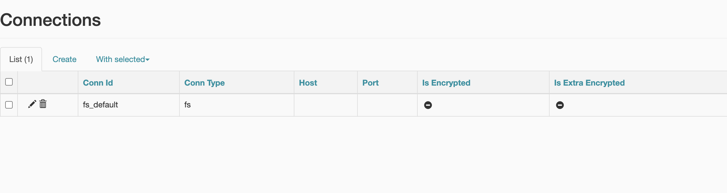
Let’s add fs_default connection
20

Slide 21
Macros vs Jinja2 Template
"../shop123/${current_date}/${hour}/data.json”
Parameters
that depends on DAG Run (when we execute our pipeline):
${current_date} – {{ ds_nodash }} (variable from - https://airflow.apache.org/docs/apache-airflow/1.10.8/macros.html )
${hour} - {{ ts_nodash.split('T')[1][:2] }} - ts_nodash returns 20180101T000000
21

Slide 22
Macros vs Jinja2 Template
"../shop123/${current_date}/${hour}/data.json”
Parameters
that depends on DAG Run (when we execute our pipeline):
${current_date} – {{ ds_nodash }} (variable from - https://airflow.apache.org/docs/apache-airflow/1.10.8/macros.html )
${hour} - {{ ts_nodash.split('T')[1][:2] }} - ts_nodash returns 20180101T000000
Parametrized path:
get_new_data = FileSensor(task_id="get_new_data", filepath="../shop123/ {{ ds_nodash }} / {{ ts_nodash.split('T')[1][:2] }} /data.json")
22

Slide 23
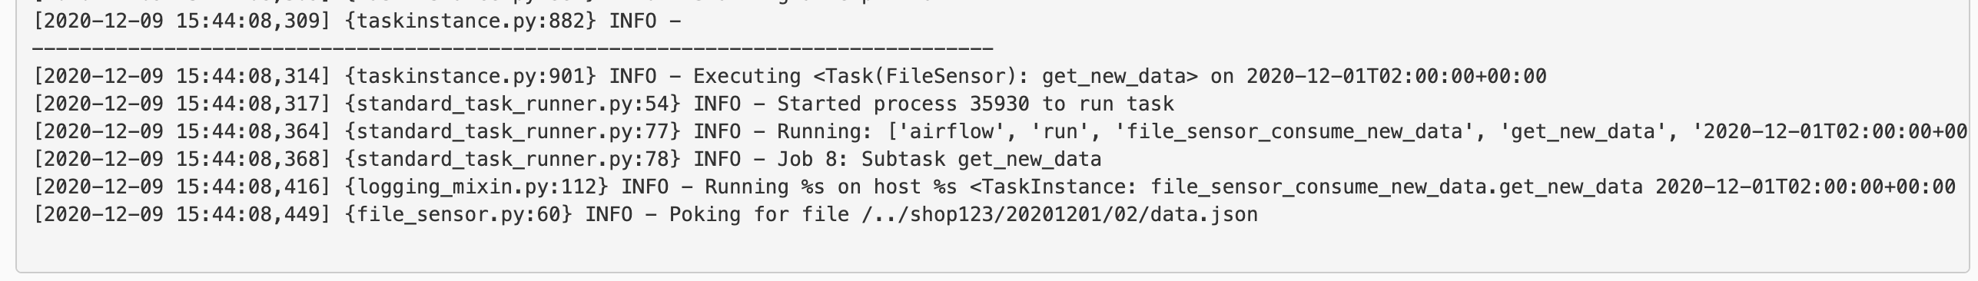
Macros vs Jinja2 Template
23

Slide 24
Macros vs Jinja2 Template
What if standard variables not enough?
Let’s imagine that each shop has own pipeline (DAG).
"../shop123/ {{ ds_nodash }} / {{ ts_nodash.split('T')[1][:2] }} /data.json” ->
"../${shop}/ {{ ds_nodash }} / {{ ts_nodash.split('T')[1][:2] }} /data.json”
24

Slide 25
Macros vs Jinja2 Template
What if standard variables not enough?
Let’s imagine that each shop has own pipeline (DAG).
"../shop123/ {{ ds_nodash }} / {{ ts_nodash.split('T')[1][:2] }} /data.json” ->
"../${shop}/ {{ ds_nodash }} / {{ ts_nodash.split('T')[1][:2] }} /data.json”
25

Slide 26
Macros vs Jinja2 Template
What if standard variables not enough?
Let’s create the custom macros.
26

Slide 27
Macros vs Jinja2 Template
def shop_filepath_macros(shop_id, date, hour): file_path = f"./{shop_id}/{date}/{hour}/data.json" return file_path with DAG( dag_id="custom_macros_file_sensor_consume_new_data", start_date=datetime(2020, 12, 1), schedule_interval="0 * * * *", user_defined_macros={ 'shop_filepath_macros': shop_filepath_macros } ) as dag: # task 1 get_new_data = FileSensor(task_id="get_new_data", filepath="{{ shop_filepath_macros('shop123', ds_nodash, ts_nodash.split('T')[1][:2])}}")
Macros callable
27

Slide 28
Macros vs Jinja2 Template
def shop_filepath_macros(shop_id, date, hour): file_path = f"./{shop_id}/{date}/{hour}/data.json" return file_path with DAG( dag_id="custom_macros_file_sensor_consume_new_data", start_date=datetime(2020, 12, 1), schedule_interval="0 * * * *", user_defined_macros={ 'shop_filepath_macros': shop_filepath_macros } ) as dag: # task 1 get_new_data = FileSensor(task_id="get_new_data", filepath="{{ shop_filepath_macros('shop123', ds_nodash, ts_nodash.split('T')[1][:2])}}")
Define macros
28

Slide 29
Macros vs Jinja2 Template
def shop_filepath_macros(shop_id, date, hour): current_dir = os.path.dirname(os.path.abspath(__file__)) file_path = f"./{shop_id}/{date}/{hour}/data.json" return file_path with DAG( dag_id="custom_macros_file_sensor_consume_new_data", start_date=datetime(2020, 12, 1), schedule_interval="0 * * * *", user_defined_macros={ 'shop_filepath_macros': shop_filepath_macros } ) as dag: # task 1 get_new_data = FileSensor(task_id="get_new_data", filepath="{{ shop_filepath_macros('shop123', ds_nodash, ts_nodash.split('T')[1][:2])}}")
use macros
29

Slide 30
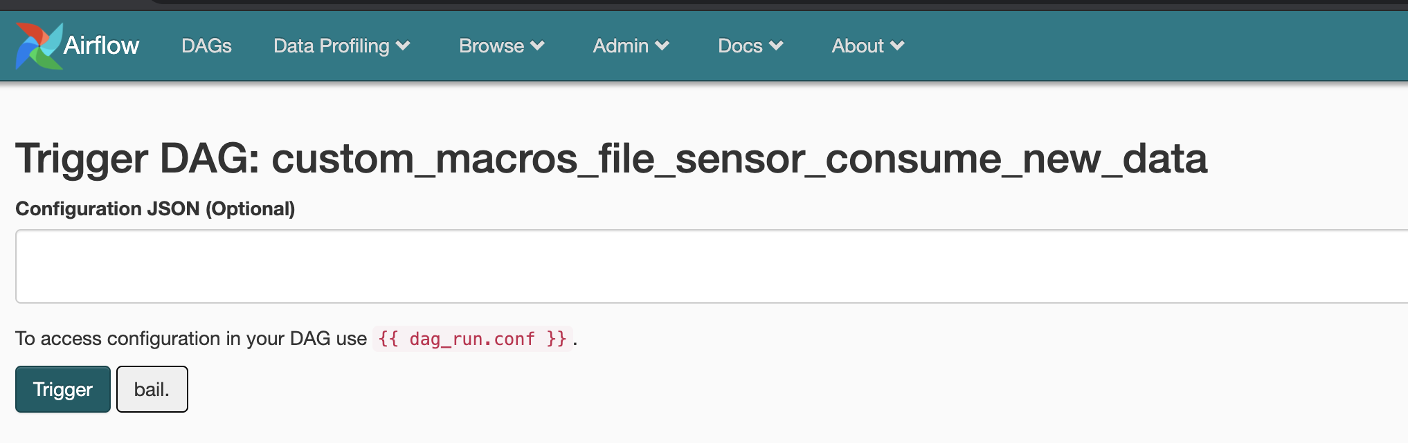
DAGRun Config
get_new_data = FileSensor(task_id="get_new_data", filepath="{{ shop_filepath_macros('shop123', ds_nodash, ts_nodash.split('T')[1][:2])}}")
30

Slide 31
DAGRun Config
get_new_data = FileSensor(task_id="get_new_data", filepath="{{ shop_filepath_macros('shop123', ds_nodash, ts_nodash.split('T')[1][:2])}}")
airflow trigger_dag 'example_dag_conf' -r 'run_id' --conf '{"message":"value"}'
31

Slide 32
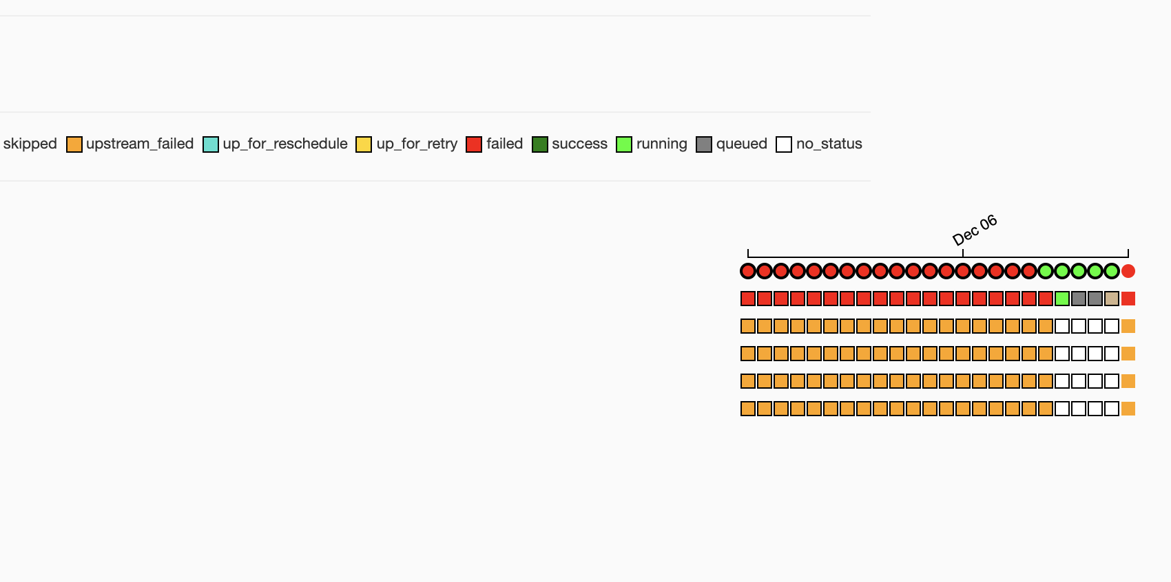
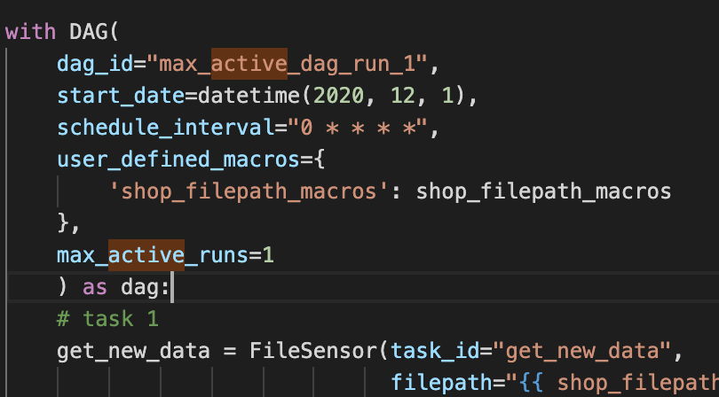
Max Active DAG Runs
32

Slide 33
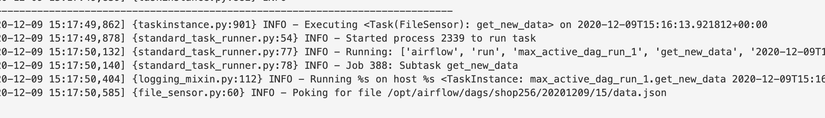
Check result with config trigger
33

Slide 34
Xcom
Data exchange between tasks.
Points:
Xcom – table in DB
Less count of data – it’s not processing tool
Xcom by default pulled from last task
34

Slide 35
Python Operator
35

Slide 36
BranchOperator
36

Slide 37
Trigger Rules
https://airflow.apache.org/docs/apache-airflow/stable/concepts.html#trigger-rules
all_success: (default) all parents have succeeded
all_failed: all parents are in a failed or upstream_failed state
all_done: all parents are done with their execution
37

Slide 38
Trigger Rules
https://airflow.apache.org/docs/apache-airflow/stable/concepts.html#trigger-rules
all_success: (default) all parents have succeeded
all_failed: all parents are in a failed or upstream_failed state
all_done: all parents are done with their execution
one_failed: fires as soon as at least one parent has failed, it does not wait for all parents to be done
one_success: fires as soon as at least one parent succeeds, it does not wait for all parents to be done
none_failed: all parents have not failed (failed or upstream_failed) i.e. all parents have succeeded or been skipped
Etc.
38

Slide 39
Trigger Rules
https://airflow.apache.org/docs/apache-airflow/stable/concepts.html#trigger-rules
all_success: (default) all parents have succeeded
all_failed: all parents are in a failed or upstream_failed state
all_done: all parents are done with their execution
one_failed: fires as soon as at least one parent has failed, it does not wait for all parents to be done
one_success: fires as soon as at least one parent succeeds, it does not wait for all parents to be done
none_failed: all parents have not failed (failed or upstream_failed) i.e. all parents have succeeded or been skipped
Etc.
39

Slide 40
Callbacks
40

Slide 41
Tasks Default Params
41

Slide 42
PostgreSQL Operator
42

Slide 43
Flower
43

Slide 44
Questions?

