Slide 1
Coursera Capstone Project For IBM Professional Certification in Data Sciece
The Battle of the Neighborhoods
Analysis of purchasing homes in Hong Kong
By:LIANG Jingyuan, Dean
June, 2019

Slide 2
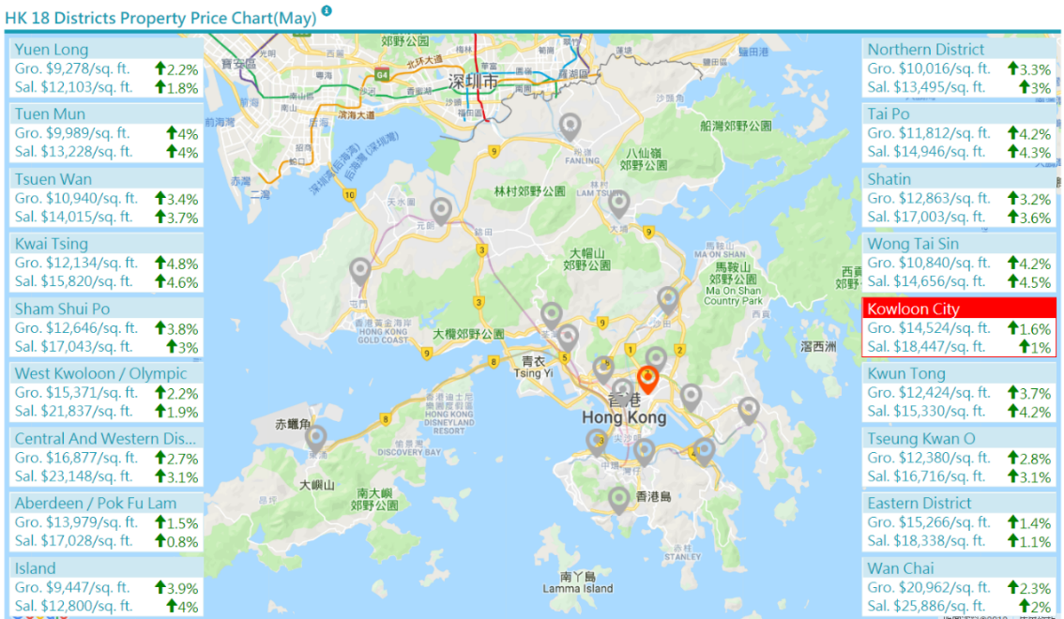
Problem and background: Hong Kong: the least affordable city in the world to buy a home. Property rents and prices have seen substantial growth in the past few years.
Question:
If we are helping a young couples who just start a family to buy a home, which estate/neighbourhood is the best choice?
Elements to consider:
1. Avg price per square feet of a state.
2. Distance to work place.
3. Living environment of the house. (restaurant, supermarket, mall etc.)
4. Schools.

Slide 3
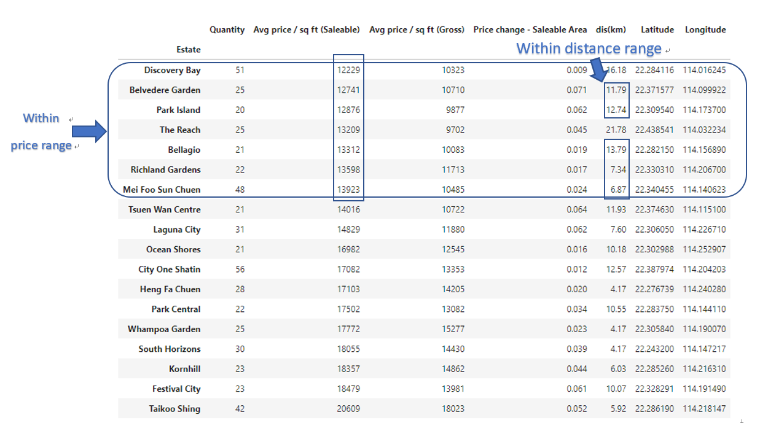
Preliminary analysis: dataset info consist of average price per feet, distance to workplace, each latitude and longitude of neighbourhood.

Slide 4
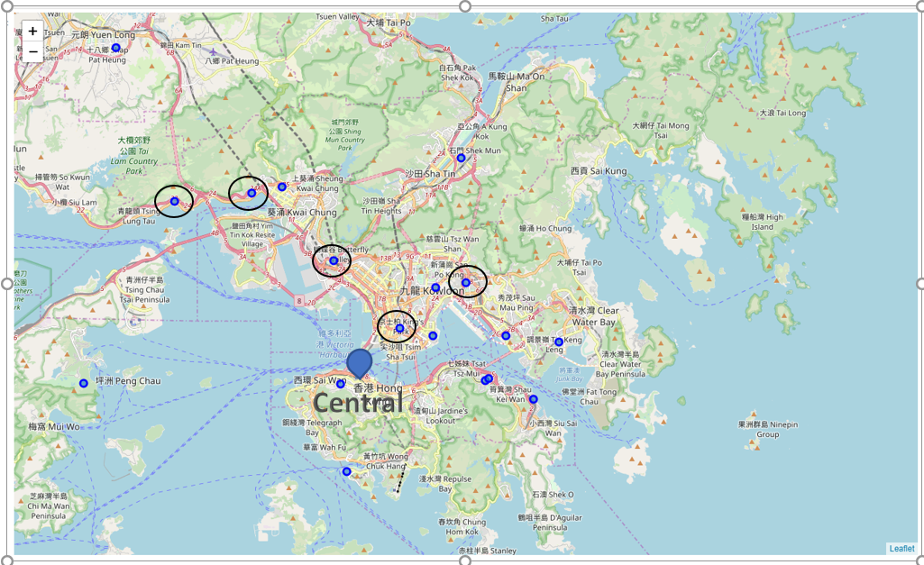
Initial mapping of neighborhoods
The potential target estates determined from the datasets we prepared for this project are pointed out in the map:
Belvedere Garden
Park Island
Bellagio
Richland Gardens
Mei Foo Sun Chuen

Slide 5
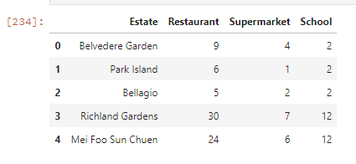
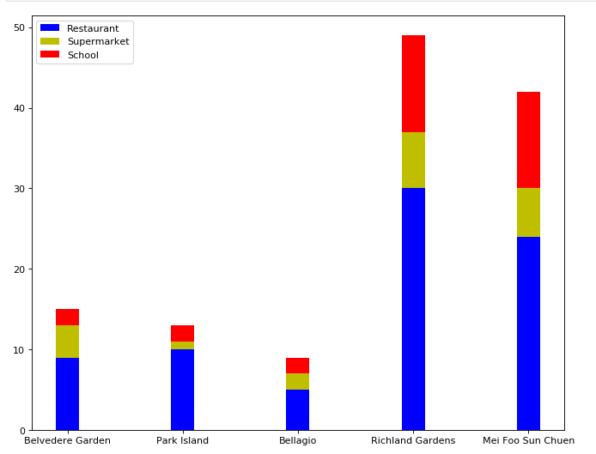
Further analysis: explore the elements via four-square
From the bar chart, we can conclude:
The living environment is good for a family is either Richland Gardens or Mei Foo Sun Chuen. Both neighborhoods have enough restaurants, supermarkets and schools.

Slide 6
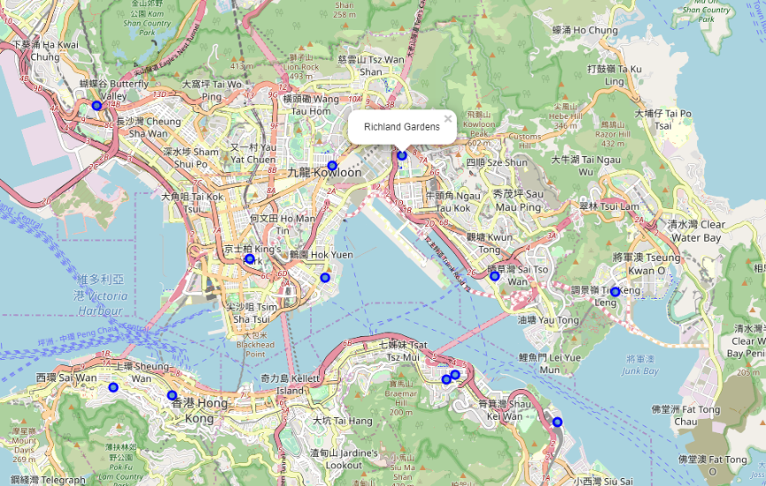
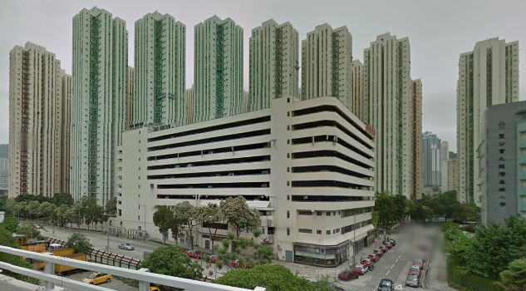
Final selection:
Consider the other factor – price per feet. The price of Richland Gardens is HKD 13598 per feet which is slightly less than Mei Foo Sun Chuen. Therefore, Richland Garden seems preferable
Richland Garden would be the best choice considering all the factors: average price per feet, living environment such as number of restaurants, supermarkets and school, distance to workplace. It is at the reasonable price range and in a better living environments neighborhood.

