Slide 1

RTEMS Filesystem
21 이태우
Notes:
버츄얼박스와 우분투를 설치 데모영상입니다.

Slide 2
Contents
RTEMS Filesystme Architecture Analysis
Core Philosophy : Layered Architecture
Role of the VFS
Features of Key Filesystems(IMFS,RFS,DOSFS, etc)
Performance Analysis
Benchmark Environment and key Variables
Performance Comparison Result by Filesystem
Conclusion & Improvement Directions
Summery of Analysis Reults
Proposals for Optimization

Slide 3
Layered File System in RTEMS
Application logic
Libbsd network
filesystems
File interface
Logical filesystem
Libnetworking
filesystems
VFS
IMFS
M-MIMFS
YAFFS2
JFFS2
RFS
DOSFS
DEVFS
Buffer,cache
Device driver

Slide 4
Layered File System in RTEMS
Application Logic
C/C++ program created by the user
File I/O
File interface
A set of standardized functions (POSIX API) for application programs to communicate with the kernel.
Examples include open(),read() and write().
It hides the internal complexity of the operating system.
Logical File System
The kernel’s first gateway translate user requests into a format that the kernel can understand.
Main roles : Path resolution, access control verification, and conversion of file names into kernel data structures.

Slide 5
Mount
The process of connecting one file system to a specific directory of another file system.
Since RTEMS starts with a small file system(IMFS) upon booting, it attaches file systems from various devices as needed.
Root filesystem
The top-level file system where all paths originate.
In RTEMS, the default is IMFS.
Mount point
The directory that serves as the attachment point where another file system is connected
Mount table
A list that manages which file systems are currently connected to which mount points
Mount Point | filesystem | Device
/(root) | IMFS | RAM
/mnt/fat | FAT FS | /dev /mmcsd0
/tftp | TFTP FS | Network
Mount table

Slide 6


VFS
Provides a unified interface : Offers a consistent POSIX API(e.g.,open(),read) to application programs.
File system switching : Analyzes the requested file path to route and switch the request to the correct physical file system that will handle the task.
File system registration and management : Manage the overall file system configuration, such as registering a new file system via the mount command and releasing it via unmount.
DOSFS
read(“/mnt/fat/data.txt”)
Handler table
File system
YAFFS2
Mount Table
Handler table
File system
VFS

Slide 7
Physical File Systems : IMFS
A fully-functional POSIX file system that stores and manages all files, directory structures, and data in RAM
It is volatile because it uses RAM.
All elements of the file system are managed through a data structure called j node.
Copy-on-Write
Stores a file bundle in ROM
At boot time, only the structure is created in RAM.
For a read request, it reads directly from ROM.
For a write request, it copies to RAM.
Pros | Cons
Exceptional speed | Volatility
Perfect POSIX compatibility | Limited capacity
No separate device required | Internal fragmentation
Efficient RAM useage

Slide 8
Physical File Systems : IMFS
fd 0
Rtems_libio_t
fd 1
jnode struct
Original
DATA
fd 2
fd 3
fd 4
Rtems_libio_t
fd 5
Global File Descriptor Table
RAM or ROM

Slide 9
Physical File Systems : Blocked-based
Blocked-based file systems are used for devices that store data in constant block units, such as SD cards, USB drives, and hard disks.
DOSFS(FAT)
An implementation of the FAT file systems, used since the MS-DOS era, for RTEMS.
Compatibility with external systems : an SD card with data saved by DOSFS on an RTEMS device can be immediately read and written on PC.
Used for data logger systems and when exchanging files with other systems.
RFS
A proprietary file system designed exclusively for RTEMS
Predictability and stability: Operates stably even in environments (like RTEMS) with low-spec CPUs and small amounts of RAM.
Supports block sizes that are powers of 2, not just 512 bytes.
Block Buffer Cache
A space that temporarily stores frequently used data blocks in fast RAM to prevent repeated access to media like SD cards, which are block devices similar to those used by RFS or DOSFS.
Drastically reduces the number of physical I/O operations, greatly improving the overall performance of the block-based file system.

Slide 10
Physical File Systems : Blocked-based
Feature | DOSFS(FAT file system) | RFS(RTEMS file systems
Core Objective | Compatibility | Predictability & Stability
Primary Use Case | File exchange with external systems like PCs | Specialized for RTEMS (e.g., real-time control, aerospace)
Unique Feature | Supports FAT12/16/32 formats | Supports block sizes that are not powers of two
Advantage | Convenient for data sharing | Stable performance optimized for the RTEMS environment
Disadvantage | Lower real-time predictability than RFS | Not directly compatible with external systems like PCs

Slide 11

Physical File Systems : Flash-based
Flash Memory
Cannot be overwritten: To overwrite data, the entire large block to which the data belongs must be erased. This erase operation is very slow.
Limited write lifespan: Each block of flash memory has a set number of times it can be erased.
JFFS2 and YAFFS were created to solve these problems.
Log-structured
The core technology of JFFS2 and YAFFS.
Instead of overwriting data, it always appends it to a new, empty space.
Since the old data is simply marked as invalid, there is no need to perform the slow erase operation every time.
A(i=1)
Data
A(i=0)
Data
A’(i=1)
Data
A(i=1)
Data
A(i=0)
Data
A’(i=1)
Data

Slide 12
Physical File Systems : Flash-based
JFFS2: Reliability and Space Efficiency
Garbage collection: Gathers scattered valid data into a new location, then erases the blocks filled with old, invalid data to create usable space.
Wear leveling: The process of garbage collection constantly moves the location of data, naturally causing all memory blocks to be used evenly.
Data compression: Compresses data before storing it to save space. While effective for text files, it is less effective for already compressed images (JPEG).
Power failure stability: Logs every change, making it possible to recover even if power is lost in the middle of an operation.
YAFFS: Speed and Performance
Higher performance: According to benchmark results, YAFFS is generally faster than JFFS2.
No data compression: Unlike JFFS2, YAFFS does not have a built-in compression feature. This results in less overhead.
License: Uses a dual-license policy that requires the purchase of a separate license for use in commercial, closed-source products.

Slide 13
DEVFS : All hardware as files
Device File System
A virtual file system that makes all of the system’s hardware devices(e.g., console, SD card, controller) appear as if they are files under the /dev directory.
Core Role: Providing a consistent access method
Application programs can control all hardware using the same standard POSIX functions (open(), read(), write(), ioctl()) regardless of the type of device.
Operating Principle: The driver hidden behind the file
DEVFS File: A shell file that doesn't contain actual data, but has 'major/minor numbers' to identify the device.
Device Driver: When an I/O request is made to a DEVFS file, the VFS (Virtual File System) reads these major/minor numbers and calls the actual 'device driver' for the corresponding device.
Conclusion: DEVFS serves as a 'standardized interface', while the actual hardware control is handled by the device driver behind it.

Slide 14
Performance Analysis Overview
Analysis Goal: To measure and compare the I/O performance of major file systems available in RTEMS under various conditions.
Test Environment
Hardware: BeagleBone Black board
Software: RTEMS 5, FIO (Flexible I/O tester) performance measurement tool
Core Test Methodology
RAM-disk: Most tests are conducted by creating a virtual disk using a portion of RAM. This is done to eliminate variables from physical storage devices (e.g., SD cards) and purely compare the performance of the software-based file systems themselves.
Key Variables
I/O Block Size: The size of data read or written in a single operation.
I/O Engine : The method (API) used to read and write data, such as read() or pread().
Cache Size: The size of the block buffer cache.

Slide 15
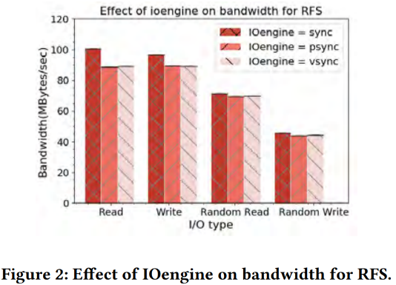
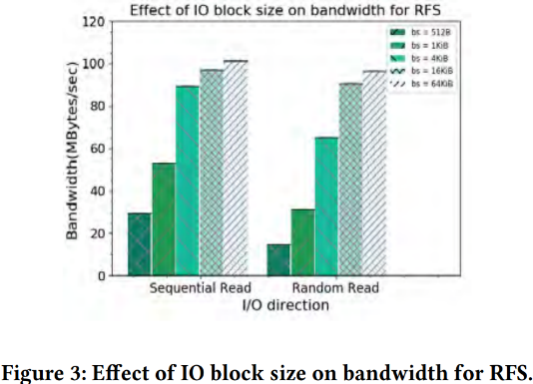
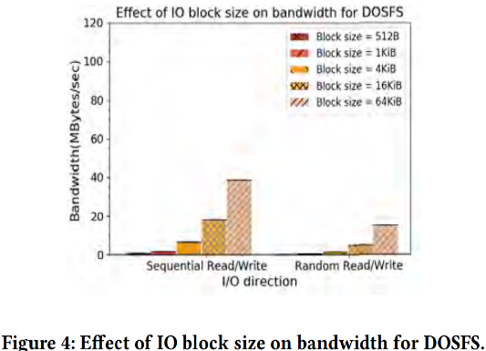
Results : RFS & DOSFS
Performance improves as the block size increases
For both RFS and DOSFS, the larger the amount of data processed at once (I/O block size), the greater the throughput (bandwidth) increases.
Requesting a large amount of data in a single operation is far more effective than requesting small amounts of data multiple times, as it results in less system call overhead.
RFS is the fastest in native I/O.
In the case of RFS, the sync engine, which uses the basic read()/write() functions, exhibits the best performance.
This is because POSIX functions in RTEMS, such as pread() and readv(), are implemented internally by repeatedly calling read(), which creates additional overhead.

Slide 16
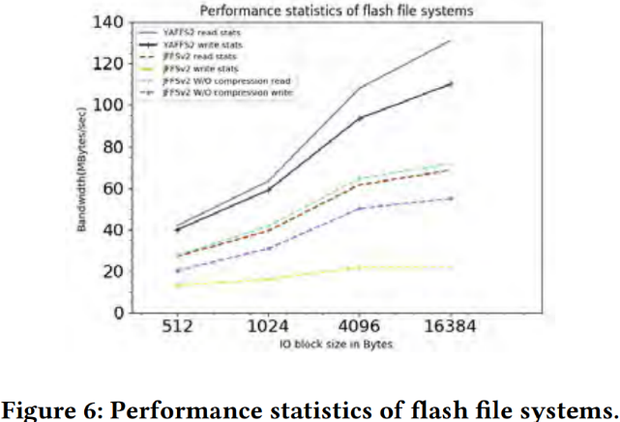
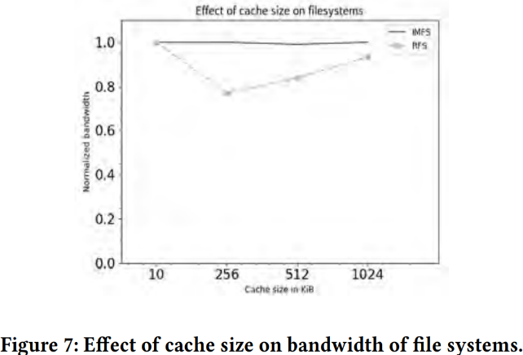
Results : JFFS2 vs YAFFS2,cache size effect
YAFFS2 is generally faster than JFFS2.
Benchmark results show that YAFFS2 delivers higher performance than JFFS2.
This is due to YAFFS2's more efficient garbage collection method and its lack of a data compression feature, resulting in lower CPU overhead
In JFFS2, the compression feature affects performance.
When JFFS2's default data compression feature is turned off, write performance improves noticeably.
Consider using compression if saving storage space is important, and consider turning it off if speed is the priority.
IMFS is not affected by the cache, whereas RFS is sensitive to cache size.

Slide 17
Conclusion
Architecture: A VFS-centric, Layered, Hybrid Structure
Layered: A flexible structure where the Virtual File System (VFS) receives standard POSIX requests from applications and routes them to the appropriate implementation for each file system.
Hybrid: An efficient approach that uses the high-speed In-Memory File System (IMFS) on RAM as a base during boot, and expands by mounting file systems that require persistent storage, such as RFS, DOSFS, and JFFS2.
DEVFS: Allows hardware devices to be treated as files and standardizes the interaction with device drivers.
Performance Analysis: The Key is How You Use It
Block Size: For all file systems, performance significantly improves as the I/O block size processed in a single operation increases.
Purpose: It is advantageous to choose DOSFS for compatibility, RFS for persistent storage, and YAFFS2/JFFS2 for flash memory reliability.
Conclusion: The RTEMS file system provides excellent scalability and portability through its VFS. However, to achieve optimal performance, the careful selection of a file system—taking into account the application's I/O patterns and the characteristics of the target hardware—is essential.

Slide 18
Thank You!

