Slide 1
chapter 1
Data Communications – An Introduction

Slide 2
CHAPTER OBJECTIVES
1-<number>
Define data communications and its building blocks.
Identify and describe three different types of data encoding.
Describe the differences between analog and digital data.
Describe the differences between analog transmission and digital transmission.
Recognize the differences between parallel and serial transmission.

Slide 3
CHAPTER OBJECTIVES (cont’d)
1-<number>
Identify and describe asynchronous and synchronous transmission.
Define simplex, half-duplex, and full-duplex data transmission.
Examine common data communications media options.
Describe key data communications standards, standards organizations, and standards-making processes.
Identify the layers of the OSI and TCP/IP models and describe their layered architectures.

Slide 4
DATA COMMUNICATIONS DEFINED
1-<number>
It moves data from point A to point B.
It requires at least one communications medium.
Data must be formatted for transmission across the medium.
High-tech hardware, software, and services are used.
It’s the transmission of encoded data and information in a medium-specific format between two or more nodes, people, businesses, or entities.

Slide 5
BITS, BYTES, and DATA ENCODING
1-<number>
To transfer human readable data, the data must be transmitted in a format that machines can understand. To do this, we use bits, bytes, and data encoding.
Bit – smallest unit of encoding in the binary number system.
Byte – 8 bits.
Data Encoding – the method by which data is represented in digital or binary format.

Slide 6
BITS, BYTES, and DATA ENCODING (cont’d)
1-<number>
Examples of data encoding include:
EBCDIC – the Extended Binary Coded Decimal Interchange Code.
ASCII – the American Standard Code for Information Interchange.
Unicode – surpasses the limitations of ASCII by employing more bits.

Slide 7
DIGITAL and ANALOG DATA
1-<number>
Analog data - is represented and reproduced by a continuously variable level of sound, light, electricity, or other input.
Digital data – is represented and reproduced by discrete levels of sound, light, electricity, or other input.

Slide 8
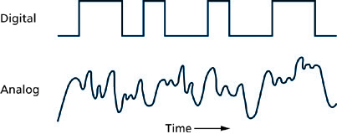
Digital Transmission and Analog Transmission
1-<number>

Slide 9
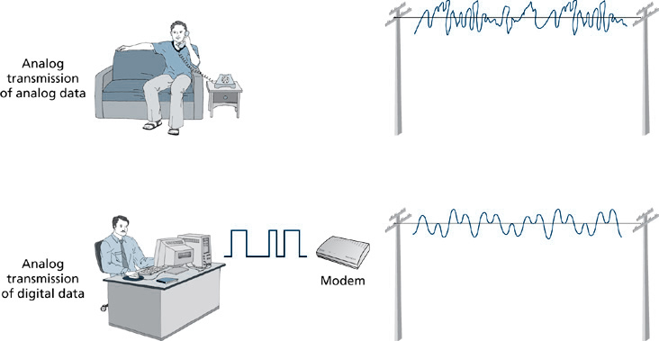
Analog Transmission of Analog Data versus Analog Transmission of Digital Data
1-<number>

Slide 10
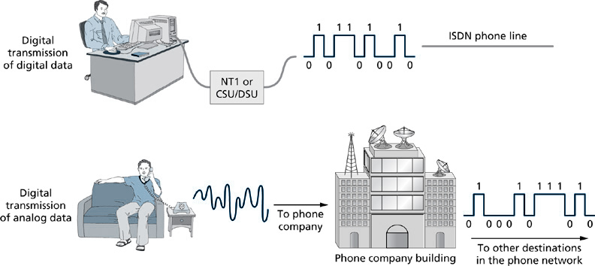
Digital Transmission of Digital Data versus Digital Transmission of Analog Data
1-<number>

Slide 11
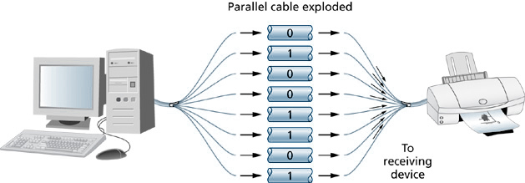
Parallel Transmission
1-<number>

Slide 12
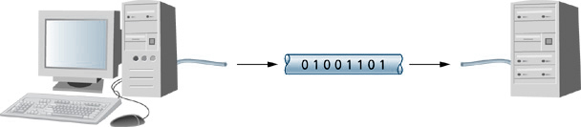
Serial Transmission
1-<number>

Slide 13

Asynchronous Transmission
1-<number>

Slide 14
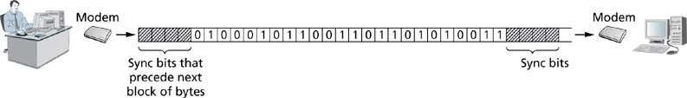
Synchronous Transmission
1-<number>

Slide 15
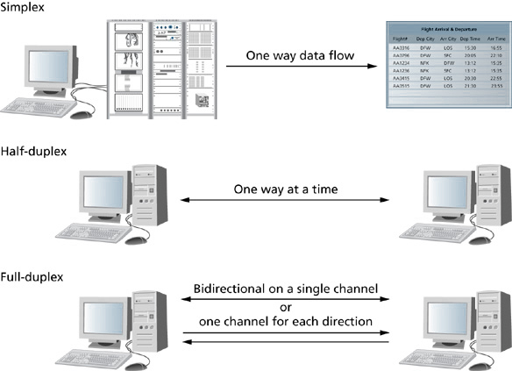
Simplex, Half-Duplex, and Full-Duplex Transmission
1-<number>

Slide 16
DATA COMMUNICATIONS MEDIA OPTIONS
1-<number>
Guided Media utilizes one or more wires to convey data.
  Examples include coaxial cable, unshielded twisted pair, fiber optic cabling.
Unguided Media does not provided a wired boundary to contain the communications channel.
  Examples include numerous types of wireless.

Slide 17
DATA COMMUNICATIONS MEDIA OPTIONS (cont’d)
1-<number>
Coaxial Cable – utilizes a core conductor that is surrounded by insulating material and a mesh of grounding metal fabric.

Slide 18
DATA COMMUNICATIONS MEDIA OPTIONS (cont’d)
1-<number>
Unshielded Twisted Pair (UTP) is comprised of one or more pairs of solid-core wires twisted together.

Slide 19
DATA COMMUNICATIONS MEDIA OPTIONS (cont’d)
1-<number>
Fiber Optic Cabling – is comprised of glass core fiber strands that are enveloped in one or more protective coatings and packaged with reinforcing fibers that provide added strength to the cable.

Slide 20
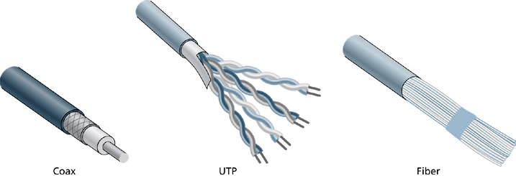
Coaxial, UTP, and Fiber Media
1-<number>

Slide 21
DATA COMMUNICATIONS MEDIA OPTIONS (cont’d)
1-<number>
Wireless transmission technologies include: terrestrial microwave, satellite microwave, and infrared.
Terrestrial microwave utilizes antennas and line of site to connect locations.

Slide 22
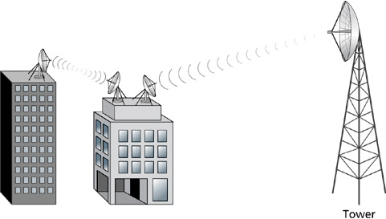
Terrestrial Microwave
1-<number>

Slide 23
DATA COMMUNICATIONS MEDIA OPTIONS (cont’d)
1-<number>
Satellite microwave requires
transmissions between a ground-based transmitter/receiver and one or more communications satellites that are in geosynchronous orbit around the earth.

Slide 24
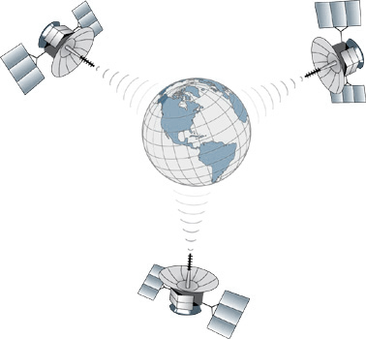
Satellite Microwave
1-<number>

Slide 25
DATA COMMUNICATIONS MEDIA OPTIONS (cont’d)
1-<number>
Infrared uses light waves to transmit data between devices over short distances.

Slide 26
DATA COMMUNICATIONS STANDARDS
1-<number>
A standard is an accepted model or pattern.
Standards are used extensively in data communications and networks.
Standards provide a basic level of compatibility and interoperability among devices.
Morse code and the Bell telephone are historical examples of standards.

Slide 27
DATA COMMUNICATIONS STANDARDS (cont’d)
1-<number>
Many standards organizations develop and publish data communications standards.
ANSI – represents member companies in the pursuit of national standards.
IEEE – fosters the development and publication of electrical, computer, and control standards.

Slide 28
DATA COMMUNICATIONS STANDARDS (cont’d)
1-<number>
ITU – assists in the standardization of numerous data communications standards.
ISO – develops and publishes standards for data communications technologies as well as standards for non-technical products and services.

Slide 29
DATA COMMUNICATIONS MODELS
1-<number>
Layered architectures and protocols provide the framework for two important data communications models.
These models are the OSI model and the TCP/IP model.
These models provide frameworks by which vendors can develop products that have compatibility and interoperability.

Slide 30
DATA COMMUNICATIONS MODELS (cont’d)
1-<number>
OSI Model – dates back to the late 1970s.
  It uses a 7-layer framework to define communications functions that assure compatible communications among devices or systems.
  Its layered architecture provides modularity to systems developers.
  Each layer provides a set of rules or protocols.

Slide 31
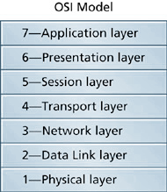
The OSI Reference Model
1-<number>

Slide 32
LAYERS OF THE OSI MODEL
1-<number>
Physical Layer
  It’s also known as layer 1 of the OSI model.
  Defines the protocols that govern the physical connection and transmission of bits between devices.
  Defines the signaling method such as digital or analog.
  Specifies transmission characteristics such as asynchronous, synchronous, simplex, half-duplex, or full-duplex.
  Defines the data rate such as 10 Mbps, 100 Mbps, 1000 Mbps, etc.

Slide 33
LAYERS OF THE OSI MODEL (cont’d)
1-<number>
Data Link Layer
  Prepares data for the physical layer and provides services to the network layer that’s above it.
  Organizes data bits into frames.
  Defines node addresses.
  Also defines how data bits access the transmission medium.
  Includes error detection and correction protocols.

Slide 34
LAYERS OF THE OSI MODEL (cont’d)
1-<number>
Network Layer
  Defines logical network and node addressing.
  Specifies creation of packets and sequencing of the packets.
  Prepares data for the data link layer and provides support services for the transport layer.
  Provides route discovery and determination of best route between separate networks.

Slide 35
LAYERS OF THE OSI MODEL (cont’d)
1-<number>
Transport Layer
  Receives messages from upper layers and segments those messages into smaller chunks.
  Provides connection-oriented data services.
  Provides end-to-end flow control.
  Identifies service addresses, or port numbers.

Slide 36
LAYERS OF THE OSI MODEL (cont’d)
1-<number>
Session Layer
  Is responsible for establishing, maintaining, synchronizing, and terminating communications between two devices.

Slide 37
LAYERS OF THE OSI MODEL (cont’d)
1-<number>
Presentation Layer
  Provides data transformation services, such as encoding – ASCII, EBCDIC, or Unicode.
  Can provide end-to-end encryption services within data transmissions.

Slide 38
LAYERS OF THE OSI MODEL (cont’d)
1-<number>
Application Layer
  Provides services such as file, print, and email services that support user applications.
  Remote access services exist in this layer.
  Collaborative computing services and service advertising mechanisms exist here.

Slide 39
DATA ENCAPSULATION IN A LAYERED ARCHITECTURE
1-<number>
Data encapsulation is a process that adds an additional set of protocol information known as a header to a set of data bits for each layer in a layered architecture.
Protocols at each layer provide a framework that describes how data communications should take place between similar processes, services, or functions running on two or more devices that are exchanging data.
Protocols that function according to the rules that describe each layer facilitate the exchange of data between communicating devices.

Slide 40
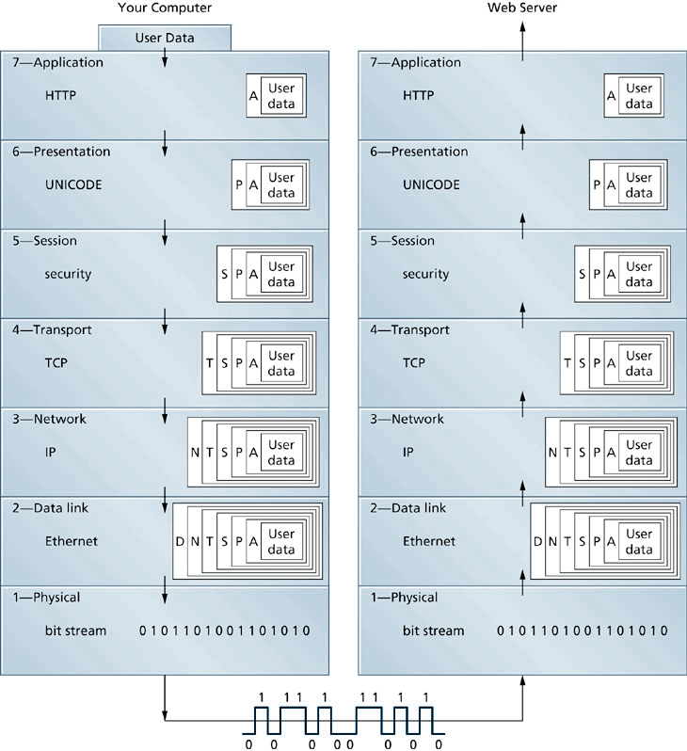
Layered Approach to Data Encapsulation
1-<number>

Slide 41
THE TCP/IP MODEL
1-<number>
Dates back to the early 1970s.
Uses a layered architecture for defining communications functions between devices.
It’s not a formal standard.
Can be represented as either a 4-layer or 5-layer model.

Slide 42
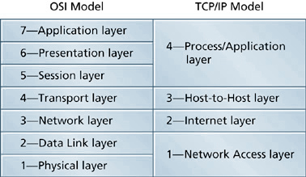
The TCP/IP Model and the OSI Reference Model Compared
1-<number>

